Slide 1
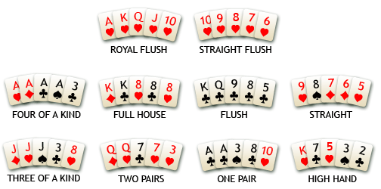
Poker hands: best to worst

Slide 2
How should a computer shuffle?

Slide 3
Goal
Input: Given n items to shuffle (cards, …)
Output: Return some list of exactly those n items;
all n! lists should be equally likely.
Not the same as saying “each card is equally likely at each position!” Why not?
Possible methods?
  Swap a pair of randomly chosen cards?
  Choose keys and sort?
  Swap each card with a randomly chosen card?
Comp 550,

Slide 4
Choose key and sort
Book suggests:
Assign each card a key number from [1..K].
Sort keys to permute cards
What is the probability that…
  the second card gets the same key as the first? 1/K
  the third gets the first or second, assuming that the first and second have different keys? 2/K
  That we have some duplicate key among n cards?
  1/K + 2/K + … + n/K = n(n+1)/(2K)
Choose K = n^3 and the probability is < 1/n
  Expected time: T(n) = O(n lg n) + T(n)/n = O(n lg n).
Comp 550,

Slide 5
Random Shuffle?
Goal: uniform random permutation of an array.
RANDOM(n) – returns an integer 1 ≤ r ≤ n with each of the n values of r being equally likely.
In iteration i, choose A[i] randomly from A[1..?].
Running Time: O(n)
Shuffle(A)
n ← length[A]
for i ← n downto 2
do swap A[i] ↔ A[RANDOM(?)]
n? i? (i-1)?
Comp 550,

Slide 6
Finding the correct shuffle
Shuffle(A)
n ← length[A]
for i ← n downto 2
do swap A[i] ↔ A[RANDOM(?)]
(i-1) forces change
in each element.
n has n^{n-1} possible
outcomes, but since
n! does not divide n^{n-1}, some must occur more frequently than others.
i works … we should prove it.
Comp 550,

Slide 7
Proving the shuffle correct
Shuffle(A)
n ← length[A]
for i ← n downto 2
do swap A[i] ↔ A[RANDOM(i)]
Consider the random
numbers chosen by a
run of the algorithm:
RANDOM(n), RANDOM(n-1), …, RANDOM(2), RANDOM(1)
Choices are independent: n·(n-1) ···2·1 = n! choices
  We have chosen one uniformly at random.
Claim: Each choice produces to a unique permutation
  By running algorithm, choices determine the permutation
  Run algorithm backwards: permutation determines choices!
Comp 550,

Slide 8
Random Shuffle
Goal: uniform random permutation of an array.
RANDOM(n) – returns an integer 1 ≤ r ≤ n with each of the n values of r being equally likely.
In iteration i, choose A[i] randomly from A[1..i].
A[i] is never altered after iteration i.
Running Time: O(n)
Shuffle(A)
n ← length[A]
for i ← n downto 1
do swap A[i] ↔ A[RANDOM(i)]
Comp 550,

