Slide 1
Quicksort
Ack: Several slides from Prof. Jim Anderson’s COMP 202 notes.
Comp 550, Spring 2010

Slide 2
Performance
A triumph of analysis by C.A.R. Hoare
Worst-case execution time – Θ(n²).
Average-case execution time – Θ(n lg n).
  How do the above compare with the complexities of other sorting algorithms?
Empirical and analytical studies show that quicksort can be expected to be twice as fast as its competitors.
Comp 550

Slide 3
Design
Follows the divide-and-conquer paradigm.
Divide: Partition (separate) the array A[p..r] into two (possibly empty) subarrays A[p..q–1] and A[q+1..r].
  Each element in A[p..q–1] ≤ A[q].
  A[q] ≤ each element in A[q+1..r].
  Index q is computed as part of the partitioning procedure.
Conquer: Sort the two subarrays by recursive calls to quicksort.
Combine: The subarrays are sorted in place – no work is needed to combine them.
How do the divide and combine steps of quicksort compare with those of merge sort?
Comp 550

Slide 4
Pseudocode
Quicksort(A, p, r)
if p < r then
q := Partition(A, p, r);
Quicksort(A, p, q – 1);
Quicksort(A, q + 1, r)
fi
Partition(A, p, r)
x, i := A[r], p – 1;
for j := p to r – 1 do
if A[j] ≤ x then
i := i + 1;
A[i] ↔ A[j]
fi
od;
A[i + 1] ↔ A[r];
return i + 1
A[p..r]
5
A[p..q – 1]
A[q+1..r]
Partition
5
≤ 5
≥ 5
Comp 550

Slide 5
Partitioning
Select the last element A[r] in the subarray A[p..r] as the pivot – the element around which to partition.
As the procedure executes, the array is partitioned into four (possibly empty) regions.
  A[p..i] — All entries in this region are ≤ pivot.
  A[i+1..j – 1] — All entries in this region are > pivot.
  A[r] = pivot.
  A[j..r – 1] — Not known how they compare to pivot.
The above hold before each iteration of the for loop, and constitute a loop invariant. (4 is not part of the LI.)
Comp 550

Slide 6
Example
p r
initially: 2 5 8 3 9 4 1 7 10 6 note: pivot (x) = 6
i j
next iteration: 2 5 8 3 9 4 1 7 10 6
i j
next iteration: 2 5 8 3 9 4 1 7 10 6
i j
next iteration: 2 5 8 3 9 4 1 7 10 6
i j
next iteration: 2 5 3 8 9 4 1 7 10 6
i j
Partition(A, p, r)
x, i := A[r], p – 1;
for j := p to r – 1 do
if A[j] ≤ x then
i := i + 1;
A[i] ↔ A[j]
fi
od;
A[i + 1] ↔ A[r];
return i + 1
Comp 550

Slide 7
Example (Continued)
next iteration: 2 5 3 8 9 4 1 7 10 6
i j
next iteration: 2 5 3 8 9 4 1 7 10 6
i j
next iteration: 2 5 3 4 9 8 1 7 10 6
i j
next iteration: 2 5 3 4 1 8 9 7 10 6
i j
next iteration: 2 5 3 4 1 8 9 7 10 6
i j
next iteration: 2 5 3 4 1 8 9 7 10 6
i j
after final swap: 2 5 3 4 1 6 9 7 10 8
i j
Partition(A, p, r)
x, i := A[r], p – 1;
for j := p to r – 1 do
if A[j] ≤ x then
i := i + 1;
A[i] ↔ A[j]
fi
od;
A[i + 1] ↔ A[r];
return i + 1
Comp 550

Slide 8
Partitioning
Select the last element A[r] in the subarray A[p..r] as the pivot – the element around which to partition.
As the procedure executes, the array is partitioned into four (possibly empty) regions.
  A[p..i] — All entries in this region are ≤ pivot.
  A[i+1..j – 1] — All entries in this region are > pivot.
  A[r] = pivot.
  A[j..r – 1] — Not known how they compare to pivot.
The above hold before each iteration of the for loop, and constitute a loop invariant. (4 is not part of the LI.)
Comp 550

Slide 9
Correctness of Partition
Use loop invariant.
Initialization:
  Before first iteration
    A[p..i] and A[i+1..j – 1] are empty – Conds. 1 and 2 are satisfied (trivially).
    r is the index of the pivot – Cond. 3 is satisfied.
Maintenance:
  Case 1: A[j] > x
    Increment j only.
    LI is maintained.
Partition(A, p, r)
x, i := A[r], p – 1;
for j := p to r – 1 do
if A[j] ≤ x then
i := i + 1;
A[i] ↔ A[j]
fi
od;
A[i + 1] ↔ A[r];
return i + 1
Comp 550

Slide 10
Correctness of Partition
Case 1: A[j] > x
p
i
j
r
>x
x
≤ x
> x
p
i
j
r
x
≤ x
> x
Comp 550

Slide 11
Correctness of Partition
Case 2: A[j] ≤ x
  Increment i
  Swap A[i] and A[j]
    Condition 1 is maintained.
  Increment j
    Condition 2 is maintained.
  A[r] is unaltered.
    Condition 3 is maintained.
p
i
j
r
≤ x
x
≤ x
> x
p
i
j
r
x
≤ x
> x
Comp 550

Slide 12
Correctness of Partition
Termination:
  When the loop terminates, j = r, so all elements in A are partitioned into one of the three cases:
    A[p..i] ≤ pivot
    A[i+1..j – 1] > pivot
    A[r] = pivot
The last two lines swap A[i+1] and A[r].
  Pivot moves from the end of the array to between the two subarrays.
  Thus, procedure partition correctly performs the divide step.
Comp 550

Slide 13
Complexity of Partition
PartitionTime(n) is given by the number of iterations in the for loop.
Θ(n) : n = r – p + 1.
Partition(A, p, r)
x, i := A[r], p – 1;
for j := p to r – 1 do
if A[j] ≤ x then
i := i + 1;
A[i] ↔ A[j]
fi
od;
A[i + 1] ↔ A[r];
return i + 1
Comp 550

Slide 14
Algorithm Performance
Running time of quicksort depends on whether the partitioning is balanced or not.
Worst-Case Partitioning (Unbalanced Partitions):
  Occurs when every call to partition results in the most unbalanced partition.
  Partition is most unbalanced when
    Subproblem 1 is of size n – 1, and subproblem 2 is of size 0 or vice versa.
    pivot ≥ every element in A[p..r – 1] or pivot < every element in A[p..r – 1].
  Every call to partition is most unbalanced when
    Array A[1..n] is sorted or reverse sorted!
Comp 550

Slide 15
Worst-case Partition Analysis
Recursion tree for
worst-case partition
n
Running time for worst-case partitions at each recursive level:
T(n) = T(n – 1) + T(0) + PartitionTime(n)
= T(n – 1) + c·n
= ∑_{1≤k≤ n} c·k
= c(∑ _{1≤k≤ n} k )
= Θ(n²)
n – 1
n – 2
n
n – 3
2
1
Comp 550

Slide 16
Best-case Partitioning
Size of each subproblem ≤ n/2.
  One of the subproblems is of size ⎣n/2⎦
  The other is of size ⎡n/2⎤ −1.
Recurrence for running time
  T(n) ≤ 2T(n/2) + PartitionTime(n)
  = 2T(n/2) + c·n
T(n) = Θ(n lg n)
Comp 550

Slide 17
Recursion Tree for Best-case Partition
cn
cn
cn/2
cn/2
cn
lg n
cn/4
cn/4
cn/4
cn/4
cn
c
c
c
c
c
c
cn
Total : O(n lg n)
Comp 550

Slide 18
Recurrences – II
Comp 550, Spring 2010

Slide 19
Recurrence Relations
Equation or an inequality that characterizes a function by its values on smaller inputs.
Solution Methods (Chapter 4)
  Substitution Method.
  Recursion-tree Method.
  Master Method.
Recurrence relations arise when we analyze the running time of iterative or recursive algorithms.
  Ex: Divide and Conquer.
    T(n) = Θ(1) if n ≤ c
    T(n) = a T(n/b) + D(n) + C(n) otherwise
Comp 550

Slide 20
Technicalities
We can (almost always) ignore floors and ceilings.
Exact vs. Asymptotic functions.
  In algorithm analysis, both the recurrence and its solution are expressed using asymptotic notation.
  Ex: Recurrence with exact function
  T(n) = 1 if n = 1
  T(n) = 2T(n/2) + n if n > 1
  Solution: T(n) = n lg n + n
    Recurrence with asymptotics (BEWARE!)
  T(n) = Θ(1) if n = 1
  T(n) = 2T(n/2) + Θ(n) if n > 1
  Solution: T(n) = Θ(n lg n)
“With asymptotics” means we are being sloppy about the exact base case and non-recursive time – still convert to exact, though!
Comp 550

Slide 21
Substitution Method
Guess the form of the solution, then
use mathematical induction to show it correct.
  Substitute guessed answer for the function when the inductive hypothesis is applied to smaller values – hence, the name.
Works well when the solution is easy to guess.
No general way to guess the correct solution.
Comp 550
Notes:
Talk about how mathematical induction works.

Slide 22
Example – Exact Function
  Recurrence: T(n) = 1 if n = 1
  T(n) = 2T(n/2) + n if n > 1
  Guess: T(n) = n lgn + n.
  Induction: we establish the guess by induction on n
    Basis: n = 1 ⇒ n lgn + n = 1 = T(n).
    Hypothesis: T(k) = k lg k + k for all k < n.
    Inductive Step: T(n) = 2 T(n/2) + n
    = 2 ((n/2)lg(n/2) + (n/2)) + n
    = n (lg(n/2)) + 2n
    = n lgn – n + 2n
    = n lgn + n
Comp 550

Slide 23
Example – With Asymptotics
To Solve: T(n) = 3T(⎣n/3⎦) + n
Guess: T(n) = O(n lg n)
Want to prove: T(n) ≤ cn lg n, for some c > 0.
Hypothesis: T(k) ≤ ck lg k, for all k < n.
Calculate:
T(n) = 3T(⎣n/3⎦) + n (by definition)
≤ 3c ⎣n/3⎦ lg ⎣n/3⎦ + n (by I.H.)
≤ c n lg (n/3) + n (prop. floor)
= c n lg n – c n lg3 + n (prop. lg)
= c n lg n – n (c lg 3 – 1)
≤ c n lg n as long as c ≥ 1/lg 3
Comp 550

Slide 24
Example – With Asymptotics
To Solve: T(n) = 3T(⎣n/3⎦) + n
To show T(n) = Θ(n lg n), must show both upper and lower bounds, i.e., T(n) = O(n lg n) AND T(n) = Ω(n lg n)
Show: T(n) = Ω(n lg n)
Calculate:
T(n) = 3T(⎣n/3⎦) + n
≥ 3c ⎣n/3⎦ lg ⎣n/3⎦ + n
≥ c n lg (n/3) + n
= c n lg n – c n lg3 + n
= c n lg n – n (c lg 3 – 1)
≥ c n lg n as long as r c ≤ 1 / lg3.
Comp 550

Slide 25
Example – With Asymptotics
If T(n) = 3T(⎣n/3⎦) + O (n), as opposed to T(n) = 3T(⎣n/3⎦) + n,
then rewrite T(n) ≤ 3T(⎣n/3⎦) + cn, c > 0.
To show T(n) = O(n lg n), use second constant d, different from c.
Calculate:
T(n) = 3T(⎣n/3⎦) + n,
≤ 3d ⎣n/3⎦ lg ⎣n/3⎦ +c n
≤ d n lg (n/3) + cn
= d n lg n – d n lg3 + cn
= d n lg n – n (d lg 3 – c)
≤ d n lg n as long as d ≥ c / lg3.
It is OK for d to depend on c; we choose d after c is given to us.
Comp 550

Slide 26
Making a Good Guess
If a recurrence is similar to one seen before, then guess a similar solution.
  T(n) = 3T(⎣n/3⎦ + 5) + n (Similar to T(n) = 3T(⎣n/3⎦) + n)
    When n is large, the difference between n/3 and (n/3 + 5) is insignificant.
    Hence, can guess O(n lg n).
Method 2: Prove loose upper and lower bounds on the recurrence and then reduce the range of uncertainty.
  E.g., start with T(n) = Ω(n) & T(n) = O(n²).
  Then lower the upper bound and raise the lower bound.
Comp 550

Slide 27
Subtleties
When the math doesn’t quite work out in the induction, strengthen the guess by subtracting a lower-order term. Example:
  Initial guess: T(n) = O(n) for T(n) = 3T(⎣n/3⎦)+ 4
  Results in: T(n) ≤ 3c ⎣n/3⎦ + 4 = c n + 4
  Strengthen the guess to: T(n) ≤ c n – b, where b ≥ 0.
    What does it mean to strengthen?
    Though counterintuitive, it works. Why?
  T(n) ≤ 3(c ⎣n/3⎦ – b)+4 ≤ c n – 3b + 4 = c n – b – (2b – 4)
  Therefore, T(n) ≤ c n – b, if 2b – 4 ≥ 0 or if b ≥ 2.
  (Don’t forget to check the base case: here c>b+1.)
Comp 550

Slide 28
Changing Variables
Use algebraic manipulation to turn an unknown recurrence into one similar to what you have seen before.
  Example: T(n) = 2T(n^{1/2}) + lg n
  Rename m = lg n and we have
  T(2^{m}) = 2T(2^{m/2}) + m
  Set S(m) = T(2^{m}) and we have
  S(m) = 2S(m/2) + m ⇒ S(m) = O(m lg m)
  Changing back from S(m) to T(n), we have
  T(n) = T(2^{m}) = S(m) = O(m lg m) = O(lg n lg lg n)
Comp 550

Slide 29
Avoiding Pitfalls
Be careful not to misuse asymptotic notation.
For example:
  We can falsely prove T(n) = O(n) by guessing
  T(n) ≤ cn for T(n) = 2T(⎣n/2⎦) + n
T(n) ≤ 2c ⎣n/2⎦ + n
≤ c n + n
= O(n) ⇐ Wrong!
  We are supposed to prove that T(n) ≤ c n for all n>N, according to the definition of O(n).
Remember: prove the exact form of inductive hypothesis.
Comp 550

Slide 30
Exercises
Solution of T(n) = T(⎡n/2⎤) + n is O(n)
Solution of T(n) = 2T(⎣n/2⎦ + 17) + n is O(n lg n)
Solve T(n) = 2T(n/2) + 1
Solve T(n) = 2T(n^{1/2}) + 1 by making a change of variables. Don’t worry about whether values are integral.
Comp 550

Slide 31
Back to Quicksort
Quicksort(A, p, r)
if p < r then
q := Partition(A, p, r);
Quicksort(A, p, q – 1);
Quicksort(A, q + 1, r)
fi
Partition(A, p, r)
x, i := A[r], p – 1;
for j := p to r – 1 do
if A[j] ≤ x then
i := i + 1;
A[i] ↔ A[j]
fi
od;
A[i + 1] ↔ A[r];
return i + 1
A[p..r]
5
A[p..q – 1]
A[q+1..r]
Partition
5
≤ 5
≥ 5
Comp 550

Slide 32
Unbalanced Partition Analysis
What happens if we get poorly-balanced partitions,
e.g., something like: T(n) ≤ T(9n/10) + T(n/10) + Θ(n)?
Still get Θ(n lg n)!! (As long as the split is of constant proportionality.)
Intuition: Can divide n by c > 1 only Θ(lg n) times before getting 1.
        n
        ↓
        n/c
        ↓
        n/c²
        ↓
        
        ↓
        1= n/c^{log}c^{n}
≤ n
≤ n
Roughly log_{c} n levels;
Cost per level is O(n).
≤ n
(Remember: Different base logs are related by a constant.)
Comp 550

Slide 33
Intuition for the Average Case
Partitioning is unlikely to happen in the same way at every level.
  Split ratio is different for different levels.
  (Contrary to our assumption in the previous slide.)
Partition produces a mix of “good” and “bad” splits, distributed randomly in the recursion tree.
What is the running time likely to be in such a case?
Comp 550

Slide 34
Intuition for the Average Case
n
Bad split (1:(n-1))followed by
a good split (at least ¼:3/4) :
Produces subarrays of sizes 0, (n – 2)/4, and 3(n – 2)/4.
Cost of partitioning :
Θ(n) + Θ(n-1) = Θ(n).
Θ(n)
0
n – 1
(n – 2)/4
3(n – 2)/4
Good split (at least ¼:3/4) at first level:
Produces two subarrays of size (n – 1)/2.
Cost of partitioning :
Θ(n).
n
Θ(n)
(n – 1)/4
3(n – 1)/4
Situation at the end of case 1 is not worse than that at the end of case 2.
When splits alternate between good and bad, the cost of bad split can be absorbed into the cost of good split.
Thus, running time is O(n lg n), though with larger hidden constants.
Comp 550

Slide 35
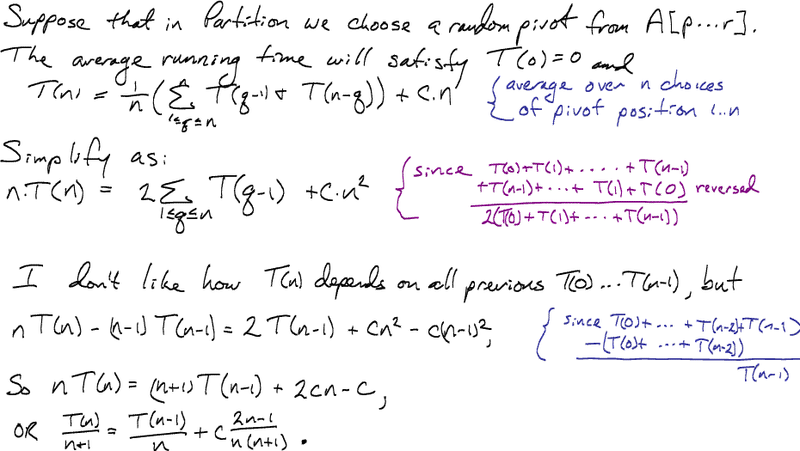
Ok, enough beating around the bush
Comp 550

Slide 36
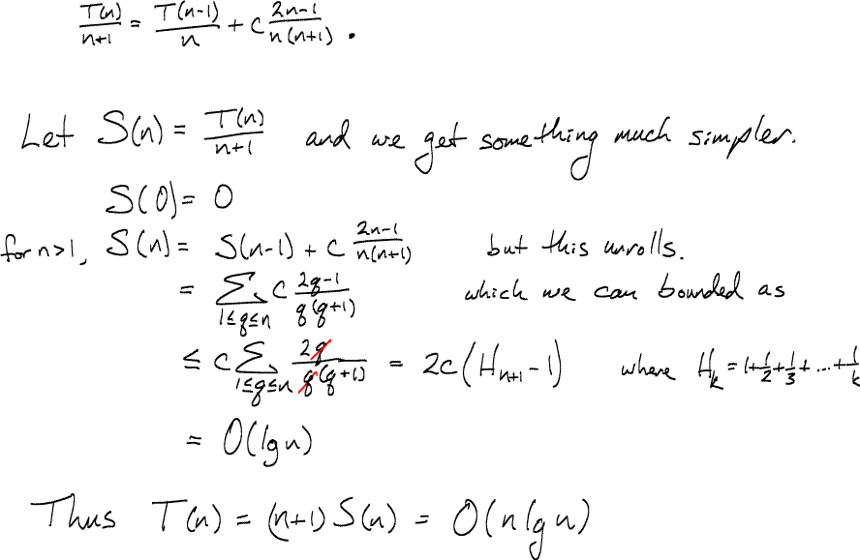
Make that easier…
Comp 550

Slide 37
Variations
Quicksort is not very efficient on small lists.
  Switch to Insertion Sort on small subproblems, or
  Skip small subproblems, and finish with a final Insertion Sort (fast because few inversions).
Quicksort is slow if there are many identical keys
  Three-way partitioning
  (see slides by Sedgewick & Bentley)
Quicksort is not stable.
  Switch to mergesort if this is important.
Comp 550

Slide 38
Variations (Continued)
Input distribution may not be uniformly random.
Fix 1: Use “randomly” selected pivot.
  We’ll analyze this in detail.
Fix 2: Median-of-three Quicksort.
  Use median of three fixed elements (say, the first, middle, and last) as the pivot.
  To get O(n²) behavior, we must continually be unlucky to see that two out of the three elements examined are among the largest or smallest of their sets.
Comp 550

Slide 39
Randomized Quicksort
Want to make running time independent of input ordering.
How can we do that?
  Make the algorithm randomized.
  Make every possible input equally likely.
    Can randomly shuffle to permute the entire array.
    For quicksort, it is sufficient if we can ensure that every element is equally likely to be the pivot.
    So, we choose an element in A[p..r] and exchange it with A[r].
    Because the pivot is randomly chosen, we expect the partitioning to be well balanced on average.
Comp 550

Slide 40
Randomized Version
Want to make running time independent of input ordering.
Randomized-Partition(A, p, r)
i := Random(p, r);
A[r] ↔ A[i];
Partition(A, p, r)
Randomized-Quicksort(A, p, r)
if p < r then
q := Randomized-Partition(A, p, r);
Randomized-Quicksort(A, p, q – 1);
Randomized-Quicksort(A, q + 1, r)
fi
Comp 550

Slide 41
Deterministic vs. Randomized Algorithms
Deterministic Algorithm : Identical behavior for different runs for a given input.
Randomized Algorithm : Behavior is generally different for different runs for a given input.
Algorithms
Deterministic
Randomized
Worst-case
Analysis
Probabilistic
Analysis
Probabilistic
Analysis
Worst-case
Running Time
Average
Running Time
Average
Running Time
Comp 550

