Slide 1
Lower bounds, Linear-time sorts
From CLRS ch9

Slide 2
Comparison-based Sorting
Comparison sort
Only comparison of pairs of elements may be used to gain order information about a sequence.
Hence, a lower bound on the number of comparisons will be a lower bound on the complexity of any comparison-based sorting algorithm.
All our sorts have been comparison sorts
The best worst-case complexity so far is Θ(n lg n) (merge sort and heapsort).
We prove a lower bound of Ω(n lg n) for any comparison sort: merge sort and heapsort are optimal.
The idea is simple: there are n! outcomes, so we need a tree with at least n! leaves, and depth lg(n!) = Θ(n lg n).

Slide 3
Decision Tree
For insertion sort operating on three elements.
1:2
≤
>
Simply unroll all loops for all possible inputs.
Node i:j means compare A[i] to A[j].
Leaves show outputs; we need at least one leaf per sequence.
(It happens in insertion sort that no two leaves have same sequence.)
2:3
1:3
≤
≤
>
⟨1,2,3⟩
1:3
⟨2,1,3⟩
2:3
≤
>
≤
>
⟨1,3,2⟩
⟨3,1,2⟩
⟨2,3,1⟩
⟨3,2,1⟩
Contains 3! = 6 leaves.

Slide 4
Decision Tree (Contd.)
Execution of sorting algorithm corresponds to tracing a path from root to leaf.
The tree models all possible execution traces.
At each internal node, a comparison a_{i} ≤ a_{j} is made.
If a_{i} ≤ a_{j}, follow left subtree, else follow right subtree.
View the tree as if the algorithm splits in two at each node, based on information it has determined up to that point.
When we come to a leaf, ordering a_{π(1)} ≤ a _{π(2)} ≤ … ≤ a _{π(n)} is established.
A correct sorting algorithm must be able to produce any permutation of its input.
Hence, each of the n! permutations must appear at one or more of the leaves of the decision tree.

Slide 5
A Lower Bound for Worst Case
Worst case no. of comparisons for a sorting algorithm is
Length of the longest path from root to any of the leaves in the decision tree for the algorithm.
Which is the height of its decision tree.
A lower bound on the running time of any comparison sort is given by
A lower bound on the heights of all decision trees in which each permutation appears as a reachable leaf.

Slide 6
Optimal sorting for three elements
Any sort of six elements has 5 internal nodes.
1:2
≤
>
2:3
1:3
≤
≤
>
⟨1,2,3⟩
1:3
⟨2,1,3⟩
2:3
≤
>
≤
>
⟨1,3,2⟩
⟨3,1,2⟩
⟨2,3,1⟩
⟨3,2,1⟩
There must be a worst-case path of length ≥ 3.

Slide 7
A Lower Bound for Worst Case
Theorem 8.1:
Any comparison sort algorithm requires Ω(n lg n) comparisons in the worst case.
Proof:
Suffices to determine the height of a decision tree.
The number of leaves is at least n! (# outputs)
The number of internal nodes ≥ n!–1
The height is at least lg (n!–1) = Ω(n lg n) QED

Slide 8
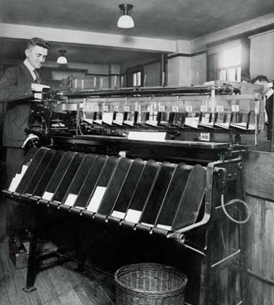
Beating the lower bound
We can beat the lower bound if we don’t base our sort on comparisons:
Counting sort for keys in [0..k], k=O(n)
Radix sort for keys with a fixed number of “digits”
Bucket sort for random keys (uniformly distributed)

Slide 9
Counting Sort
Assumption: we sort integers in {0, 1, 2, …, k}.
Input: A[1..n] ⊂{0, 1, 2, …, k}^{n}. Array A and values n and k are given.
Output: B[1..n] sorted. Assume B is already allocated and given as a parameter.
Auxiliary Storage: C[0..k] counts
Runs in linear time if k = O(n).

Slide 10
Counting-Sort (A, B, k)
CountingSort(A, B, k)
1. for i ← 1 to k
2. do C[i] ← 0
3. for j ← 1 to length[A]
4. do C[A[j]] ← C[A[j]] + 1
5. for i ← 2 to k
6. do C[i] ← C[i] + C[i –1]
7. for j ← length[A] downto 1
8. do B[C[A[ j ]]] ← A[j]
9. C[A[j]] ← C[A[j]]–1
O(k) init counts
O(n) count
O(k) prefix sum
O(n) reorder

Slide 11
Radix Sort
Used to sort on card-sorters:
Do a stable sort on each column, one column at a time.
The human operator is part of the algorithm!
Key idea: sort on the “least significant digit” first and on the remaining digits in sequential order. The sorting method used to sort each digit must be “stable”.
If we start with the “most significant digit”, we’ll need extra storage.

Slide 12
An Example
Input
After sorting
on LSD
After sorting
on middle
digit
After sorting
on MSD
392 631 928 356
356 392 631 392
446 532 532 446
928 ⇒ 495 ⇒ 446 ⇒ 495
631 356 356 532
532 446 392 631
495 928 495 928
↑ ↑ ↑

Slide 13
Radix-Sort(A, d)
RadixSort(A, d)
1. for i ← 1 to d
2. do use a stable sort to sort array A on digit i
Correctness of Radix Sort
By induction on the number of digits sorted.
Assume that radix sort works for d – 1 digits.
Show that it works for d digits.
Radix sort of d digits ≡ radix sort of the low-order d – 1 digits followed by a sort on digit d .

Slide 14
Algorithm Analysis
Each pass over n d-digit numbers then takes time Θ(n+k). (Assuming counting sort is used for each pass.)
There are d passes, so the total time for radix sort is Θ(d (n+k)).
When d is a constant and k = O(n), radix sort runs in linear time.
Radix sort, due to using counting sort as the intermediate stable sort, does not sort in place.
If primary memory storage is an issue, quicksort or other sorting methods may be preferable.

Slide 15
Sorting algorithms
Alg sorts best avg worst stable in-pl

Slide 16
Bucket Sort
Assumes input is generated by a random process that distributes the elements uniformly over [0, 1).
Idea:
Divide [0, 1) into n equal-sized buckets.
Distribute the n input values into the buckets.
Sort each bucket.
Then go through the buckets in order, listing elements in each one.

Slide 17
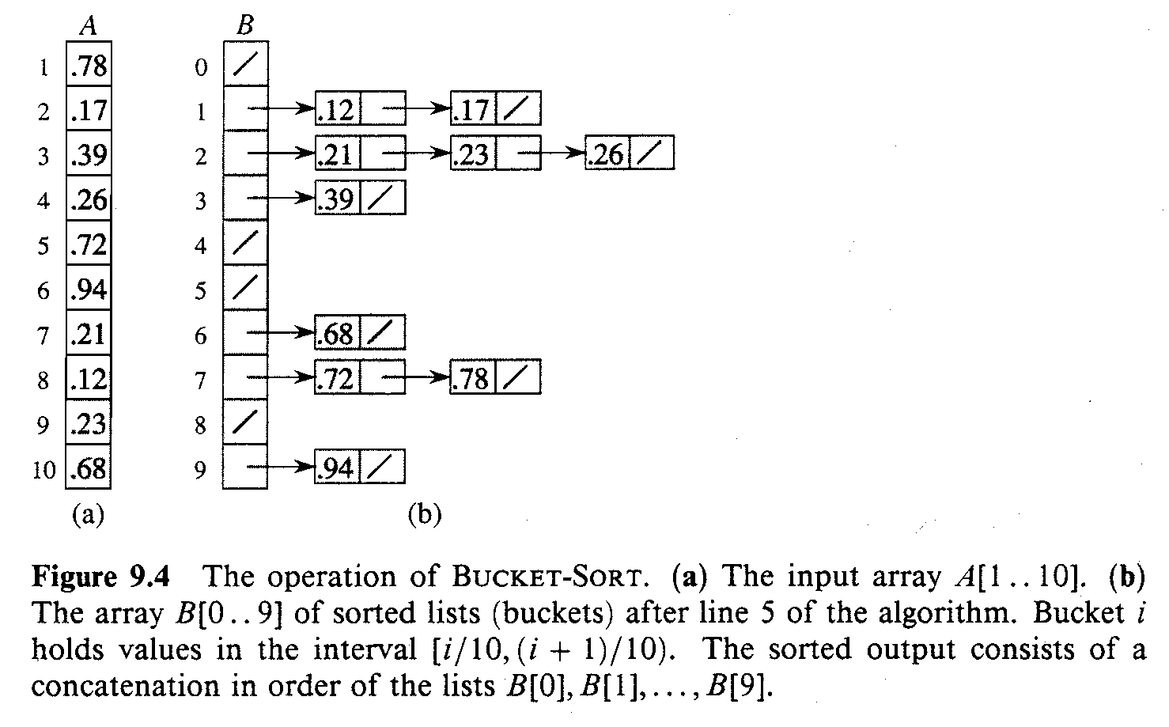
An Example

Slide 18
Bucket-Sort (A)
Input: A[1..n], where 0 ≤ A[i] < 1 for all i.
Auxiliary array: B[0..n – 1] of linked lists, each list initially empty.
BucketSort(A)
1. n ← length[A]
2. for i ← 1 to n
3. do insert A[i] into list B[ ⎣nA[i]⎦ ]
4. for i ← 0 to n – 1
5. do sort list B[i] with insertion sort
concatenate the lists B[i]s together in order
return the concatenated lists

Slide 19
Analysis
Relies on no bucket getting too many values.
All lines except insertion sorting in line 5 take O(n) altogether.
Intuitively, if each bucket gets a constant number of elements, it takes O(1) time to sort each bucket ⇒ O(n) sort time for all buckets.
We “expect” each bucket to have few elements, since the average is 1 element per bucket.
But we need to do a careful analysis.

Slide 20
Analysis – Contd.
RV n_{i} = no. of elements placed in bucket B[i].
Insertion sort runs in quadratic time. Hence, time for bucket sort is:
(8.1)

Slide 21
Analysis – Contd.
Claim: E[n_{i}²] = 2 – 1/n.
Proof:
Define indicator random variables.
X_{ij} = I{A[j] falls in bucket i}
Pr{A[j] falls in bucket i} = 1/n.
n_{i} =
(8.2)

Slide 22
Analysis – Contd.
(8.3)

Slide 23
Analysis – Contd.

Slide 24
Analysis – Contd.
(8.3) is hence,
Substituting (8.2) in (8.1), we have,

