Slide 1
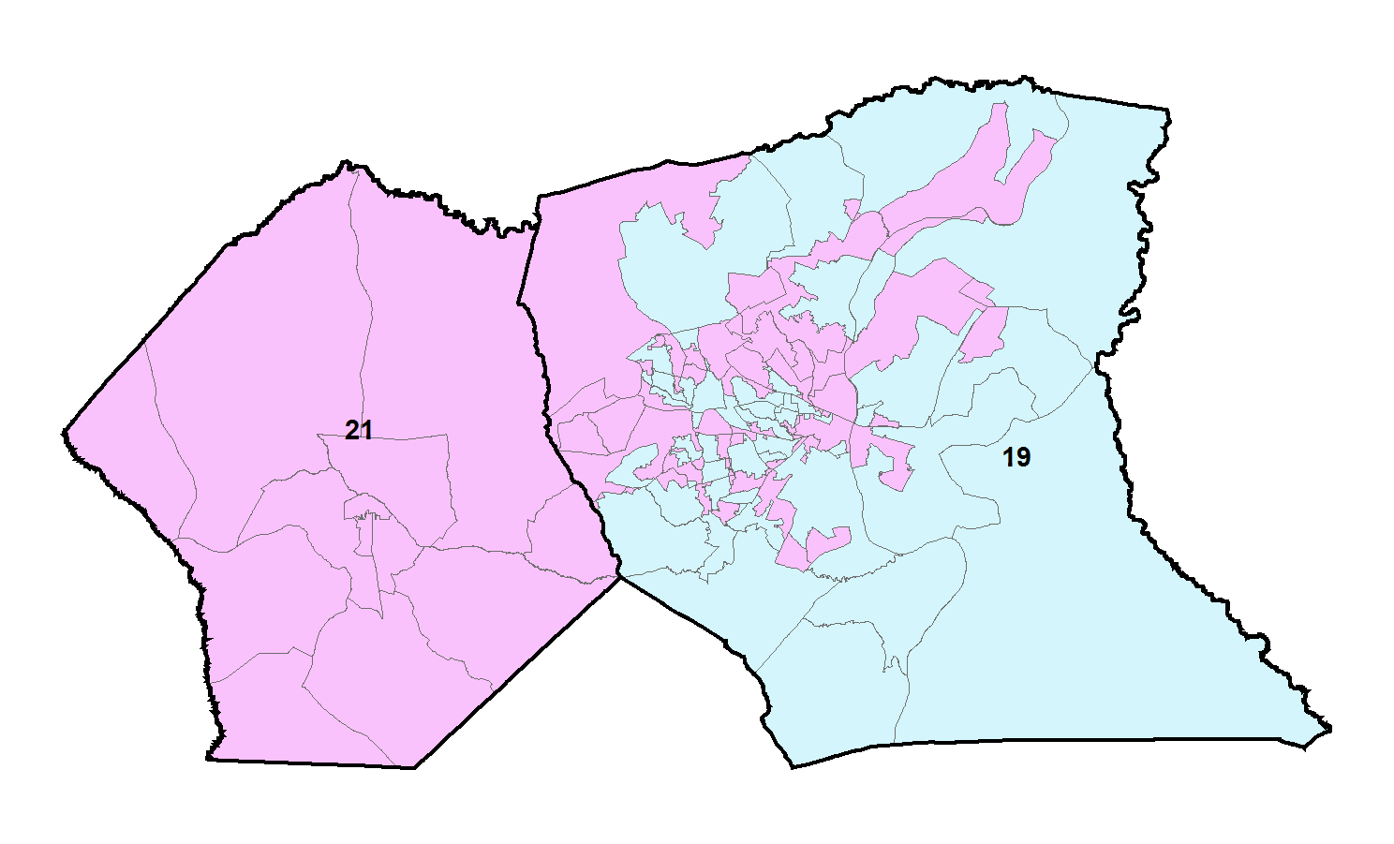
Algorithms
Are in the news (& select which news you see!)
Gerrymandering: an important algorithmic fairness question for NC
Hoke and Cumberland Counties

Slide 2
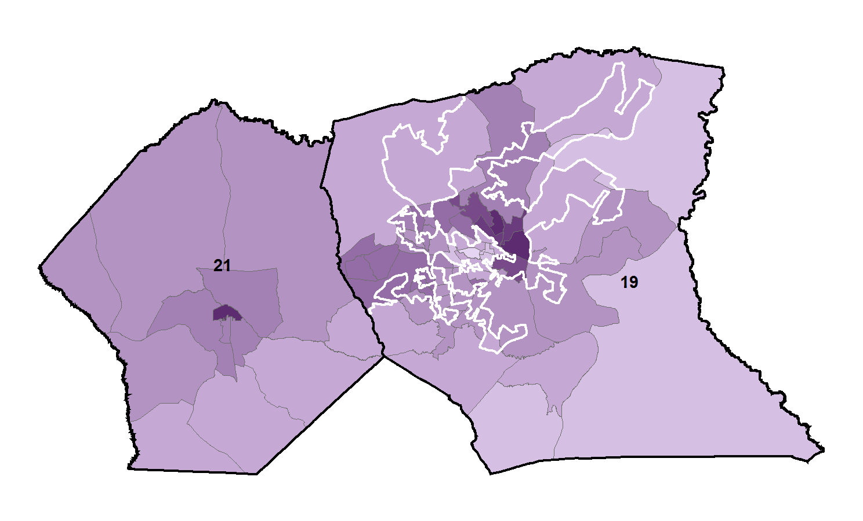
Hoke and Cumberland Counties 2011districts

Slide 3
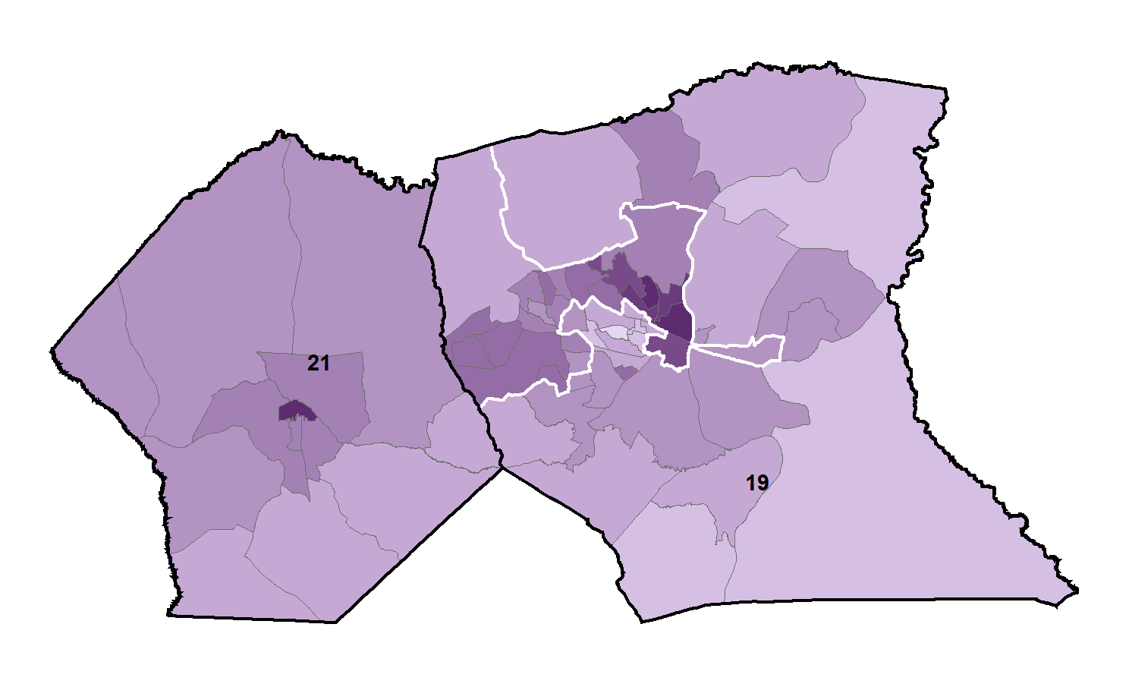
Is this still Gerrymandered?
Consider all possible splits off Cumberland that have the right population, are connected, and “compact,”
and estimate election probabilities for parties.

Slide 4
What is an Algorithm? (And how do we analyze one?)
COMP 550

Slide 5
Goals
Pin down the definition of algorithm
Machine model
Pseudocode conventions
Worst &average-case complexity
Examples (with algorithm design approaches):
linear & binary search (coding from invariants)
Insertion sort (Incremental)
merge sort (Divide & Conquer)
Recurrences to analyze D&C algorithms

Slide 6
Algorithms
Informally,
A tool for solving a well-specified computational problem.
Example: sorting
input: A sequence of numbers.
output: An ordered permutation of the input.
issues: correctness, efficiency, storage, etc.
Input
Algorithm
Output

Slide 7
Strengthening the Informal Definiton
An algorithm is a finite sequence of unambiguous instructions for solving a well-specified computational problem.
Important Features:
Finiteness.
Definiteness.
Input.
Output.
Effectiveness.

Slide 8
Algorithm – In Formal Terms…
In terms of mathematical models of computational platforms (general-purpose computers).
One definition – Turing Machine that always halts.
Other definitions are possible (e.g. Lambda Calculus.)
Mathematical basis is necessary to answer questions such as:
Is a problem solvable? (Does an algorithm exist?)
Complexity classes of problems. (Is an efficient algorithm possible?)
Interested in learning more?
Take COMP 485 and/or David Harel’s book Algorithmics.

Slide 9
Algorithm Analysis
Determining performance characteristics. (Predicting the resource requirements.)
Time, memory, communication bandwidth etc.
Computation time (running time) is of primary concern.
Why analyze algorithms?
Choose the most efficient of several possible algorithms for the same problem.
Is the best possible running time for a problem reasonably finite for practical purposes?
Is the algorithm optimal (best in some sense)? – Is something better possible?

Slide 10
Running Time
Run time expression should be machine-independent.
Use a model of computation or “hypothetical” computer.
Our choice – RAM model (most commonly-used).
Model should be
Simple.
Applicable.

Slide 11
RAM Model
Generic single-processor model.
Supports simple constant-time instructions found in real computers.
Arithmetic (+, –, *, /, %, floor, ceiling).
Data Movement (load, store, copy).
Control (branch, subroutine call).
Run time (cost) is uniform (1 time unit) for all simple instructions.
Memory is unlimited.
Flat memory model – no hierarchy.
Access to a word of memory takes 1 time unit.
Sequential execution – no concurrent operations.

Slide 12
Model of Computation
Should be simple, or even simplistic.
Assign uniform cost for all simple operations and memory accesses. (Not true in practice.)
Question: Is this OK?
Should be widely applicable.
Can’t assume the model to support complex operations. Ex: No SORT instruction.
Size of a word of data is finite.
Why?

Slide 13
Running Time – Definition
Call each simple instruction and access to a word of memory a “primitive operation” or “step.”
Running time of an algorithm for a given input is
The number of steps executed by the algorithm on that input.
Often referred to as the complexity of the algorithm.

Slide 14
Complexity and Input
Complexity of an algorithm generally depends on
Size of input.
Input size depends on the problem.
Examples: No. of items to be sorted.
No. of vertices and edges in a graph.
Other characteristics of the input data.
Are the items already sorted?
Are there cycles in the graph?

Slide 15
Worst, Average, and Best-case Complexity
Worst-case Complexity
Maximum steps the algorithm takes for any possible input.
Most tractable measure.
Average-case Complexity
Average of the running times of all possible inputs.
Demands a definition of probability of each input, which is usually difficult to provide and to analyze.
Best-case Complexity
Minimum number of steps for any possible input.
Not a useful measure. Why?

Slide 16
Pseudo-code Conventions
Read about pseudo-code in the text. pp 19 – 20.
Indentation (for block structure).
Value of loop counter variable upon loop termination.
Conventions for compound data. Differs from syntax in common programming languages.
Call by value not reference.
Local variables.
Error handling is omitted.
Concerns of software engineering ignored.
…

Slide 17
A Simple Example – Linear Search
INPUT: a sequence of n numbers, key to search for.
OUTPUT: true if key occurs in the sequence, false otherwise.
LinearSearch(A, key) cost times
1 i ← 1 c₁ 1
2 while i ≤ n and A[i] != key c₂ x
3 do i++ c₃ x-1
if i ≤ n c₄ 1
then return true c₅ 1
else return false c₆ 1
x ranges between 1 and n+1.
So, the running time ranges between
c₁+ c₂+ c₄ + c₅ – best case
and
c₁+ c₂(n+1)+ c₃n + c₄ + c₆ – worst case

Slide 18
A Simple Example – Linear Search
INPUT: a sequence of n numbers, key to search for.
OUTPUT: true if key occurs in the sequence, false otherwise.
LinearSearch(A, key) cost times
1 i ← 1 1 1
2 while i ≤ n and A[i] != key 1 x
3 do i++ 1 x-1
if i ≤ n 1 1
then return true 1 1
else return false 1 1
Assign a cost of 1 to all statement executions.
Now, the running time ranges between
1+ 1+ 1 + 1 = 4 – best case
and
1+ (n+1)+ n + 1 + 1 = 2n+4 – worst case

Slide 19
A Simple Example – Linear Search
INPUT: a sequence of n numbers, key to search for.
OUTPUT: true if key occurs in the sequence, false otherwise.
LinearSearch(A, key) cost times
1 i ← 1 1 1
2 while i ≤ n and A[i] != key 1 x
3 do i++ 1 x-1
if i ≤ n 1 1
then return true 1 1
else return false 1 1
If we assume that we search for a random item in the list,
on an average, Statements 2 and 3 will be executed n/2 times.
Running times of other statements are independent of input.
Hence, average-case complexity is
1+ n/2+ n/2 + 1 + 1 = n+3

Slide 20
Order of growth
Principal interest is to determine
how running time grows with input size – Order of growth.
the running time for large inputs – Asymptotic complexity.
In determining the above,
Lower-order terms and coefficient of the highest-order term are insignificant.
Ex: In the function f(n) = 7n⁵+6n³+n+10, which term dominates the running time for large n?
Complexity of an algorithm is denoted by the highest-order term in the expression for running time.
Ex: Ο(n), Θ(1), Ω(n²), etc.
Constant complexity when running time is independent of the input size – denoted Ο(1).
Linear Search: Best case Θ(1), Worst and Average cases: Θ(n).
More on Ο, Θ, and Ω in next class. Use Θ for the present.

Slide 21
Comparison of Algorithms
Complexity function can be used to compare the performance of algorithms.
Algorithm A is more efficient than Algorithm B for solving a problem, if the complexity function of A is of lower order than that of B.
Examples:
Linear Search – Θ(n) vs. Binary Search – Θ(lg n)
Insertion Sort – Θ(n²) vs. Quick Sort – Θ(n lg n)

Slide 22
Comparisons of Algorithms
Multiplication
classical technique: O(nm)
divide-and-conquer: O(nm^{ln1.5}) ~ O(nm^{0.59})
For operands of size 1000, takes 40 & 15 seconds respectively on a Cyber 835.
Sorting
insertion sort: Θ(n²)
merge sort: Θ(n lg n)
For 10⁶ numbers, it took 5.56 hrs on a supercomputer using machine language and 16.67 min on a PC using C/C++.

Slide 23
Why Order of Growth Matters?
Computer speeds double every two years, so why worry about algorithm speed?
When speed doubles, what happens to the amount of work you can do?
What about the demands of applications?

Slide 24
Effect of Faster Machines
No. of items sorted
Ο(n²)
H/W Speed
1 M*
2 M
Gain
Comp. of Alg.
1000
1414
1.414
O(n lgn)
62700
118600
1.9
* Million operations per second.
Higher gain with faster hardware for more efficient algorithm.
Results are more dramatic for more higher speeds.

Slide 25
Correctness Proofs
Proving (beyond “any” doubt) that an algorithm is correct.
Prove that the algorithm produces correct output when it terminates. Partial Correctness.
Prove that the algorithm will necessarily terminate. Total Correctness.
Techniques
Proof by Construction.
Proof by Induction.
Proof by Contradiction.

Slide 26
Loop Invariant
Logical expression with the following properties.
Holds true before the first iteration of the loop – Initialization.
If it is true before an iteration of the loop, it remains true before the next iteration – Maintenance.
When the loop terminates, the invariant ― along with the fact that the loop terminated ― gives a useful property that helps show that the loop is correct – Termination.
Similar to mathematical induction.
Are there differences?

Slide 27
Correctness Proof of Linear Search
Use Loop Invariant for the while loop:
At the start of each iteration of the while loop, the search key is not in the subarray A[1..i-1].
LinearSearch(A, key)
1 i ← 1
2 while i ≤ n and A[i] != key
3 do i++
if i ≤ n
then return true
else return false
If the algm. terminates, then it produces correct result.
Initialization.
Maintenance.
Termination.
Argue that it terminates.

Slide 28
Insertion Sort – review of loop invariants

Slide 29
Sorting – Definitions
Input: n records, R₁ … R_{n} , from a file.
Each record R_{i} has
a key K_{i}
possibly other (satellite) information
The keys must have an ordering relation that satisfies the following properties:
Trichotomy: For any two keys a and b, exactly one of a b, a = b, or a b is true.
Transitivity: For any three keys a, b, and c, if a b and b c, then a c.
The relation = is a total ordering (linear ordering) on keys.

Slide 30
Sorting – Definitions
Sorting: determine a permutation Π = (p₁, … , p_{n}) of n records that puts the keys in non-decreasing order Kp₁ < … < Kp_{n}.
Permutation: one-to-one function from {1, …, n} onto itself. There are n! distinct permutations of n items.
Rank: Given a collection of n keys, the rank of a key is the number of keys that precede it: rank(K_{j}) = |{K_{i}| K_{i} < K_{j}}| If keys are distinct, then the rank of a key gives its position in the output.

Slide 31
Sorting Terminology
Internal (the file is stored in main memory and can be randomly accessed) vs. External (the file is stored in secondary memory & can be accessed sequentially only)
Comparison-based sort: uses only the relation among keys, not any special property of the representation of the keys themselves.
Stable sort: records with equal keys retain their original relative order; i.e., i < j & Kp_{i} = Kp_{j} ⇒ p_{i} < p_{j}
Array-based (consecutive keys are stored in consecutive memory locations) vs. List-based sort (may be stored in nonconsecutive locations in a linked manner)
In-place sort: needs only a constant amount of extra space in addition to that needed to store keys.

Slide 32
Sorting Categories
Sorting by Insertion insertion sort, shellsort
Sorting by Exchange bubble sort, quicksort
Sorting by Selection selection sort, heapsort
Sorting by Merging merge sort
Sorting by Distribution radix sort

Slide 33
Insertion Sort
Problem: sort n numbers in A[1..n].
Input: n, numbers in A
Output: A in sorted order: ∀ i ∈ [2..n], A[i-1] <= A[i]
for j=2 to length(A)
do key=A[j]
i=j-1
while i>0 and A[i]>key
do A[i+1]=A[i]
i--
A[i+1]=key

Slide 34
Loop Invariants
Invariants – statements about an algorithm that remain valid
We must show three things about loop invariants:
Initialization – statement is true before first iteration
Maintenance – if it is true before an iteration, then it remains true before the next iteration
Termination – when loop terminates the invariant gives a useful property to show the correctness of the algorithm

Slide 35
Example: Insertion Sort
Invariant: at the start of each for loop, A[1…j-1] consists of elements originally in A[1…j-1] but in sorted order; all other elements are unchanged.
for j=2 to length(A)
do key=A[j]
i=j-1
while i>0 and A[i]>key
do A[i+1]=A[i]
i--
A[i+1]:=key

Slide 36
Example: Insertion Sort
Invariant: at the start of each for loop, A[1…j-1] consists of elements originally in A[1…j-1] but in sorted order; all other elements are unchanged
for j=2 to length(A)
do key=A[j]
i=j-1
while i>0 and A[i]>key
do A[i+1]=A[i]
i--
A[i+1]:=key
Initialization: j = 2, the invariant trivially holds because A[1] is a sorted array. √

Slide 37
Example: Insertion Sort
Invariant: at the start of each for loop, A[1…j-1] consists of elements originally in A[1…j-1] but in sorted order; all other elements are unchanged
for j=2 to length(A)
do key=A[j]
i=j-1
while i>0 and A[i]>key
do A[i+1]=A[i]
i--
A[i+1]:=key
Maintenance: the inner while loop finds the position i with A[i] <= key, and shifts A[j-1], A[j-2], …, A[i+1] right by one position. Then key, formerly known as A[j], is placed in position i+1 so that A[i] ≤ A[i+1] < A[i+2].
A[1…j-1] sorted + A[j] → A[1…j] sorted

Slide 38
Example: Insertion Sort
Invariant: at the start of each for loop, A[1…j-1] consists of elements originally in A[1…j-1] but in sorted order; all other elements are unchanged
for j=2 to length(A)
do key=A[j]
i=j-1
while i>0 and A[i]>key
do A[i+1]=A[i]
i--
A[i+1]:=key
Termination: the loop terminates, when j=n+1. Then the invariant states: “A[1…n] consists of elements originally in A[1…n] but in sorted order.” √

Slide 39
Divide and Conquer (Merge Sort)

Slide 40
Divide and Conquer
Recursive in structure
Divide the problem into sub-problems that are similar to the original but smaller in size
Conquer the sub-problems by solving them recursively. If they are small enough, just solve them in a straightforward manner.
Combine the solutions to create a solution to the original problem

Slide 41
An Example: Merge Sort
Sorting Problem: Sort a sequence or n elements into non-decreasing order.
Divide: Divide the n-element sequence to be sorted into two subsequences of n/2 elements each
Conquer: Sort the two subsequences recursively using merge sort.
Combine: Merge the two sorted subsequences to produce the sorted answer.

Slide 42
Merge Sort – Example
18
26
32
6
43
15
9
1
22
26
19
55
37
43
99
2
18
26
32
6
43
15
9
1
22
26
19
55
37
43
99
2
18
26
32
6
43
15
9
1
22
26
19
55
37
43
99
2
18
26
32
6
43
15
9
1
22
26
19
55
37
43
99
2
18
26
32
6
43
15
9
1
22
26
19
55
37
43
99
2

Slide 43
Merge Sort – Example
Original Sequence
Sorted Sequence
18
26
32
6
43
15
9
1
18
26
32
6
43
15
9
1
1
6
9
15
18
26
32
43
43
15
9
1
18
26
32
6
43
15
9
1
18
26
32
6
6
26
32
6
18
26
32
18
1
9
15
43
1
9
15
43
18
26
43
15
9
1
18
26
32
6
43
15
9
1
32
6
18
26
6
32
15
43
18
26
6
32
15
43
1
9
1
9
18
26
32
15
1
15
18
26
32
6
43
15
9
1
18
26
6
43
9
26
32
6
43
15
9
9
1
18
32
6
43
1
18
26
32
6
43
15
9
1
18
26
32
6
43
15
9
1

Slide 44
Merge-Sort (A, p, r)
INPUT: a sequence of n numbers stored in array A
OUTPUT: an ordered sequence of n numbers
MergeSort (A, p, r) // sort A[p..r] by divide & conquer
if p < r
then q ← ⎣(p+r)/2⎦
MergeSort (A, p, q)
MergeSort (A, q+1, r)
Merge (A, p, q, r) // merges A[p..q] with A[q+1..r]
Initial Call: MergeSort(A, 1, n)

Slide 45
Procedure Merge
Merge(A, p, q, r)
1 n₁ ← q – p + 1
2 n₂ ← r – q
for i ← 1 to n₁
do L[i] ← A[p + i – 1]
for j ← 1 to n₂
do R[j] ← A[q + j]
L[n₁+1] ← ∞
R[n₂+1] ← ∞
i ← 1
j ← 1
for k ←p to r
do if L[i] ≤ R[j]
then A[k] ← L[i]
i ← i + 1
else A[k] ← R[j]
j ← j + 1
Input: Array containing sorted subarrays A[p..q] and A[q+1..r].
Output: Merged sorted subarray in A[p..r].
Sentinels, to avoid having to
check if either subarray is
fully copied at each step.

Slide 46
Merge – Example
A
…
6
8
26
32
1
9
42
43
…
1
6
8
9
26
32
42
43
k
k
k
k
k
k
k
k
k
L
6
8
26
32
∞
R
6
8
26
32
1
9
42
43
∞
1
9
42
43
i
i
i
i
i
j
j
j
j
j

Slide 47
Correctness of Merge
Merge(A, p, q, r)
1 n₁ ← q – p + 1
2 n₂ ← r – q
for i ← 1 to n₁
do L[i] ← A[p + i – 1]
for j ← 1 to n₂
do R[j] ← A[q + j]
L[n₁+1] ← ∞
R[n₂+1] ← ∞
i ← 1
j ← 1
for k ←p to r
do if L[i] ≤ R[j]
then A[k] ← L[i]
i ← i + 1
else A[k] ← R[j]
j ← j + 1
Loop Invariant for the for loop
At the start of each iteration of the
for loop:
Subarray A[p..k – 1]
contains the k – p smallest elements
of L and R in sorted order.
L[i] and R[j] are the smallest elements of
L and R that have not been copied back into
A.
Initialization:
Before the first iteration:
A[p..k – 1] is empty.
i = j = 1.
L[1] and R[1] are the smallest
elements of L and R not copied to A.

Slide 48
Correctness of Merge
Merge(A, p, q, r)
1 n₁ ← q – p + 1
2 n₂ ← r – q
for i ← 1 to n₁
do L[i] ← A[p + i – 1]
for j ← 1 to n₂
do R[j] ← A[q + j]
L[n₁+1] ← ∞
R[n₂+1] ← ∞
i ← 1
j ← 1
for k ←p to r
do if L[i] ≤ R[j]
then A[k] ← L[i]
i ← i + 1
else A[k] ← R[j]
j ← j + 1
Maintenance:
Case 1: L[i] ≤ R[j]
By LI, A contains p – k smallest elements of L and R in sorted order.
By LI, L[i] and R[j] are the smallest elements of L and R not yet copied into A.
Line 13 results in A containing p – k + 1 smallest elements (again in sorted order).
Incrementing i and k reestablishes the LI for the next iteration.
Similarly for L[i] > R[j].
Termination:
On termination, k = r + 1.
By LI, A contains r – p + 1 smallest
elements of L and R in sorted order.
L and R together contain r – p + 3 elements.
All but the two sentinels have been copied
back into A.

Slide 49
Analysis of Merge Sort
Running time T(n) of Merge Sort:
Divide: computing the middle takes Θ(1)
Conquer: solving 2 subproblems takes 2T(n/2)
Combine: merging n elements takes Θ(n)
Total:
T(n) = Θ(1) if n = 1
T(n) = 2T(n/2) + Θ(n) if n > 1
⇒ T(n) = Θ(n lg n) (CLRS, Chapter 4)

Slide 50
Recurrences – I

Slide 51
Recurrence Relations
Equation or an inequality that characterizes a function by its values on smaller inputs.
Solution Methods (Chapter 4)
Substitution Method.
Recursion-tree Method.
Master Method.
Recurrence relations arise when we analyze the running time of iterative or recursive algorithms.
Ex: Divide and Conquer.
T(n) = Θ(1) if n ≤ c
T(n) = a T(n/b) + D(n) + C(n) otherwise

Slide 52
Substitution Method
Guess the form of the solution, then use mathematical induction to show it correct.
Substitute guessed answer for the function when the inductive hypothesis is applied to smaller values – hence, the name.
Works well when the solution is easy to guess.
No general way to guess the correct solution.
Notes:
Talk about how mathematical induction works.

Slide 53
Example – Exact Function
Recurrence: T(n) = 1 if n = 1
T(n) = 2T(n/2) + n if n > 1
Guess: T(n) = n lg n + n.
Induction:
Basis: n = 1 ⇒ n lgn + n = 1 = T(n).
Hypothesis: T(k) = k lg k + k for all k < n.
Inductive Step: T(n) = 2 T(n/2) + n
= 2 ((n/2)lg(n/2) + (n/2)) + n
= n (lg(n/2)) + 2n
= n lg n – n + 2n
= n lg n + n

Slide 54
Recursion-tree Method
Making a good guess is sometimes difficult with the substitution method.
Use recursion trees to devise good guesses.
Recursion Trees
Show successive expansions of recurrences using trees.
Keep track of the time spent on the subproblems of a divide and conquer algorithm.
Help organize the algebraic bookkeeping necessary to solve a recurrence.

Slide 55
Recursion Tree – Example
Running time of Merge Sort:
T(n) = Θ(1) if n = 1
T(n) = 2T(n/2) + Θ(n) if n > 1
Rewrite the recurrence as
T(n) = c if n = 1
T(n) = 2T(n/2) + cn if n > 1
c > 0: Running time for the base case and
time per array element for the divide and
combine steps.

Slide 56
Recursion Tree for Merge Sort
For the original problem, we have a cost of cn, plus two subproblems each of size (n/2) and running time T(n/2).
Each of the size n/2 problems has a cost of cn/2 plus two subproblems, each costing T(n/4).
cn
cn
Cost of divide and merge.
cn/2
cn/2
T(n/2)
T(n/2)
T(n/4)
T(n/4)
T(n/4)
T(n/4)
Cost of sorting subproblems.

Slide 57
Recursion Tree for Merge Sort
Continue expanding until the problem size reduces to 1.
cn
cn
cn/2
cn/2
cn
lg n
cn/4
cn/4
cn/4
cn/4
cn
c
c
c
c
c
c
cn
Total : cnlgn+cn

Slide 58
Recursion Tree for Merge Sort
Continue expanding until the problem size reduces to 1.
cn
Each level has total cost cn.
Each time we go down one level, the number of subproblems doubles, but the cost per subproblem halves ⇒ cost per level remains the same.
There are lg n + 1 levels, height is lg n. (Assuming n is a power of 2.)
Can be proved by induction.
Total cost = sum of costs at each level = (lg n + 1)cn = cnlgn + cn = Θ(n lgn).
cn/2
cn/2
cn/4
cn/4
cn/4
cn/4
c
c
c
c
c
c

Slide 59
Other Examples
Use the recursion-tree method to determine a guess for the recurrences
T(n) = 3T(⎣n/4⎦) + Θ(n²).
T(n) = T(n/3) + T(2n/3) + O(n).

Slide 60
Recursion Trees – Caution Note
Recursion trees only generate guesses.
Verify guesses using substitution method.
A small amount of “sloppiness” can be tolerated. Why?
If careful when drawing out a recursion tree and summing the costs, can be used as direct proof.

Slide 61
The Master Method
Based on the Master theorem.
“Cookbook” approach for solving recurrences of the form
T(n) = aT(n/b) + f(n)
a ≥ 1, b > 1 are constants.
f(n) is asymptotically positive.
n/b may not be an integer, but we ignore floors and ceilings. Why?
Requires memorization of three cases.

Slide 62
The Master Theorem
Theorem 4.1
Let a ≥ 1 and b > 1 be constants, let f(n) be a function, and Let T(n) be defined on nonnegative integers by the recurrence T(n) = aT(n/b) + f(n), where we can replace n/b by ⎣n/b⎦ or ⎡n/b⎤. T(n) can be bounded asymptotically in three cases:
If f(n) = O(n^{logba–ε}) for some constant ε > 0, then T(n) = Θ(n^{logba}).
If f(n) = Θ(n^{logba}), then T(n) = Θ(n^{logba}lg n).
If f(n) = Ω(n^{logba+ε}) for some constant ε > 0, and if, for some constant c < 1 and all sufficiently large n, we have a·f(n/b) ≤ c f(n), then T(n) = Θ(f(n)).
We’ll return to recurrences as we need them…

