Slide 1
Data Assimilation in Dynamical Systems Lecture 10
Chris Jones, Amit Apte, Erik Van Vleck

Slide 2
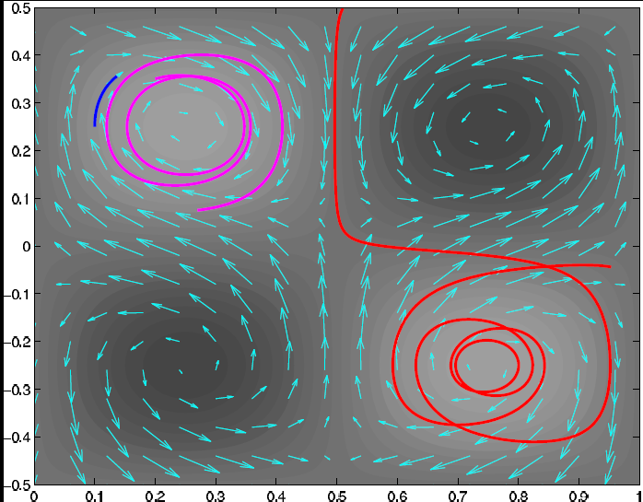
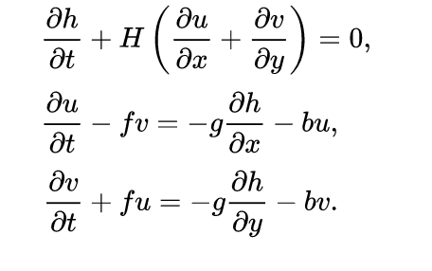
Mathematical model
Computational model
Linearized shallow water equations

Slide 3
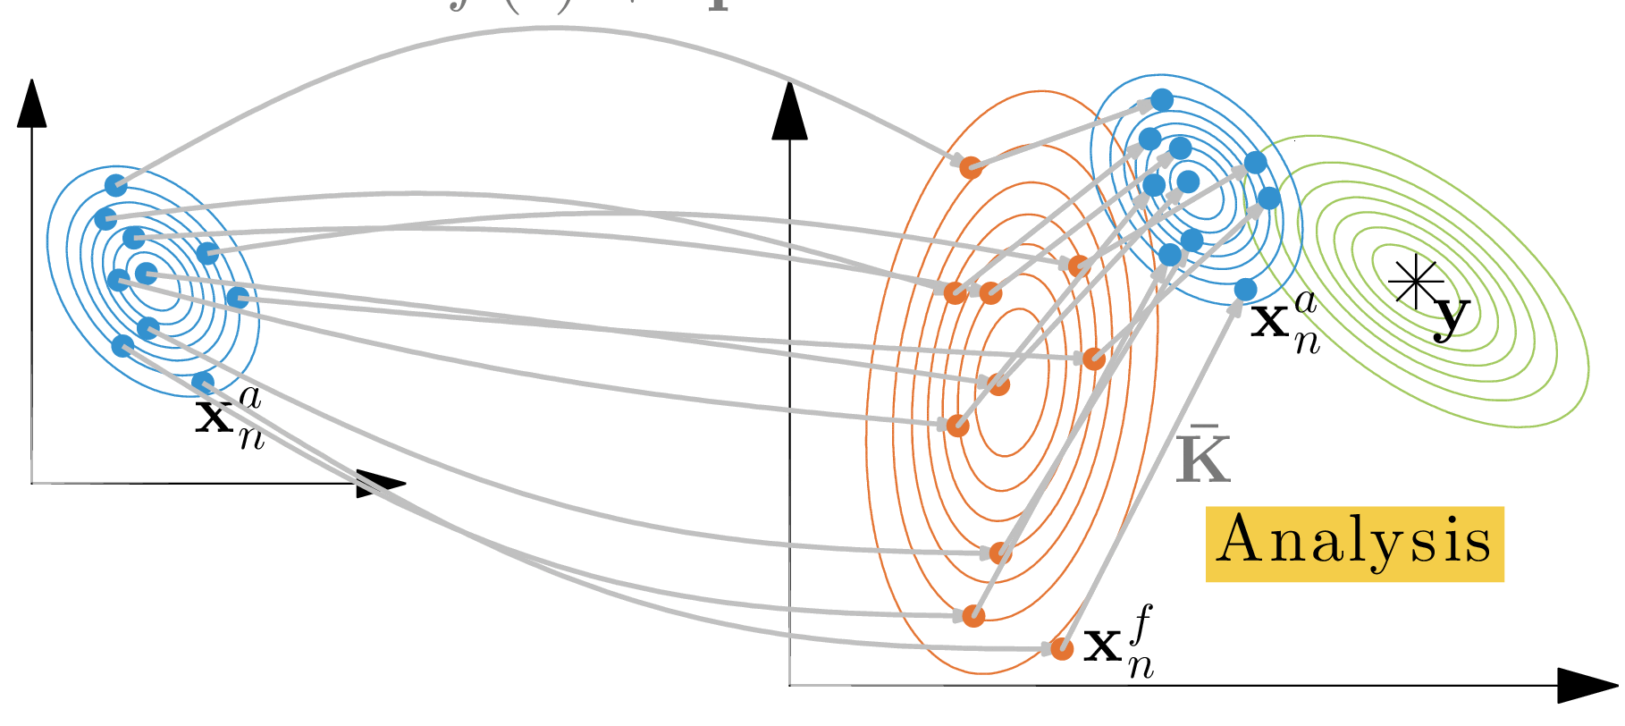
Ensemble Kalman Filter
Pdfs are Gaussian
Dynamic model evolution is nonlinear
Patrick Raanes, NERSC

Slide 4
Augmented system
Append equations for drifters (floats)
Apply filtering to augmented system
Ide, Jones and Kuznetsov (2002)
Notes:
We extend the dynamical model by including tracer advection equations.
Flow equations are not changed: tracers are assumed to be passive.
Linearized model operator can be written in a block form as above.
The dimension of the system increases from N to N+L, dimension of P: from N^2 to (N+L)^2.
Is this increase in computational cost justified? In oceanography observations are often sparse, and
L<<N, so the relative increase in dimension may be not too large. Our goal is to understand how much we can gain by carefully treating drifter observations.
The flow does not depend on tracers, but the tracer motion is does depend on the flow – tracers read flow information along the trajectory.
Observation operator corresponding to measurements of tracer positions is linear in this formulation, and Kalman gain matrix has a simple expression. The weights with which the flow variables are updated by observations are given by first N rows of K. These rows are proportional to P^DF: the correlations between the flow and the drifters. This is the only part of the error covariance matrix that we need in the end (but to predict it we need other blocks of P, perhaps some approximations for those can be used).

Slide 5
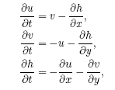

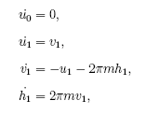
Perturbed Cellular Flow Field
Apte, J and Stuart Tellus A 2008
Apte and J. 2014

Slide 6
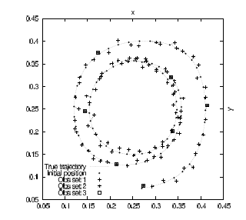
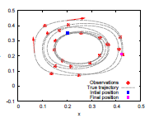
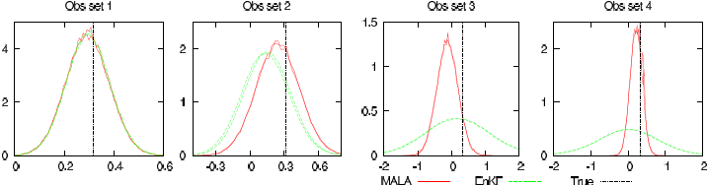
Assimilating from trajectory staying in one cell
Expt: estimate i.c. from observations of trajectory

Slide 7


Dominant methods in sequential DA:
Ensemble Kalman Filter (EnKF)
Particle Filter
Ensemble members
Particles with weights
Evolve under model
Evolve under model with additive noise
Covariance matrix $P$from ensemble
Evolved particles form prior
Update ensemble using Kalman filter with $K$ based on covariance $P$
Weight particles by distance from observations
New ensemble
Posterior pdf

Slide 8
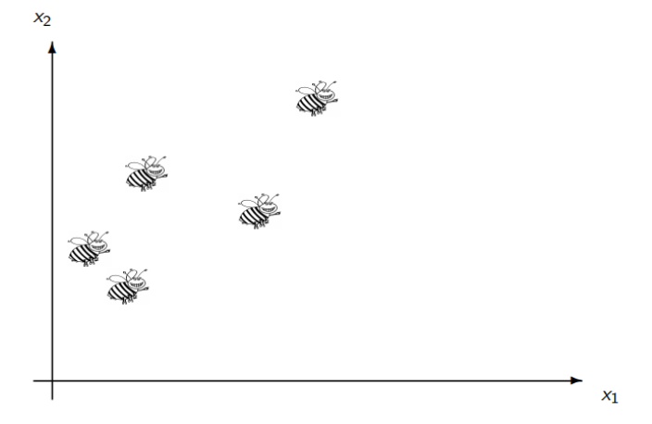
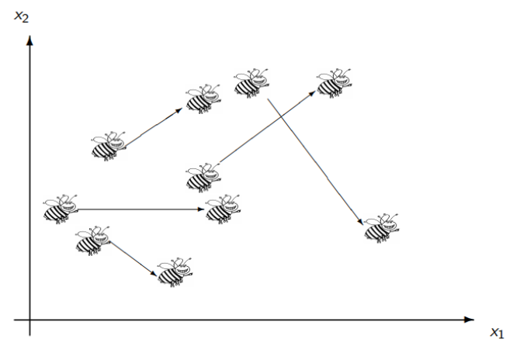
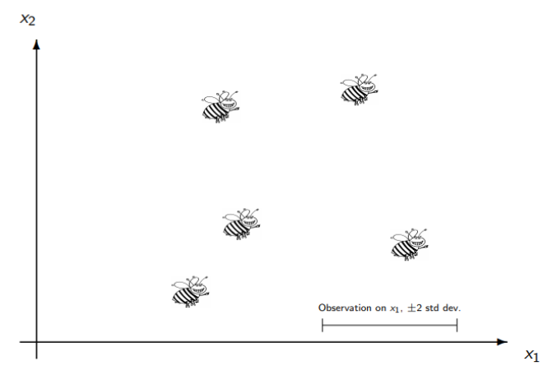
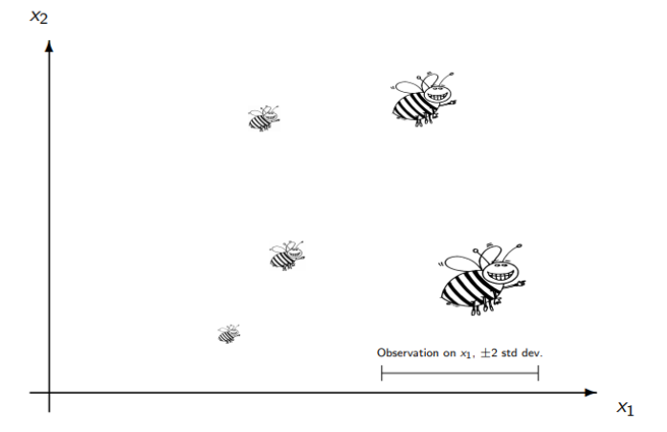
Rougier’s cartoon of a particle filter

Slide 9
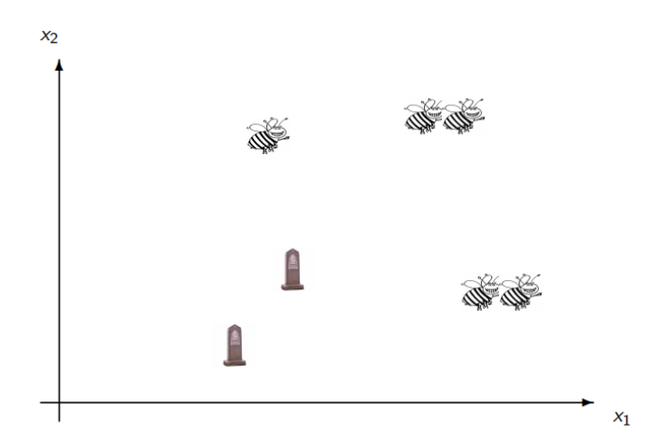

Slide 10
EnKF
Particle Filter
model
model
assimilation
assimilation
Problem: nonlinearity
Problem: dimension

Slide 11
EnKF
PF
Issue: nonlinear system has a “hole” but linear assimilation step puts the ensemble members in this no-go area
Issue: particles can collapse into a small region, especially in high dimensions. You can end up with a delta function pdf

Slide 12
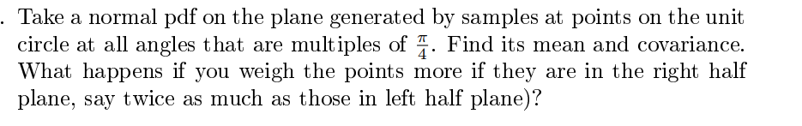
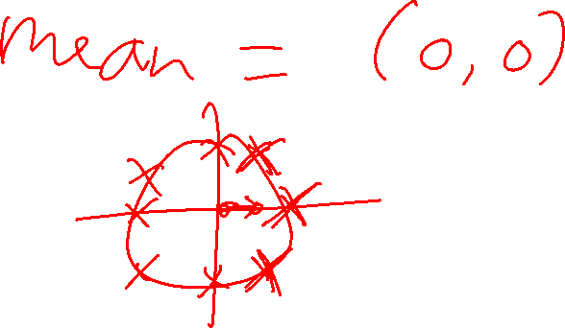

Slide 13
Assimilating from trajectory staying in one cell pf cellular flow field
Expt: estimate i.c. from observations of trajectory
Apte and J. NPG 2014

Slide 14

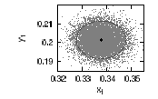
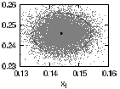
Problem with EnKF
Before second observation
After first observation and assimilation
After SECOND observation and assimilation

Slide 15
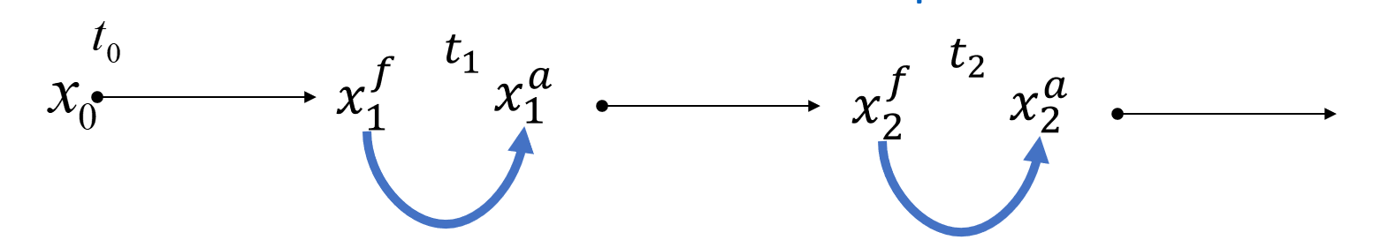








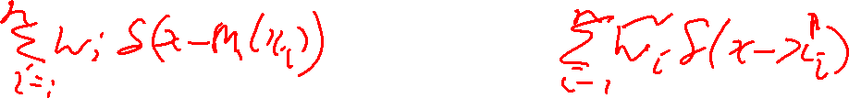


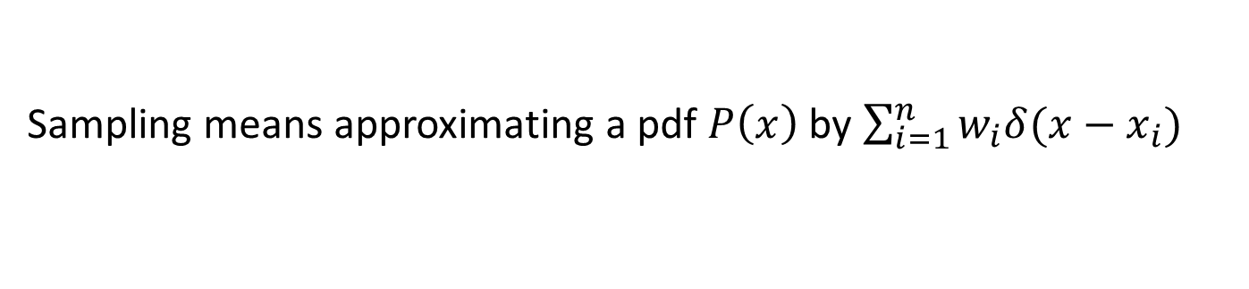
$$m_{1}$$
$$m_{2}$$
$$y_{1}$$
$$m_{1}$$
$$m_{2}$$
$$P(x_{0})$$
$${P(x}_{1}^{f}\left|x_{0})\right.$$
$${P(x}_{1}^{a}\left|y_{1})\right.$$
What is approx. of
$$y_{1}$$
Any guesses?
Sampling means approximating a pdf $P\left(x\right)$ by $\sum_{i=1}^{n}{w_{i}δ(x−x_{i})}$

Slide 16
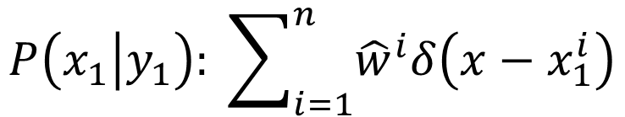
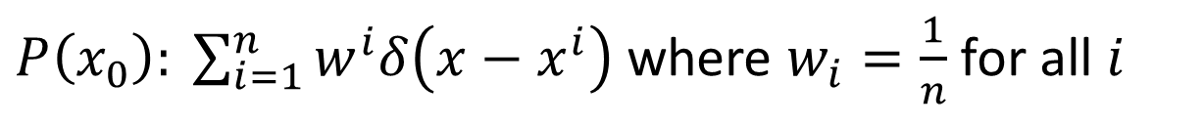
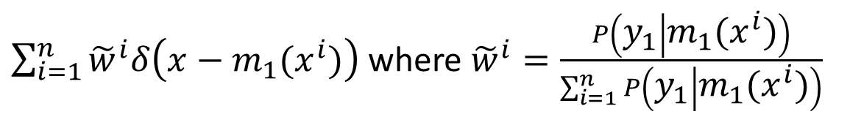
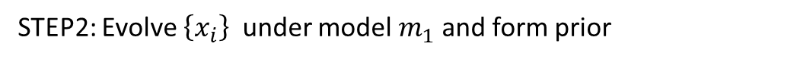
PARTICLE FILTER
STEP1: Start with $P(x_{0})$ and sample from it
$P\left(x_{0}\right): \sum_{i=1}^{n}{w^{i}δ\left(x−x^{i}\right)}$ where $w_{i}=\frac{1}{n}$for all $i$
STEP2: Evolve $\left\{x_{i}\right\}$under model $m_{1}$ and form prior
$$P\left(x_{1}\left|x_{0}\right.\right): \sum_{i=1}^{n}{w^{i}δ\left(x−{m_{1}(x}^{i})\right)} \text{where} w_{i}=\frac{1}{n} \text{for} \text{all} i$$
STEP3: Reweight the samples ${m_{1}(x}^{i}$) from proximity to obs
$\sum_{i=1}^{n}{{\tilde{w}}^{i}δ\left(x−{m_{1}(x}^{i})\right)}$ where ${\tilde{w}}^{i}=\frac{P\left(y_{1} | {m_{1}(x}^{i})\right)}{\sum_{i=1}^{n}{P\left(y_{1} | {m_{1}(x}^{i})\right)}}$
STEP4: Cull and resample from proximity to obs and form posterior
$$P\left(x_{1}\left|y_{1}\right.\right): \sum_{i=1}^{n}{{\hat{w}}^{i}δ\left(x−x_{1}^{i}\right)}$$

