Slide 1
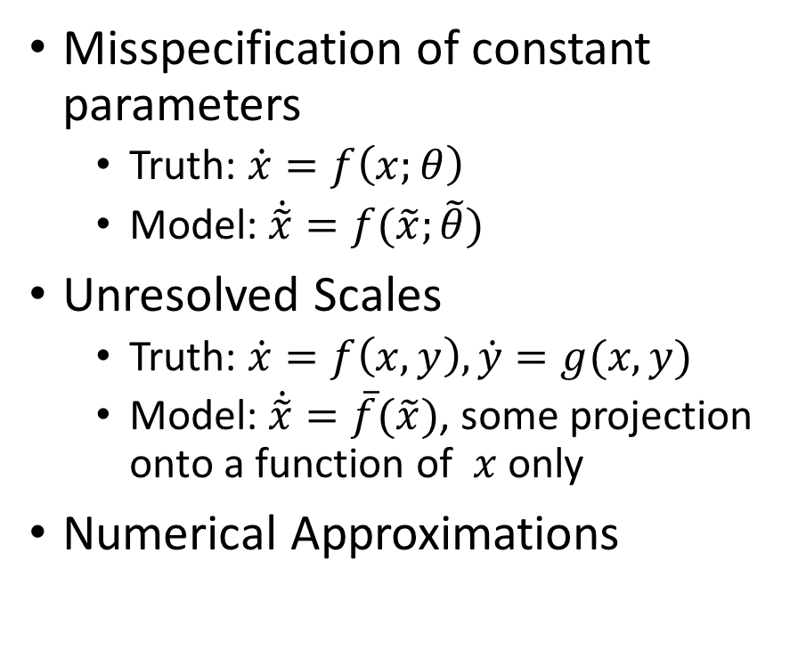
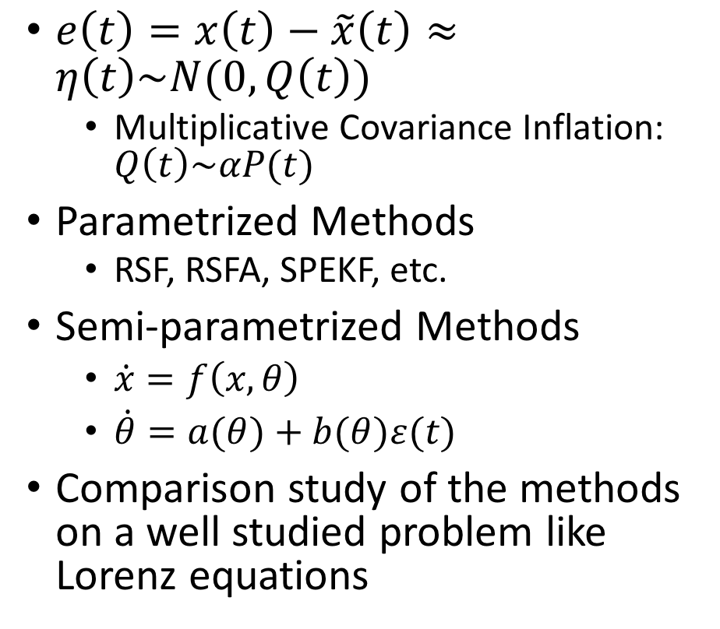
Model Error
Misspecification of constant parameters
Truth: $\dot{x}=f\left(x;θ\right)$
Model: $\dot{\tilde{x}}=f(\tilde{x};\tilde{θ})$
Unresolved Scales
Truth: $\dot{x}=f\left(x,y\right),\dot{y}=g(x,y)$
Model: $\dot{\tilde{x}}=\overline{f}(\tilde{x})$, some projection onto a function of $x$ only
Numerical Approximations
$e\left(t\right)=x\left(t\right)−\tilde{x}\left(t\right)≈η\left(t\right)\sim N(0,Q\left(t\right))$
Multiplicative Covariance Inflation: $Q\left(t\right)\sim αP(t)$
Parametrized Methods
RSF, RSFA, SPEKF, etc.
Semi-parametrized Methods
$\dot{x}=f\left(x,θ\right)$
$\dot{θ}=a(θ)+b(θ)ε(t)$
Comparison study of the methods on a well studied problem like Lorenz equations

