Slide 1

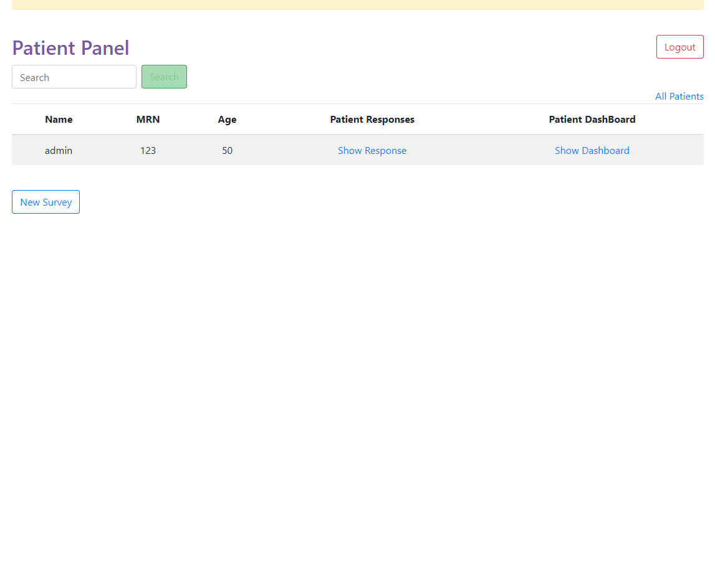
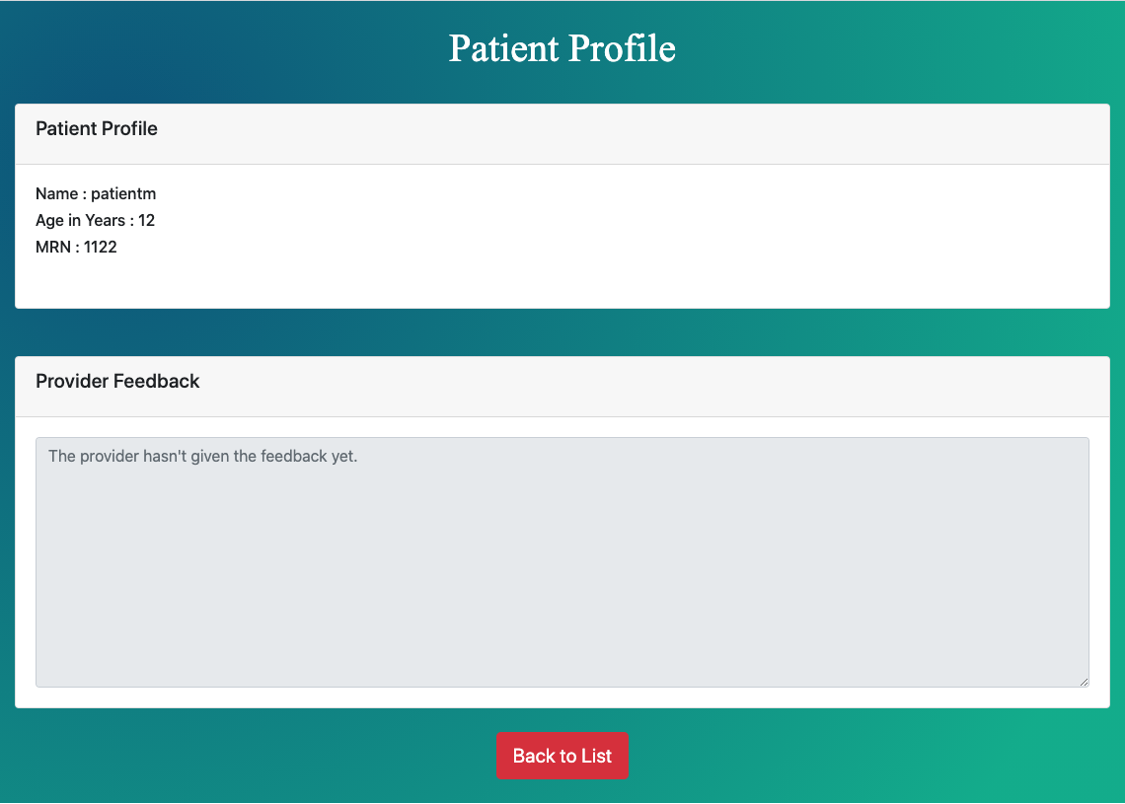
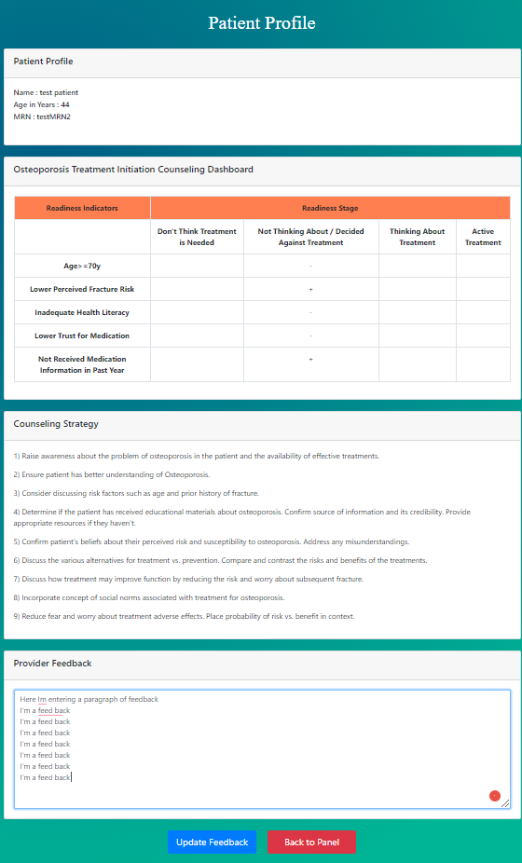
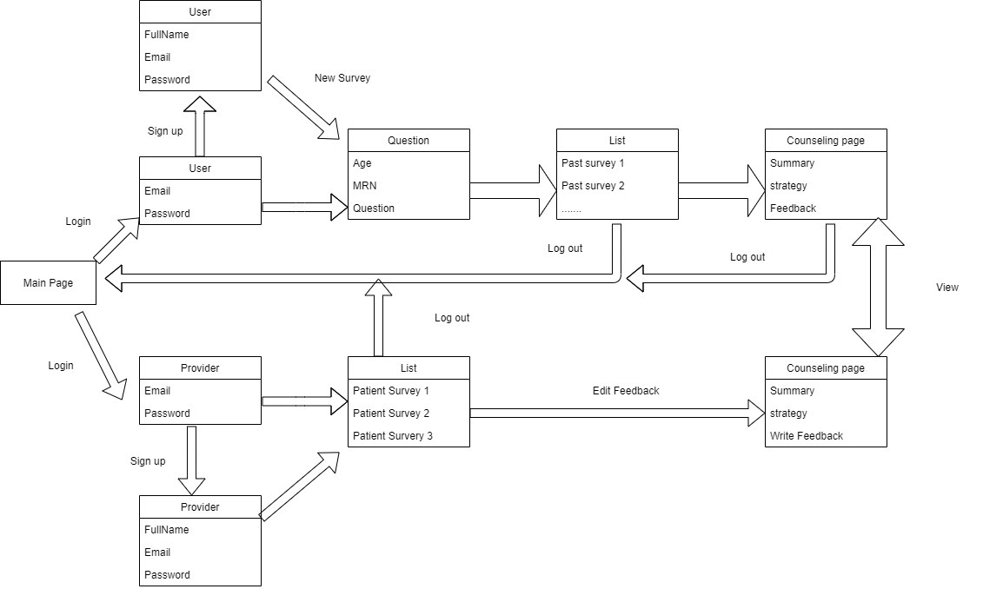
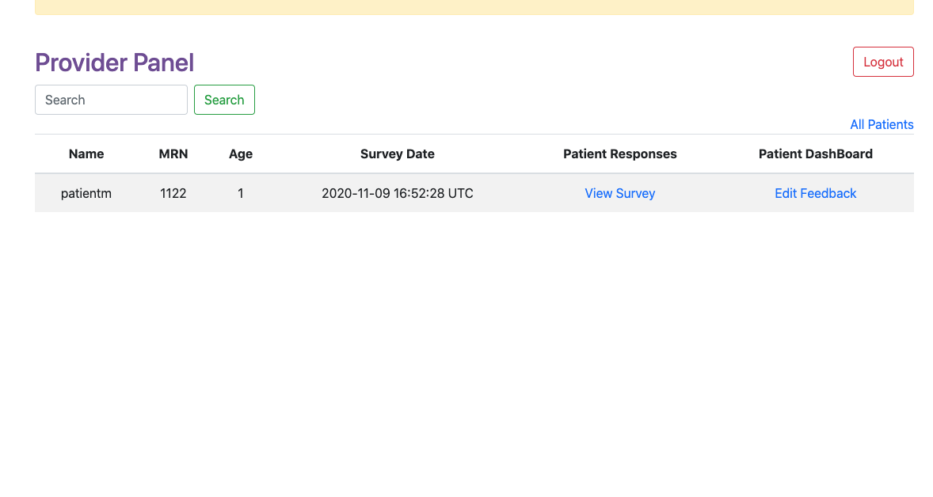
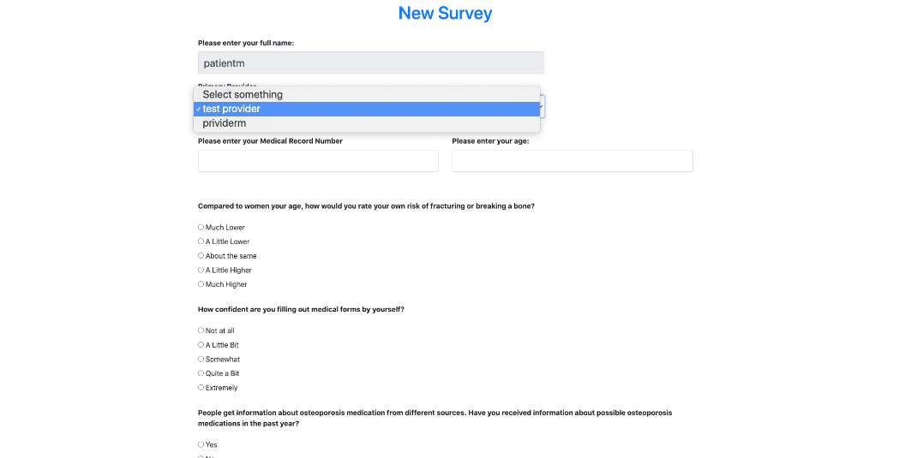
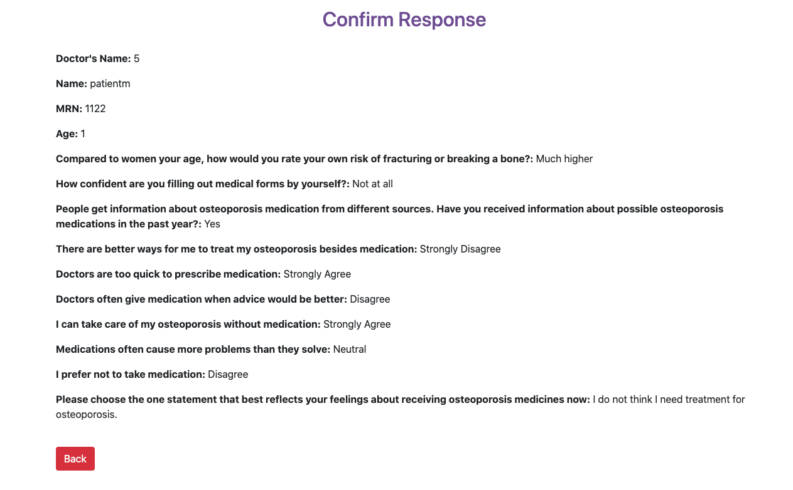
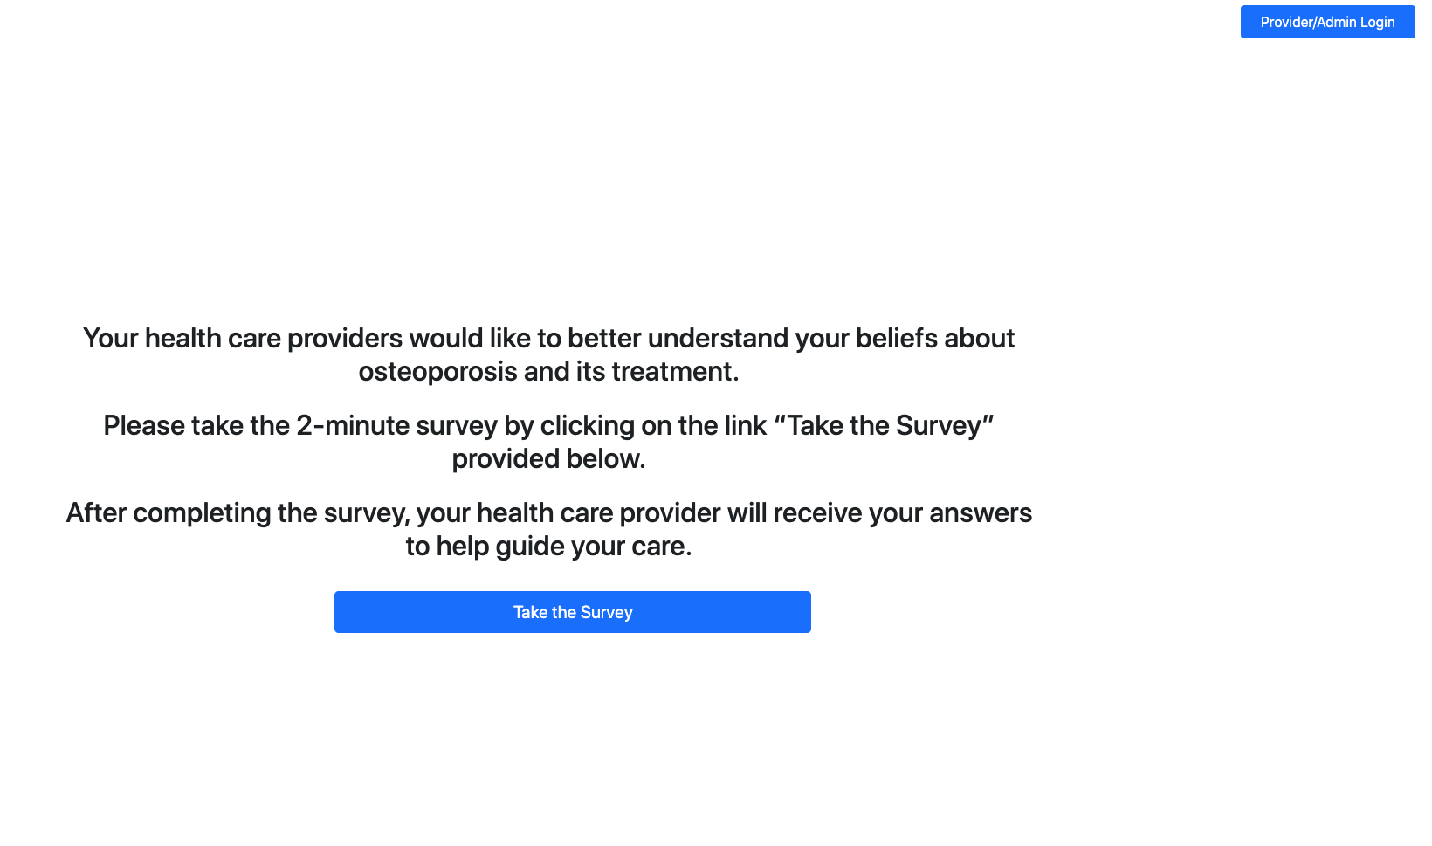
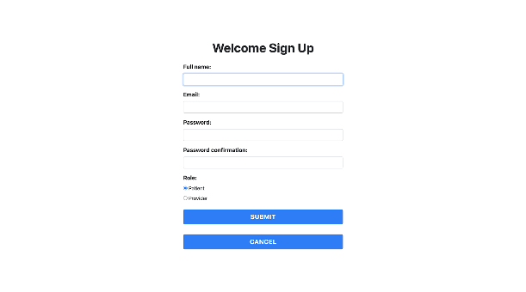
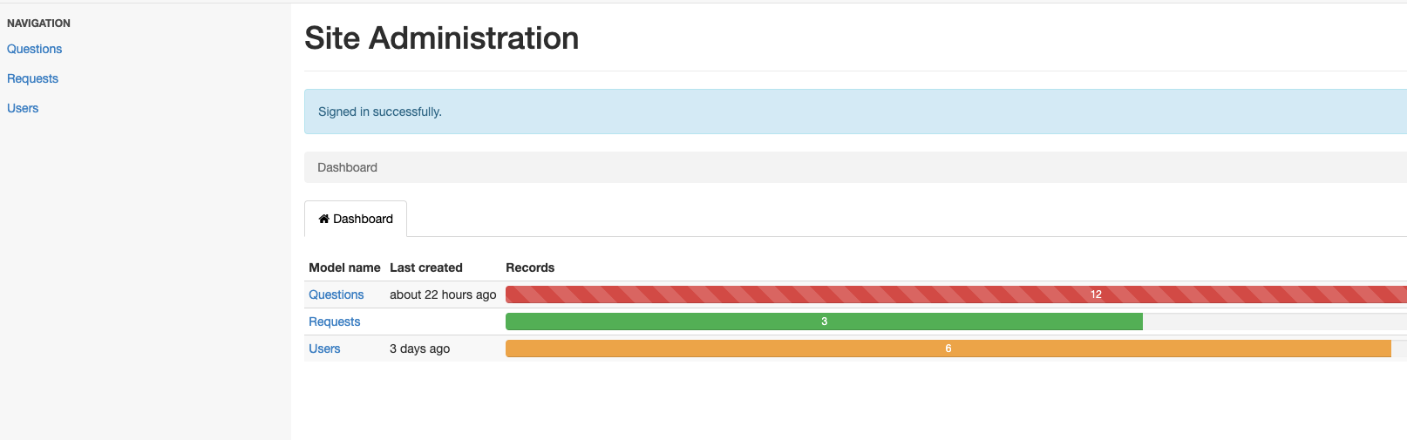
Medical Persistence System
Customer: Dr. Michael J. Miller; Programming Members: Yue Zhuo, Zihao Zheng, Minreng Wu; Product Owner: Mingyang Wan; Scrum Master: Siyang Yang;
Department of Computer Science and Engineering, Texas A&M University
Update Feature: add the guideline for creating the new account password
As a new user, when creating my account, I know how to create my password without repeating the process
Provider could give out the feedback comments based on the patient’s survey results, which will be displayed and reviewed from the patient’s side.
Set up feedback loop for patients (read-only) and providers (editable).
Feedback Pages
After the survey, the patient panel will save the information and will be available for provider to review and give feedback.
Patient Pages
Provider Pages
Major improvement
1). For the patients and providers, rearrange the login and signup portal.
2). Reconstructed the display pages for patient and providers.
3) .Add feedback loop to bridge between providers and patients.
4). Polish all the page display to make it clear and efficient.
The survey page will automatically save the basic information and pass the results to provider for a professional feedback.
1). Cover page with “take survey” and “provider/admin login” option;
2). Login page for patient and provider.
Login Portal
.
Admin Pages
Dev Process
.
Iteration 0
Iteration 1
Iteration 2
Iteration 3
Final Iteration
Set Communication loop between patients and providers.
patients should be able to: login into a “patient’s page”; read provider’s posting; (on backend) having their survey linked to their accounts.
Providers should be able to: accessing a list of patients in the panel and survey linked to their patient
Identify a subset of stories we work on during this iteration and use BDD+TDD (two develop techniques) to develop these stories and deploy to Heroku (a modern apps platform).
Show the first version of modification and get feedback from customer and learn how this will affect the next iteration.
On the meeting day with our customer, we have shown the updated stories from Iteration 1 such as updates on the login and signup pages.
Code refactoring such as removing the background image, increasing the text's contrast and enlarging the descriptions satisfies the customer needs.
During this meeting, we demonstrated the modified demo to our customer. We have shown our progress and all the user stories we have accomplished.
We have updated a lot on the user stories since the first meeting, so far, our customer is quite satisfied with our product.
Demonstrate the final version for customer during the final meeting.
Summarize the whole modification work to get feedback from customer and advisor.
Send up link and QR code and make sure everything is up-to-date.

