Slide 1
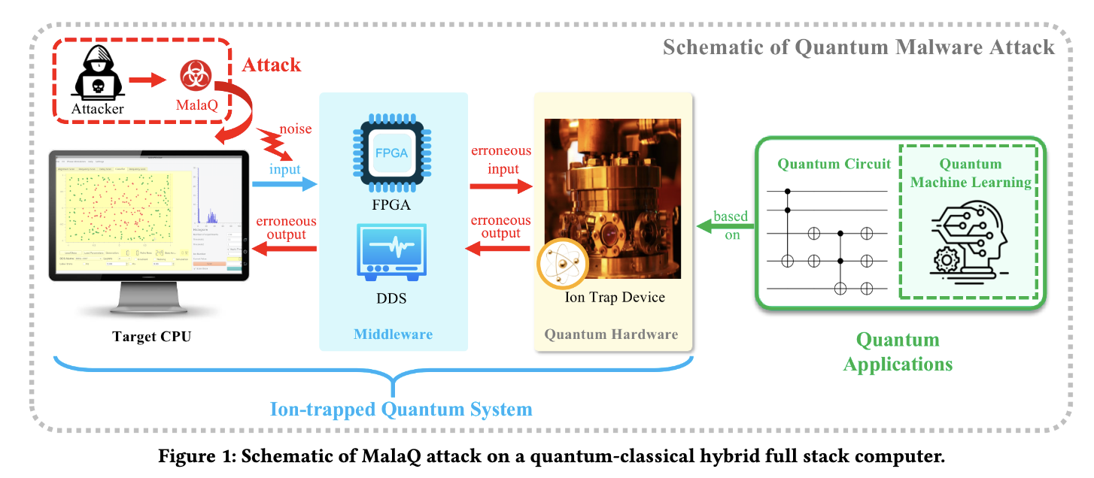
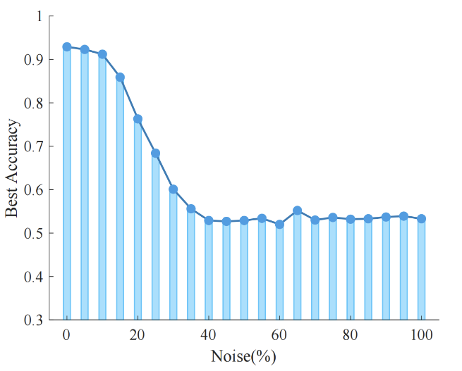
MALAQ: MALware Attacks Quantum Computer
Lowest Accuracy
Schematic of MALAQ attack on a quantum-classical hybrid full-stack computer.

