Slide 1
Database design for faster fetching
8/14/2023 Siyi Wang
Hackathon
Main tools: R, Python, SQL database

Slide 2


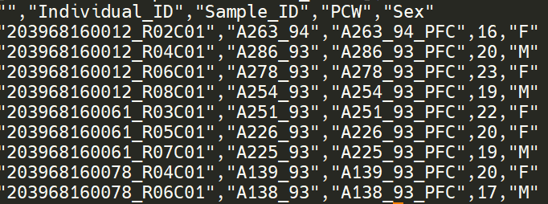
1. Data Structure
epicManifest.csv
probeID | Name | Address | CHR | CpG Island | Gene | Group | UCSC_RefGene_Accession | SNP_MinorAlleleFrequency | …
fetalBrain_betas.csv
Sample name
fetalBrain_pheno.csv
 | 203968160012_R02C01 | 203968160012_R04C01 | 203968160012_R06C01
cg00000029 | 0.59700111599691 | 0.705110056799562 | 0.656097277383743
cg00000103 | 0.839221108771016 | 0.82677903241099 | 0.825852619397048
Probe_ID

Slide 3
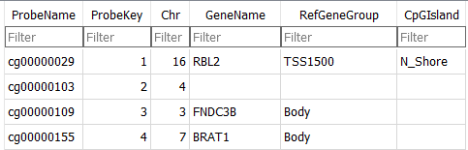
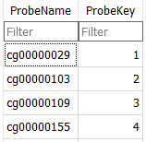
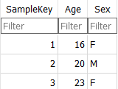
2. Restructure Data
epicManifest.csv
fetalBrain_pheno.csv
Because we do not need the Smple ID, I use number(SampleKey) to replace the characters(Sample_ID).

Slide 4
2. Restructure Data
epicManifest.csv
fetalBrain_pheno.csv
Because we do not need the Smple ID, I use number(SampleKey) to replace the characters(Sample_ID).
fetalBrain_betas.csv
 | 203968160012_R02C01 | 203968160012_R04C01 | 203968160012_R06C01
cg00000029 | 0.59700111599691 | 0.705110056799562 | 0.656097277383743
cg00000103 | 0.839221108771016 | 0.82677903241099 | 0.825852619397048
ProbeKey | SampleKey | Value
1 | 1 | 0.59700111599691
1 | 2 | 0.705110056799562
1 | 3 | 0.656097277383743
2 | 1 | 0.839221108771016
2 | 2 | 0.82677903241099
2 | 3 | 0.825852619397048
1
2
3
1
2

Slide 5
2. Restructure Data
ProbeKey | SampleKey | Value
1 … | 1
107899 | ..
fetalBrain_betas.csv
tableA
ProbeKey | SampleKey | Value
1 | 1 | 0.59700111599691
1 | 2 | 0.705110056799562
1 | 3 | 0.656097277383743
2 | 1 | 0.839221108771016
2 | 2 | 0.82677903241099
2 | 3 | 0.825852619397048
ProbeKey | SampleKey | Value
107900 | 1
307899 | ..
tableB
tableC
ProbeKey | SampleKey | Value
307900 | 1
507899 | ..
tableD
ProbeKey | SampleKey | Value
507900 | 1
807899 | ..

Slide 6
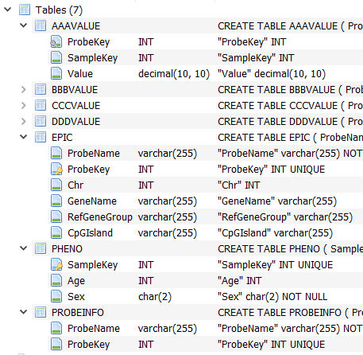
4. Build, Link, and Fill Tables
ProbeKey and SampleKey are used to link tables.

Slide 7
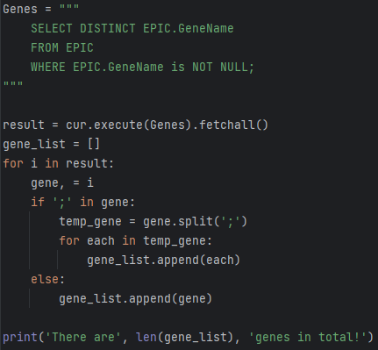
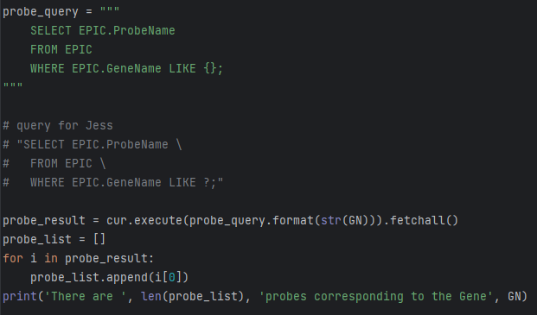
5. Fetch Data from Tables
1. Fetch a list of whole Gene Name
2. Based on the Gene Name to find the Probe Name

Slide 8
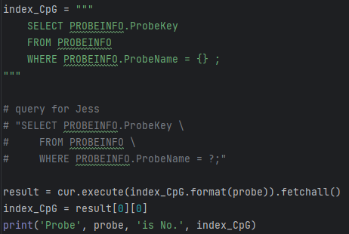
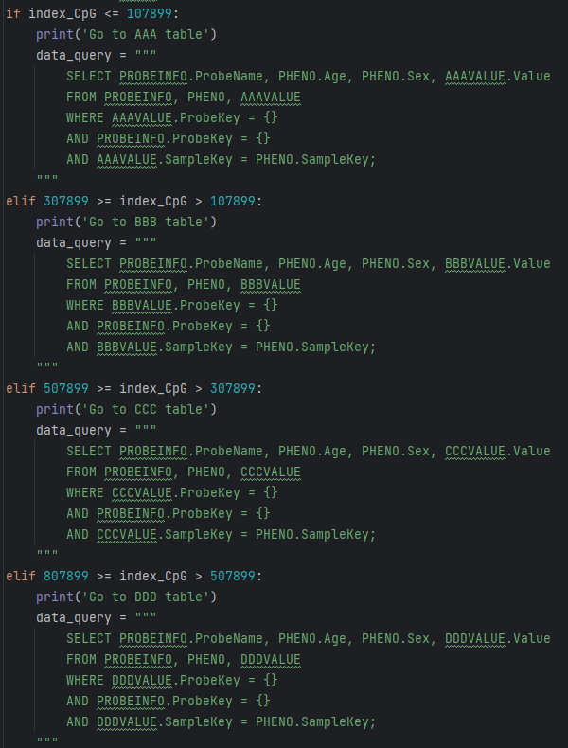
5. Fetch Data from Tables
3. Fetch the Probe Key, based on the Probe Name
4. Based on the Probe Key, select one of the beats table

Slide 9
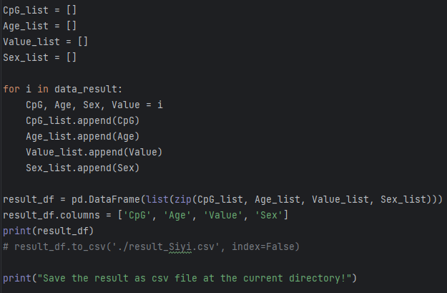
6. Testing – save the result
CpG | Age | Value | Sex
… | … | … | …
… | … | … | …
… | … | … | …
… | … | … | …

Slide 10
Small tips:
Int is better than character;
Delete non-necessary data;
Figure out the relationships among different tables;

