Slide 1

CMIE Data Imputation Project
EDA Summary
Supervised by David Antony Selby
Presented by Siyi Sun
Dec, 16th, 2024

Slide 2
Contents
Project Summary
Data Description
Aggregation Analysis

Slide 3
Project Summary
Stage1 Goal: Data Imputation with various methods at aggregation level (by Household Region)
Stage2 Goal: Develop an imputation method at aggregation level
Suppose you have wave 1 ~ (n-1) + part of result from wave n -> How to impute remaining 1 or multiple columns of wave n at aggregation level?
Stage3 Goal: Develop a forecasting method based on stage2 at aggregation level (Main idea: extend Imputation to Forecasting)
Suppose you have wave 1 ~ (n-1) -> How to forecast 1 (Univariate time series forecasting, e.g. IS_HEALTHY) or multiple columns (multivariate time series forecasting) of wave n at aggregation level?

Slide 4
Data Description
Target variable: IS_HEALTHY
Proposed Preprocessing: remove nan
Target Variable | Class | Missing Ratio | Distinct Values | Values
IS_HEALTHY | Cat - Binary | 37.41% | 2 | {0.0, 1.0, nan}

Slide 5
Data Description
Columns that we considered are related with IS_HEALTHY
Meta Data | Numerical | Categorical
 |  | Binary | Multi-categories
WAVE_NO | AGE_YRS | REGION_TYPE | STATE
HH_ID | TS_ON_WORK_FOR_EMPLOYER | IS_HOSPITALISED | HR
MEM_ID | TS_ON_TRAVEL | WAS_HOSPITALISED | MEM_STATUS
 | TS_ON_OUTDOOR_SPORTS | HAS_BANK_AC | GENDER
 |  | HAS_MOBILE | RELIGION
 |  | WILL_EMIGRATE | EMPLOYMENT_STATUS
 |  |  | PLACE_OF_WORK

Slide 6
Data Description
Meta Data
Meta Data | Class | Missing Ratio (%) | Distinct Values | Range
WAVE_NO | numeric | 0 | 32 | 1-32
HH_ID | numeric | 0 | 265224 | 10000061 - 99999278
MEM_ID | numeric | 0 | 48 | 1 - 48

Slide 7
Data Description
Numerical Features
Proposed Preprocessing
What’s the difference between nan and -100, -99?
Replace them with 0 or remove them?
Numerical Features | Class | Missing Ratio (%) | Values
AGE_YRS | numeric | 0 | 0-110, -100, -99
TS_ON_WORK_FOR_EMPLOYER | numeric | 50.06 | {0.0, 1.5, 0.5, 3.5, 4.5, 5.0, 6.0, nan, 8.0, 9.0, 7.0, 8.5, 5.5, 6.5, 9.5, 7.5, 10.0, 10.5, 11.0, 12.0, 2.0, 4.0, 3.0, 14.5, 15.0, 16.0, -100.0, -99.0, 1.0, 11 .5, 2.5, 12.5, 13.0, 13.5, 14.0}
TS_ON_TRAVEL | numeric | 50.06 | {0.5, 1.5, 1.0, 2.5, 2.0, 0.0, 3.0, nan, 7.0, 4.0, 4.5, 5.0, 3.5, 6.0, 8.0, 6.5, 9.0, 8.5, 11.0, 10.0, 5.5, -100.0, -99.0, 7.5}
TS_ON_OUTDOOR_SPORTS | numeric | 50.06 | {0.0, 1.5, 1.0, 0.5, 2.0, 2.5, 3.5, 3.0, 4.0, 4.5, 5.0, 7.0, 5.5, 6.0, 8.0, 7.5, 8.5, -100.0, -99.0, 6.5, nan}

Slide 8
Data Description
Categorical – Binary Features
Proposed Preprocessing
Remove WILL_EMIGRATE and HAS_MOBILE (missing ratio > 80%) if remove the nan.
One-Hot coding for REGION_TYPE, map character class to 0 / 1
Replace them with the mode class or remove them?
Categorical Binary Features | Class | Missing Ratio (%) | Values
REGION_TYPE | character | 0 | {'URBAN‘, 'RURAL'}
IS_HOSPITALISED | numeric | 40.23 | {0.0, 1.0, nan}
WAS_HOSPITALISED | numeric | 37.41 | {0.0, 1.0, nan}
HAS_BANK_AC | numeric | 39.24 | {0.0, 1.0, nan}
HAS_MOBILE | numeric | 85.28 | {0.0, 1.0, nan}
WILL_EMIGRATE | character | 97.18 | {0.0, 1.0, nan}

Slide 9
Data Description
Categorical – Multiclass Features
Proposed Preprocessing
GENDER: ‘Data Not Available’ -> Remove it or treat it as a category?
RELIGION: ‘Data Not Available’ -> Remove it or treat it as a category?
EMPLOYMENT_STATUS & PLACE_OF_WORK: ‘Data Not Available’/ nan -> Remove or treat it as a category?
Categorical Multiclass Features | Class | Missing Ratio (%) | Values
STATE | character | 0 | {’Andhra Pradesh’, …, ‘West Bengal’} / 28 distinct values
HR | character | 0 | {‘HR 1’, .., ‘HR 110’} / 102 distinct values
MEM_STATUS | character | 0 | {'Emigrated‘, 'Family shifted‘, 'Dropped (Member not part of the household)‘, 'Unaccounted for and deleted‘, 'Unaccounted for and added', 'Dead‘, 'Member of the household‘, 'Immigrated'}
GENDER | character | 0 | {'M‘, 'Not Applicable‘, 'F‘, 'Data Not Available'}
RELIGION | character | 0 | {'Christian‘, 'Not Applicable', 'Buddhist', 'Hindu’, 'Sikh', 'Khasi', 'Muslim', 'Other Religion', 'Parsi', 'Jain', 'Religion not stated', 'Data Not Available'}
EMPLOYMENT_STATUS | character | 16.62 | {‘Not Applicable‘, 'Employed‘, ’Unemployed, willing but not looking for a job‘, ’Unemployed, not willing and not looking for a job‘, ’Unemployed, willing and looking for a job‘, 'Data Not Available‘, nan}
PLACE_OF_WORK | character | 28.1 | {’Government’, …, ‘Not Applicable‘, ‘Data Not Available’, nan}

Slide 10
Contents
Project Summary
Data Description
Aggregation Analysis

Slide 11
1. Household Change During Waves
WAVE_NO | HH_ID
1 | 1
1 | 2
1 | 3
1 | 4
1 | 5
2 | 1
2 | 2
2 | 3
2 | 5
2 | 6
2 | 7
3 | 1
3 | 2
3 | 4
3 | 7
3 | 8
WAVE_NO | 1 | 2 | 3
TOTAL | 5 | 6 | 5
DISAPPEAR | 0 | 1 | 3
NEW_IN | 0 | 2 | 1
BACK | 0 | 0 | 1
TOTAL _{WAVE(N)} = TOTAL _{WAVE(N-1)}
– DISAPPEAR
+ NEW_IN + BACK

Slide 12
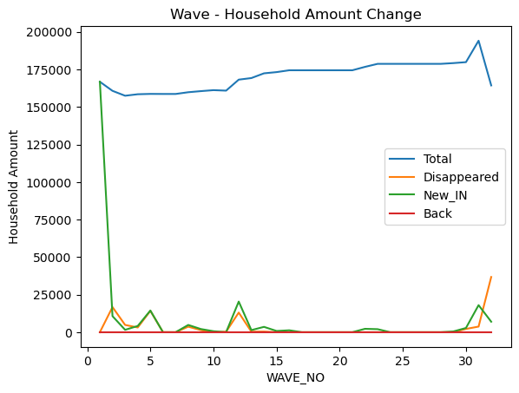
1. Household Change During Waves
Conclusions:
Once a household disappears, they never come back.
The correlation between Disappear and New_IN is 0.57, which indicates a moderate positive relationship. This suggests that waves with a higher number of disappearing households tend to also have a higher number of new households joining the survey. This could imply that as old households drop out of the survey, new households are recruited to maintain or replenish the total number of participants.

Slide 13
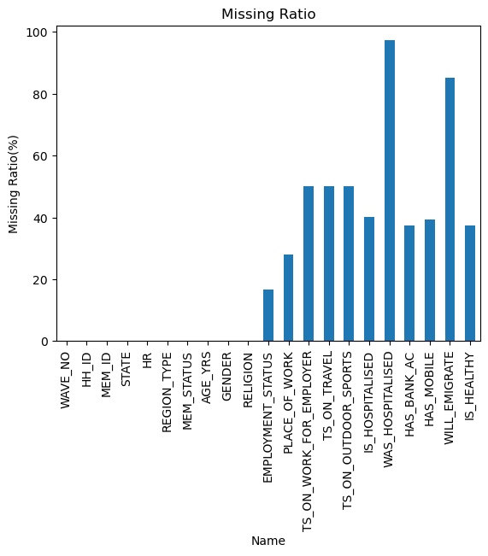
2. Missingness
90% missing ratio > 25%
50% missing ratio > 50%
20% missing ratio > 75%
Meta Columns = 10
Feature Columns = 10
Target Columns = 1
37.4%
Meta Columns
Feature
Columns

Slide 14
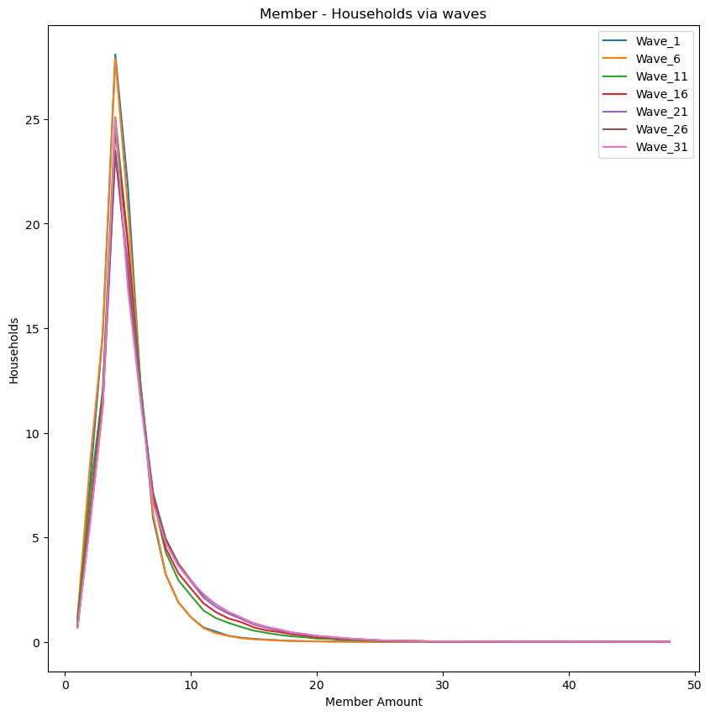
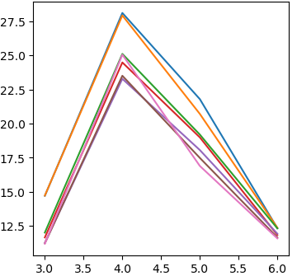
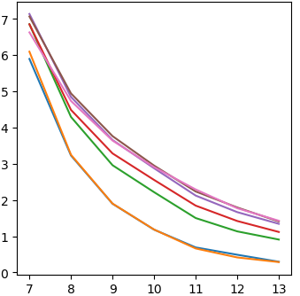
3. MEM_ID: Family member amount distribution (%)
Conclusion:
The distribution of the number of family members in each household becomes more spread out (brown/pink line), rather than being concentrated around 4 (blue/orange line).

Slide 15
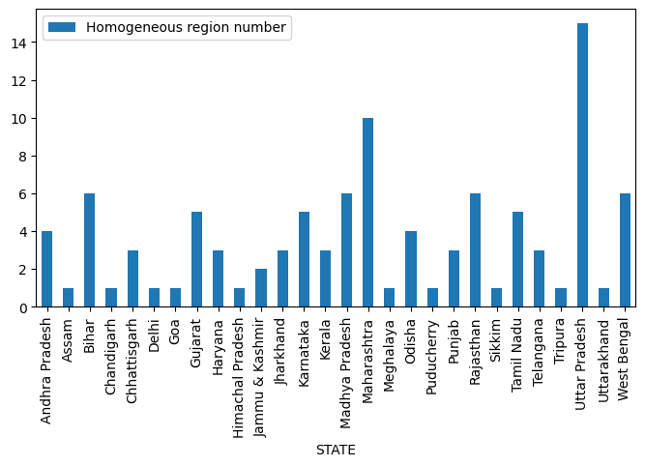
4. STATE-HR (Homogeneous region)

Slide 16
5. STATE-Households

Slide 17
6. HR -Households
Mean
=2600

Slide 18
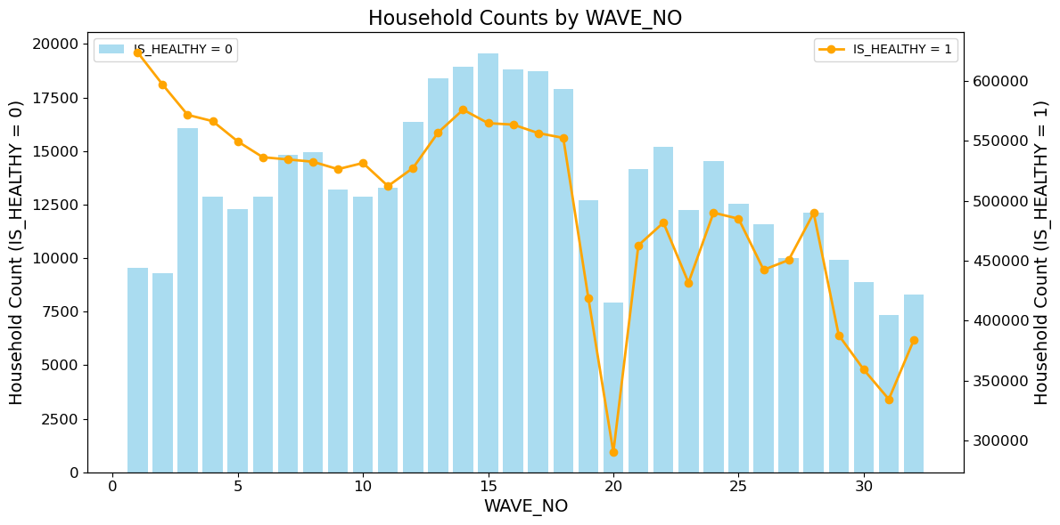
7. IS_HEALTHY Distribution

Slide 19
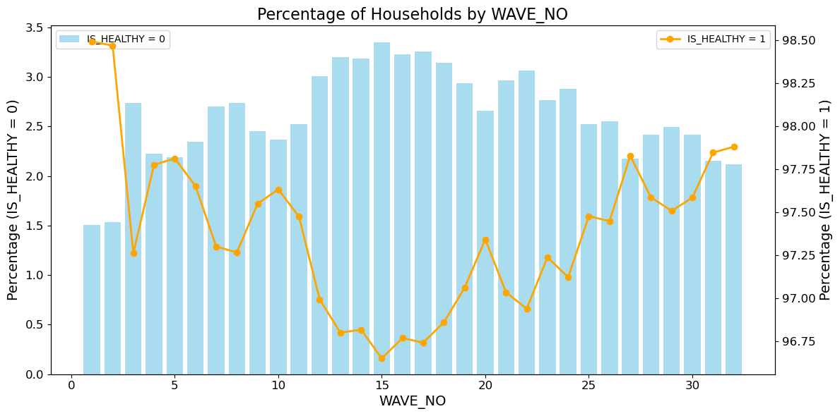
7. IS_HEALTHY Distribution (Percentage)

