Slide 1
EE569: Digital Image Processing Discussion 7: midterm 1 review
Part II
University of Southern California
Instructor: Professor C.-C. Jay Kuo
TA: Yao Zhu

Slide 2
Contents
Edge detection
Sobel
Canny
Structured Edge
Digital half-toning
Dithering: How to choose threshold
Error diffusion
Separable color half-toning vs. MBVQ

Slide 3
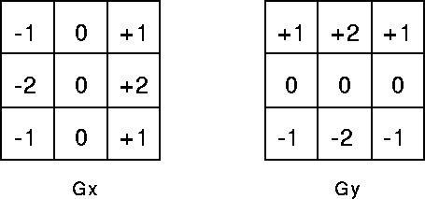
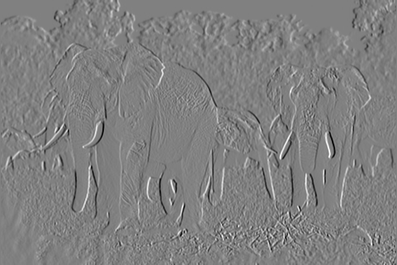
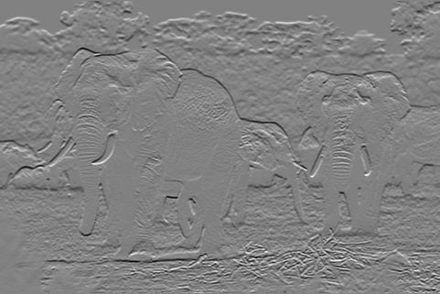
Edge detection
Sobel: 1st order derivative edge detection method
How to do Sobel?
Gx: horizontal gradient, capture vertical edges
Gy: vertical gradient, capture horizontal edges
What are gradient maps and magnitude maps look like? Why?
What’s disadvantage of Sobel?
Sensitive to noise
Not thin edge
2nd order derivative edge detection method:
ex. LoG
Why use 2nd order?
Gx map
Gy map

Slide 4
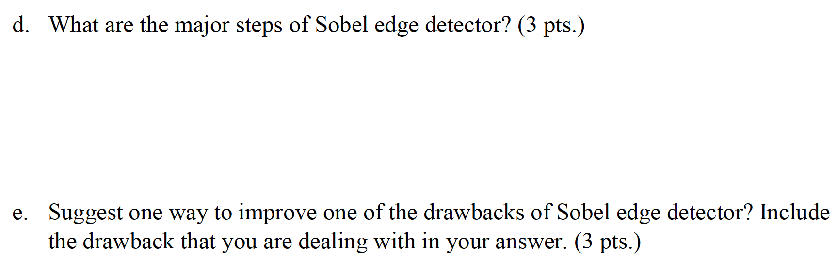
Sample exam problems
i. Compute Horizontal gradient, compute vertical gradient
ii. Compute magnitude of gradient
iii. Thresholding
Sensitive to noise: apply gaussian filter before Sobel
Not thin edge: apply NMS

Slide 5
Edge detection
Canny
Steps:
gaussian filtering (different sigma influences)
calculate gradient maps, magnitude maps
NMS
Double hysteresis thresholding (different pair of threshold result)
Each step’s purpose
Why better than Sobel?
Canny has Gaussian filtering step → effect
NMS step → effect
Double thresholding → effect

Slide 6
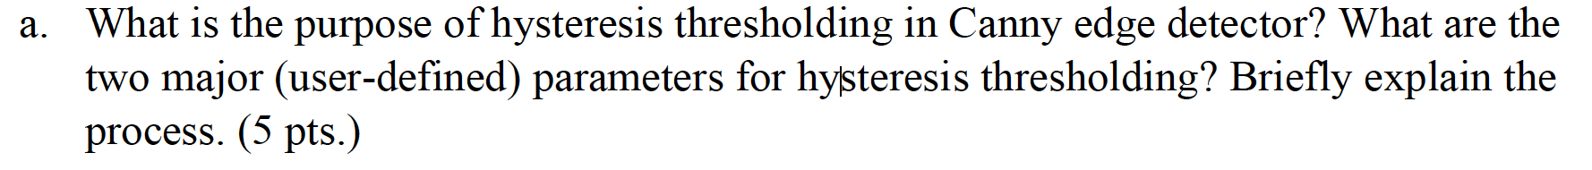
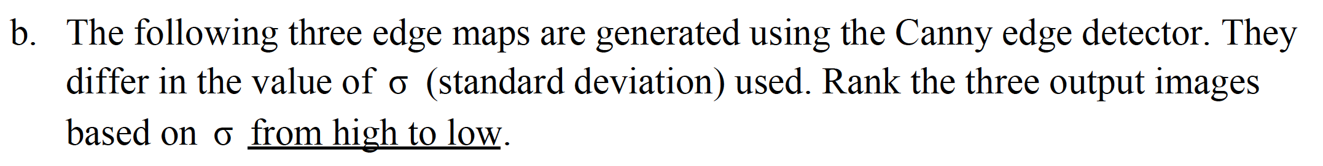
Sample exam problems
Purpose: use neighborhood information to determine which edges are really edges and what are not. So that to increase the connectivity of edges

Slide 7
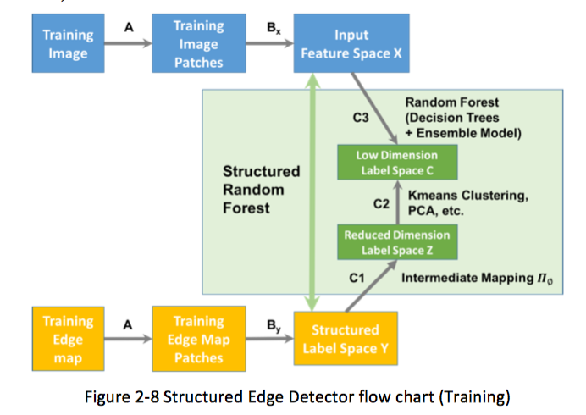
Edge detection
Structured edge
Data-driven edge detector, involve training, validation and testing splitting
Use machine learning algorithm, random forest
Difference with Sobel, Canny?

Slide 8
Sample exam problem
Data-driven edge detector, involve training, validation and testing splitting
Use machine learning algorithm, random forest
Use larger patch information to do decision instead of single pixel

Slide 9
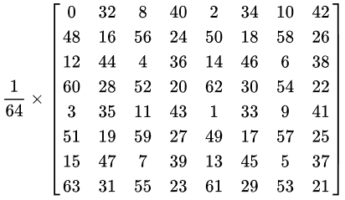
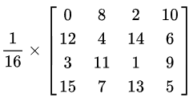

Digital halftoning
Dithering: How to choose threshold? Difference in result image
Fixed threshold: 127 or 128
Random threshold
Dithering matrix (ordered dithering)
Dithering matrix:
Different effect of I2, I4, I8
All have block pattern, difference in pattern detail
I₂=
I₄=
I₈=

Slide 10
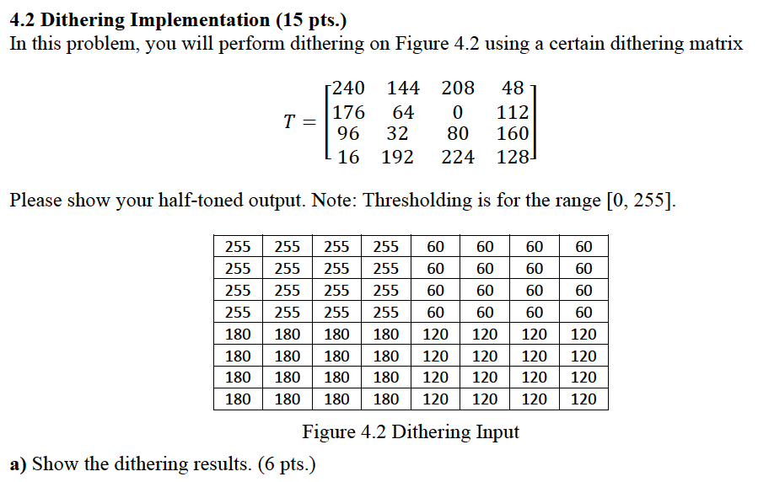
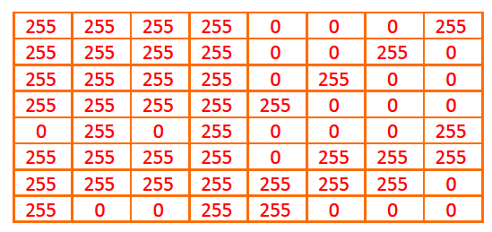
Sample exam problem

Slide 11
Sample exam problem
The output halftoning has diagonal artifacts due to the small elements in the matrix diagonal (top right to bottom left)
88 151 104 167
215 24 231 40
120 183 72 135
247 56 199 8
Bayer I4 also not good! Diagonal terms small!
Should be evenly distributed to avoid small elements in one line, one column or diagonal lines
Bayer I₄ =

Slide 12
Digital halftoning
Error diffusion:
Floyd-Steinberg
JJN
Stucki
Practice question: Difference with ordered dithering?
Time complexity
Result image quality
Cases where ordered dithering give bad performance

Slide 13
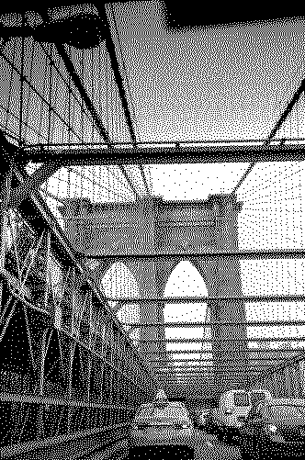

Digital halftoning
Practice problem
Which is FS result, which is dithering matrix I2 result?
Left: FS
Right: I2

Slide 14
Color halftoning
Color spaces:
RGB color space
CMY color space
Separable color image half-toning with error diffusion
MBVQ with error diffusion
Relationship, Application field
How to convert?
Difference?
Where does this difference come from?

Slide 15


