Slide 1
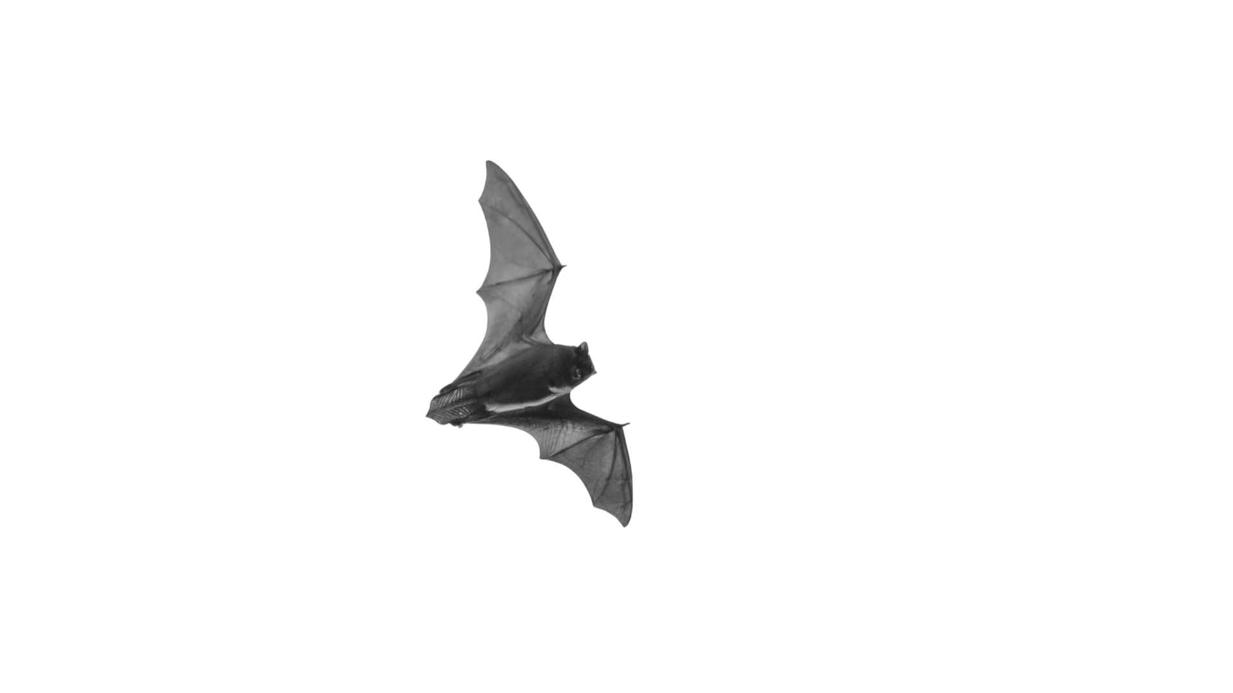
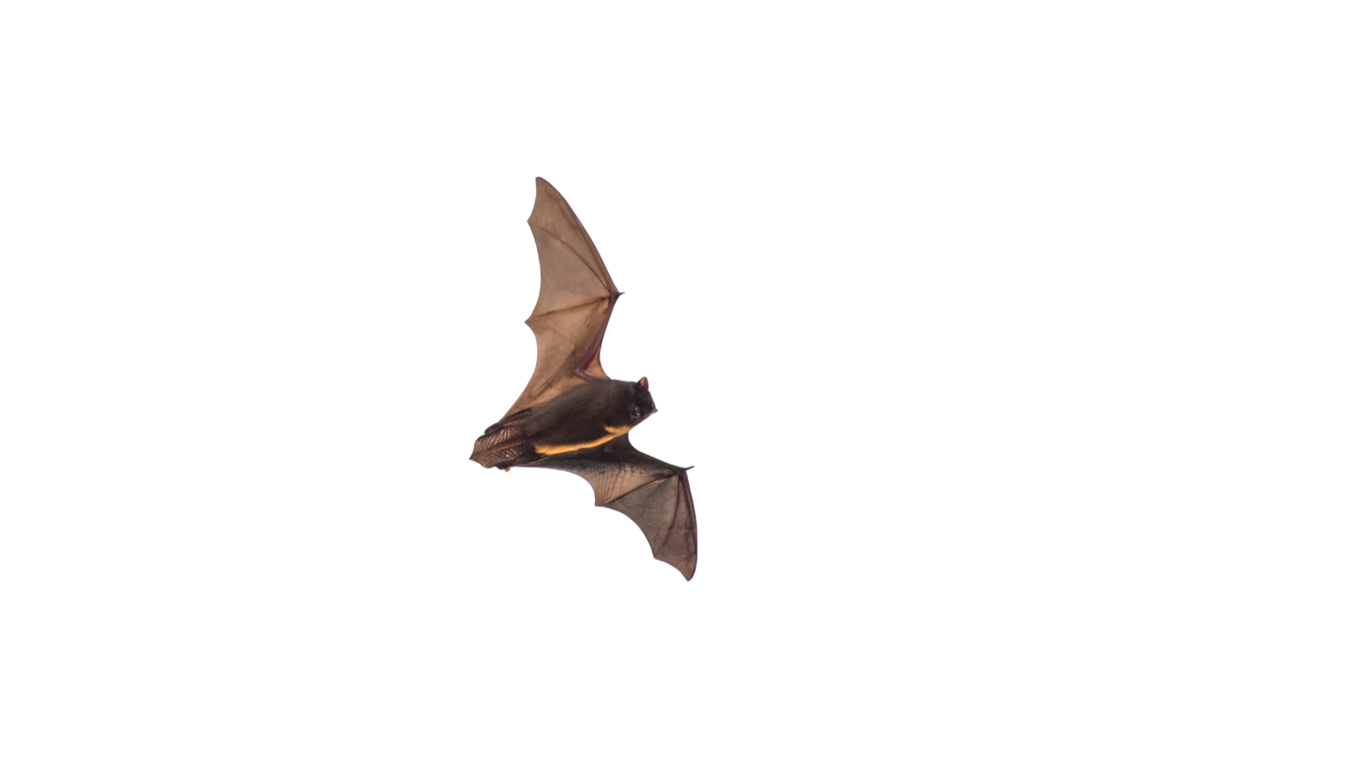
Echoes of oneself
Calls from conspecific
Echoes from conspecific
Obstacle

