Slide 1
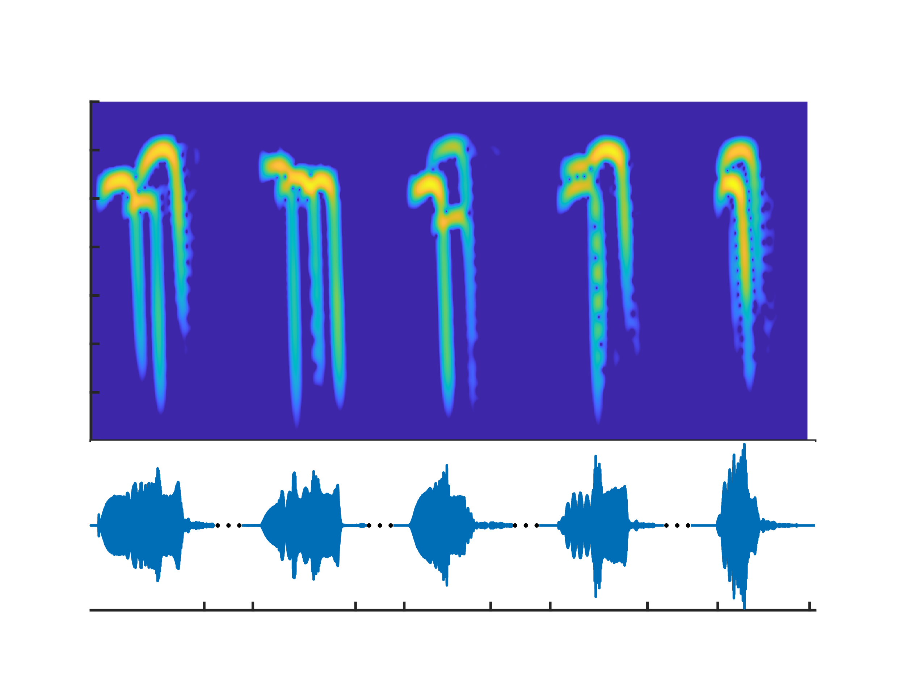
Frequency (kHz)
72
Bat 1
Bat 3
Bat 5
Bat 3
Bat 8
Bat 3
70
Bat 1
68
Bat 10
Bat 4
66
Bat 6
Bat 6
Bat 9
64
Bat 7
62
60
Bat 2
58
0
23
122
141
321
337
552
570
1005
1022
t (ms)

