Slide 1
WR2 Flanker model: progress, limits, and next test
From RT-bin diagnostics to a controlled target–flanker source test
Current best model: WR2 uncertainty schedule + four-choice Wong–Wang
Internal validation: 12 young and 4 older participants
Mentor meeting · 19 July 2026
Notes:
我今天主要汇报目前 Flanker 模型的进展。当前表现最好的是 WR2：它保留 VGG-16 和四选择 Wong–Wang，主要改变视觉证据进入决策模型的时间。之前我们先看总体 RT 和正确率，后来使用 RT bins 检查错误发生在分布的什么位置，最近又检验了 target–flanker 双通道机制。今天我主要讲 WR2 已经解决了什么、始终无法克服什么，以及最新实验能够把问题定位到什么程度。数据包括 12 名年轻被试和 4 名老年被试，所以仍然是内部验证。

Slide 2
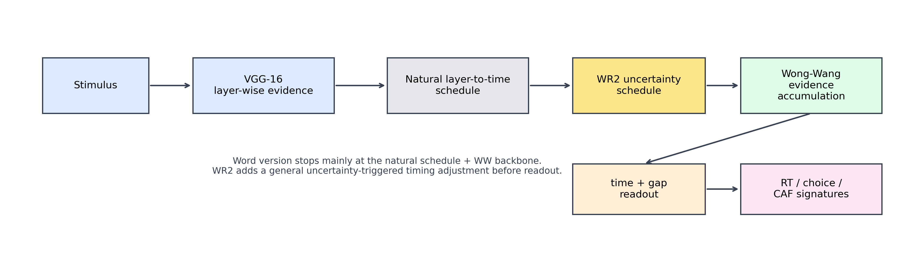
WR2 changes evidence timing—not the backbone
The model is not trained end-to-end. A frozen VGG provides layer-wise direction evidence; WR2 changes when that evidence reaches a four-choice accumulator.
WR2 timing rule
Early uncertainty is computed over the first 150 ms.
Low uncertainty uses compression = 0.72.
High uncertainty moves toward 0.42.
The change is continuous—not a condition label or lapse process.
Wong–Wang role: competing state variables integrate the four direction channels. Threshold crossing provides decision time; the winning state provides choice.
Notes:
这一页是 WR2 的完整结构。刺激先进入冻结的 VGG-16，VGG 提供不同网络层上的四方向证据。layer-to-time mapping 把不同层映射到时间轴。WR2 根据早期证据不确定性调整时间压缩：普通试次接近 0.72，高不确定性试次向 0.42 移动。这些值来自训练数据上的局部候选比较，并不是使用 congruent 或 incongruent 标签直接指定。随后四方向证据进入 Wong–Wang，相互竞争的状态越过阈值时产生选择和决策时间，再加上非决策时间得到 RT。

Slide 3
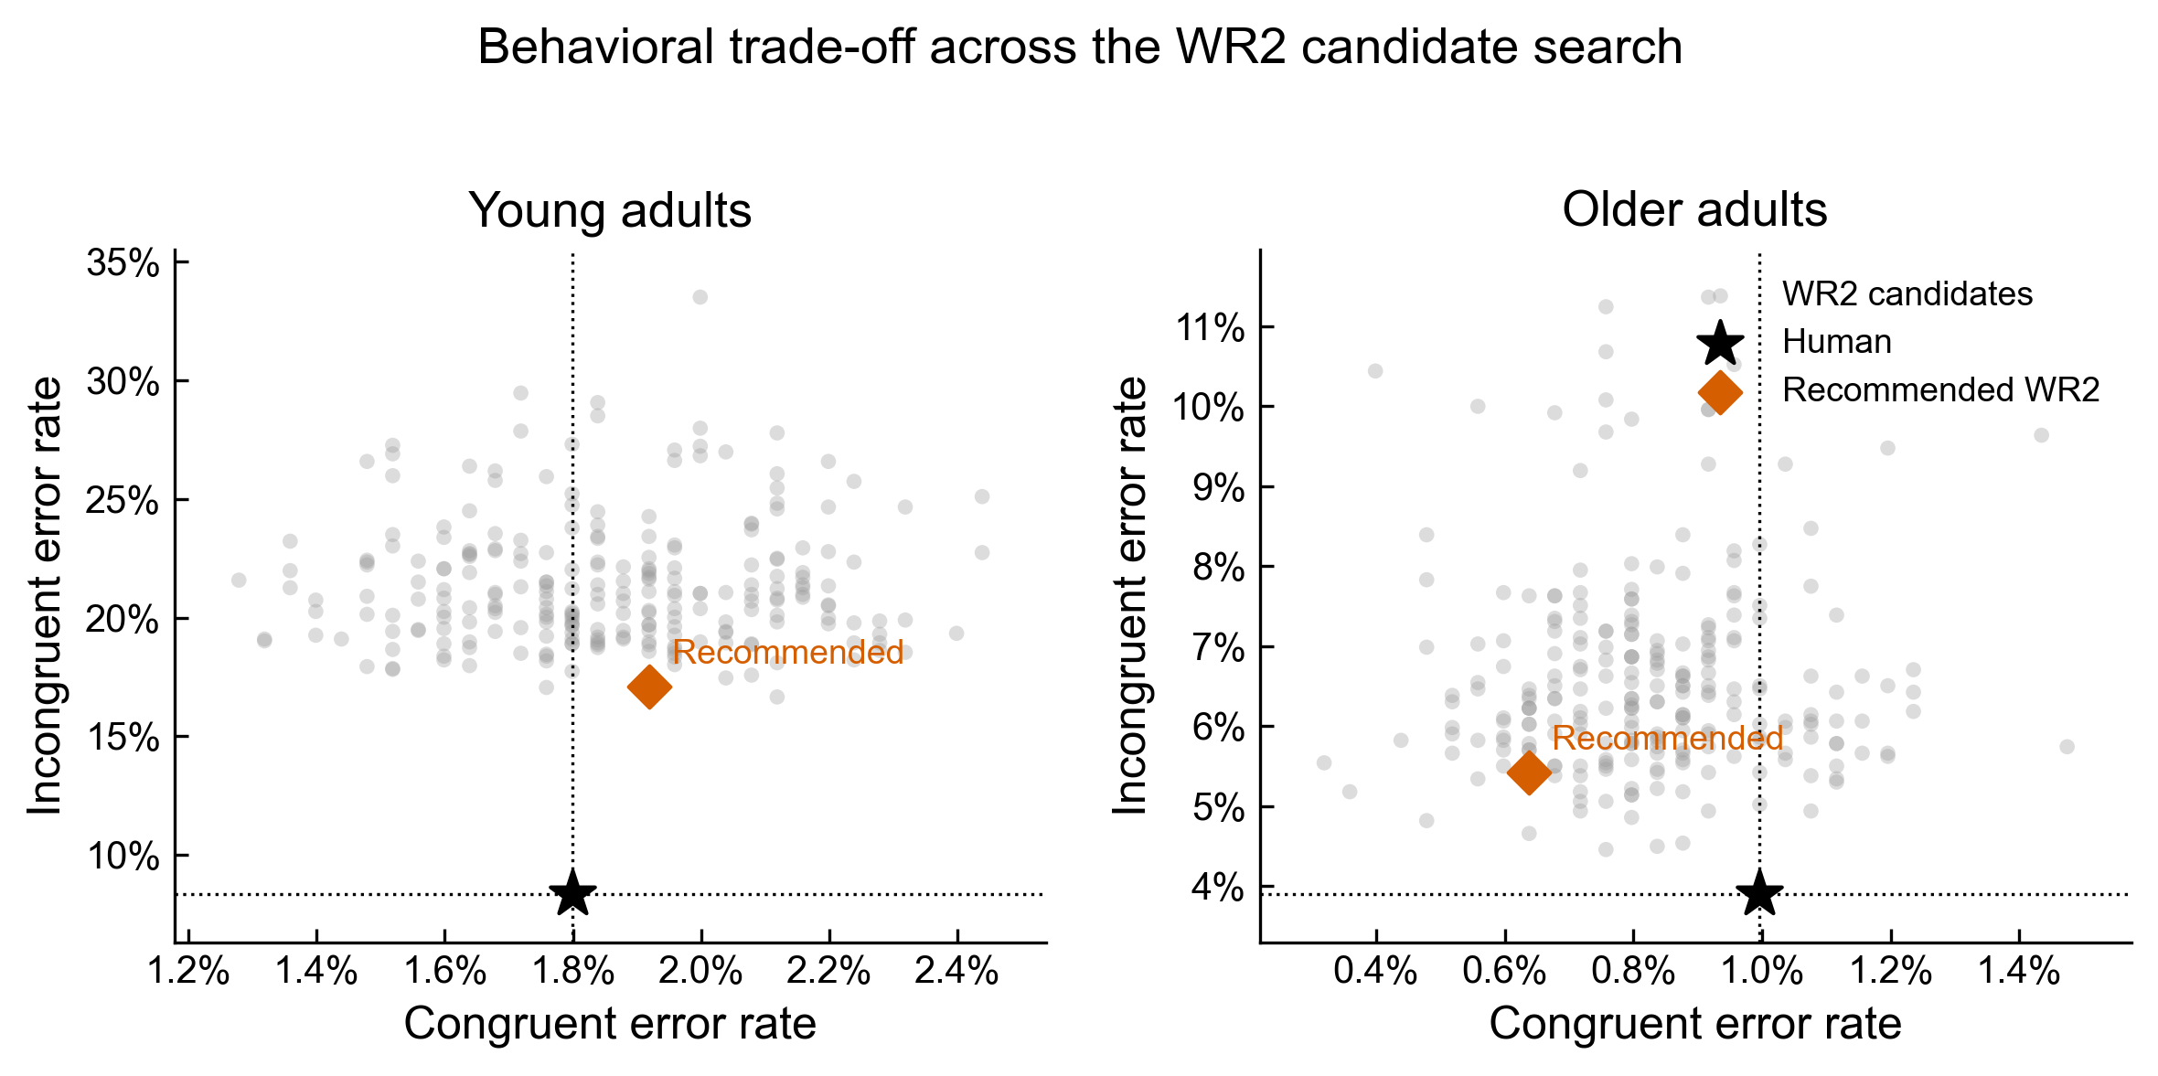
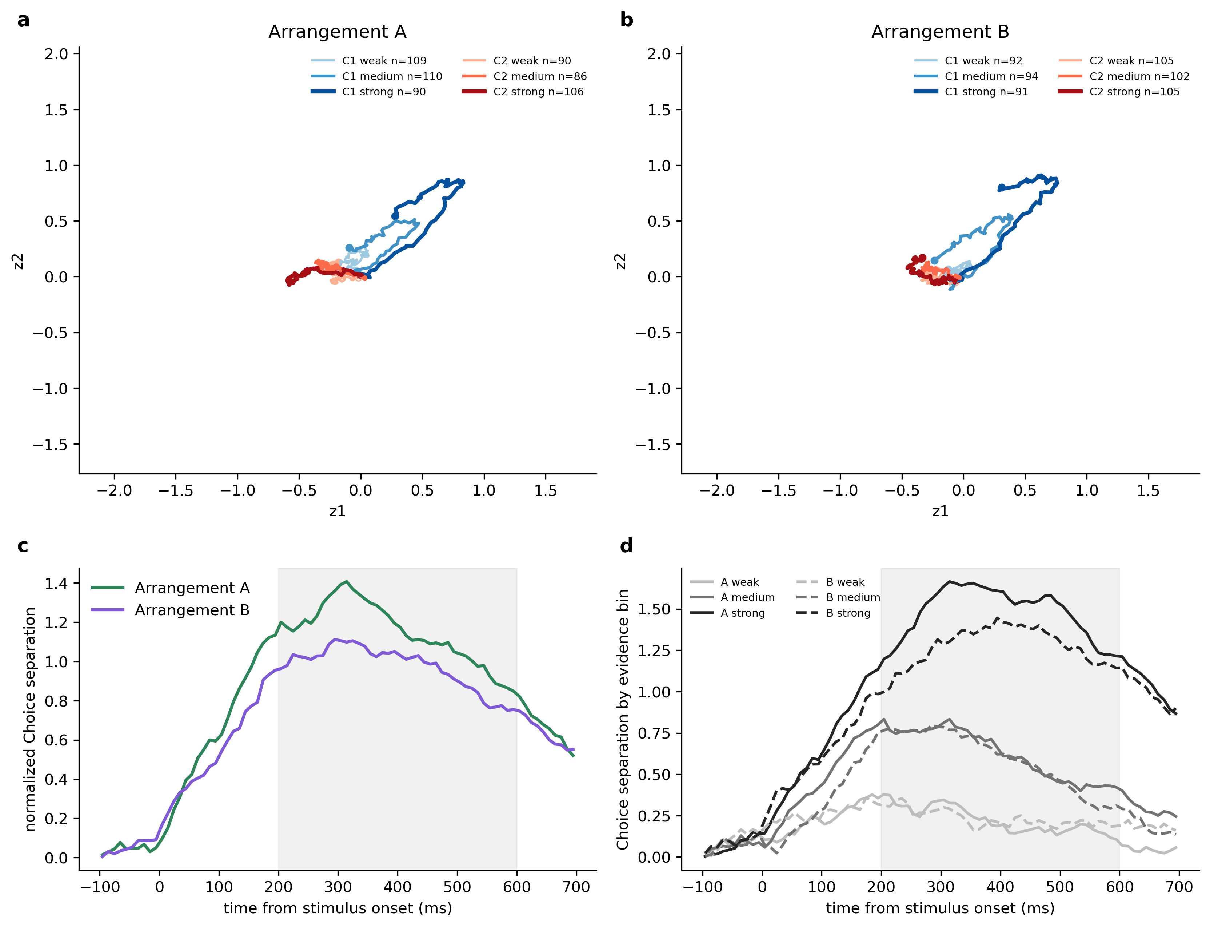
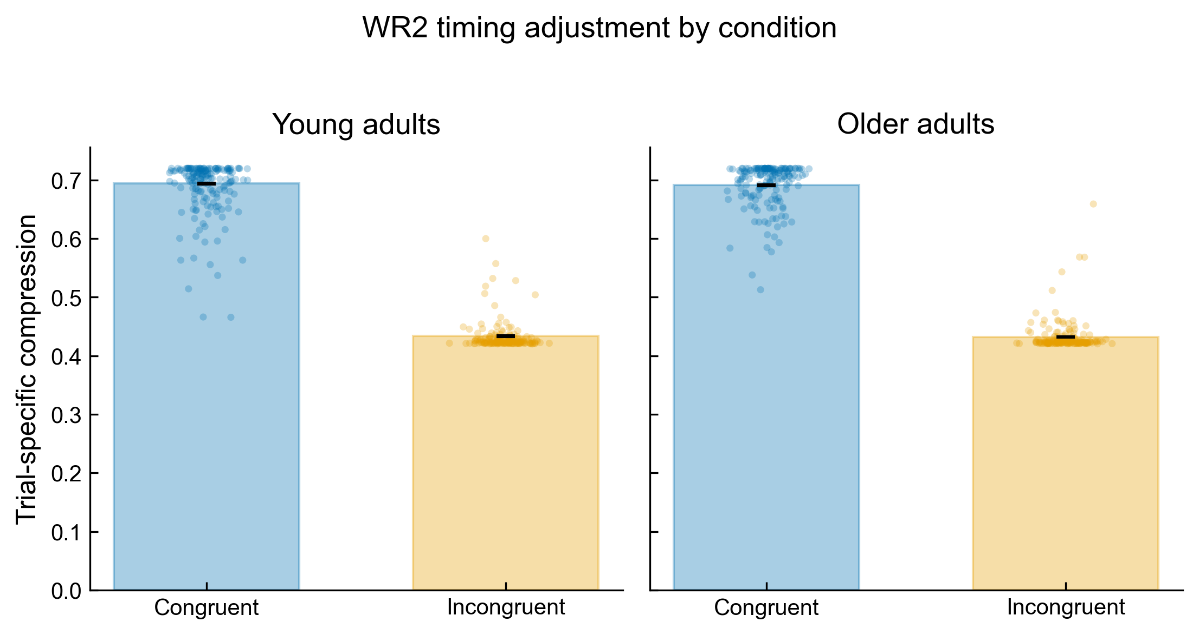
WR2 fitting and participant-held-out validation
The selected WR2 candidate came from 240 local timing configurations; validation was internal and participant-held-out, not external.
Stage | What was fitted | Protection
VGG-16 | Frozen Stage-1 weights | No refit on test behavior
WR2 | 240 local candidates | Training-based ranking
WW + t0 | R5 age-group values | Fixed in follow-up tests
Validation | 4 participant folds | 3 young + 1 older held out
Notes:
WR2 不是端到端重新训练的模型。VGG 使用第一阶段已有权重，并在行为拟合中冻结。WR2 的时间参数来自 240 个局部候选，我们用训练被试比较它们在一致与不一致错误率、RT 和年龄差异上的表现。Wong–Wang 和非决策时间主要沿用 R5 年龄组参数。评价采用四折被试留出：每折留出 3 名年轻人和 1 名老年人，模型选择只看训练被试，留出被试用于评价。因此它比全样本拟合更严格，但仍不是独立外部验证。

Slide 4
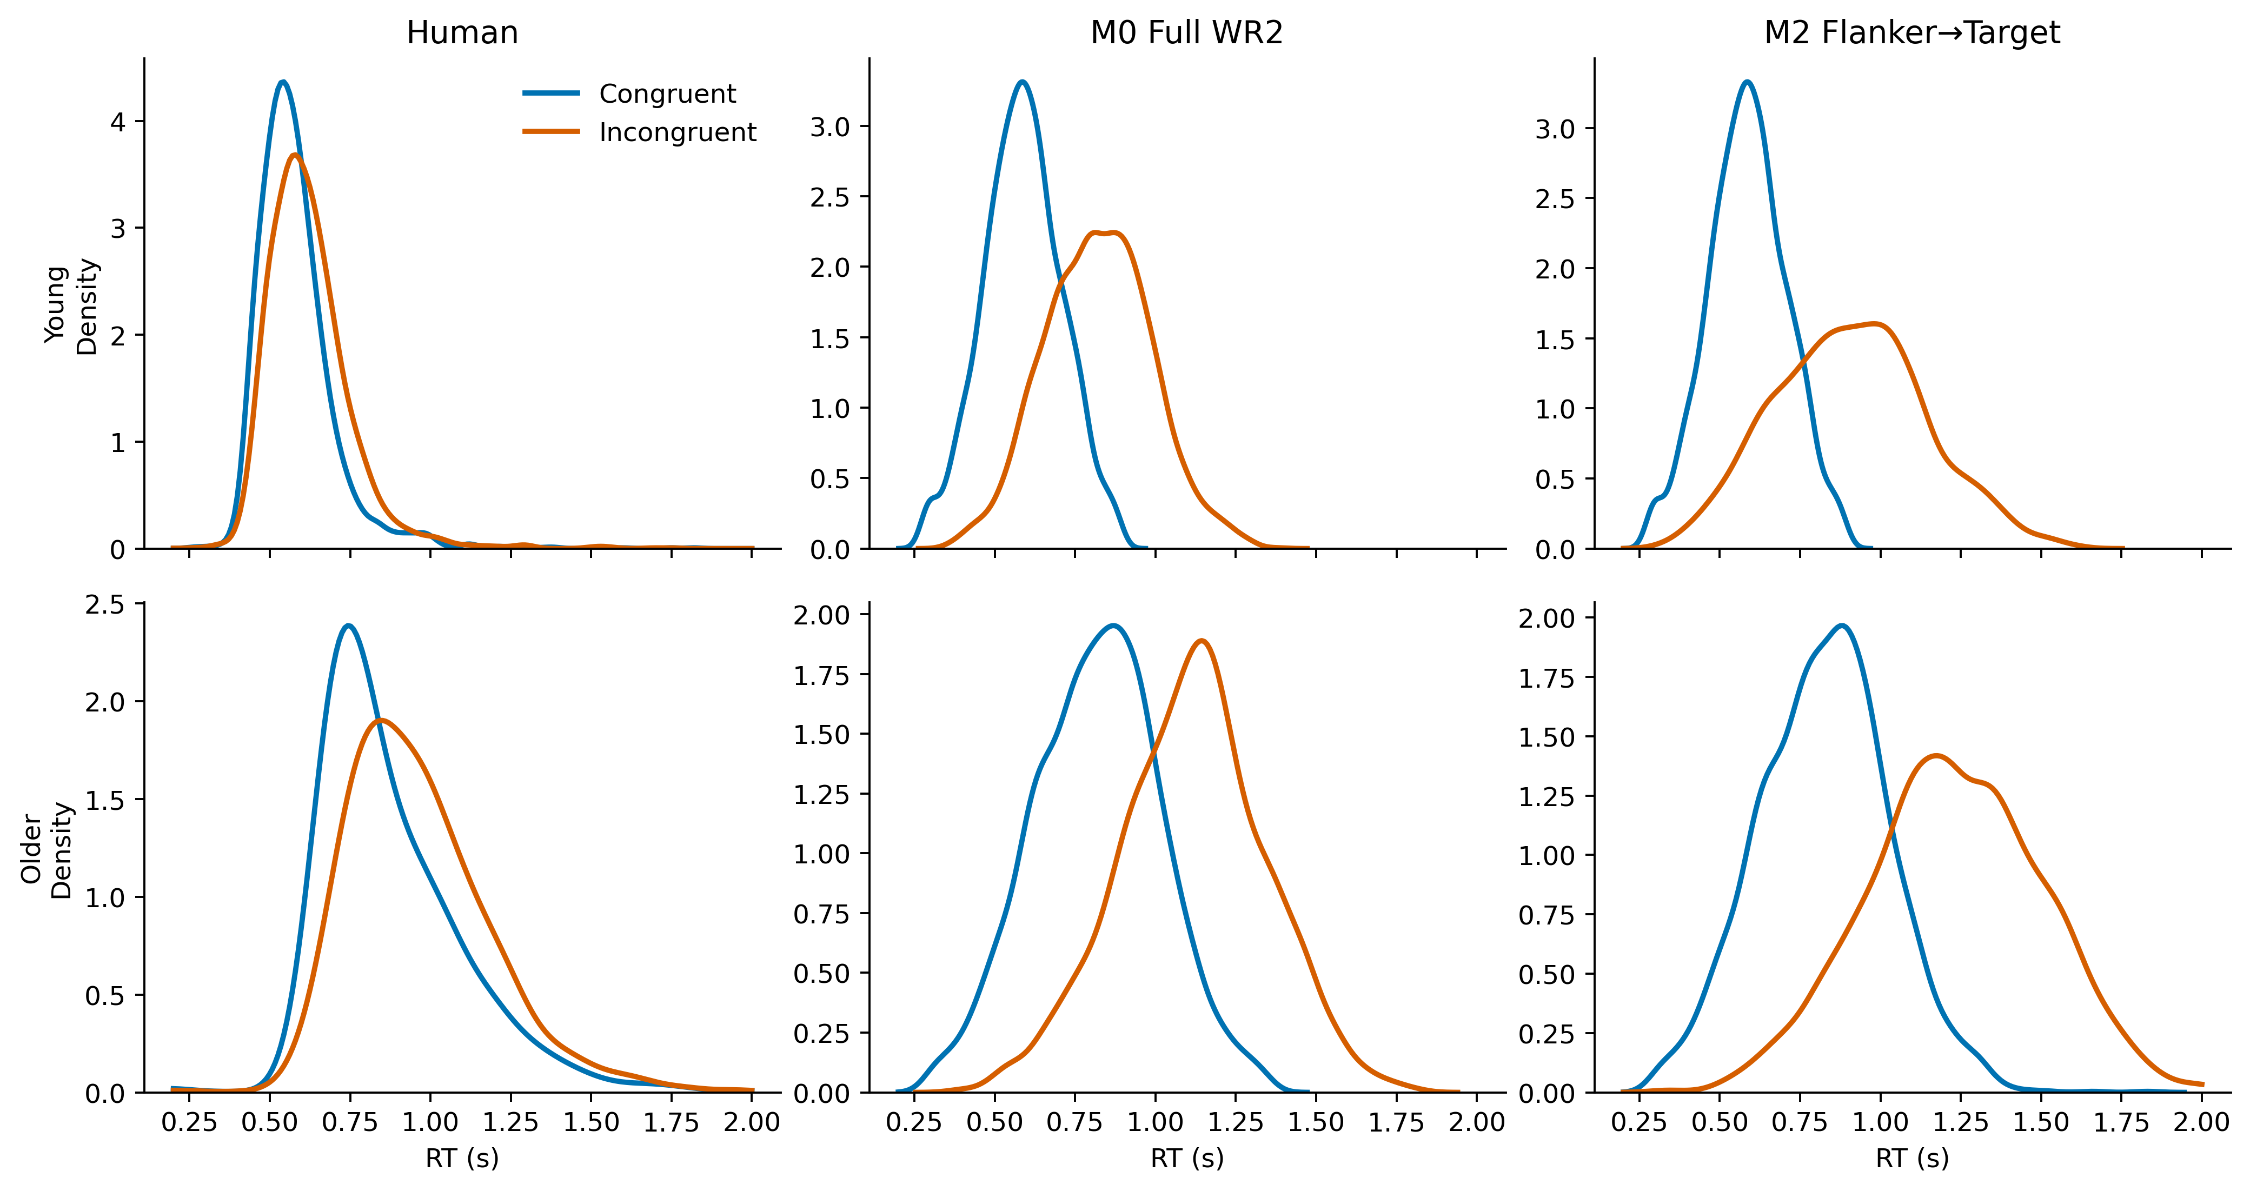
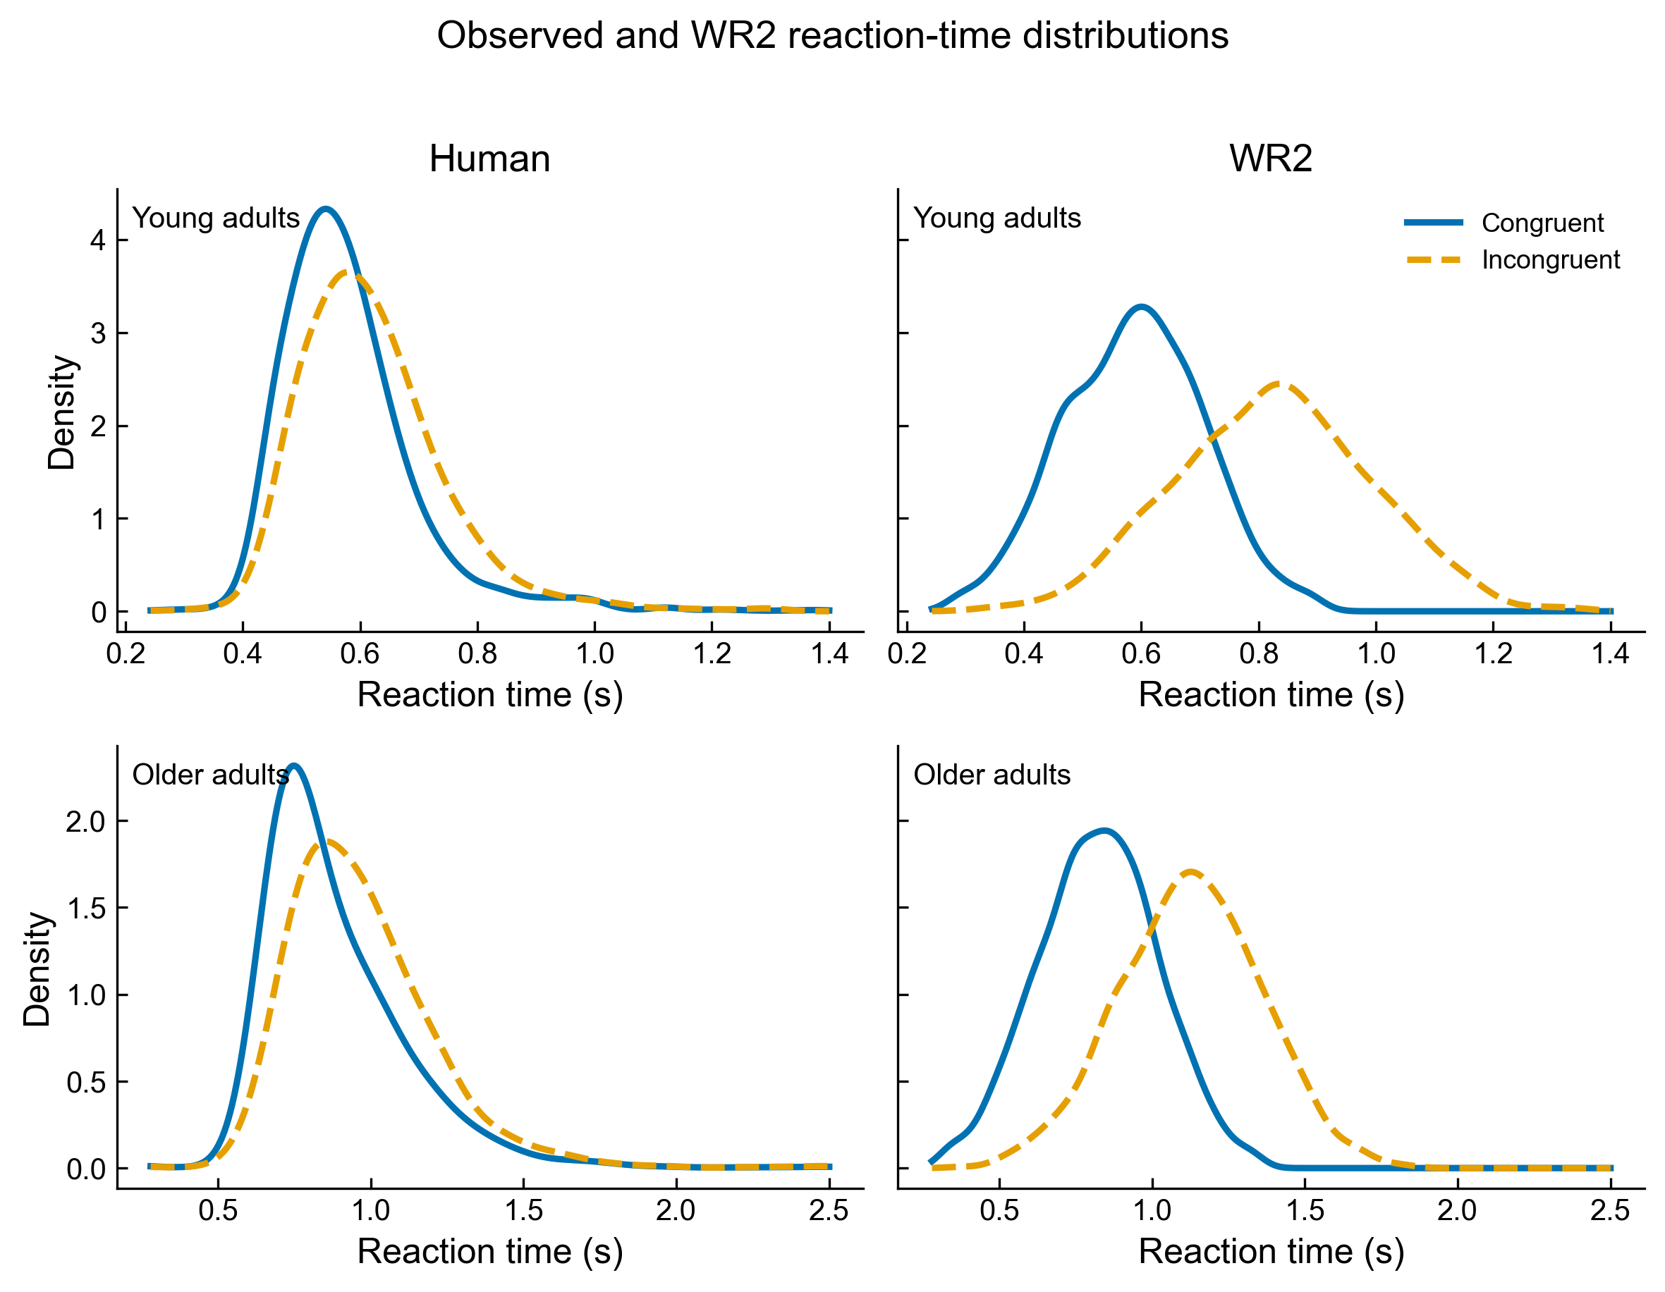
What WR2 captures—and what it misses
The model preserves the expected age and congruency ordering and produces right-skewed RTs, but its incongruent distributions remain too displaced.
The model reproduces several first-order facts:
• older responses are slower than young responses;
• incongruent trials are slower than congruent trials;
• evidence timing produces non-Gaussian RT variation;
• one shared visual backbone works across both age groups.
These successes justify keeping WR2 as the current best working model.
What is already useful
The remaining question is not whether the model can produce errors and RT variation. It is whether the same mechanism places errors at the human-like points of the RT distribution.
Notes:
WR2 并不是完全失败。它能够复现几个宏观规律：老年组整体更慢，不一致条件比一致条件更慢，RT 具有右偏和试次变异，而且同一个视觉模型能够应用于两个年龄组。KDE 中蓝色是一致条件，橙色是不一致条件，模型基本能把不一致分布推向更慢的位置。所以问题不是模型完全没有 congruency effect 或年龄差异，而是分布移动的程度与错误出现的位置仍然不准确。我把 WR2 看作能够解释一阶行为方向、但还不能解释完整联合分布的基线。

Slide 5
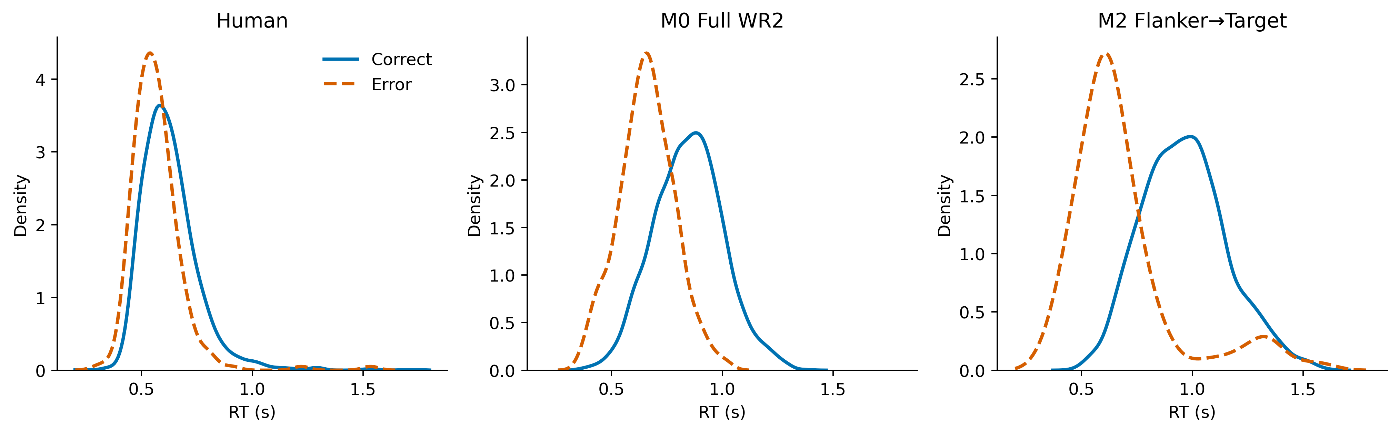
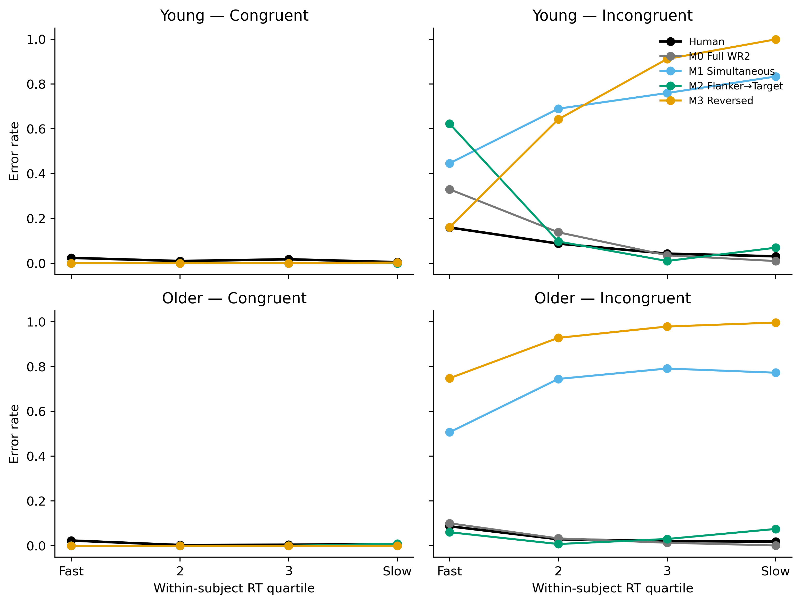
The main failure is the joint error–RT shape
Human errors exist, and model errors exist; the mismatch is where those errors occur in reaction time and how frequently they occur by condition.
For young incongruent trials, the full WR2 control overestimates the fastest-bin error rate and remains roughly 205 ms away in median RT during the joint-first-passage comparison.
Congruent errors are the opposite problem: the controlled accumulation models usually become perfectly correct, while humans show small but non-zero error rates.
Therefore, optimizing overall accuracy alone can hide a mechanistically wrong error–RT relationship.
Young incongruent trials
The density split by correctness makes this visible: human correct and error distributions overlap differently from model correct and error distributions.
Notes:
目前最关键的问题不是模型会不会犯错，而是错误发生在 RT 分布的什么位置。人类会犯错，模型也会犯错，但年轻组不一致条件下模型的快速错误过多，正确与错误分布的相对位置也与人类不同。在统一首达规则的比较中，完整 WR2 的 RT 中位数仍与人类相差约 205 毫秒。另一方面，人类在一致条件下有少量错误，模型却往往接近完美正确。因此只优化总体正确率可能得到数值不错、机制却不对的模型。真正需要解释的是在什么条件、以什么速度、为什么犯错。

Slide 6
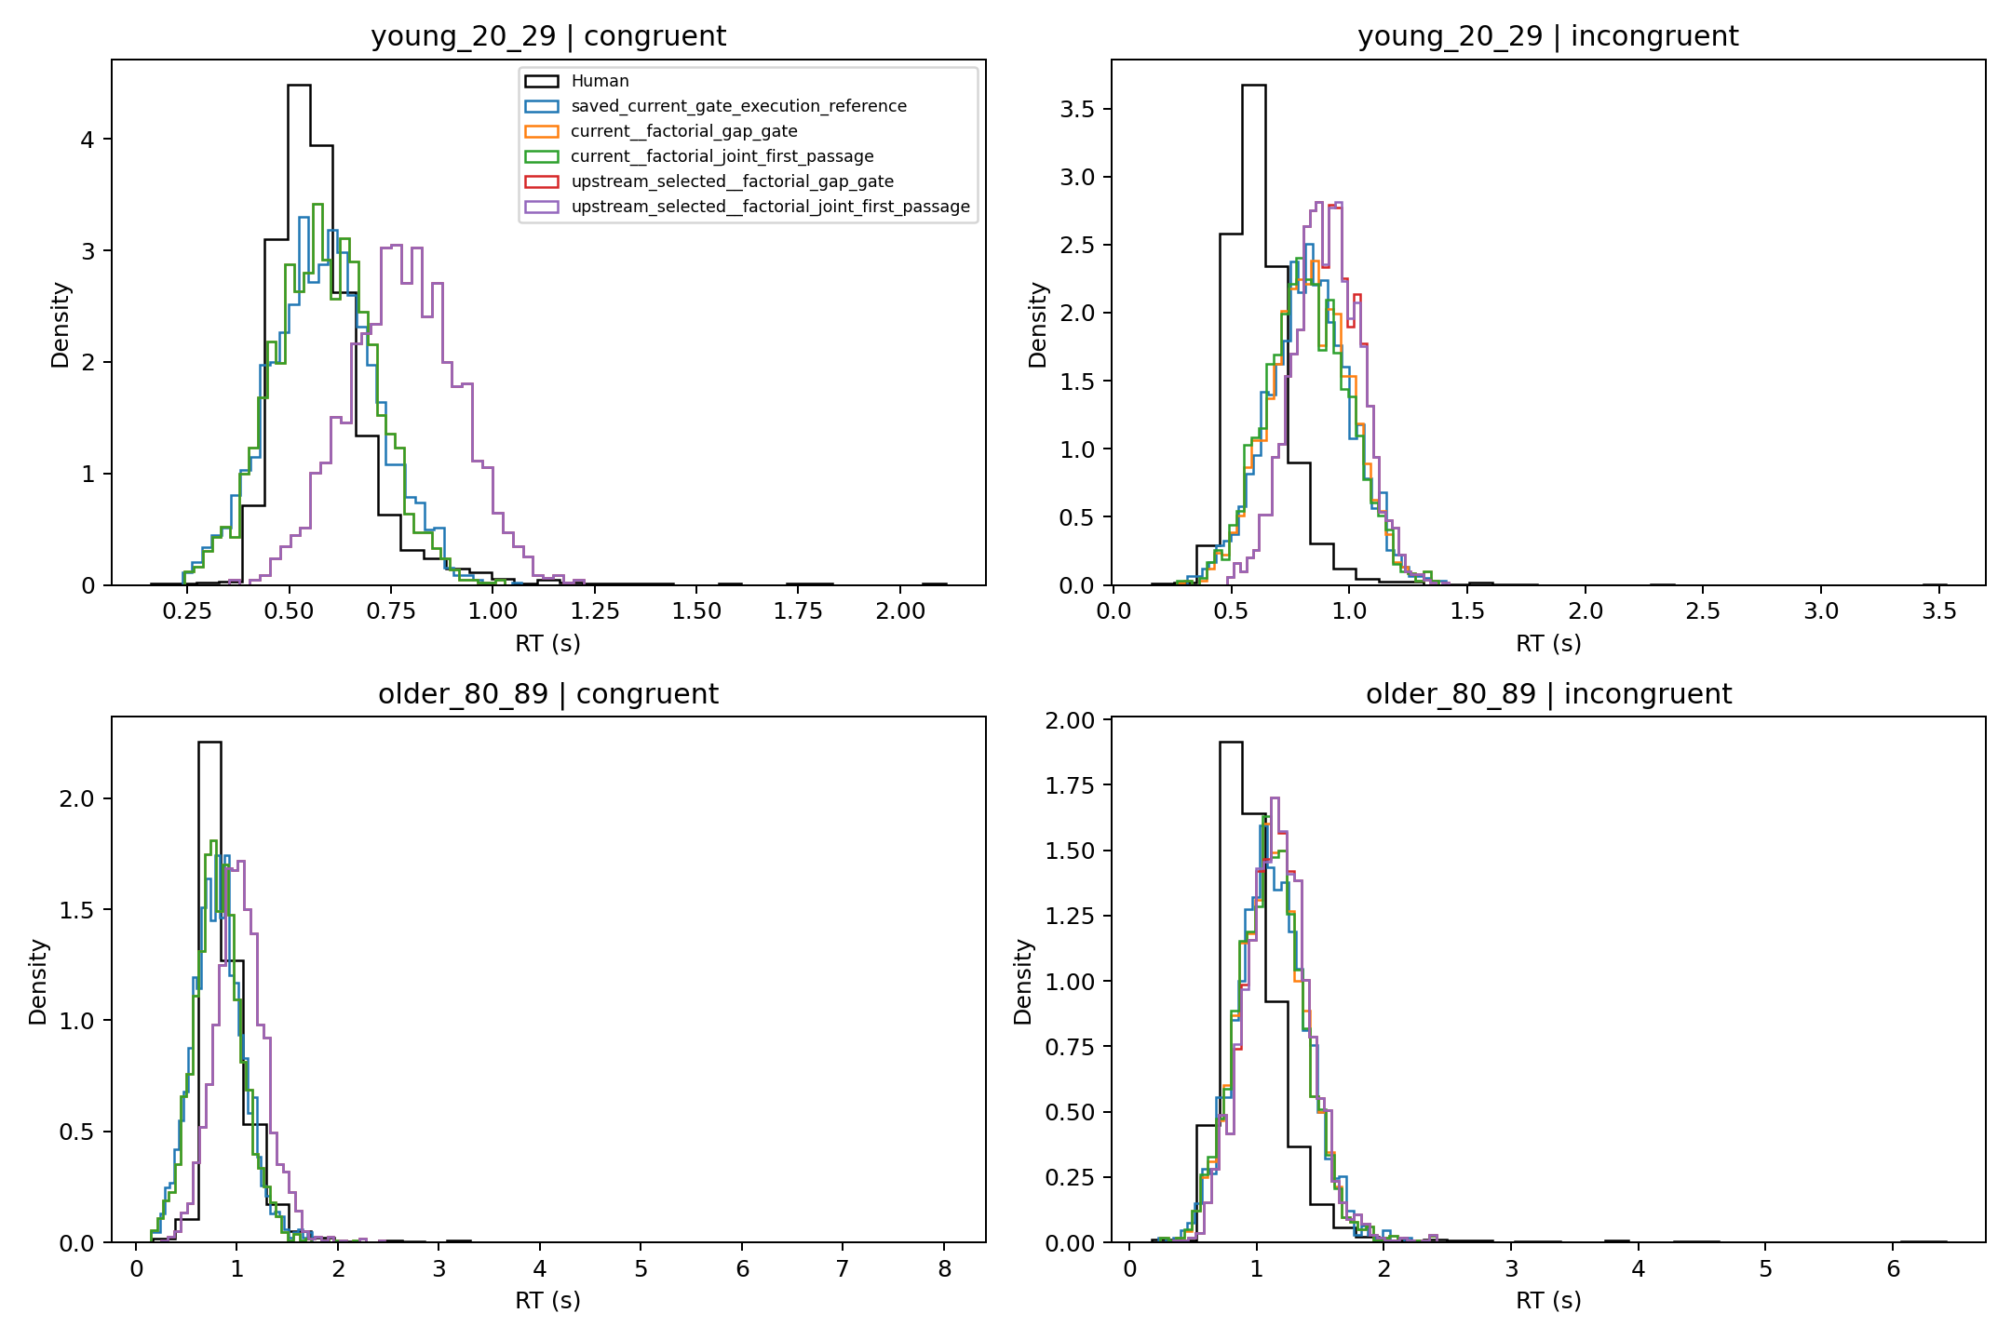
Measurement error does not explain the mismatch
Audit: bins, ECDFs, and timing discretization.
Result: discretization did not shrink the gap.
Conclusion: conflict dynamics dominate.
Bins remain valuable as a diagnostic view: equal-count bins show the relative fast-to-slow error curve, while fixed-time bins preserve absolute age and RT differences. They are not a substitute for fitting the continuous joint distribution.
Notes:
因为 compression 文章讨论 measurement error 对 observed RT distribution 的影响，我们检查了固定时间 bins、被试内等人数 bins、连续密度和 ECDF，也做了 1/60 秒离散以及 60 Hz 显示器加 125 Hz 键盘的敏感性情景。由于没有真实硬件记录，这些不能称为真实校正。结果是离散化会改变局部形状，但没有让核心差距消失，也没有根本改变模型排名。因此 bins 很适合定位失败：等人数 bins 看快到慢的错误曲线，固定 bins 保留绝对 RT 和年龄差异；但 binning 不能修复模型机制。

Slide 7

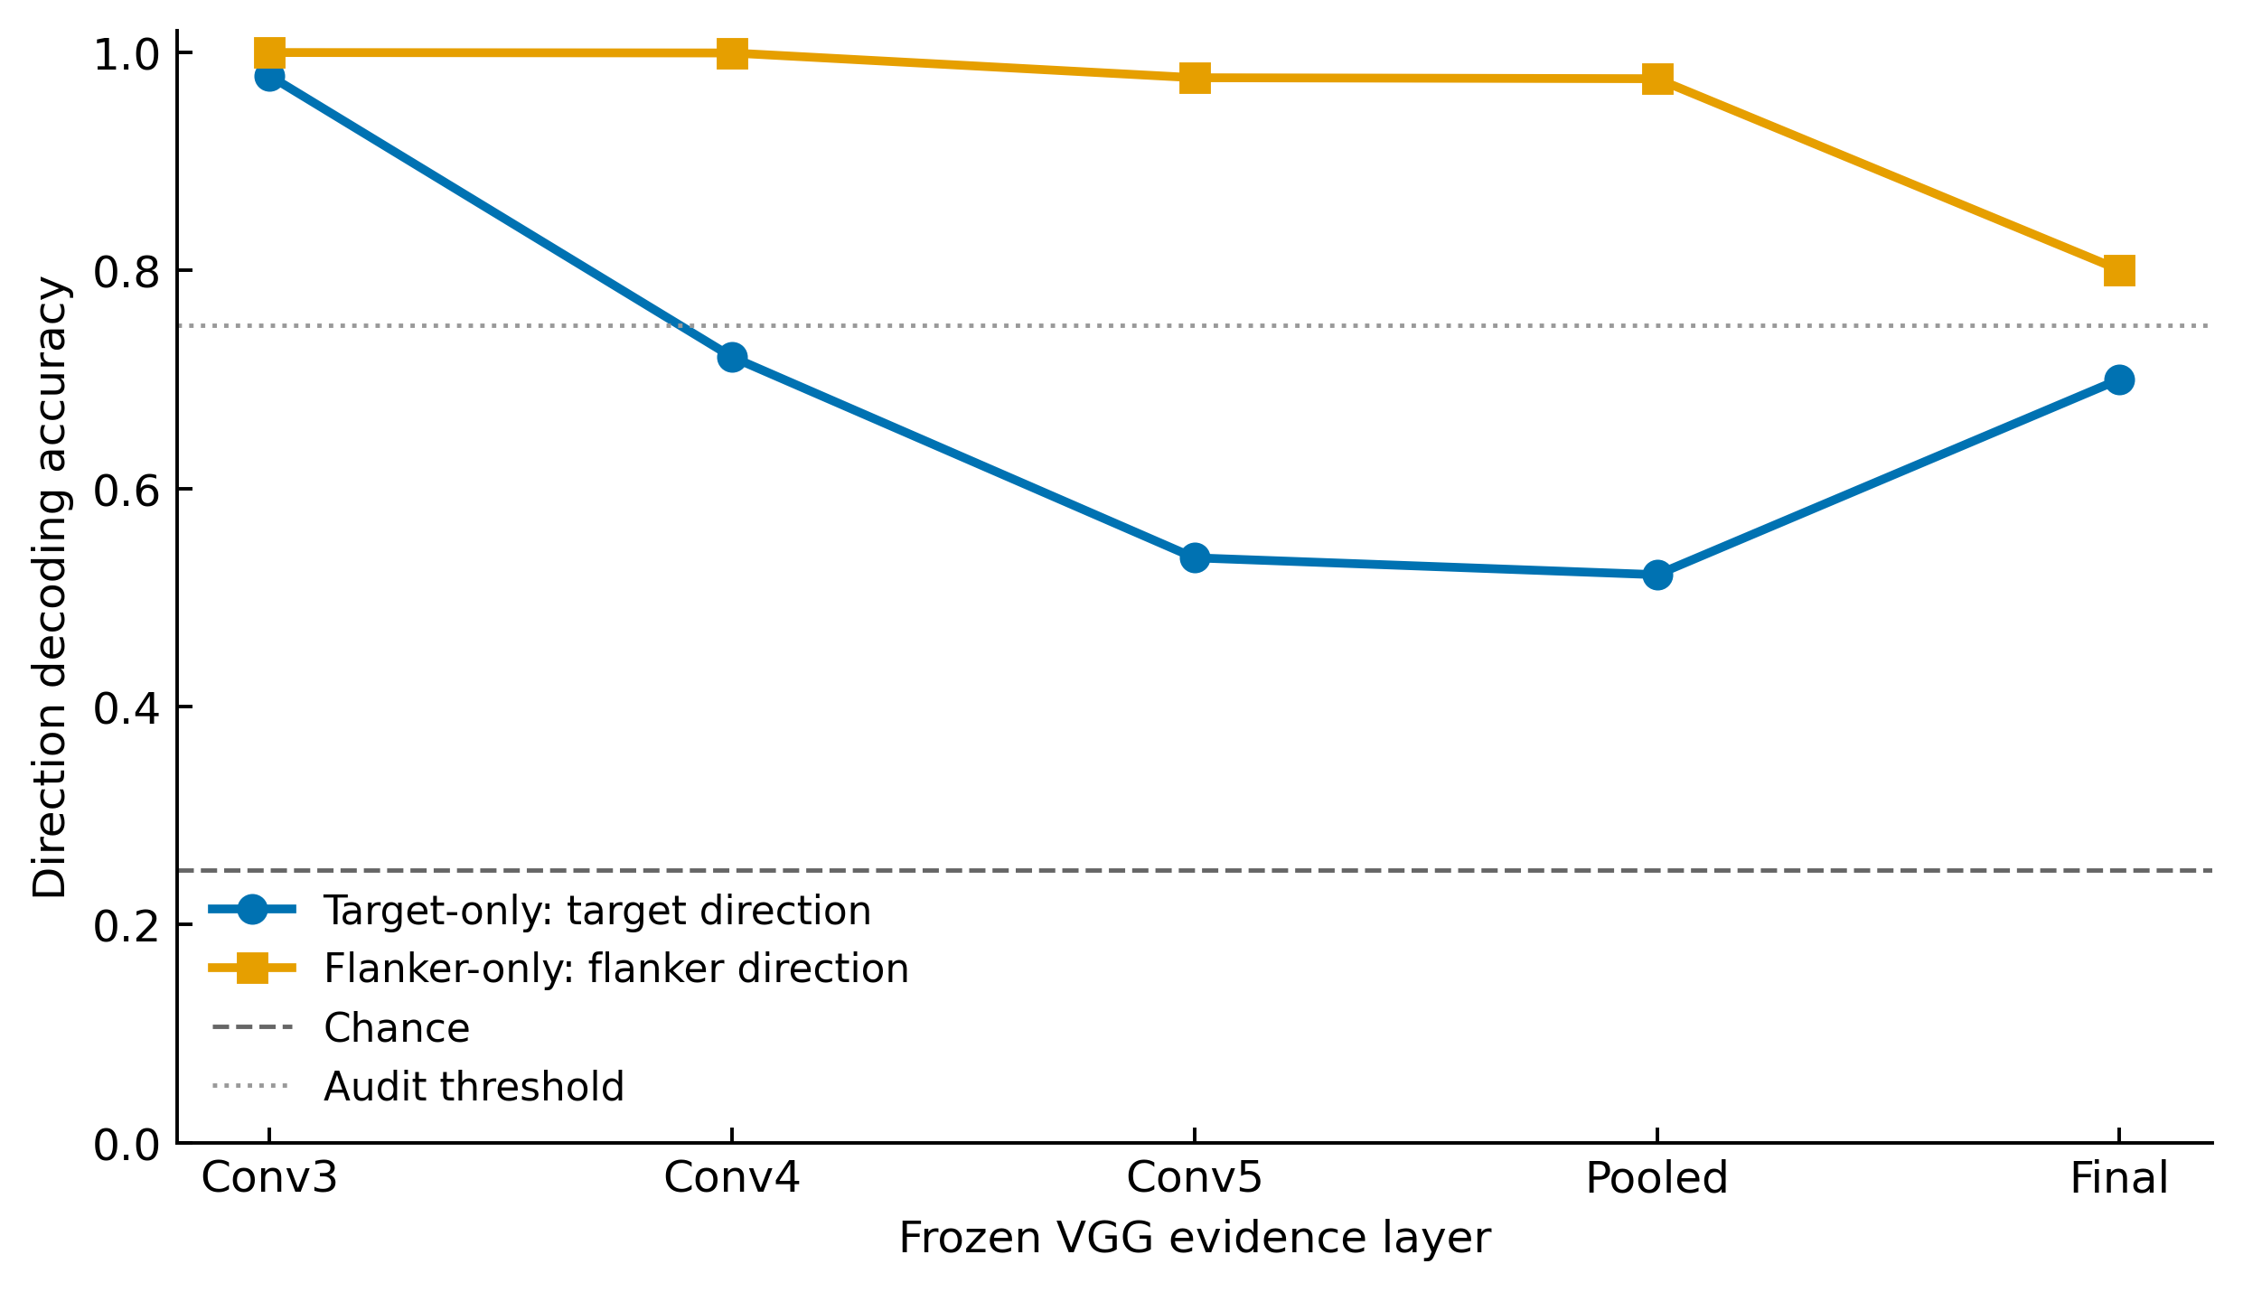
VGG retains target and flanker information
Clean target-only and flanker-only stimuli were reconstructed from the original assets, then passed through the same frozen VGG and direction probes.
Audit | Result | Interpretation
Target-only | Conv3 = 97.9% | Central direction is readable
Flanker-only | Conv3 = 100% | Peripheral direction is readable
Full rebuild | Argmax = 100% | Pipeline matches old cache
Coverage | 9,990 stimuli | Formal source audit passed
Notes:
接下来我们检查更上游的问题：VGG 是否根本无法区分中央 target 与外围 flankers。我们从同一刺激重建完整、target-only 和 flanker-only 三个版本，并输入同一个冻结 VGG。Conv3 上 target-only 的 target 方向解码率约 97.9%，flanker-only 的 flanker 方向为 100%；完整刺激重建也与原缓存结果完全一致，共覆盖 9,990 个刺激。因此 VGG 中存在可分的 target 和 flanker 信息。但信息存在不等于当前读取方式正确使用了它；完整图像证据可能在进入 Wong–Wang 前已经混合了来源身份。

Slide 8
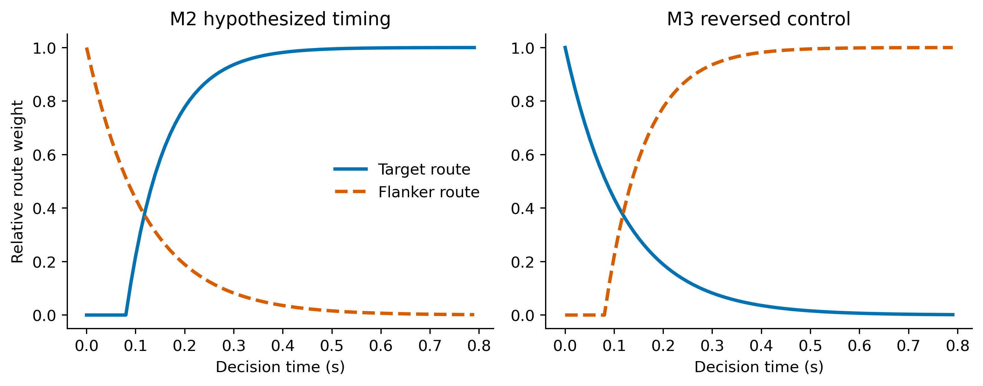
Controlled test: source information versus timing
VGG, WR2, WW parameters, thresholds, non-decision time, evidence energy, folds, and random seeds were held fixed. Only source composition and timing changed.
Four comparison cells
M0 — current full-image WR2
M1 — target and flanker simultaneous
M2 — flanker early/decaying; target delayed/ramping
M3 — reversed timing placebo
Timing grid: target delay 40/80/120 ms; flanker decay 80/120/160 ms.
A mechanism could pass only if continuous RT distance, total error, and error-by-RT shape all improved—without eliminating congruent errors or worsening the other age × condition cells.
Notes:
既然 VGG 中存在可分信息，我们测试把 target 和 flanker 作为不同时间路径输入同一个 Wong–Wang。VGG、WR2、Wong–Wang 参数、阈值、非决策时间、证据总能量、被试折和随机种子都保持不变，只改变来源组成与时间。M0 是完整图像 WR2；M1 是两类证据同时进入；M2 是 flanker 早期较强并衰减、target 延迟增强；M3 是 target 早、flanker 晚的反向控制。通过标准要求连续 RT、总体错误率和错误率随 RT 的曲线同时改善，不能只改善一个最快 bin。

Slide 9
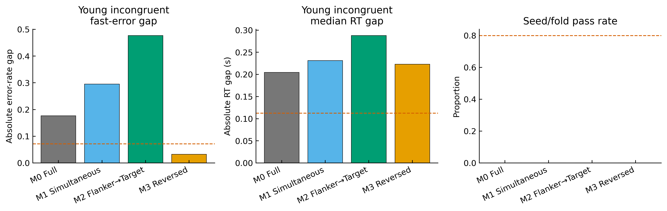
No dual-route candidate passes the joint behavioral criteria
Four-fold × ten-seed result
M0 Full WR2: 17.7 pp; 205 ms
M1 Simultaneous: 29.5 pp
M2 Flanker → Target: 47.7 pp
M3 Reversed: 3.2 pp; overall fit fails
Pass: 0/40 runs; 0/4 folds
A small fast-error gap is not sufficient. M3 looks good on that one number only because it creates the wrong error curve elsewhere. The joint criteria correctly reject this apparent improvement.
Notes:
结果是没有一个双通道候选通过完整标准。M0 的快速错误差距约 17.7 个百分点，RT 中位数差约 205 毫秒。M1 的差距扩大到 29.5 个百分点。原本最期待的 M2 扩大到 47.7 个百分点，说明简单实现中的早期 flanker 路径过强。M3 的最快 bin 差距只有 3.2 个百分点，但总体错误率、较慢 bins 和 RT 分布明显恶化，所以它只是通过在其他地方制造错误获得局部改善。四折、每折十个种子中，全部模型都是 0/40 次运行和 0/4 个折通过。

Slide 10
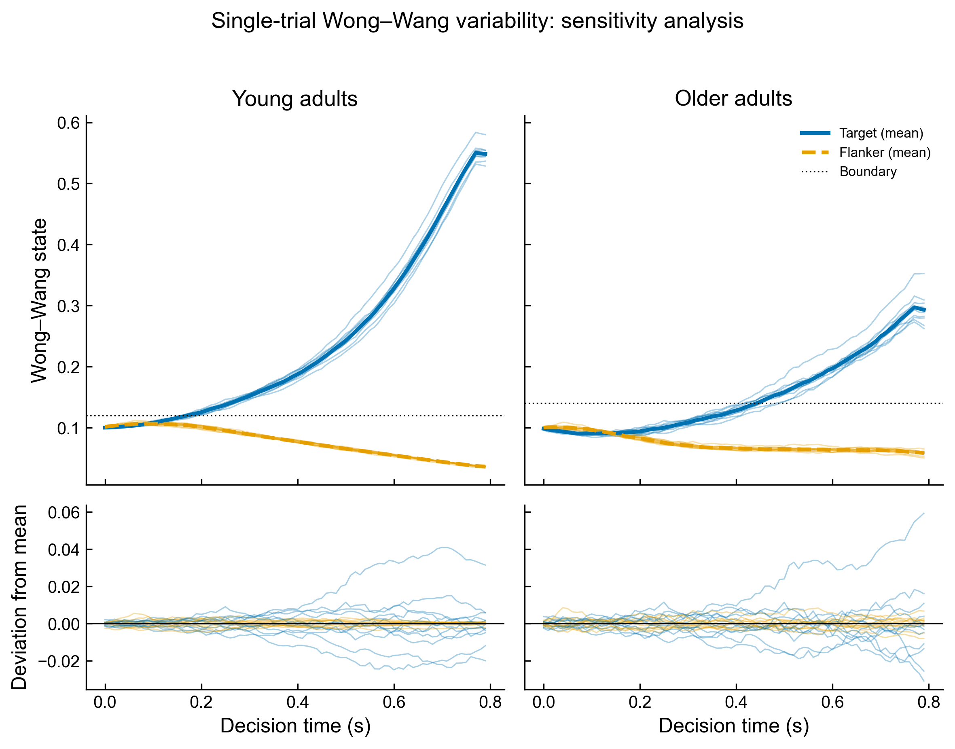
RT-bin curves expose misleading aggregate gains
The dual-route manipulation changes the shape strongly—but in the wrong way for at least one age group or condition.
M2 creates the intended early flanker dominance, but it produces far too many young fast errors.
M3 reduces the first-bin gap, yet errors rise toward 100% in slower incongruent bins.
M1 remains persistently inaccurate because simultaneous source vectors make conflict trials too ambiguous.
All controlled variants still underproduce natural congruent errors.
The model needs trial-varying conflict strength, recovery, urgency, or readout dynamics—not only two fixed source envelopes.
Mechanistic reading
The key result is a dissociation: source separation is representationally feasible, but the simple temporal rule is behaviorally inadequate.
Notes:
错误率随相对 RT 的曲线解释了这些失败。M2 实现了早期 flanker 占优，却产生过多年轻快速错误；M3 缩小最快 bin 差距，却在慢速不一致 bins 中接近完全错误；M1 让两类证据长期成为近似对等竞争者，导致冲突试次持续过度模糊。所有模型还共同缺少一致条件下的自然少量错误。因此固定的两条时间包络不够，可能还缺少试次间冲突强度、恢复速度、紧迫性或读出动态。右下图中的主轨迹是平均趋势，细线显示单次 Wong–Wang 内部噪声。

Slide 11
The implementation fails—but the bottleneck remains open
The evidence narrows the diagnosis without yet deciding whether the next change belongs in spatial readout, decision dynamics, or the modeling objective itself.
Component | What the evidence says | Question for discussion
VGG-16 | Target/flanker directions are readable | Is spatial source identity lost at readout?
Spatial readout | Full-image evidence mixes sources | Test this before changing the accumulator?
Wong–Wang | Fixed dual routes still fail | Are recovery, urgency, or readout missing?
Modeling goal | Joint error–RT shape remains wrong | Better fit or a discriminating mechanism first?
Notes:
综合这些结果，目前受到挑战的是具体实现，而不是已经能够否定 VGG、Wong–Wang 或证据积累理论。VGG 中可以读出来源方向，但当前空间读取可能丢失来源身份；一种固定双通道规则失败，也不足以否定竞争积累框架。稳定的失败是冲突条件下错误—RT 曲线不正确，以及一致条件缺少自然错误。我想停在这里听您的判断：您觉得更像是空间证据读取问题，还是 Wong–Wang 决策动力学问题？我们应继续在现有框架内做机制检验，还是加入其他模型作对照？接下来应优先追求更好的联合拟合，还是优先建立能被新实验区分的机制？

