Slide 1
Finding Simplex Items in Data Streams
Zhuochen Fan, Jiarui Guo, Xiaodong Li, Peking University, China
Tong Yang, Peking University & Peng Cheng Laboratory, China
Yikai Zhao, Yuhan Wu, Bin Cui, Peking University, China
Yanwei Xu, Huawei Technologies Co. Ltd., China
Steve Uhlig, Queen Mary University of London, UK
Gong Zhang, Huawei Technologies Co. Ltd., China
Notes:
Good afternoon, everyone. My name is Jiarui Guo. I am from Peking University.
Today my topic is ``Finding Simplex Items in Data Streams’’.
The authors include Zhuochen Fan, Jiarui Guo and Xiaodong Li, which are from Peking University, and these three authors contributed equally to the paper; Tong Yang, which is my advisor; Yikai Zhao, Yuhan Wu, Bin Cui, which also come from Peking University; Yanwei Xu, which is from Huawei; Steve Uhlig from Queen Mary and Gong Zhang from Huawei.

Slide 2
Outline
PART 01
Background
PART 02
Problem Statement
PART 03
X-Sketch Design
PART 04
Experimental Results
PART 05
X-Sketch for ML
PART 06
Conclusion
Notes:
Here is the outline, and we first introduce the background.

Slide 3
01
PART ONE
Background
Notes:
First, we introduce the background.

Slide 4
01
Background
Frequency estimation is important
Finding frequent items in data streams have been well studied by the community .
Best solution: Sketch
1) Memory efficient and time efficient
2) Small errors
Notes:
Frequency estimation and finding frequent items in data streams are important in many situations, and sketches, as a kind of probabilistic data structures, have gained widespread acceptance for these tasks because they can well handle large-scale and high-speed data streams with limited memory and small errors.

Slide 5
01
Background
Patterns in which item frequencies present in a certain number of consecutive windows are also worth exploring.
Such patterns in p consecutive windows may be fitted by k-degree polynomials.
Notes:
However, we find that patterns in which item frequencies present in a certain number of consecutive windows are also worth exploring, but have not been investigated. We first divide the data stream into several contiguous windows. We claim that such patterns in p continuous windows may be fitted by k-degree polynomials, and only consider the low-order polynomials of k = 0, 1, 2, because constant, linear and quadratic functions are the most common and most basic function forms.

Slide 6
01
Background
k=0:
1) stable cache lines
2) stable flows in network management
Notes:
And now, we will give some use cases for simplex items when k=0,1,2.
When k = 0, we are looking for items whose frequencies remain essentially stable over p consecutive windows, and call them 0-simplex items. For example:
1) If we consider a cache line as an item, then 0-simplex items mean that these stable cache lines will be fetched in the near future. Therefore, we can apply 0-simplex items to prefetch the upcoming cache line, thereby improving the cache hit ratio.
2) If we consider a network flow as an item, we can precisely pre-allocate bandwidth for such stable flows in the next time period for network management.

Slide 7
01
Background
k=1:
1) speed up machine learning models
2) detect DDoS attacks
Notes:
When k = 1, we are looking for items whose frequencies increase or decrease linearly over p consecutive windows, and call them 1-simplex items. For example:
1) We can consider the slopes of the 1-simplex items as important features for the input of machine learning models. In particular, we can speed up the running of some machine learning models by finding 1-simplex items in data streams in advance, so as to greatly reduce the time required.
2) Some network attacks such as DDoS have traffic patterns that can be described linearly after processing. Finding 1-simplex items can help to detect such attacks dynamically in real time.

Slide 8
01
Background
k=2:
1) monitor traffic in wireless networks
Notes:
When k = 2, we are looking for items whose frequencies are parabola shaped over p consecutive windows, and call them 2-simplex items. For example:
1) Periodic 2-simplex items are considered to be the main traffic patterns generated in some wireless networks, so we can dynamically monitor such traffic to judge the performance of the corresponding networks.

Slide 9
01
Background- CMSketch
Insertion
+1
+1
+1
+1
Query
19
24
’frequency: 18
= Min{19, 24, 26, 18}
26
18
Notes:
And before we start introducing our solution, we first introduce two sketches: CMSketch and TowerSketch. These sketches are all designed to estimate the frequency of a certain item in the data stream.
The first is Count-Min Sketch, or CMSketch for short. CMSketch is composed of several counter arrays, each associated with a hash function and having a certain number of counters.
When inserting an item, CM Sketch first maps it to a counter in each array by computing the hash function, and then increments all mapped counters by 1.
When querying an item, CM reports the minimum value among the mapped counters.

Slide 10
01
Background- TowerSketch
+1
8-bit
+1
4-bit
+1
2-bit
Notes:
The data structure of TowerSketch is similar to CMSketch, except that TowerSketch uses different-sized counters for different arrays. Experimental results show that TowerSketch estimates the frequency of infrequent items more accurately.

Slide 11
02
PART TWO
Problem Statement
Notes:
And now we move on to the second part, problem statement.

Slide 12
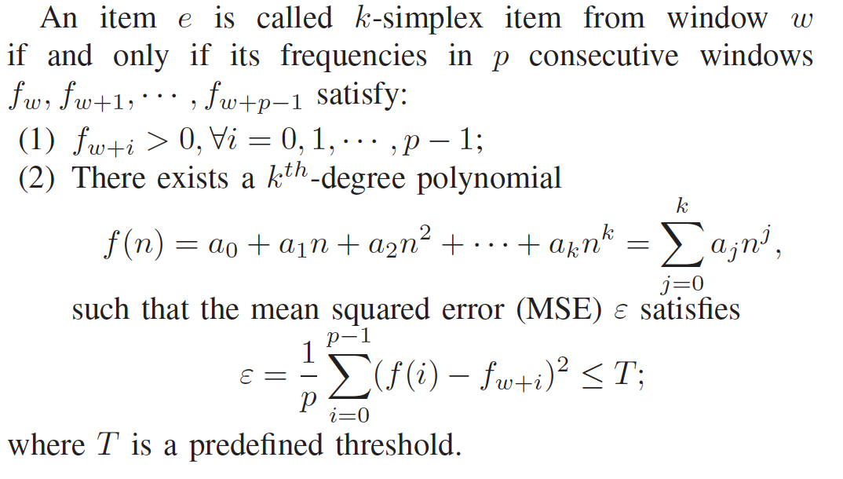
02
Problem Statement
k-simplex items
Notes:
We now give the official definition of k-simplex items: an item e is called k=simplex item from window w, if and only if its frequencies in p consecutive windows satisfy two requirements:
The first requirement is that all these frequencies are positive. In other words, the item e must appear in every window.
The second requirement has something to do with the fitting polynomial. There shall exist a k-th degree polynomial f(n), such that the mean square error \epsilon is smaller than T, where T is a predefined threshold.

Slide 13
02
Problem Statement
simplex items and persistent items
1) number of windows items appear
2) frequency is important
3) consecutive windows
Notes:
And we have to claim the relationship and difference between simplex items and persistent items. An item is called persistent item if the number of windows it appears exceeds a predefine threshold.
So we see that both items have something to do with the number of windows that items appear. However, to find persistent items, we only care whether it appears in a window, but do not care how many times it appears in a window or whether the frequencies can be fitted by a polynomial. Further, simplex items have to appear in consecutive windows, but we do not expect persistent items to meet this requirement.

Slide 14
03
PART THREE
X-Sketch
Notes:
Next, we present out solution – X-Sketch.

Slide 15
X-Sketch
01
Baseline Solution
02
An Optimization
03
Data Structure
Notes:
We explain our X-Sketch in terms of the following three aspects.

Slide 16
03
X-Sketch - Baseline Solution
Part 1:
Record frequencies for last p windows using CMSketch
Part 2:
Record lasting time of simplex items using a set and a hash table.
Notes:
First, we propose the baseline solution for finding simplex items using CMSketch. The baseline solution uses two parts of data structures: Part 1, which is just p CMSketches, to record the frequencies for last p windows. Moreover, the baseline solution use a set to store the ID of simplex items, and a hash table to record the lasting time of these items.
However, even if the baseline solution can fulfill the need to find simplex items in data streams, there is still much room for improvement in terms of memory and accuracy.

Slide 17


03
X-Sketch - Optimization
The fitting error will not increase if we simply increase k.
Distinguish k-simplex items from (k-1)-simplex items:
Threshold for |a_{k}|
I have a constant velocity, so I have a constant acceleration!
Notes:
So we already know that if the frequencies of an item in the last p windows can be fitted by a k-th polynomial, then the item is k-simplex. However, the fitting error will not increase if we simply increase the degree k, so (k-1)-simplex items will surely be k-simplex items in our problem definition.
We can use an example to show this fact: Suppose the frequency is related to the position of an object in physics, then 0-simplex, 1-simplex and 2-simplex items will have a nearly stable position, velocity and acceleration respectively. And if a train is moving as a constant velocity, it will surely have a constant acceleration, which is equal to 0!
So, to distinguish true k-simplex items from (k-1)-simplex items, we add a threshold for the highest coefficient of the polynomial, a_k and only items with large absolute value of a_k will be viewed as k-simplex items. In this way, we guarantee that the highest dominates the polynomial, so all items will be true k-simplex items.

Slide 18
03
X-Sketch - Data Structure
Stage 1:
Record frequencies for last s windows using TowerSketch.
Stage 2:
Record potential simplex items and their lasting time using a hash table.
Notes:
And now we start introducing the data structure of SimpleX-Sketch, or X-Sketch for short. X-Sketch still includes two stages, stage 1 and stage 2. However, in Stage 1, we use TowerSketch instead of CMSketch, and we only record frequencies for last s windows, where s is smaller than p; Stage 2 records potential simplex items and their lasting time using a hash table.

Slide 19

03
X-Sketch - Data Structure
Stage 1:
1) Short-Term Filtering: quickly filter non-simplex items
2) Potential: measure the probability of becoming simplex items
Notes:
The technique used in Stage 1 is called short-term filtering, and its key idea is to record frequency accurately and quickly filter non-simplex items, which either do not appear in consecutive windows, or cannot use a polynomial to fit their frequency.
And to measure the probability of becoming simplex item, we define a potential. Again, we add a threshold for the potential lambda, and items with insufficient potential are not allowed to enter Stage 2.

Slide 20
03
X-Sketch - Data Structure
Stage 2:
Weight Election: a reasonable replacement strategy
Notes:
Stage 2 records the id, last p frequencies and the lasting time of an item. To construct a reasonable replacement strategy to evict non-simplex items in Stage 2, we define a weight for every item, and use probability method to randomly evict items in Stage 2 to make room for simplex items.

Slide 21
03
X-Sketch - Data Structure
Notes:
And this is an example of X-Sketch. Items with large potential is selected from stage 1, and evict an item in stage 2 with small weight.

Slide 22
04
PART FOUR
Experimental Results
Notes:
Now we will introduce the experimental results of X-Sketch.

Slide 23
04
Experiments (Setup)
Datasets: CAIDA, MAWI, Data Center, Synthetic.
Metrics:
PR, RR, F1 Score, ARE, Throughput
Notes:
This is the experimental setup.
We use three real datasets, caida, mawi, data center, and one synthetic dataset. We compare X-Sketch with the baseline solution on 5 metrics: PR, RR, F1 Score, ARE and Throughput.
We will only list the results of F1 Score, ARE and throughput here.

Slide 24
04
Experiments (F1 Score)
Notes:
For experimental results, we find that on all these datasets, X-Sketch achieves higher F1 score.

Slide 25
04
Experiments (ARE)
Notes:
Also, X-Sketch has smaller ARE, which shows that it reports the lasting time of simplex items more accurately.

Slide 26
04
Experiments (Throughput)
Notes:
Finally, X-Sketch filters many non-simplex items in advance, so it prevents unnecessary polynomial fitting and has higher throughput.

Slide 27
05
PART Five
X-Sketch for ML
Notes:
Now we will give a practical application of X-Sketch, where X-Sketch can be used to accelerate machine learning algorithms.

Slide 28

05
X-Sketch for ML
ML for predicting frequency:
1) massive training datasets
2) loops of training epochs
3) not all items are predictable
Solution: X-Sketch + ML
ML
X-Sketch+ML
Notes:
So we all know that machine learning can be used to predict the frequency of items. However, to the best of our knowledge, these models require massive training datasets and loops of training epochs to achieve high performance. Also, not all items in reality follow a strict and predictable pattern. Simply predicting the frequency of all items in the datasets is inefficient, and most of these predictions are even false or inaccurate. Therefore, X-Sketch can be used to accelerate machine learning algorithms.

Slide 29
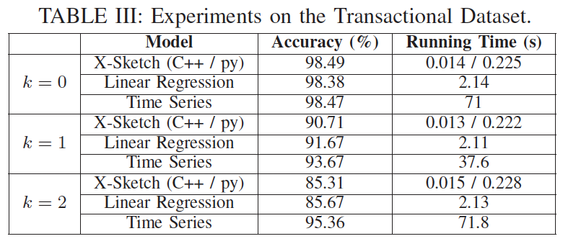
05
X-Sketch for ML
Notes:
Specifically, we first run X-Sketch to find all simplex items. Then, we predict the frequency for these simplex items using the fitting polynomial. The frequency of other items can be further predicted by machine learning algorithms if necessary. Our experiments show that X-Sketch can improve the running time of predictions by at least a factor of 100/9 and still maintain a high level of accuracy.

Slide 30
06
PART SIX
Conclusion
Notes:
So now let us conclude our paper.

Slide 31
06
Conclusion
k-simplex items
X-Sketch Key technique: Short-Term Filtering & Weight Election
Theoretical & experimental results
Accelerating machine learning
Notes:
In our paper, we define k-simplex items for the first time, and we generally focus on small k, especially when k=0,1,2. We propose a novel sketch, namely X-Sketch to find simplex items in data streams. Its key technique is called short-term filtering and weight election. Both theoretical and experimental results show the superiority of X-Sketch with respect to the baseline solution. Further, we use X-Sketch to accelerating machine learning.

Slide 32
THANKS
Source code: https://github.com/SimpleX-Sketch/X-Sketch
Jiarui Guo
Peking University, China
Email: ntguojiarui@pku.edu.cn
Homepage: https://ntguojiarui.github.io/
Notes:
This is all for my paper. Thanks.

