Slide 1
组会汇报
2022/7/14
黄思远

Slide 2
Outline
GNN
A single GNN Layer
GNN Layer connectivity
Prediction Heads
Hierarchically pooling - DiffPool
Basic coding skills
Deep-Learning-with-PyTorch
PyTorch Geometric (PyG) library (CS224w)

Slide 3
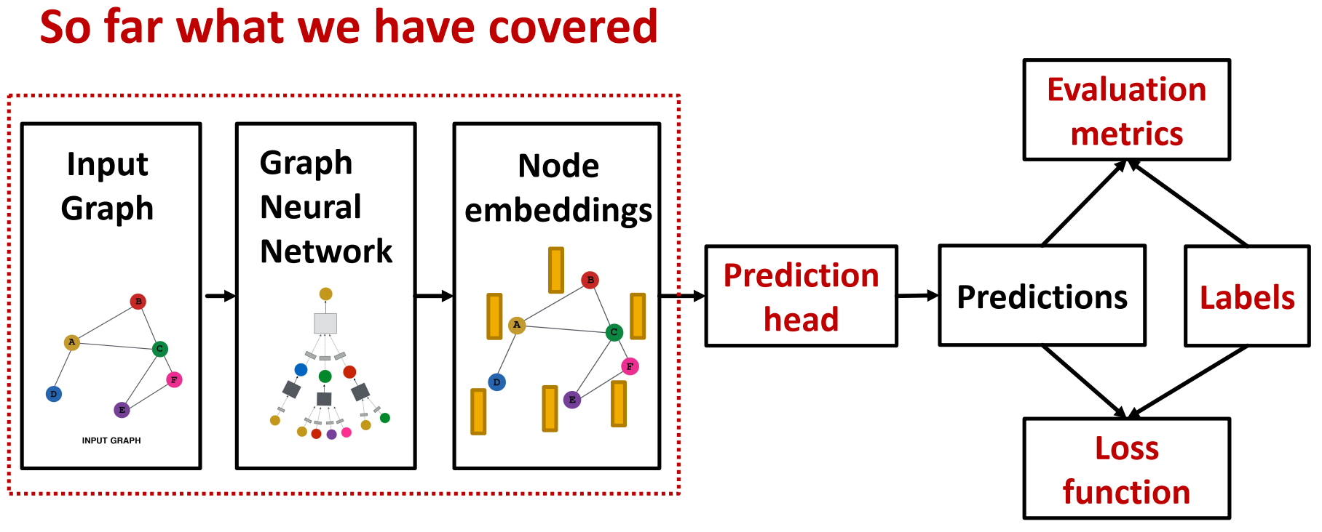
GNN Training Pipeline
Output of a GNN: set of node embeddings

Slide 4
GNN Training Pipeline
Output of a GNN: set of node embeddings

Slide 5
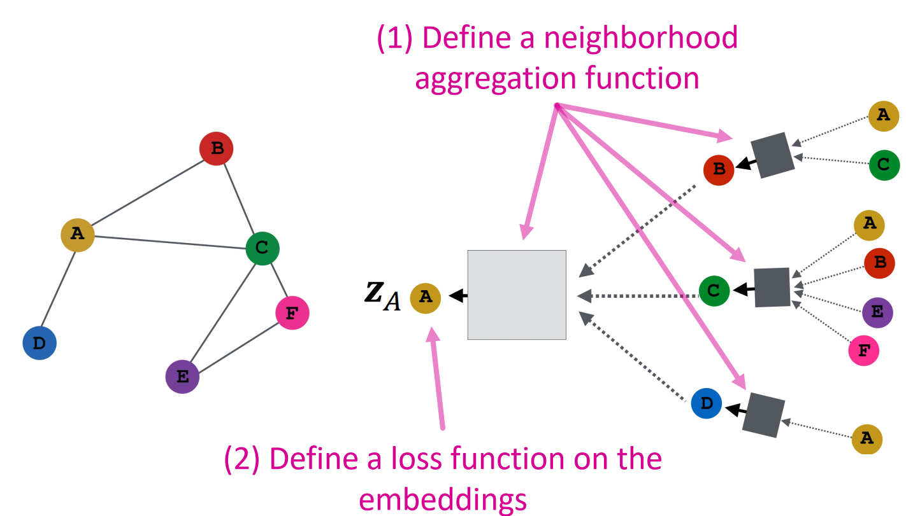
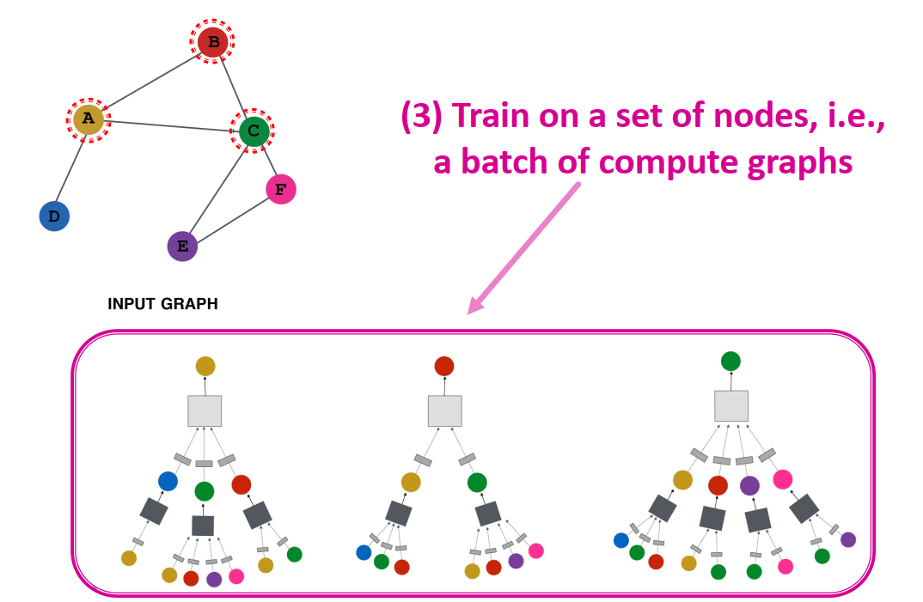
GNN Model Design Pipeline

Slide 6
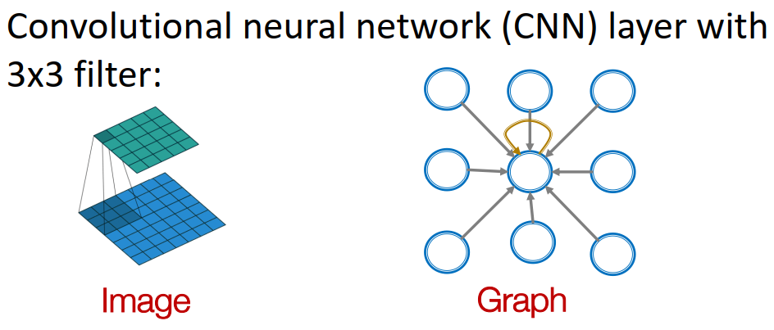
GNN vs CNN

Slide 7
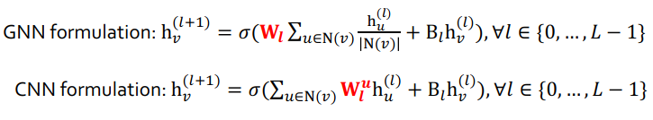
GNN vs CNN

Slide 8
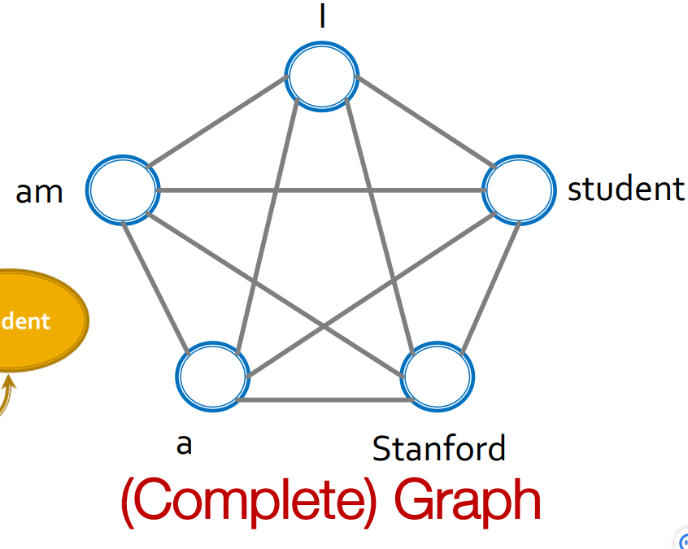
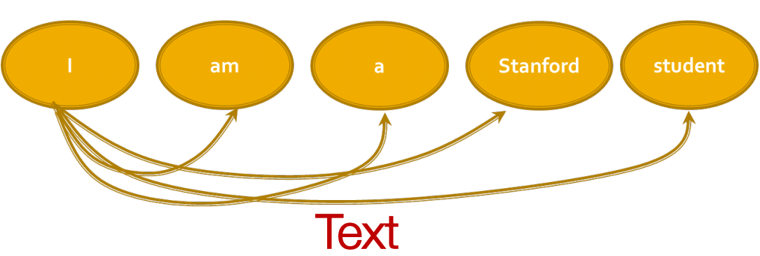
GNN vs Transformer
Transformer layer is identical to that of a GNN on the fully-connected “word” graph

Slide 9
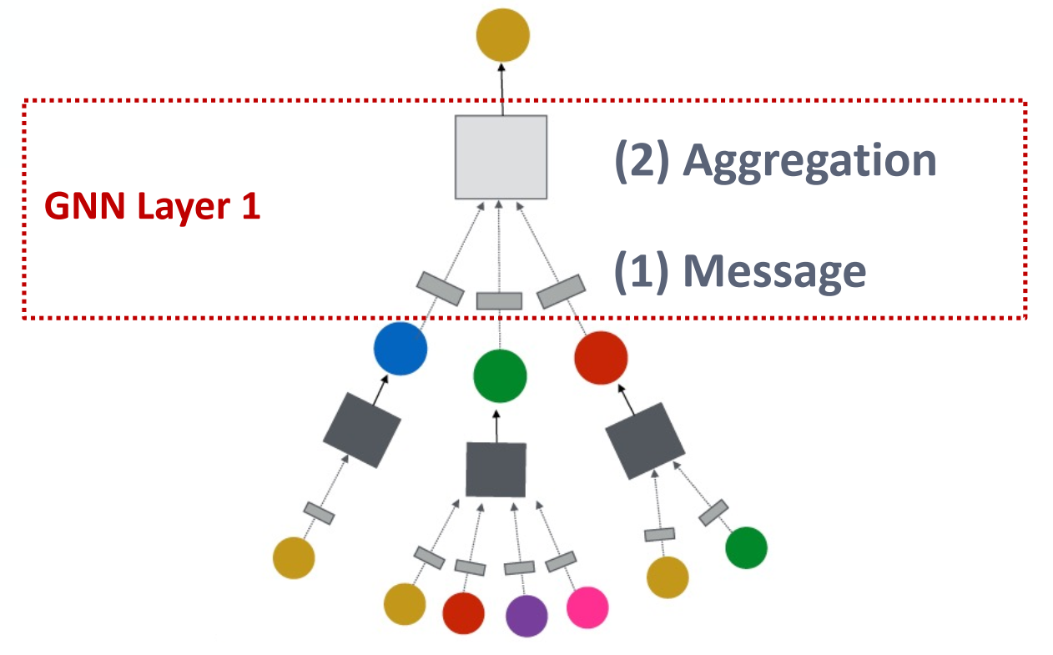
General GNN Framework
GNN Layer = Message + Aggregation

Slide 10
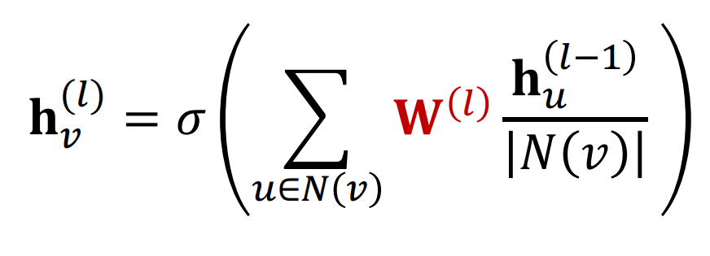
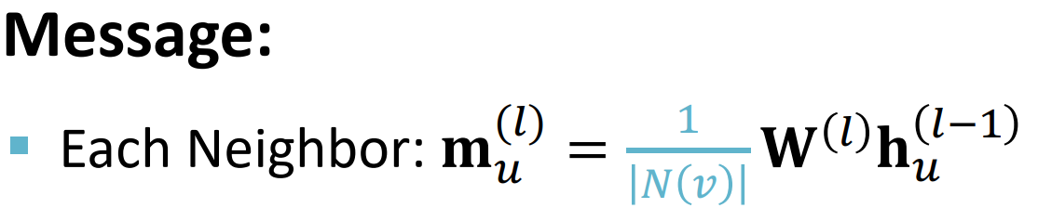
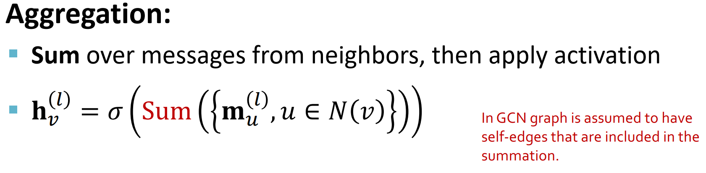
A single GNN Layer
(1) Graph Convolutional Networks (GCN)

Slide 11
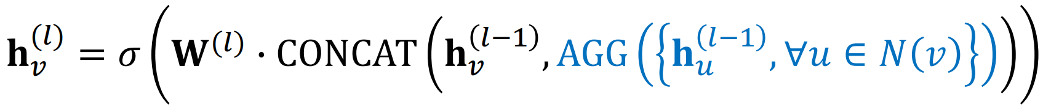

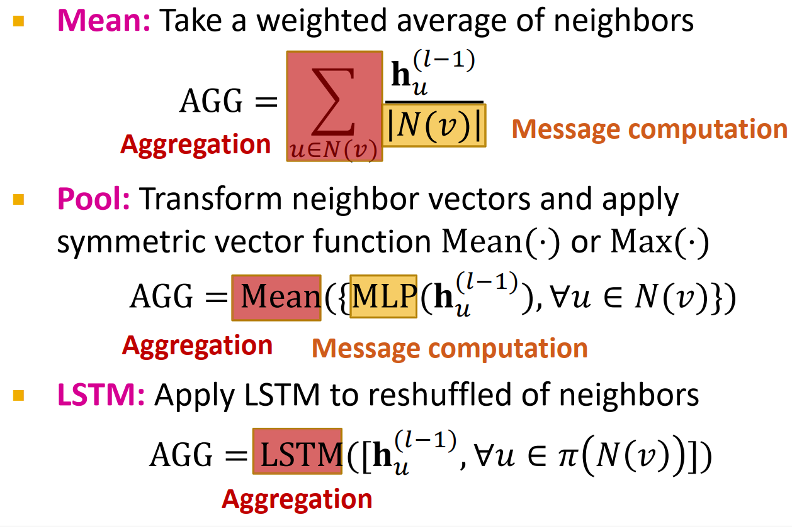
A single GNN Layer
(1) Graph Convolutional Networks (GCN)
(2) GraphSAGE

Slide 12
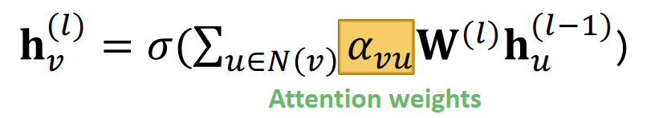
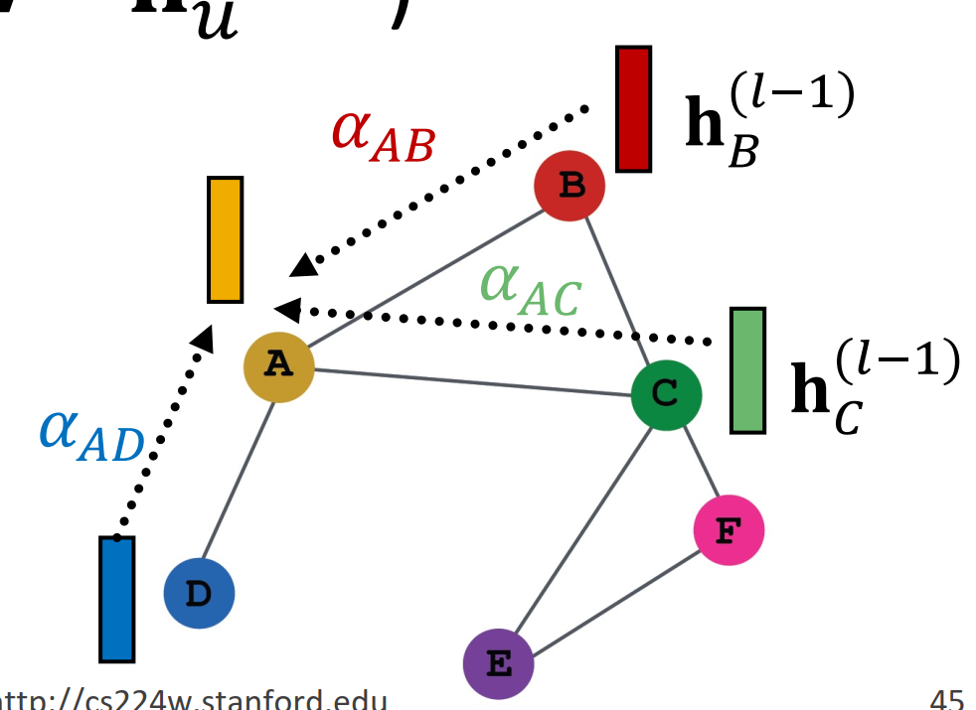
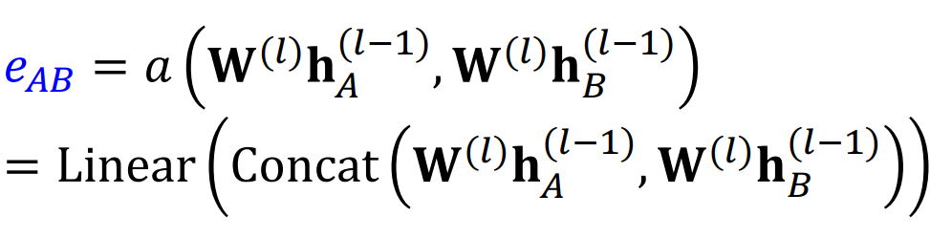
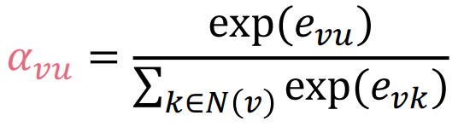
A single GNN Layer
(3) Graph Attention Networks (GAT)
[Velickovic et al., ICLR 2018; Vaswani et al., NIPS 2017]

Slide 13
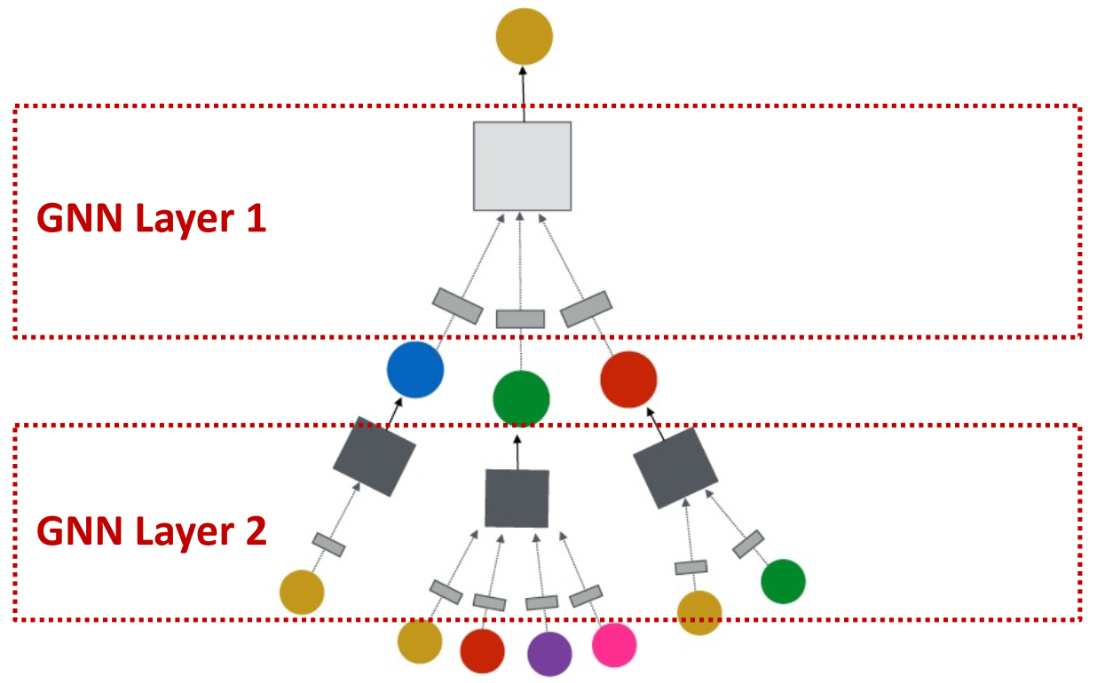
General GNN Framework
Connect GNN layers into a GNN
(3) Layer connectivity

Slide 14
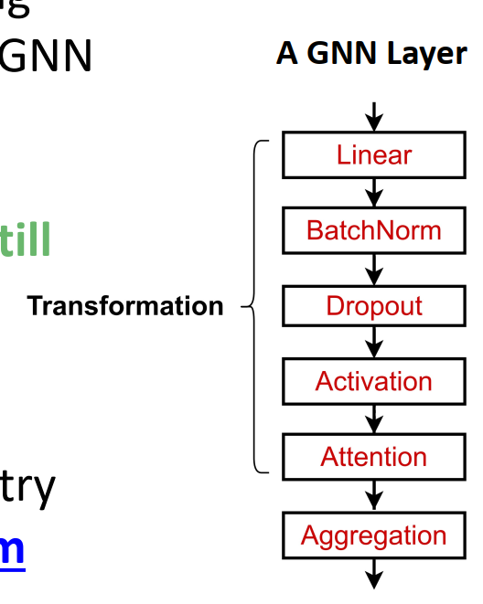
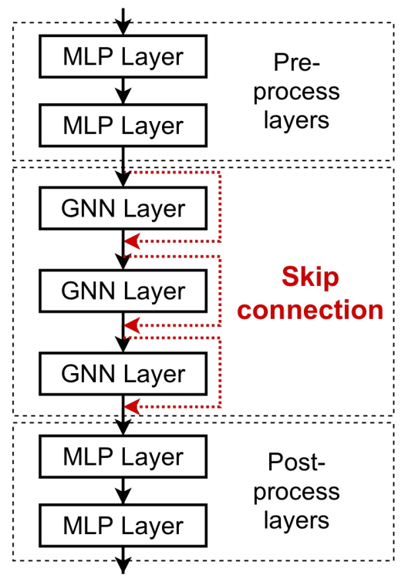
From single Layer to GNN
A single GNN Layer
Design GNN Layer connectivity

Slide 15
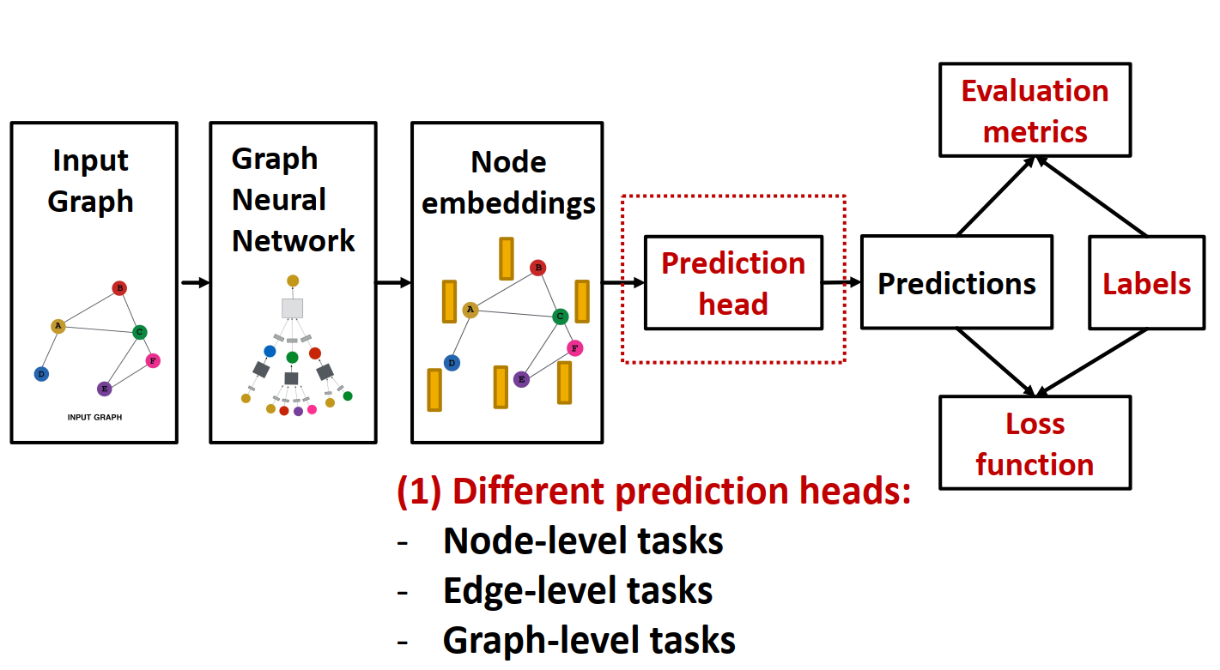
GNN Training Pipeline
Output of a GNN: set of node embeddings

Slide 16
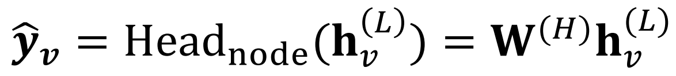
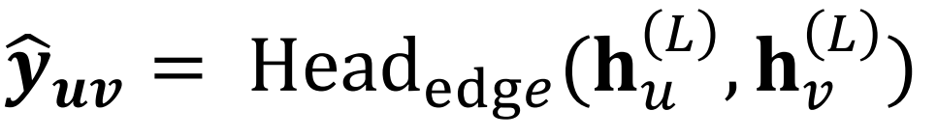
Prediction Heads
Node-level prediction
Edge-level prediction
Graph-level prediction

Slide 17
Prediction Heads
Node-level prediction
Edge-level prediction
Graph-level prediction

Slide 18
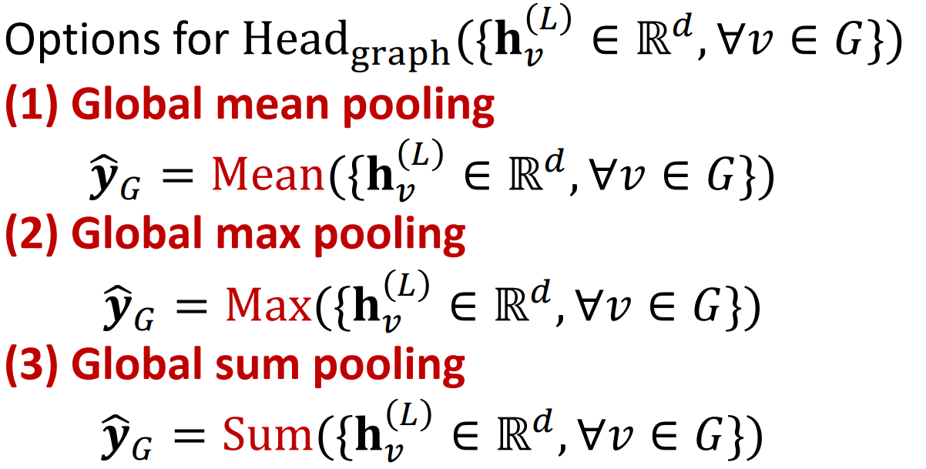
Graph-level Prediction Heads
(1) Small graphs
(2) Larger graphs
A solution: Let’s aggregate all thenode embeddings hierarchically

Slide 19
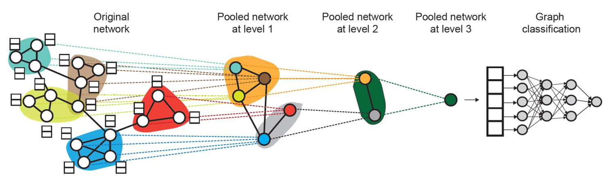
Hierarchically pooling - DiffPool
Leverage 2 independent GNNs at each level GNN A: Compute node embeddings GNN B: Compute the cluster that a node belongs to
Ying et al. Hierarchical Graph Representation Learning with Differentiable Pooling, NeurIPS 2018

Slide 20
Hierarchically pooling - DiffPool
For each Pooling layer § Use clustering assignments from GNN B to aggregate node embeddings generated by GNN A
§ Create a single new node for each cluster, maintaining edges between clusters to generated a new pooled network
Ying et al. Hierarchical Graph Representation Learning with Differentiable Pooling, NeurIPS 2018

Slide 21
Outline
GNN
GNN Model Design Pipeline
A single GNN Layer
GNN Layer connectivity
Prediction Heads
Hierarchically pooling - DiffPool
Basic coding skills
Deep-Learning-with-PyTorch
PyTorch Geometric (PyG) library (CS224w)

Slide 22
Paper reading
A Comprehensive Survey on Graph Neural Networks, TNNLS-21 √
Hierarchical Graph Representation Learning with Differentiable Pooling, NIPS-19
Graph U-Nets, ICML-19
Rethinking pooling in graph neural networks, NIPS-20
Graph Pooling for Graph Neural Networks: Progress, Challenges, and Opportunities arxiv-22
√

