Slide 1
组会汇报
2022/8/11
黄思远

Slide 2
Outline
Coding
SparseTensor
Paper and code reading
Accurate Learning of Graph Representations with Graph Multiset Pooling (ICLR 2021)
Structural Entropy Guided Graph Hierarchical Pooling (ICML 2022)

Slide 3
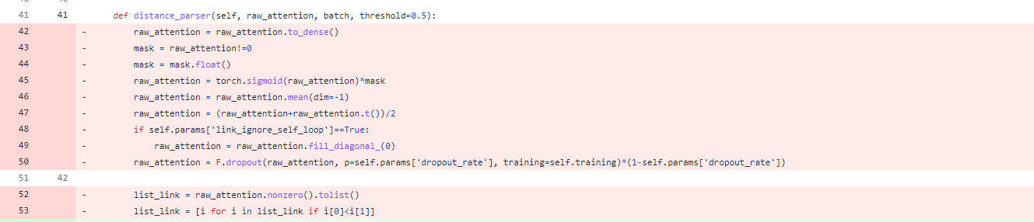
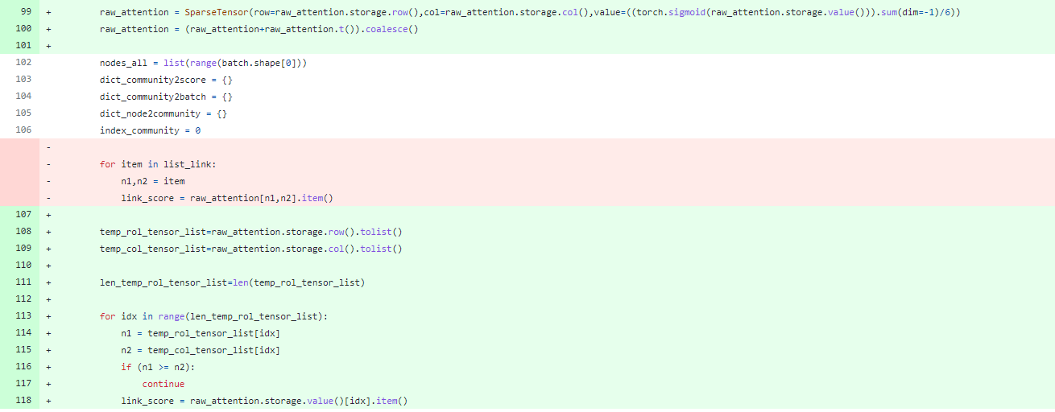
Coding - SparseTensor

Slide 4
GMT
Node drop methods unnecessarily drop some nodes at every pooling step, leading to information loss on those discarded nodes.
Node clustering methods compute the dense cluster assignment matrix with an adjacency matrix. This prevents them from exploiting sparsity in the graph topology, leading to excessively high computational complexity (Lee et al., 2019b).
Therefore, we need a sophisticated graph pooling layer that coarsens the graph with sparse implementation without discarding nodes.

Slide 5
GMT
Multi-head Attention
Graph Multi-head Attention

Slide 6
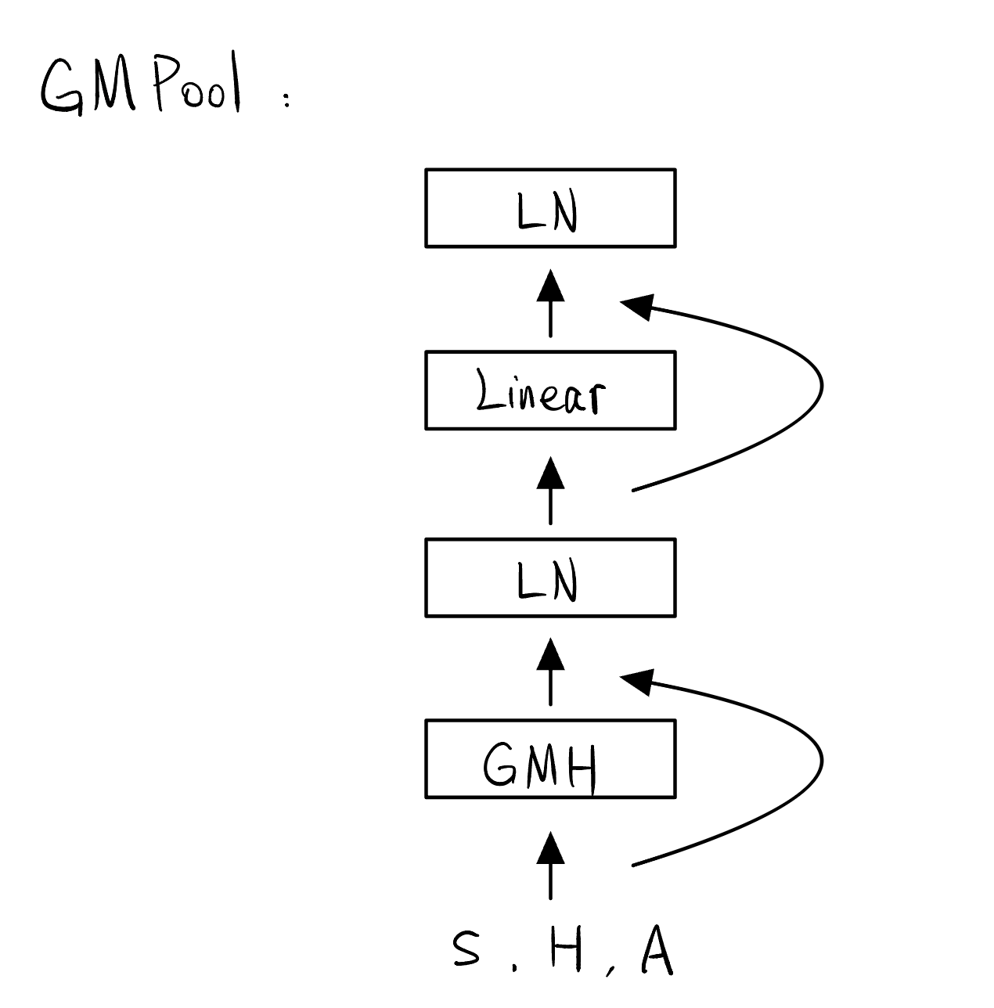
GMT
Graph Multiset Pooling with Graph Multi-head Attention

Slide 7
GMT
Self-Attention for Inter-node Relationship
A major drawback of this scheme is that it does not consider relationships between nodes.
To tackle this limitation, one should further consider the interactions among condensed k different nodes.
Overall Architecture

Slide 8
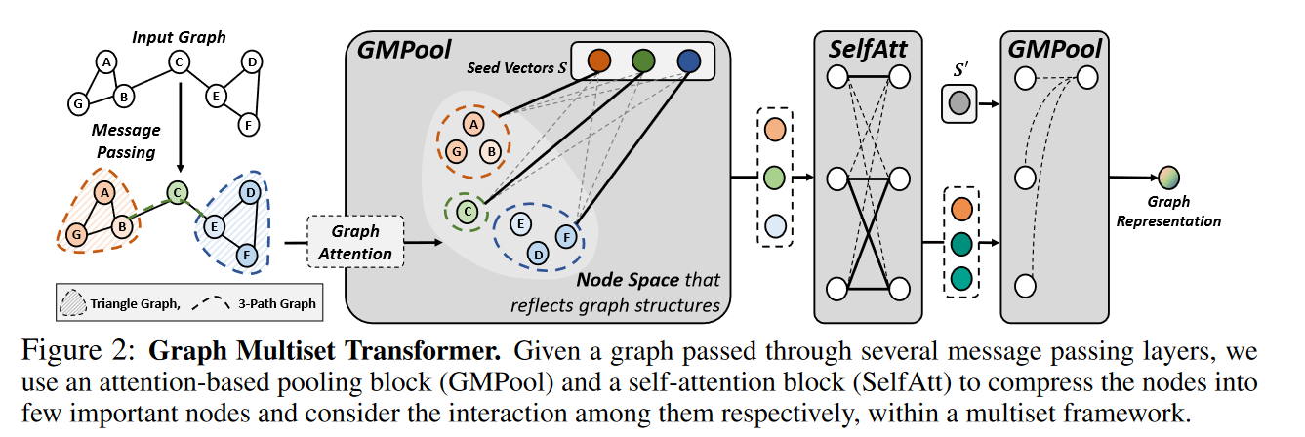
GMT
Overall Architecture

Slide 9
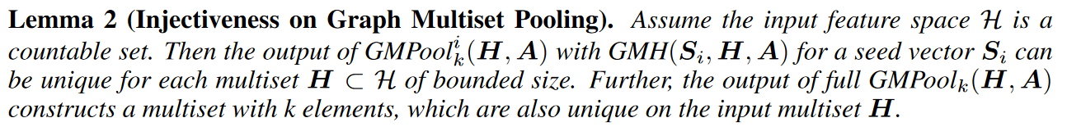
GMT
CONNECTION WITH WEISFEILER-LEHMAN GRAPH ISOMORPHISM TEST
Requirement :
Node aggregation and update functions are injective
Graph-level readout is injective.

