Slide 1
组会汇报
2022/8/18
黄思远

Slide 2
Outline
Coding
List query
Cython
Model
init
train_idx val_idx

Slide 3
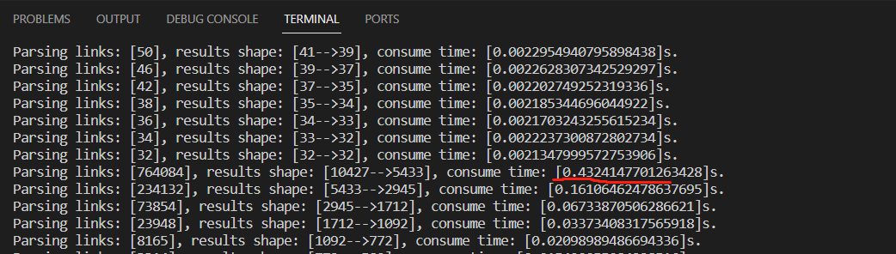
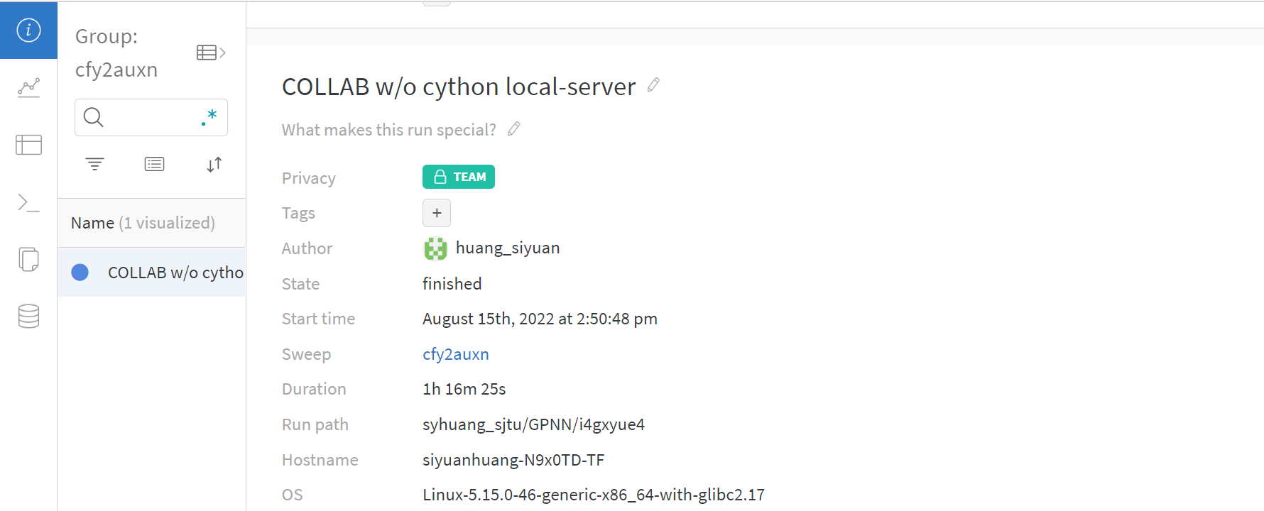
Coding –List Query

Slide 4
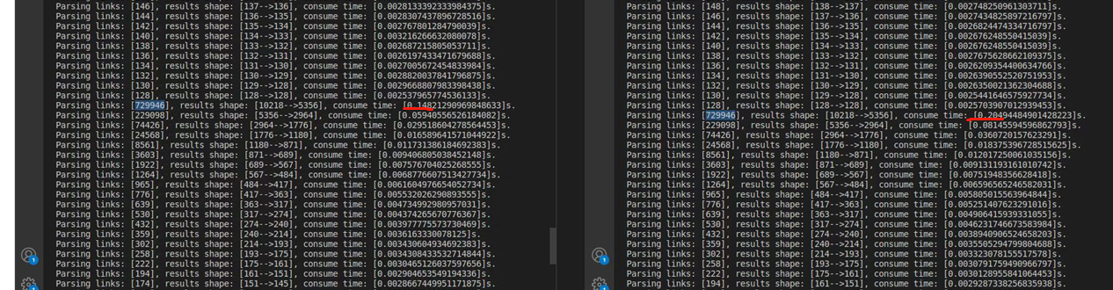
Coding -Cython

Slide 5
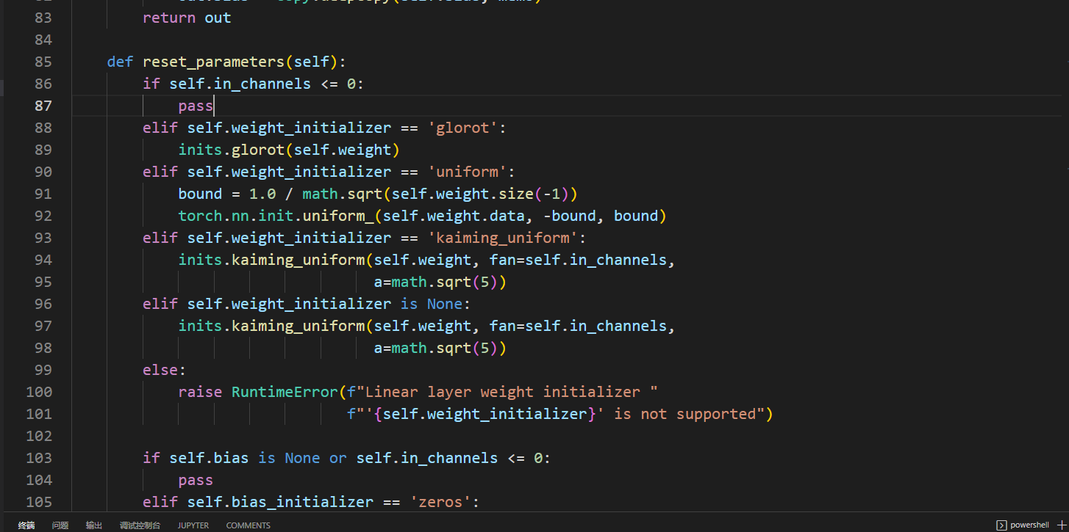
INIT
1、线性层
2、GAT层

Slide 6
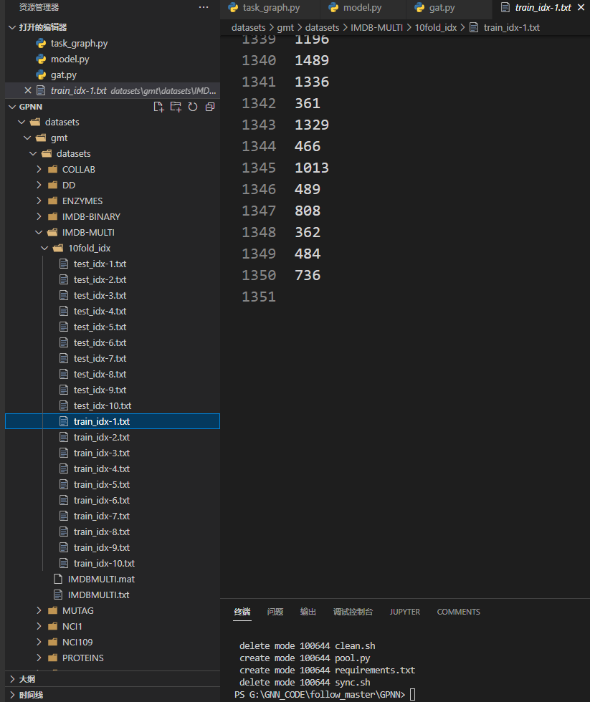
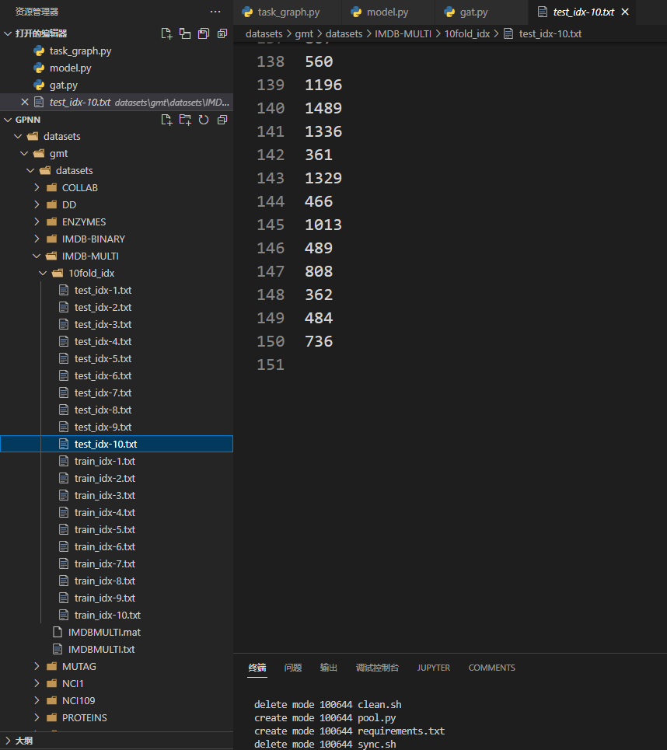
train_idx val_idx

