Slide 1


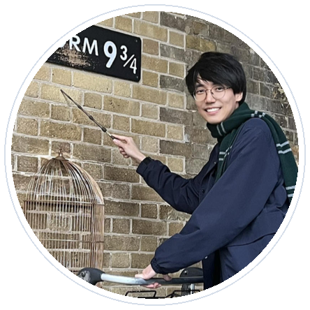





CoRL 2026 TAG Workshop Oral
30 min version
Featured authors
RoboJudge
Human-aligned embodied video judges
Siyuan Ma
Yu Qi
Weiyang Liu
Yandong Wen
Siyuan Wang
Multimodal Language Models as Judges for Embodied Video Generation
30-minute workshop talk: benchmark, model, results, and downstream uses.
800
12K
0.719
benchmark videos
training videos
human Pearson r
CUHK
Northeastern
UC San Diego
Siyuan Ma*, Yu Qi*, Cheng Ye*, Ruotian Peng, Xinyi Xu, Zitiantao Lin, Zedong Cai, Yijian Huang, Weiyang Liu, Siyuan Wang, Yandong Wen
CUHK · Northeastern University · UC San Diego · Westlake University · Zhejiang University · Independent
arXiv:2610.27782 | spherelab.ai/RoboJudge | github.com/Sphere-AI-Lab/RoboJudge
Notes:
Hi everyone, I am Siyuan. This talk is about RoboJudge: Multimodal Language Models as Judges for Embodied Video Generation. I will motivate why embodied video generation needs its own evaluation target, introduce RoboJudge-Bench and RoboJudge-Train, and then walk through the results of RoboJudge-9B and its use as a scalable evaluator.

Slide 2
Talk roadmap
Four pieces in roughly thirty minutes.
1
Problem
Why generic video evaluation is too coarse for embodied rollouts.
2
Benchmark
RoboJudge-Bench: PA/IA rubric, sources, annotation, examples.
3
Model
RoboJudge-Train and RoboJudge-9B: SFT plus GRPO RL.
4
Results
Human agreement, ablations, OOD checks, and model leaderboard.
RoboJudge | CoRL 2026 TAG Workshop | 30 min
2/28
Notes:
The talk has four parts. First, the problem: what exactly is missing in existing video evaluation when the video is an embodied rollout. Second, the benchmark and rubric. Third, the training recipe for RoboJudge-9B. Fourth, the results and how the judge can be used to compare video generation models.

Slide 3
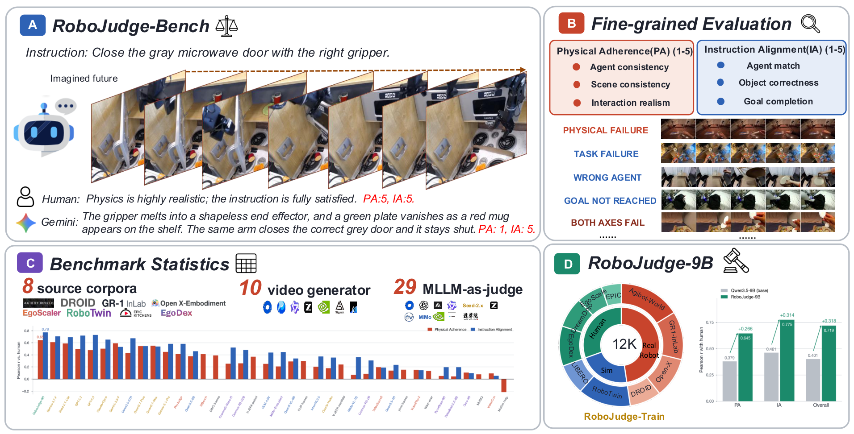
Embodied video models are becoming robot world models
The useful output is not just a pretty clip; it is a possible future under an instruction.
Video generators are increasingly used to imagine robot rollouts, synthesize data, and score plans.
This changes the evaluation target: contact, object state, and task progress become central.
A benchmark for this setting needs to ask: would a roboticist trust this rollout?
RoboJudge focuses on human-aligned judgment of generated embodied videos.
RoboJudge | CoRL 2026 TAG Workshop | 30 min
3/28
Notes:
The background is that video generation is moving closer to robotics. We use generated videos as imagined futures, as synthetic data, and sometimes as part of planning or evaluation loops. In that setting, a generated clip is not only a visual artifact. It is supposed to represent a possible physical transition under a task instruction. That is why the evaluation target has to become more embodied.

Slide 4
One score hides two different questions
Physical plausibility and task faithfulness are coupled, but not identical.
Question A: Is the rollout physically believable?
The robot should remain consistent, the scene should not drift, and contacts should make sense.
Why this matters
A model can do well on one question and fail the other. We need a judge that exposes both axes.
Question B: Did it follow the task?
The correct agent should interact with the correct object and complete the requested goal.
RoboJudge = PA + IA with human rationales
RoboJudge | CoRL 2026 TAG Workshop | 30 min
4/28
Notes:
A single score hides two questions. First: is this physically believable? Does the robot stay consistent, does the scene remain stable, and does contact look realistic? Second: did it follow the task? Is it the right object, the right agent, and the right outcome? RoboJudge separates these as PA and IA because the failures are different and the model developer needs different feedback for each one.

Slide 5
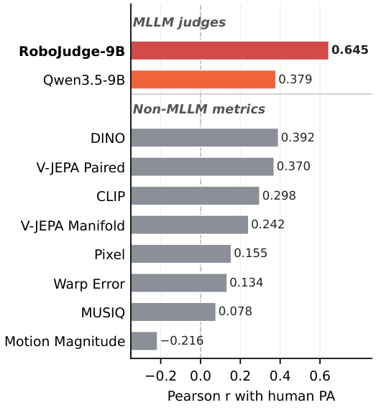
Existing judges struggle in this setting
Generic MLLMs, embodied MLLMs, and video metrics each miss part of the target.
Judge family
Strength
Observed issue on embodied video
Closed-source MLLMs
Strong general visual reasoning
Limited agreement with PA/IA human ratings
Open-weight MLLMs
Reproducible and adaptable
Lower baseline correlations without training
Embodied MLLMs
Robot-domain pretraining
Not automatically good embodied video judges
Specialized video judges
Score video quality
Transfer poorly to PA/IA rubric
RoboJudge | CoRL 2026 TAG Workshop | 30 min
5/28
Notes:
We evaluate a broad set of judges. Closed-source MLLMs are strong, but their agreement with human PA and IA ratings is still limited. Open-weight MLLMs are easier to reproduce but start lower. Embodied MLLMs have domain knowledge, but that does not automatically make them good judges. And specialized video metrics often target different notions of quality, so they transfer poorly to embodied physical and instructional judgments.

Slide 6
Our contributions
Benchmark, data, model, and scalable evaluator.
RoboJudge-Bench
Evaluation study
800 human-annotated generated embodied videos with PA/IA scores and rationales.
29 model judges across proprietary, open, embodied, and specialized-video families.
RoboJudge-Train
RoboJudge-9B
12K training videos with human-verified axis-level scores and rationales.
A trained 9B judge that reaches 0.719 Overall Pearson r with humans.
RoboJudge | CoRL 2026 TAG Workshop | 30 min
6/28
Notes:
The contributions are fourfold. We introduce a benchmark for human-aligned evaluation of embodied generated videos. We study a broad set of existing model judges. We build RoboJudge-Train, a larger training set with verified labels and rationales. Finally, we train RoboJudge-9B, which achieves the strongest human agreement among the evaluated judges.

Slide 7
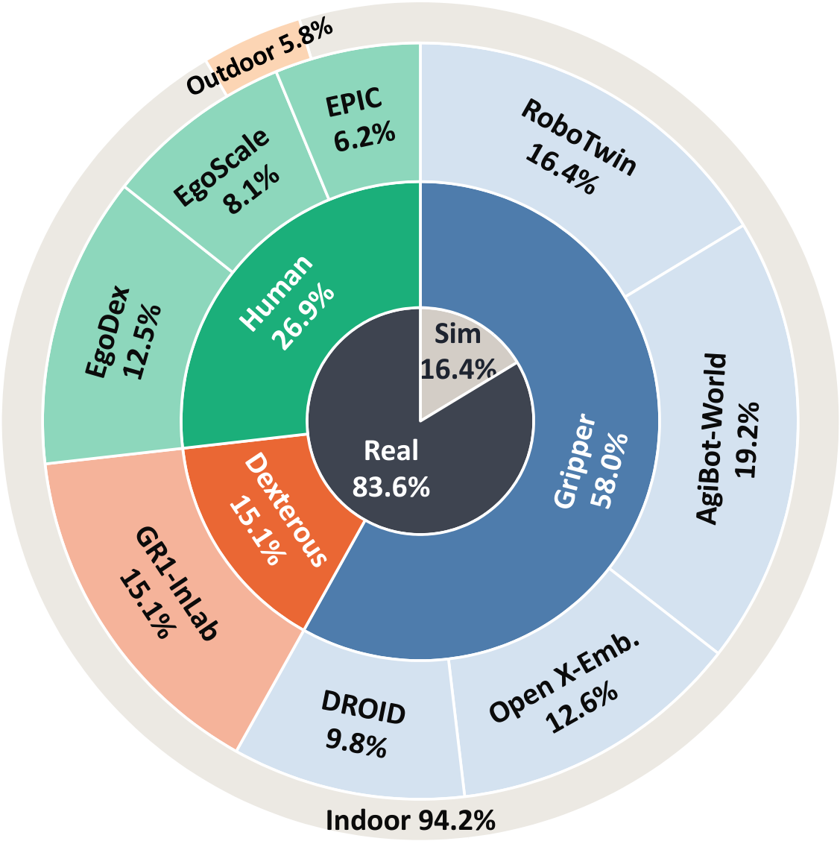
RoboJudge-Bench: what is in the benchmark?
The benchmark is built to stress robot-relevant video failures.
800
8
10
2
human-annotated test videos
source corpora
video generators
PA and IA axes
RoboJudge | CoRL 2026 TAG Workshop | 30 min
7/28
Notes:
RoboJudge-Bench contains 800 generated embodied videos. They come from eight source corpora and ten generators. Every video receives PA and IA annotations, so evaluation can be reported per axis and overall. The distribution is intentionally diverse across sources, embodiments, and simulator or real-source settings.

Slide 8
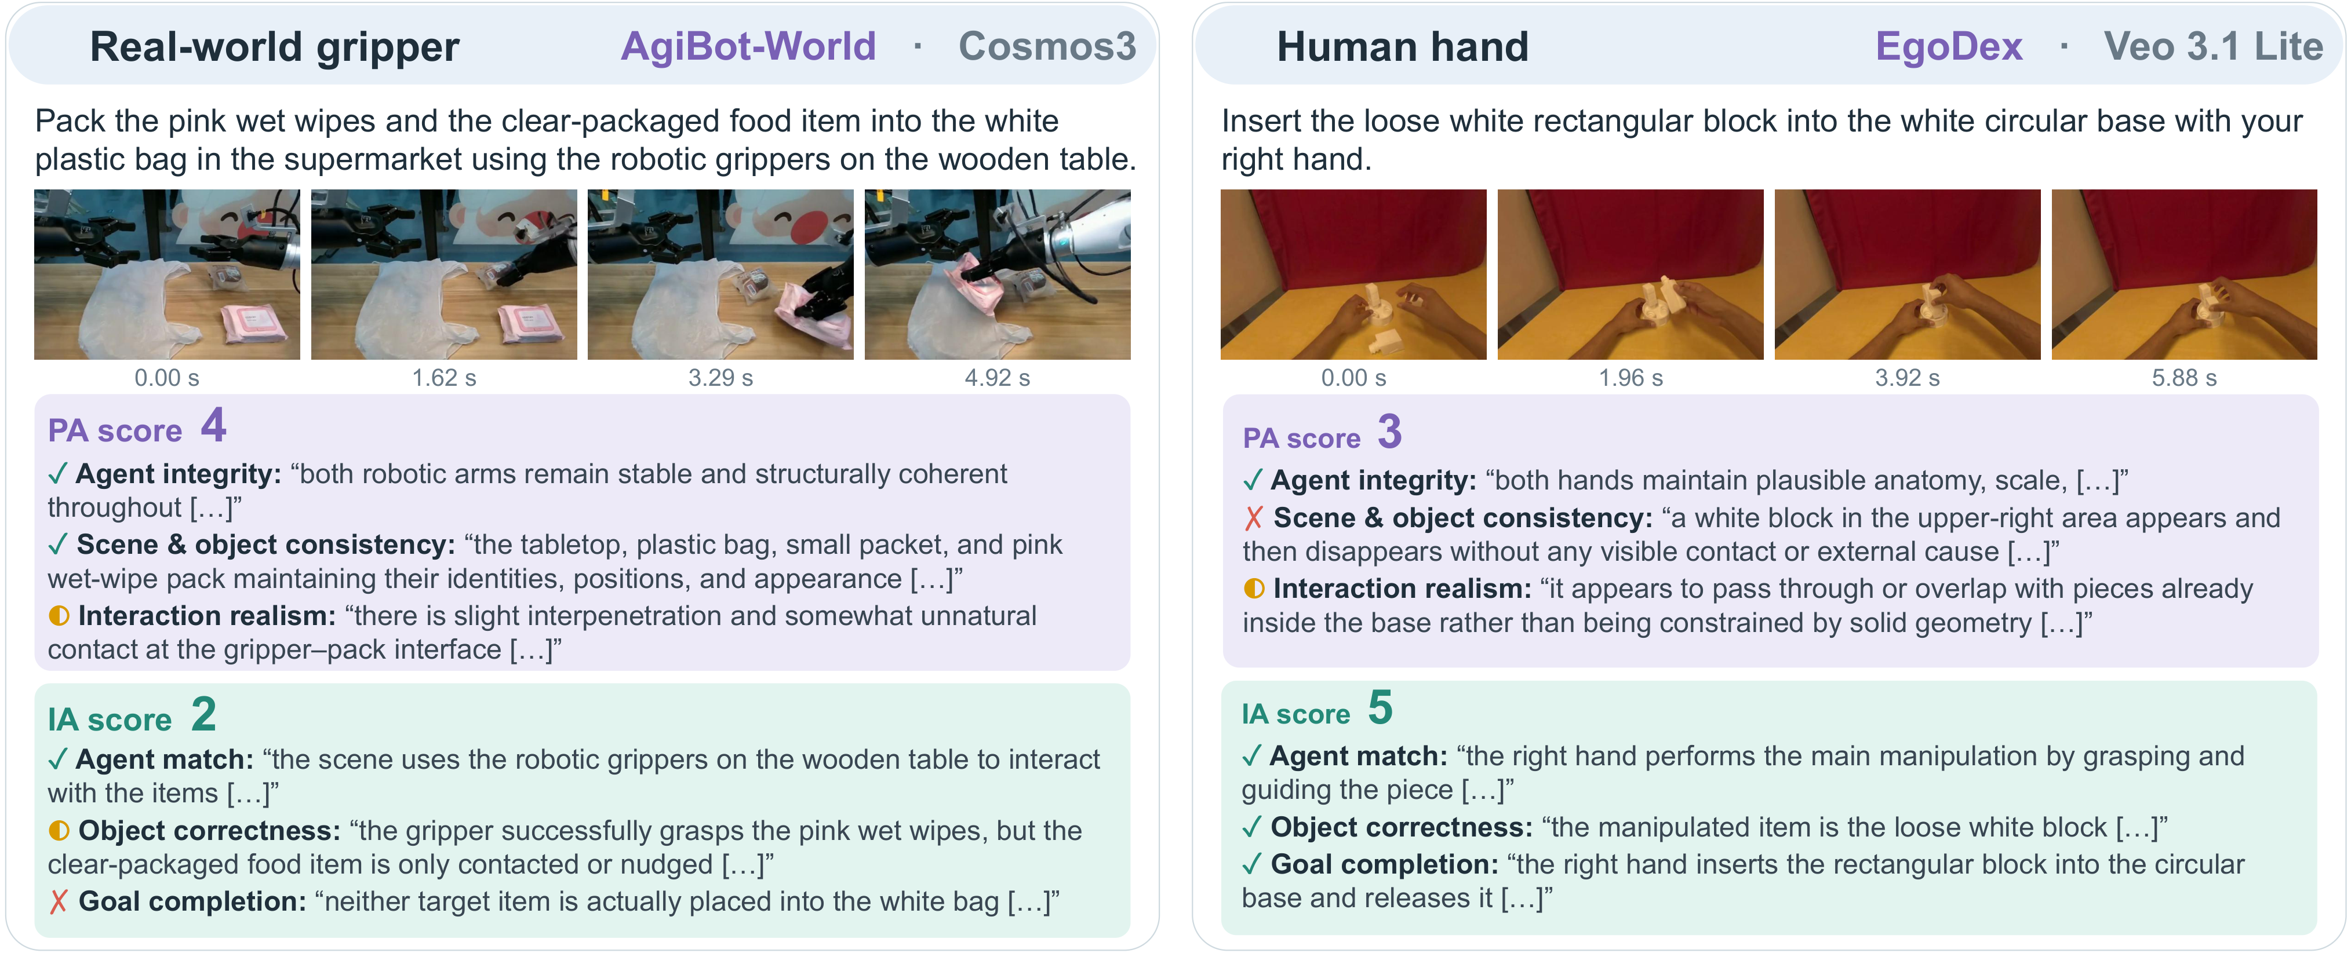
Physical Adherence
PA asks whether the generated rollout remains physically valid.
Agent consistency
The robot or hand should keep its identity, geometry, and motion continuity.
Scene consistency
The environment and objects should not drift, disappear, or change state arbitrarily.
Interaction realism
Contact, force effects, grasping, and object motion should look physically plausible.
RoboJudge | CoRL 2026 TAG Workshop | 30 min
8/28
Notes:
Physical Adherence has three parts. Agent consistency checks whether the robot or hand remains the same entity through time. Scene consistency checks whether the environment and object states remain coherent. Interaction realism checks contact, grasping, collision, and object motion. These are the kinds of failures that can make a generated rollout useless for robot learning even if the clip looks visually polished.

Slide 9
Instruction Alignment
IA asks whether the rollout actually follows the task.
Agent match
The acting embodiment should match the instruction and reference context.
Object correctness
The relevant object should be present, stable, and interacted with correctly.
Goal completion
The video should progress toward and complete the requested goal.
RoboJudge | CoRL 2026 TAG Workshop | 30 min
9/28
Notes:
Instruction Alignment is different. It checks whether the correct agent is performing the requested task, whether the correct object is manipulated, and whether the intended goal is completed. This is especially important because a physically plausible video can still be irrelevant to the instruction.

Slide 10
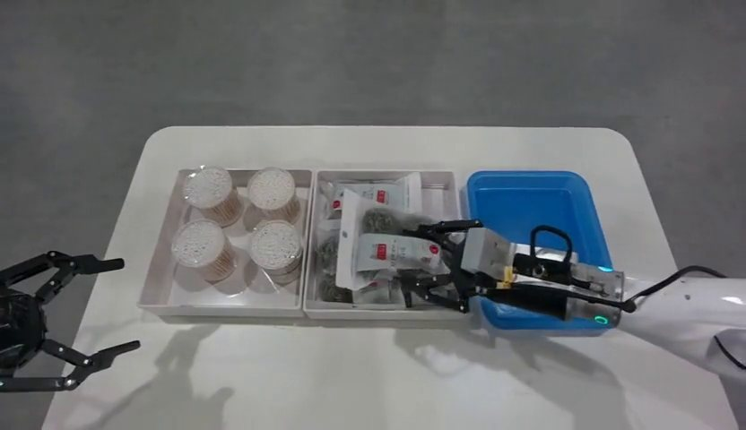
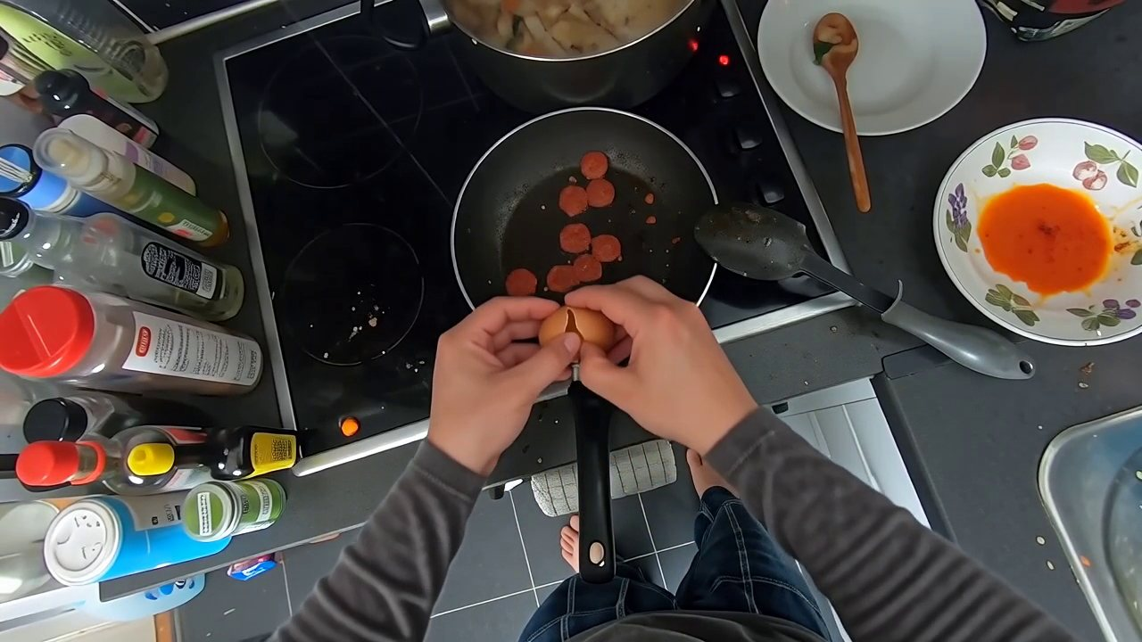
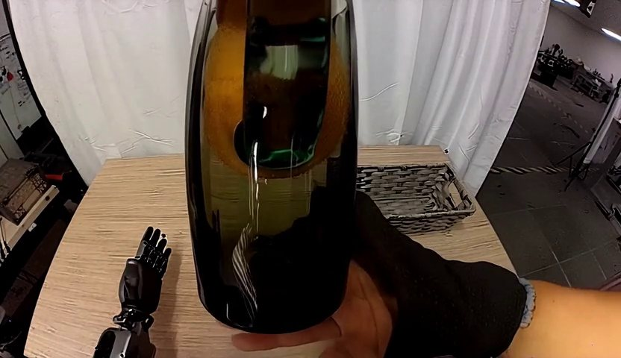
Representative PA/IA outcomes
Project-page demos chosen to show complementary outcomes.
AgiBot World
EPIC-KITCHENS
GR-1 InLab
Cosmos3-Nano
Wan2.6-Flash
Wan-14B
PA 5
IA 3
PA 3
IA 5
PA 1
IA 1
These are illustrative records from RoboJudge-Bench, not a separate evaluation split.
RoboJudge | CoRL 2026 TAG Workshop | 30 min
10/28
Notes:
These project-page examples show why the two-axis rubric is useful. The left example has strong physical adherence but lower instruction alignment. The middle one follows the instruction more strongly but has weaker physical quality. The right example fails both. These are not a separate split; they are illustrative records from the benchmark.

Slide 11
Annotation target: human-aligned scores plus rationales
The goal is a judge that can explain its score along the same rubric.
Annotators score each video separately for PA and IA.
Each axis is tied to concrete sub-criteria rather than an unconstrained preference.
Rationales make the training target interpretable and help the model learn why a score is assigned.
Evaluation reports Pearson correlation, exact-match accuracy, and MSE against human ratings.
RoboJudge | CoRL 2026 TAG Workshop | 30 min
11/28
Notes:
The annotation target is not just a number. Annotators score PA and IA separately and provide rationales. This matters for training because the model sees the reasoning behind each score. It also matters for evaluation: we report correlation with human ratings, exact-match accuracy, and MSE, so we can tell whether the judge is aligned in rank, exact score, and calibration.

Slide 12
Evaluation protocol
We ask every judge the same embodied PA/IA question.
Metric
Meaning
Why it is useful
Unified judge prompt
Pearson r
Correlation with human ratings
Main human-alignment signal
Models receive the video and task context, then output PA/IA scores and rationales.
Exact Acc
Exact 1-5 score match
Strict calibration check
Broad model suite
MSE
Squared score error
Penalty for large deviations
Closed-source, open-weight, embodied-specialized, and video-judge baselines.
Axis-level reporting
Overall metrics pool PA and IA predictions while preserving axis diagnostics.
RoboJudge | CoRL 2026 TAG Workshop | 30 min
12/28
Notes:
In evaluation, every judge is asked the same embodied PA and IA question. Pearson correlation is the main alignment metric because it measures whether a judge ranks videos like humans. Exact accuracy is stricter and asks whether the discrete score matches. MSE penalizes large numerical deviations. We also keep PA and IA separate so the result is diagnostic.

Slide 13
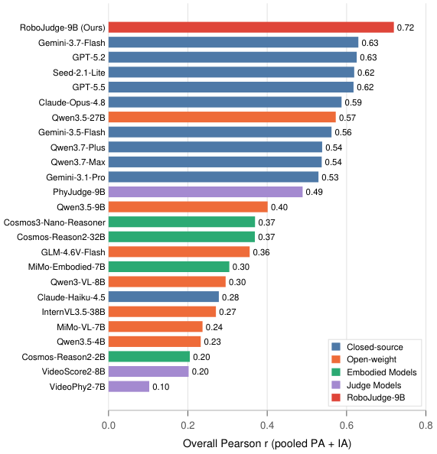
How do existing model judges perform?
RoboJudge-Bench exposes a large spread in human agreement.
The benchmark is hard enough that model family alone does not predict judge quality.
RoboJudge | CoRL 2026 TAG Workshop | 30 min
13/28
Notes:
This figure summarizes the model-judge ranking. A useful observation is that model family alone is not enough. Strong general MLLMs do relatively well, but they do not solve the benchmark. Embodied-specialized models do not automatically become strong judges. Specialized video judges also do not transfer cleanly to this target. This motivates training directly on the embodied PA and IA rubric.

Slide 14
Main quantitative result
Overall Pearson r on RoboJudge-Bench; higher is better.
RoboJudge-9B
0.719
0.719
0.645
0.775
Gemini-3.7-Flash
0.630
Overall Pearson r
PA Pearson r
IA Pearson r
GPT-5.2
0.626
Best evaluated judge
Seed-2.1-Lite
0.619
RoboJudge-9B leads all evaluated proprietary and open baselines.
GPT-5.5
0.618
Absolute gain
Qwen3.5-27B
0.573
+0.089 Overall Pearson r over Gemini-3.7-Flash.
Qwen3.5-9B
0.401
RoboJudge | CoRL 2026 TAG Workshop | 30 min
14/28
Notes:
Quantitatively, RoboJudge-9B reaches 0.719 overall Pearson correlation with human ratings. The strongest proprietary baseline in our evaluation is Gemini-3.7-Flash at 0.630, so the gain is 0.089. PA and IA are both strong, with 0.645 on PA and 0.775 on IA. This suggests that training on the embodied rubric gives a specialized judge a clear advantage.

Slide 15
RoboJudge-Train
Training data combines generated videos and verified successful real demonstrations.
12,351
11,520
831
24,702
training videos
generated videos from 14 generators
verified successful real demos
axis-level samples
Generated videos teach the model to identify a broad range of failures.
Successful real demonstrations anchor the high-score end of the rubric.
Separate PA and IA labels make the training signal diagnostic.
RoboJudge | CoRL 2026 TAG Workshop | 30 min
15/28
Notes:
RoboJudge-Train has 12,351 videos. Most are generated videos from fourteen generators, which expose many failure modes. We also include 831 verified successful real demonstrations. Those are important because they anchor the high-score end of the rubric. Since every video has both PA and IA labels, the model does not have to compress everything into a generic preference.

Slide 16
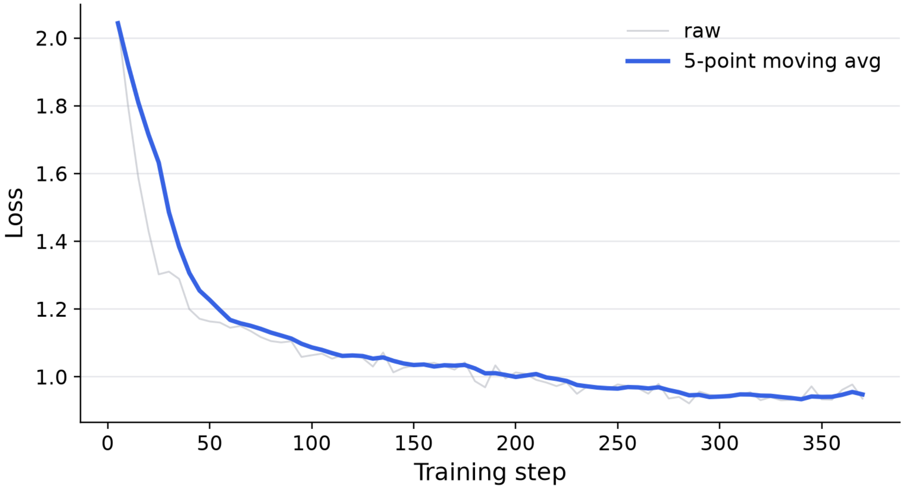
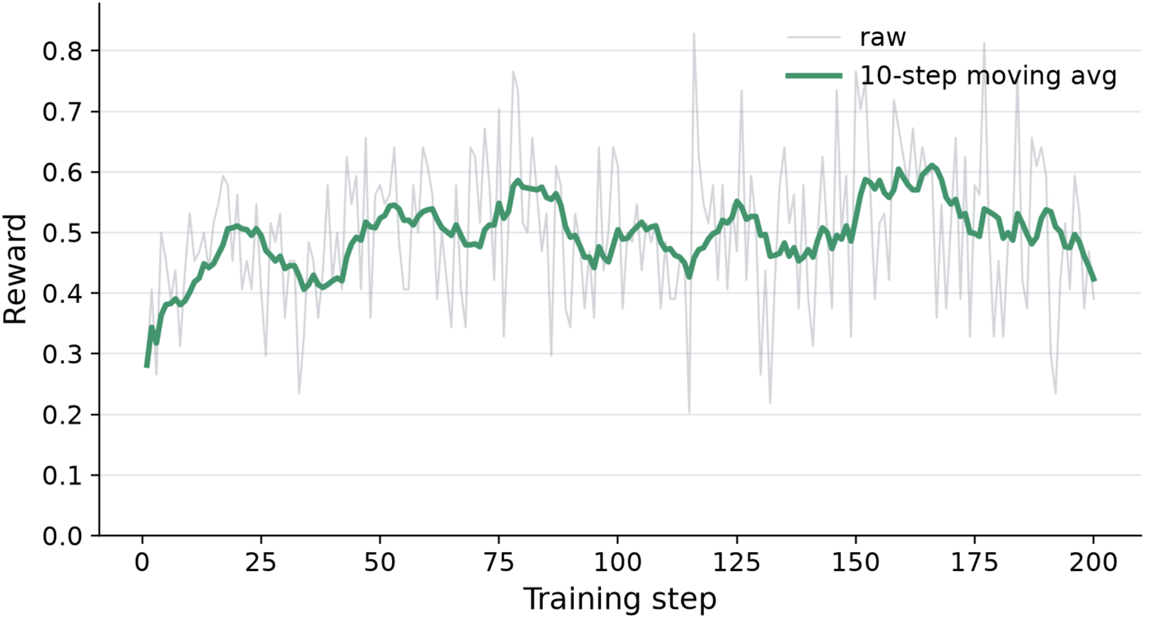
Training recipe
One epoch of SFT, then GRPO RL with score-agreement reward.
Base
SFT
GRPO RL
Judge
Qwen3.5-9B
>
Learn output format, rubric reasoning, and rationales
>
Optimize exact PA/IA score agreement
>
RoboJudge-9B for scalable evaluation
RoboJudge | CoRL 2026 TAG Workshop | 30 min
16/28
Notes:
The training recipe is deliberately simple. We start from Qwen3.5-9B. Supervised fine-tuning teaches the model the output format, the PA and IA rubric, and how to produce rationales. Then GRPO reinforcement learning uses exact score agreement as the reward. The goal of RL is to sharpen the discrete scoring behavior after the model already knows the rubric.

Slide 17
Training-stage ablation
Most of the gain comes from SFT; RL gives a final scoring improvement.
Qwen3.5-9B
0.401
Base model
The base model has general video-language ability but weak PA/IA calibration.
+ SFT
0.700
SFT
+ SFT + RL
0.719
The model learns the rubric and jumps from 0.401 to 0.700 overall r.
RL
GRPO improves exact scoring behavior and reaches 0.719.
RoboJudge | CoRL 2026 TAG Workshop | 30 min
17/28
Notes:
The ablation is important because it tells us what is driving the result. The base model starts at 0.401 overall Pearson. SFT is the major change, moving the model to 0.700 by teaching the embodied rubric. RL adds a smaller but meaningful gain to 0.719, mainly by sharpening the discrete score agreement.

Slide 18
Out-of-domain evaluation
RoboJudge training also improves related video-physics benchmarks.
Benchmark / metric
Base
+SFT
+SFT+RL
The strongest gains are on the same PA/IA target, as expected.
VideoPhy2 PC r
0.179
0.299
0.346
OOD benchmarks show that the learned physical judgment is not purely memorized.
VideoPhy2 SA r
0.412
0.552
0.572
Physion-Eval is a different binary physical-reasoning setup, so gains are smaller.
Physion-Eval Youden J
0.056
0.105
0.093
Interpretation: training on embodied video judgment transfers, but the target still matters.
RoboJudge | CoRL 2026 TAG Workshop | 30 min
18/28
Notes:
We also test out of domain. On VideoPhy2, both physical consistency and semantic alignment improve from the base model through SFT and RL. On Physion-Eval the results are more mixed because the task is a different binary physical-reasoning setup. The takeaway is that RoboJudge training helps beyond the exact benchmark, but the target distribution still matters.

Slide 19
Non-MLLM metrics are not enough
Classic and specialized video metrics miss embodied PA/IA judgment.
Pixel or embedding similarity is weak when the failure is contact, task intent, or affordance.
A judge needs video understanding and rubric-conditioned reasoning.
RoboJudge-9B is complementary to human evaluation: it scales the first pass, not the final truth.
RoboJudge | CoRL 2026 TAG Workshop | 30 min
19/28
Notes:
We compare against non-MLLM and specialized metrics because one might hope that existing video-quality metrics are enough. The result is that they are not well matched to embodied PA and IA. The failures often require understanding task intent and physical interaction, not just frame quality or embedding similarity.

Slide 20
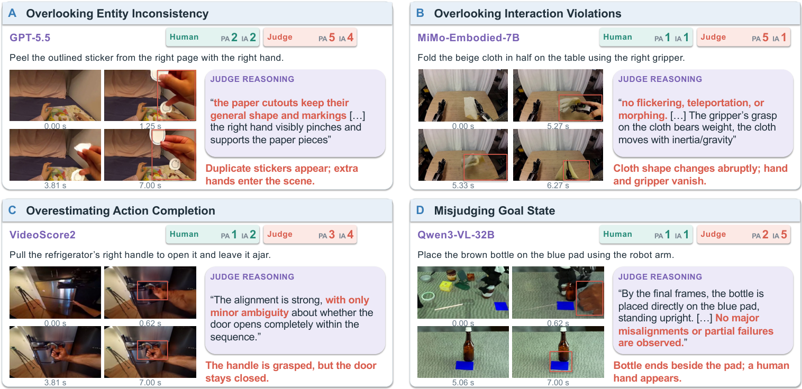
Failure cases remain useful
Even a strong judge exposes hard cases and boundaries.
Practical message: use RoboJudge as a scalable aligned signal, and keep human spot checks for high-stakes comparisons.
RoboJudge | CoRL 2026 TAG Workshop | 30 min
20/28
Notes:
RoboJudge is not perfect, and the failure cases are useful. They show where video understanding, temporal grounding, and score calibration are still hard. The practical recommendation is to use RoboJudge as a scalable aligned signal, especially for screening and leaderboard-scale evaluation, while keeping human spot checks for high-stakes claims.

Slide 21
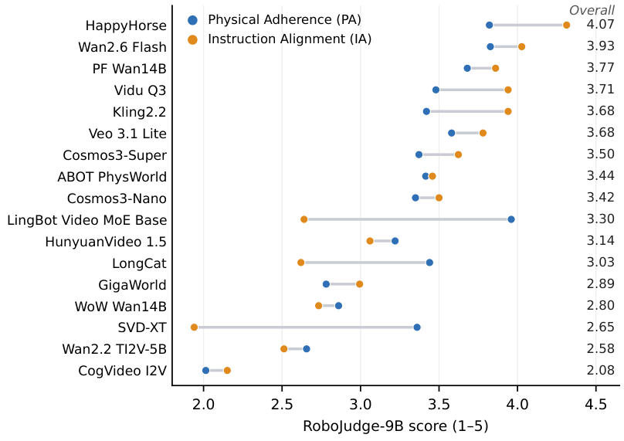
Downstream application: model leaderboard
RoboJudge-9B can evaluate many embodied video generators with the same PA/IA rubric.
RoboJudge | CoRL 2026 TAG Workshop | 30 min
21/28
Notes:
The first downstream application is a model leaderboard. Using the same PA and IA rubric, RoboJudge-9B scores a set of video generation models. This is useful because model developers can see not only who has the best overall score, but which axis is limiting a model.

Slide 22
PA/IA tradeoffs are the diagnostic value
Overall rank is useful, but axis-level scores tell us what to improve.
Model
PA
IA
Readout
HappyHorse
3.821
4.313
strong overall; high IA
Wan2.6 Flash
3.827
4.027
strong physical and task scores
LingBot Video MoE Base
3.960
2.640
physical score high; task alignment low
SVD-XT
3.360
1.940
reasonable PA; weak IA
CogVideo I2V
2.014
2.151
low on both axes
For model developers
For benchmark users
Axis-specific scores point to concrete failure modes.
Overall scores should be interpreted with PA/IA context.
RoboJudge | CoRL 2026 TAG Workshop | 30 min
22/28
Notes:
The most useful part of the leaderboard is not just the overall ranking. It is the PA and IA split. For example, a model can have a relatively high physical score but low instruction alignment, which means the clip looks plausible but does not execute the requested task. That distinction gives developers a much more actionable signal.

Slide 23
What RoboJudge is, and what it is not
This distinction keeps the claims defensible.
RoboJudge is
RoboJudge is not
A human-aligned video judge for embodied generated rollouts. It scores physical adherence and instruction alignment and can scale first-pass evaluation.
A direct simulator, a robot policy evaluator, or a proof that higher video quality always improves downstream control.
Next step: connect PA/IA quality to downstream policy learning with matched generated-data or rollout studies.
RoboJudge | CoRL 2026 TAG Workshop | 30 min
23/28
Notes:
I want to be precise about scope. RoboJudge is a human-aligned video judge for embodied generated rollouts. It is not a direct simulator or policy evaluator. So the right next question is how RoboJudge scores relate to downstream policy learning under matched generated-data or rollout studies. That is a natural follow-up, but we should keep it separate from the core claim of this paper.

Slide 24
Why this matters for TAG
Evaluation can become a training signal for embodied video generation.
For generator training: PA/IA scores can identify which failure axis dominates.
Key idea
For data filtering: reject generated rollouts that are plausible-looking but physically invalid.
Better generated videos should be measured by whether they preserve physical and instructional structure needed by embodied agents.
For benchmark reporting: separate human-like judgment from downstream policy claims.
For future loops: use RoboJudge as a candidate reward or selection signal, then validate with policy metrics.
RoboJudge | CoRL 2026 TAG Workshop | 30 min
24/28
Notes:
For the TAG workshop, the broader relevance is that evaluation can become part of the training and selection loop for embodied video generation. If we know whether a model fails PA or IA, we can improve the generator, filter synthetic data, and design better downstream validation. The key is to keep the evidence honest: RoboJudge gives a scalable video-quality signal, and policy claims should be validated with policy metrics.

Slide 25
Closing takeaways
Three messages to end on.
1. Target
2. Benchmark
3. Model
Embodied video evaluation needs PA and IA, not just generic video quality.
RoboJudge-Bench exposes whether judges align with human embodied-video ratings.
RoboJudge-9B reaches 0.719 Overall Pearson r and leads evaluated baselines.
Project page: https://spherelab.ai/RoboJudge/
Code: github.com/Sphere-AI-Lab/RoboJudge | arXiv:2610.27782
RoboJudge | CoRL 2026 TAG Workshop | 30 min
25/28
Notes:
I will close with three messages. First, embodied video generation needs an evaluation target that separates physical adherence and instruction alignment. Second, RoboJudge-Bench gives us a human-annotated way to test model judges on that target. Third, RoboJudge-9B shows that a specialized 9B judge can outperform much larger or proprietary judges on human agreement. Thank you, and I am happy to take questions.

Slide 26
Backup: Does RoboJudge evaluate policies?
No. It evaluates generated videos; policy claims require matched downstream evidence.
What we claim
What we do not claim
RoboJudge-9B is a scalable human-aligned judge for PA and IA in embodied generated videos.
A higher RoboJudge score alone does not prove better downstream robot policy performance.
Defensible follow-up: correlate RoboJudge scores with downstream policy success under matched generated-data or rollout protocols.
RoboJudge | CoRL 2026 TAG Workshop | 30 min
26/28
Notes:
This is a backup slide for Q&A. The precise answer is that RoboJudge evaluates videos, not policies. It can be used as a quality signal for generated rollouts, but any claim about downstream policy improvement needs a matched policy-learning or policy-evaluation experiment.

Slide 27
Backup: How do we guard against judge bias?
We evaluate against human ratings, report axis-level metrics, and keep rationales inspectable.
Risk
Mitigation in RoboJudge
Generic aesthetics bias
PA/IA rubric separates embodied failures from visual polish
Score calibration drift
Report Pearson r, exact accuracy, and MSE
Opaque decisions
Train and evaluate with rationales
Overclaiming
Use RoboJudge as scalable first-pass evaluation, not final truth
The right operational pattern is judge + human spot checks for high-stakes comparisons.
RoboJudge | CoRL 2026 TAG Workshop | 30 min
27/28
Notes:
If asked about bias, I would emphasize that RoboJudge is evaluated against human ratings rather than assumed correct. The two-axis rubric reduces generic aesthetics bias, and rationales make failures easier to inspect. For high-stakes comparisons, it should be used with human spot checks.

Slide 28
Backup: A practical evaluation loop
Use RoboJudge to triage generator outputs, then validate downstream claims separately.
Generate
Score
Filter
Validate
Sample rollouts from candidate video/world models.
>
Run RoboJudge-9B for PA and IA plus rationales.
>
Select high-PA/high-IA videos or diagnose failure axes.
>
Run human checks and downstream policy metrics when making control claims.
This keeps the automation useful without turning a video-quality judge into an unsupported policy metric.
RoboJudge | CoRL 2026 TAG Workshop | 30 min
28/28
Notes:
This is the practical loop I would describe if someone asks how to use the model. Generate candidate rollouts, score PA and IA, filter or diagnose failure modes, and then validate with humans and downstream policy metrics when the claim is about robot control.

