Slide 1


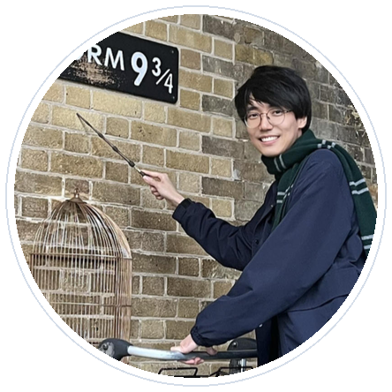





CoRL 2026 TAG Workshop Oral
5-10 min version
Featured authors
RoboJudge
Human-aligned embodied video judges
Siyuan Ma
Yu Qi
Weiyang Liu
Yandong Wen
Siyuan Wang
Multimodal Language Models as Judges for Embodied Video Generation
8-minute oral: problem, core idea, evidence, and scope.
800
12K
0.719
benchmark videos
training videos
human Pearson r
CUHK
Northeastern
UC San Diego
Siyuan Ma*, Yu Qi*, Cheng Ye*, Ruotian Peng, Xinyi Xu, Zitiantao Lin, Zedong Cai, Yijian Huang, Weiyang Liu, Siyuan Wang, Yandong Wen
CUHK · Northeastern University · UC San Diego · Westlake University · Zhejiang University · Independent
arXiv:2610.27782 | spherelab.ai/RoboJudge | github.com/Sphere-AI-Lab/RoboJudge
Notes:
Hi everyone, I am Siyuan. Today I will present RoboJudge, our work on human-aligned evaluation for embodied video generation. The short version is simple: if video generators are going to become useful world models for robotics, we need judges that understand both physics and task intent.

Slide 2
Embodied video generation needs a sharper judge
General video quality is not the same as useful robotic rollout quality.
Generated rollouts can look plausible while violating contact, agent identity, or object dynamics.
Physical Adherence
Does the video obey embodied physics and interaction constraints?
They can also be physically reasonable but miss the instruction or task goal.
For robotics, the evaluator has to separate physical adherence from instruction alignment.
Instruction Alignment
Does the agent, object, and goal match the requested task?
Human agreement
A useful judge should match trained human ratings, not only generic aesthetics.
RoboJudge | CoRL 2026 TAG Workshop | 5-10 min
2/10
Notes:
The core motivation is that embodied videos fail in ways that generic video evaluation often misses. A clip can be visually nice but physically wrong, for example by ignoring contact or changing the robot. Or it can obey physics but perform the wrong task. So we evaluate two axes: Physical Adherence and Instruction Alignment. The goal is not just to rate beauty; the goal is to match what trained humans care about for embodied rollouts.

Slide 3
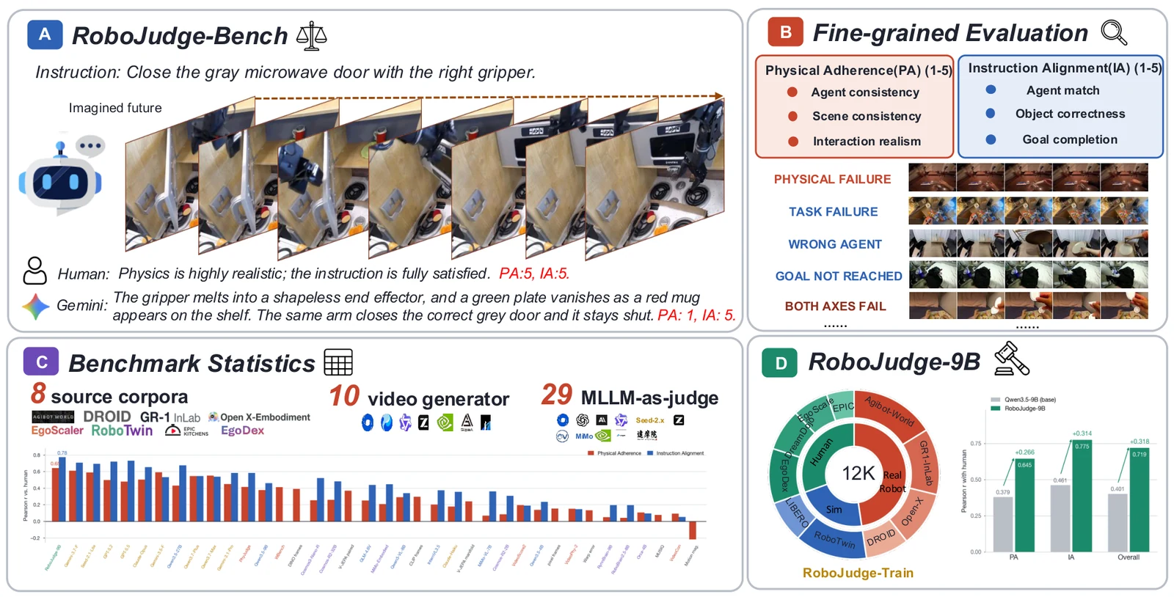
RoboJudge in one slide
A benchmark, a training set, and a 9B embodied video judge.
800
12K
29
0.719
human-annotated benchmark videos
training videos with human-verified scores
model judges evaluated
Pearson r with human ratings
RoboJudge | CoRL 2026 TAG Workshop | 5-10 min
3/10
Notes:
RoboJudge has three pieces. First, RoboJudge-Bench: 800 generated embodied videos with human ratings and rationales. Second, RoboJudge-Train: about twelve thousand videos for training an embodied-specialized judge. Third, RoboJudge-9B, trained from Qwen3.5-9B with supervised learning and reinforcement learning. The key headline is an overall Pearson correlation of 0.719 with human ratings on the benchmark.

Slide 4
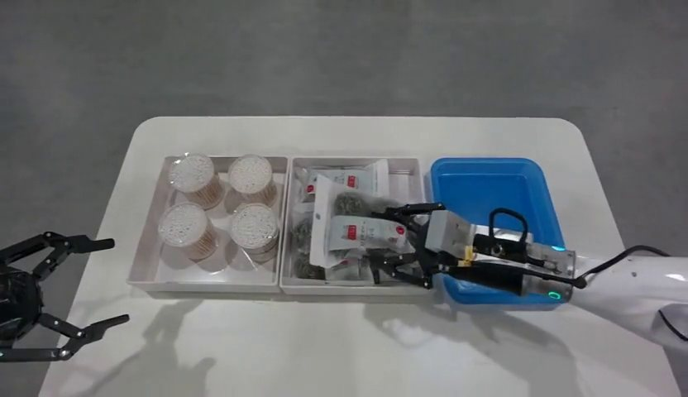
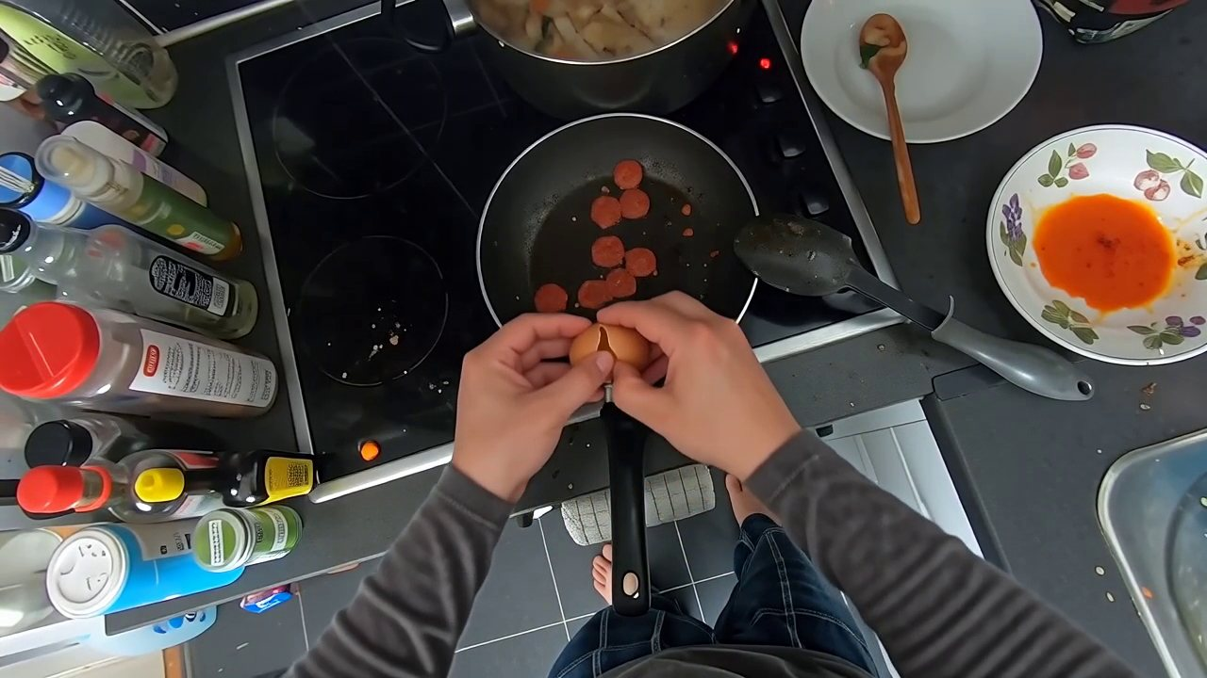
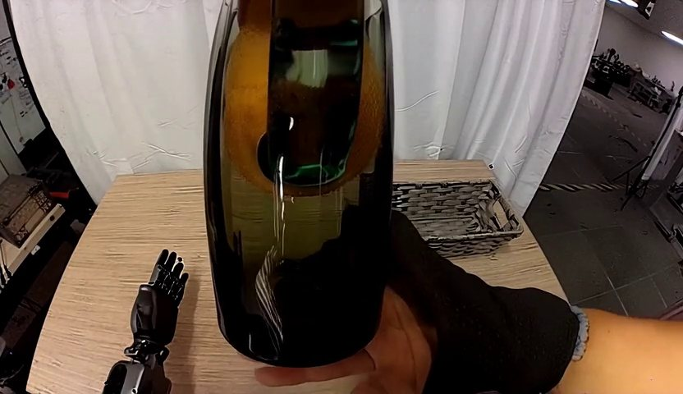
The two-axis rubric catches different failure modes
PA and IA are intentionally separated instead of collapsed into one vague score.
Axis
What it checks
Sub-criteria
PA
Physical Adherence
agent consistency; scene consistency; interaction realism
IA
Instruction Alignment
agent match; object correctness; goal completion
AgiBot World / Cosmos3-Nano
EPIC-KITCHENS / Wan2.6-Flash
GR-1 InLab / Wan-14B
PA 5 | IA 3
PA 3 | IA 5
PA 1 | IA 1
RoboJudge | CoRL 2026 TAG Workshop | 5-10 min
4/10
Notes:
The rubric separates PA and IA. Physical Adherence asks whether the agent, scene, and interactions remain physically plausible. Instruction Alignment asks whether the right agent, objects, and goal are actually followed. These examples from the project page show why this matters: PA and IA can move independently, and a single overall impression would hide that.

Slide 5
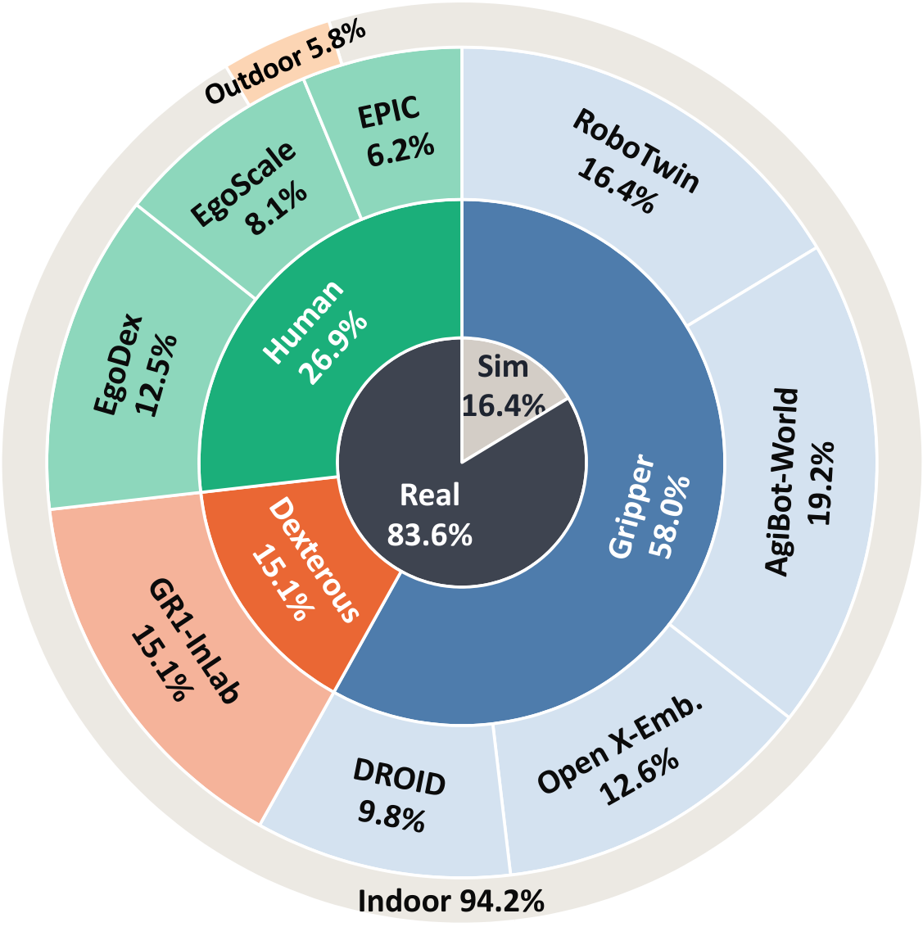
Benchmark coverage is embodied, not generic video
RoboJudge-Bench spans sources, embodiments, generators, and real/sim settings.
8 source corpora
Robot, hand, and human-object interaction video sources.
10 video generators
General, world-model, and embodied generation systems.
Embodiment diversity
Grippers, dexterous humanoids, and human hands.
Sim and real
131 simulated and 669 real-source videos in the benchmark.
RoboJudge | CoRL 2026 TAG Workshop | 5-10 min
5/10
Notes:
RoboJudge-Bench is designed around embodied video rather than generic internet clips. It covers eight source corpora and ten video generators, including different embodiments such as grippers, dexterous hands, and human hands. The point is to expose a judge to the kinds of contact, manipulation, and task-following failures that matter in robot settings.

Slide 6
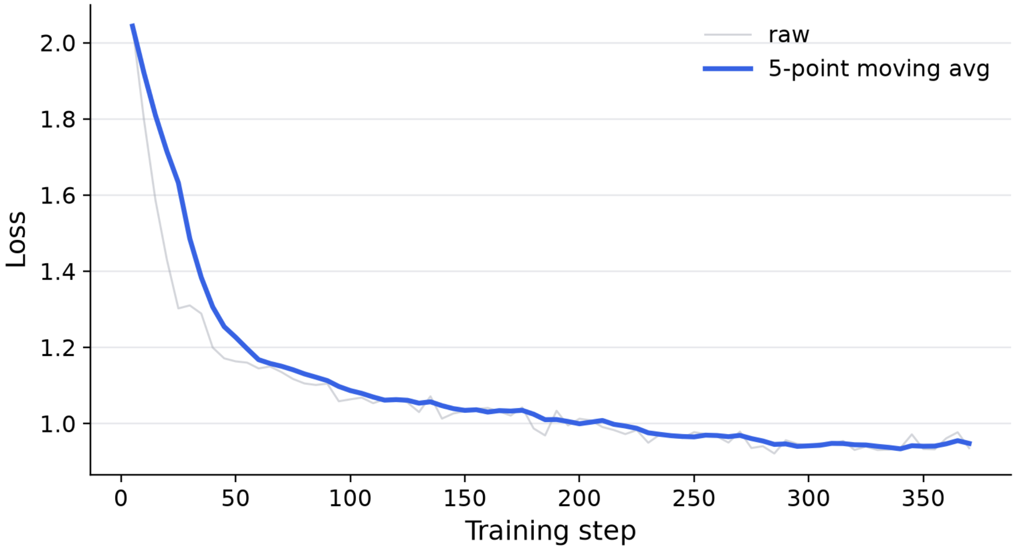
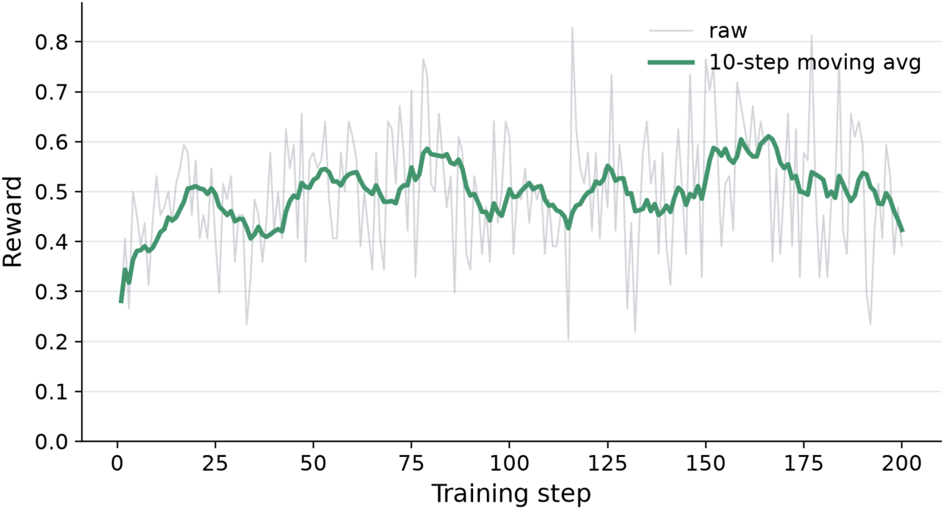
Training RoboJudge-9B
Supervised rationale learning followed by score-agreement RL.
RoboJudge-Train
Base
SFT
GRPO RL
>
Qwen3.5-9B
video MLLM backbone
>
Learn rubric reasoning
and score format
>
Reward exact-score
agreement
12,351 videos
24,702 axis-level samples
RoboJudge | CoRL 2026 TAG Workshop | 5-10 min
6/10
Notes:
The model starts from Qwen3.5-9B. We first use supervised fine-tuning so the model learns the rubric, rationales, and score format. Then we apply GRPO reinforcement learning with a direct score-agreement reward. The training set has over twelve thousand videos and two axis-level labels per video, so the model learns PA and IA explicitly instead of inferring a generic quality score.

Slide 7
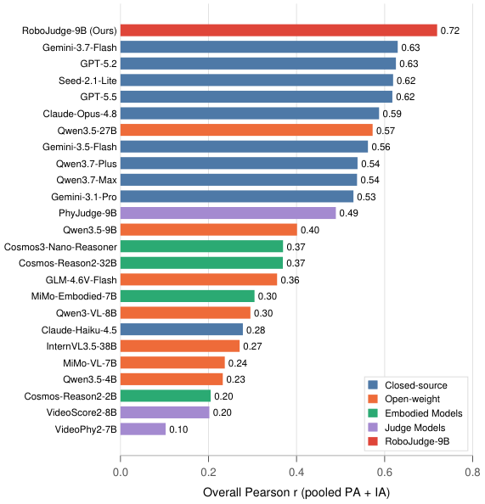
RoboJudge-9B agrees best with human ratings
Overall Pearson r on RoboJudge-Bench; higher is better.
RoboJudge-9B
0.719
+0.089
0.645
0.775
Gemini-3.7-Flash
0.630
absolute gain over strongest proprietary baseline
PA Pearson r
IA Pearson r
GPT-5.2
0.626
Seed-2.1-Lite
0.619
GPT-5.5
0.618
Qwen3.5-9B
0.401
RoboJudge | CoRL 2026 TAG Workshop | 5-10 min
7/10
Notes:
The main result is that RoboJudge-9B reaches 0.719 overall Pearson correlation with human ratings. In our evaluation, the strongest proprietary baseline is Gemini-3.7-Flash at 0.630, so the absolute gain is 0.089. The split is also useful: PA is 0.645 and IA is 0.775, which tells us the model is learning both physical and instruction-level judgments.

Slide 8
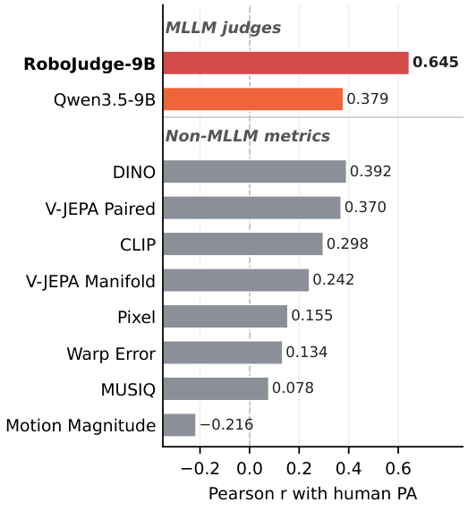
SFT gives the jump; RL sharpens the judge
Ablation on Overall Pearson r, plus out-of-domain checks.
Qwen3.5-9B
0.401
OOD benchmark
Base
+SFT
+SFT+RL
VideoPhy2 PC r
0.179
0.299
0.346
+ SFT
0.700
VideoPhy2 SA r
0.412
0.552
0.572
Physion-Eval J
0.056
0.105
0.093
+ SFT + RL
0.719
Specialized video metrics do not transfer cleanly to embodied PA/IA.
RoboJudge remains a judge of video quality, not a direct robot policy evaluator.
RoboJudge | CoRL 2026 TAG Workshop | 5-10 min
8/10
Notes:
The ablation shows where the gains come from. The base Qwen3.5-9B model is at 0.401. Supervised training moves it to 0.700, which is the major jump. RL further improves it to 0.719. We also test out-of-domain behavior on VideoPhy2 and Physion-Eval. The gains are smaller but generally positive. A careful wording point: RoboJudge evaluates generated video quality; it is not itself a simulator or policy evaluator.

Slide 9
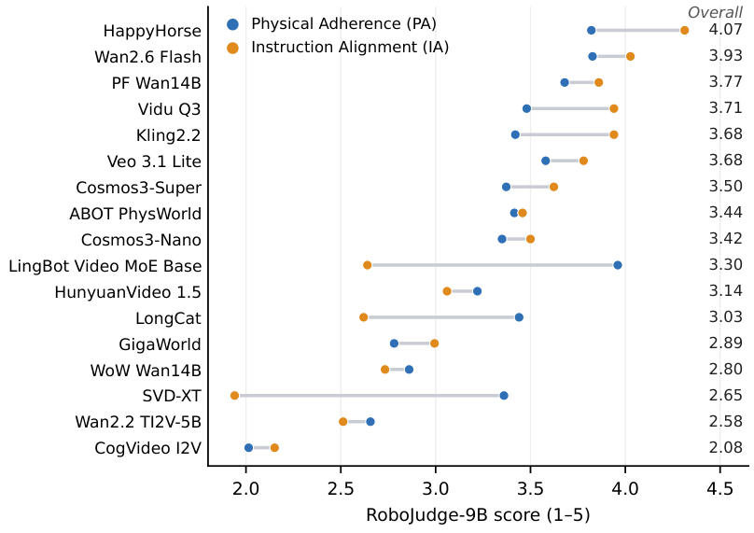
A downstream use case: ranking embodied video generators
RoboJudge-9B can scale PA/IA evaluation across model submissions.
Model
PA
IA
Overall
HappyHorse
3.821
4.313
4.067
Wan2.6 Flash
3.827
4.027
3.927
PF Wan14B
3.680
3.860
3.770
Vidu Q3
3.480
3.940
3.710
Cosmos3-Super
3.372
3.623
3.497
Wan2.2 TI2V-5B
2.656
2.512
2.584
CogVideo I2V
2.014
2.151
2.082
PA and IA expose different strengths: a model can be more physical than task faithful, or vice versa.
The leaderboard is an example of scalable evaluation, not a replacement for task-specific robot trials.
RoboJudge | CoRL 2026 TAG Workshop | 5-10 min
9/10
Notes:
Once the judge is aligned to humans, one immediate application is scalable evaluation of video generation models. The leaderboard shows PA, IA, and overall scores. Importantly, the two axes reveal tradeoffs. Some models are physically more stable but less task-aligned, while others follow the task better but have weaker physical dynamics. This gives developers a more actionable signal than a single generic video-quality number.

Slide 10
Takeaways
What I want you to remember from the short talk.
1. Evaluation target
2. Evidence
3. Result
Embodied video needs PA and IA, not only aesthetics or text-video matching.
General MLLMs and specialized video judges are not reliably human-aligned here.
RoboJudge-9B reaches 0.719 Pearson r and leads the evaluated judges.
Project page: https://spherelab.ai/RoboJudge/
Code: github.com/Sphere-AI-Lab/RoboJudge | Model + dataset: Hugging Face
RoboJudge | CoRL 2026 TAG Workshop | 5-10 min
10/10
Notes:
To close, the main message is that embodied video generation needs evaluation that understands both physics and task intent. RoboJudge-Bench gives us a testbed for that. RoboJudge-Train lets us train a specialized judge. And RoboJudge-9B reaches the best human agreement among the judges we evaluated. Thanks, and I would be happy to discuss how to connect this more tightly to downstream robot policy learning.

