Slide 1
ECE 8405 Final Project Design and Implementation of Hyperdimensional Computing for Cardio Classification
Richard Wang
Sizhe Zhang
Yujia Zhang

Slide 2
Background & Dataset overview
HDC RTL design and implementation with Design space exploration
Conclusion & Future Work

Slide 3
Cardio Dataset Overview
UCI Cardio dataset aiming at classifying measurements of fetal heart rate (FHR) and uterine contraction (UC) features into 10 classes. It has a total of 2126 fetal cardiotocograms (CTGs) signals. The 2126 fetal cardiotocograms (CTGs) were automatically processed and the respective diagnostic features measured. The CTGs were also classified by three expert obstetricians and a consensus classification label assigned to each of them. In this application, we use 1913 samples for training and 213 samples for testing.
There’s tons of model tested on CARDIO dataset on OpenML, the different prediction accuracy distributed from 10% using random forest -> 90% using SVM.
In our project, we first tested our algorithms using python then deployed using system Verilog. Then we used model-sim to validate our design.
[1] https://www.openml.org/t/9979

Slide 4
Cardio Dataset Features
# of feature values
48
20
102
16
16
2
6
75
57
87
249
154
109
86
18
9
88
103
95
133
3
LB - FHR baseline (beats per minute) AC - # of accelerations per second FM - # of fetal movements per second UC - # of uterine contractions per second DL - # of light decelerations per second DS - # of severe decelerations per second DP - # of prolonged decelerations per second ASTV - percentage of time with abnormal short-term variability MSTV - mean value of short-term variability ALTV - percentage of time with abnormal long-term variability MLTV - mean value of long-term variability Width - width of FHR histogram Min - minimum of FHR histogram Max - Maximum of FHR histogram N-max - # of histogram peaks N-zeros - # of histogram zeros Mode - histogram mode Mean - histogram mean Median - histogram median Variance - histogram variance Tendency - histogram tendency

Slide 5
Background & Dataset overview
HDC RTL design and implementation with Design space exploration
Conclusion & Future Work

Slide 6
Dataflow for Hyperdimensional Computing Hardware Design
Testbench
Encoding Module
Distance Check Module
Record-based/Permutation
Encoding
Encoded Hyper vector
Data
Distance Calculator 1
Initial/Reset Modules
Parallelized
Cosine Similarity /Hamming Distance Module
…
Level
HV
ID HV
Distance Calculator 10
Open Training/Testing Dataset
Encoded Hyper vector
Encoded Hyper vector
Associate Memory Module
Read/Transfer ASCII code
Send to module
Binary/Integer Class HV 1
…
Binary/Integer Class HV 10

Slide 7
HDC
Control Signal for Hyperdimensional Computing Hardware Design
dataReady
Associate Memory
Encoding Module
Inputdata
dataDone
argmax
Distance Check
distance
index
computeDis
bestMatchID
clk
testdone
rst_Encoding
rst

Slide 8
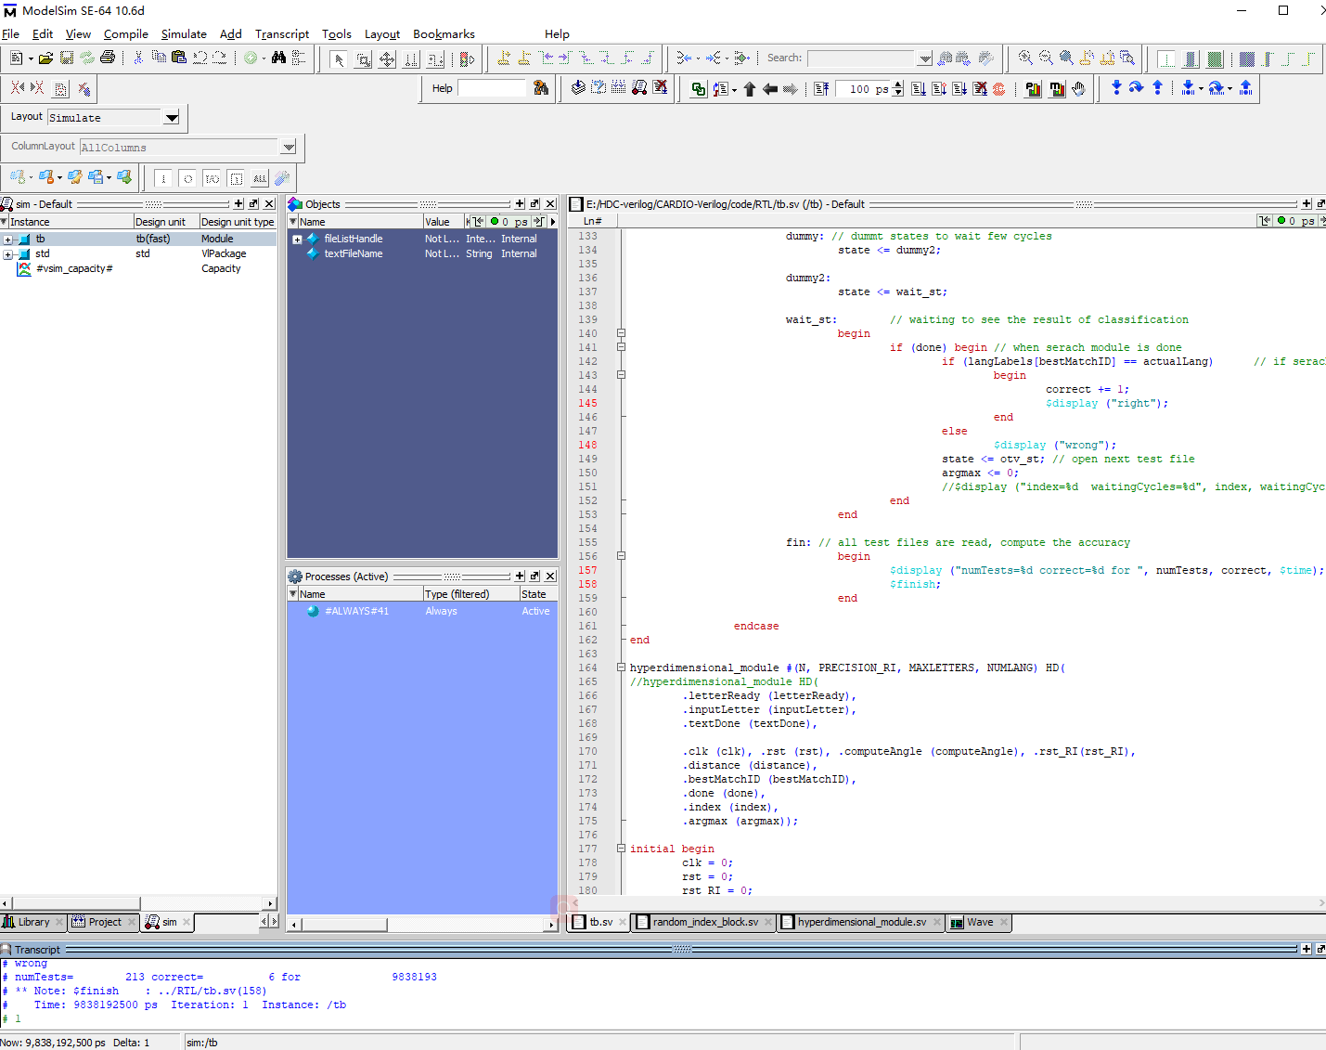
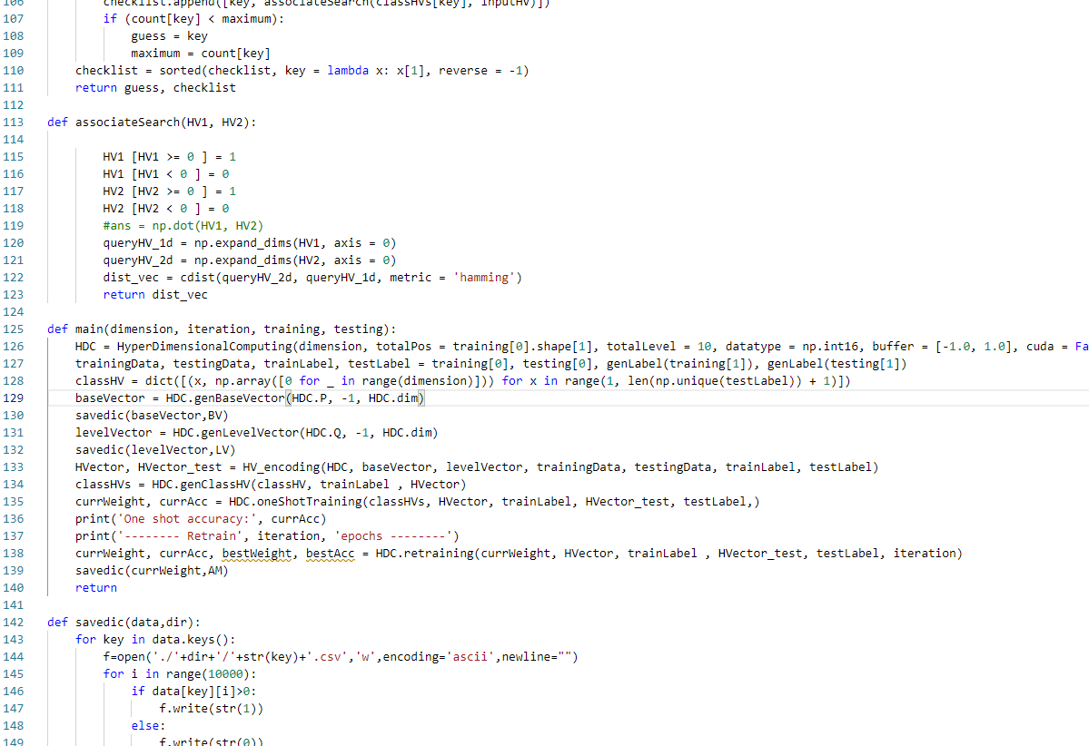
Experiment Environment and Data Preprocess
System Verilog
ModelSim 10.6d
We run the algorithm on both Python code and Verilog code, which give us similar result with binarized hyper vector.
Preprocessed the training and testing data to level number
10 level for each feature
Use integer level number in both training/testing dataset.
Record-based Encoding / Permutation Encoding

Slide 9
Data preprocessing
We did data preprocessing before dumping into our module. For each feature vector with 23 features, we split the min value to max value into 10 levels and fit the corresponding data value.
The output is a same length vector with value in [0, …, 9].
L max
L max
L max
L max
L max
L max
L min
L min
L min
L min
L min
L min
id 0
id 1
id 2
id 20
id 21
id 22

Slide 10
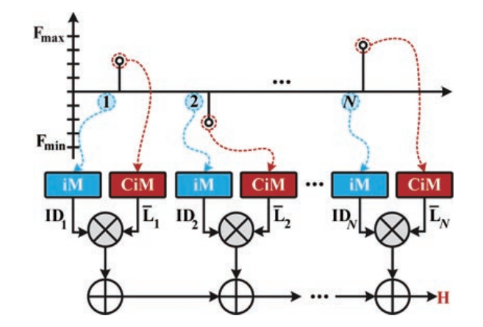
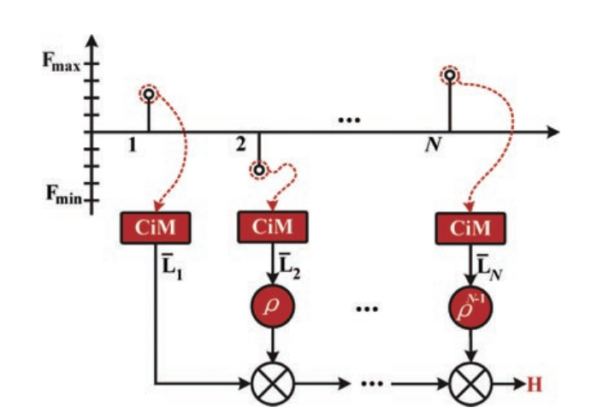
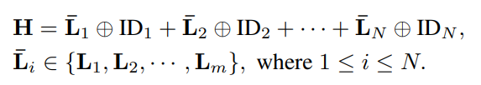
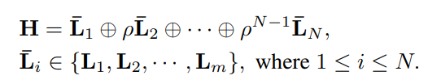
Encoding strategy
ID-based Encoding
Permutation Encoding
[1] Ge, Lulu and Parhi, Keshab K. Classification Using Hyperdimensional Computing: A Review

Slide 11
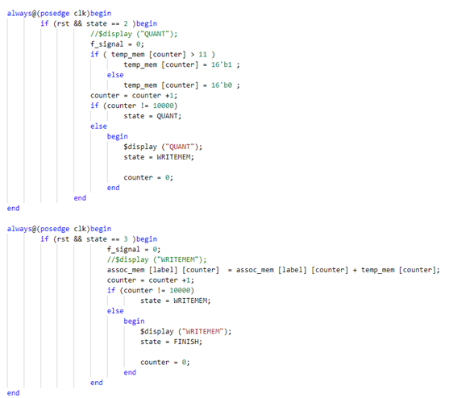
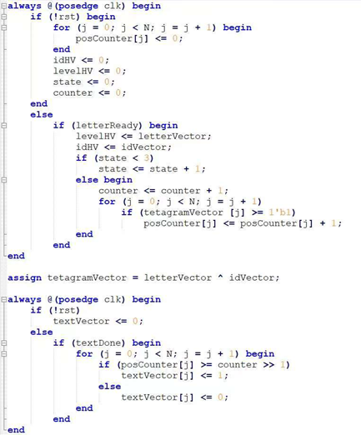
HDC Encoding & training

Slide 12
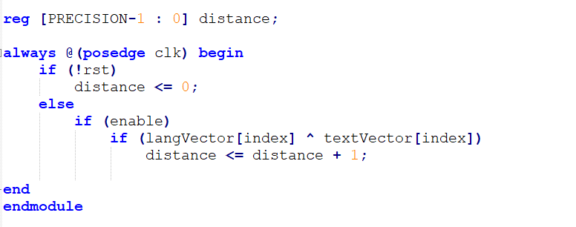
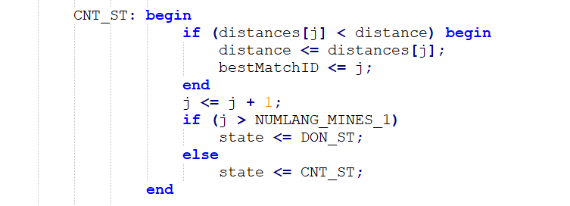
HDC inference
We use hamming distance as our similarity check.

Slide 13
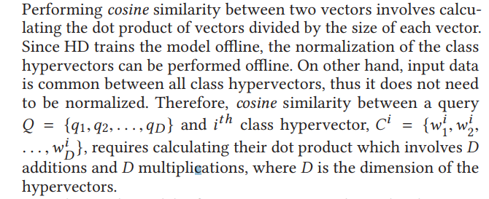
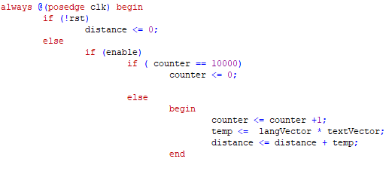
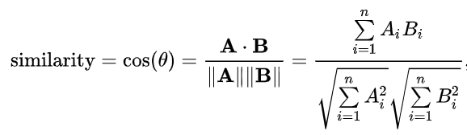
HDC
Cosine Similarity Module
Square calculation is costly.
Able to skip the normalization part especially for hyper vectors.
FACH -ASPDAC’19
Cosine similarity
Verilog Code

Slide 14
Experiment Result
We tested both python code and Verilog code on CARDIO using same configurations and our experiment result shows as following. One observation is that binarized hypervectors are not sufficient for CARDIO dataset classification.
We explored two kinds of Encoding methods, id encoding and permutation encoding; meanwhile we also tested two kinds of similarity check metrics, hamming distance and cosine distance, the experiment result shows as following.
One solution is that we can employ bipolar level/position hyper vector to generate integer-based class hyper vectors combined with retraining to get an acceptable accuracy.

Slide 15

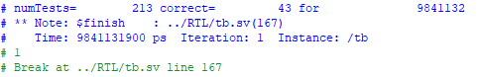

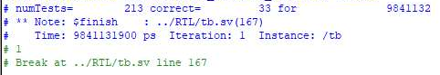
Experiment Result
Accuracy (System Verilog) | Record-based | Permutation
Cosine Similarity | 15.5% | 22.1%
Hamming Distance | 20.2% | 2.8%
Accuracy (Python) | Binary | Integer
 | 22.1% | 53.5% (91.2% with retraining)

Slide 16
Background & Dataset overview
HDC RTL design and implementation with Design space exploration
Conclusion & Future Work

Slide 17
Conclusion
In this project. We implemented Hyper dimensional computing on RTL level for CARDIO. Though we did not get a useable accuracy because off using binarized hyper vector, as the binarized hyper vector loss a large amount of data information. Which cause the HDC can not function well.
But on other hand, we build a complete framework for HDC with different encoding methods and distance calculation methods , which can be expended to other datasets and non-binarized form in the feature.

Slide 18
Future work
HDC performance improvement:
We can use a bipolar encoding approach instead of binary encoding. In python simulation, bipolar encoding gives us 2 times accuracy than binary encoding approach, but bipolar encoding takes 16 times or 32 times memory consuming, as we use only 10000 bits for each binary hypervector.
We can also employ a retraining method to increase the accuracy of model, which gives us 40% accuracy improvement than one-shot learning.

Slide 19
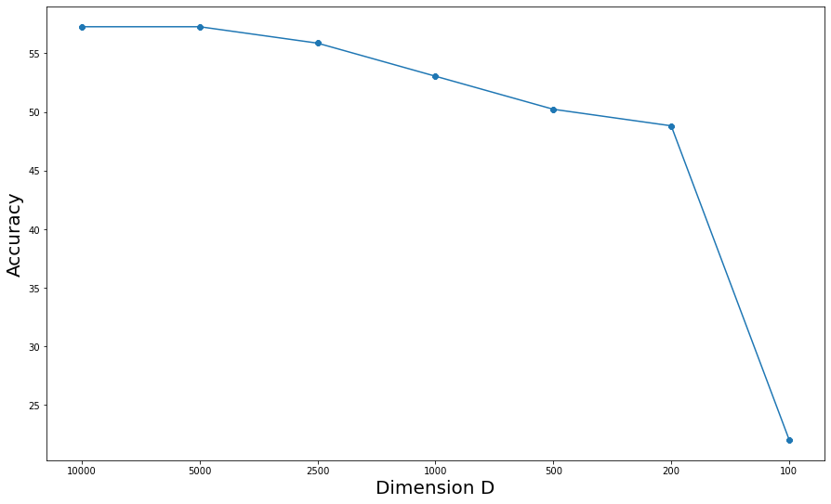
Future work
HDC hyper-parameter fine-tuning:
In HDC, the hypervectors are defined by several parameters, like dimension D, encoding level M, and the quantization like [-1, 1] or [0, 1].
Here’s a curve shows the relationship between dimension of bipolar hypervector and oneshot accuracy. The first two points show that we can halve the memory by decrease dimension from 10000 to 5000 without losing accuracy.

