Slide 1
Multi-Modal Image Retrieval System
Siziphiwe Topo

Slide 2
What is the Multi-Modal Image Retrieval System
A system that allows users to search for images by typing text descriptions.
The system uses Natural Language Processing (NLP) to understand text and Image Processing to analyze the images.
It matches the best images with the given description from a dataset.

Slide 3
How Does the System Work?
1. User Query: The user types a text description (e.g., ‘A House’ or ‘Food’).
2. Text Understanding: The system processes the text using NLP models to understand the query.
3. Image Analysis: The system processes images to extract features using image models.
4. Image Matching: The system compares the features from both text and images.

Slide 4
Key Components?
NLP Model: Analyses and understands the text description.
Image Processing Model: Analyses images and extracts features.
Matching Algorithm: Compares text and image features.
User Interface (UI): Allows users to input queries and view results.

Slide 5
Example:
User Input:
Text query: ‘A house.'
Step 1: The system processes the text using NLP to extract meaningful features.
Step 2: The image dataset is processed using image models to extract visual features.
Step 3: The system matches text features with image features.
Step 4: The top K matching images are shown to the user.

Slide 6
Technologies Used?
PyTorch: Deep learning lib for tensor operations and model interface.
Transformers: Hugging face lib to work with CLIP and other NLP models.
CLIP: A retrieval model that links text description and images.
FAISS: For finding similarities in a big vector dataset.
PIL: A lib for image processing, allows you to open and work with images.
Torchvision: Offers image modifications and pre-trained models.
NumPy: Numerical array handling lib.
Matplotlib: For showing the top k obtained images.
Ipython Widgets: Creating interactive widget for user input and display.
Front-end Interface: Built with HTML, CSS, and JavaScript.

Slide 7

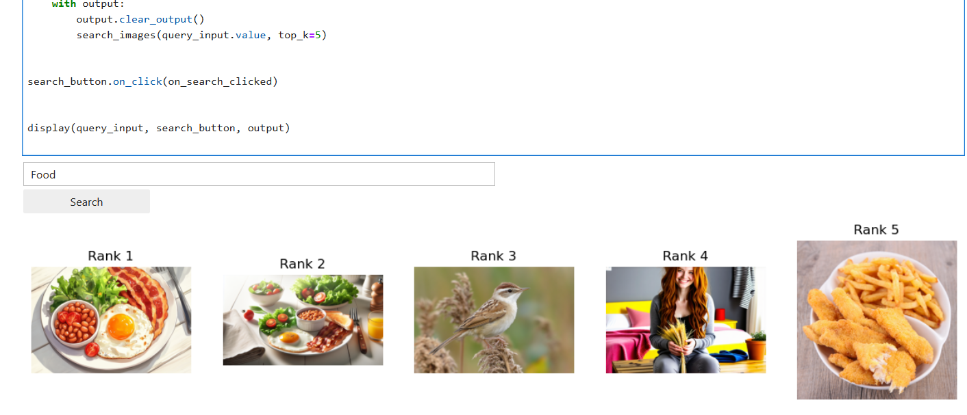
DEMO

Slide 8
Challenges:
Accurate query understanding, especially for complex descriptions.
Handling large datasets and ensuring fast retrieval.
Future Work:
- Improve accuracy with more advanced models.
- Support multi-lingual queries and other enhancements.

Slide 9
Summary
Image search application using the CLIP (Contrastive Language-Image Pre-training) model. It takes a text query as input and searches for images in a database that match the query. The code uses the Hugging Face Transformers library to load the pre-trained CLIP model and process the text query. It then uses the FAISS library to index the image embeddings and perform efficient similarity searches. The code also includes a simple UI using Jupyter widgets to input the text query and display the search results. The search results are displayed as a gallery of images with their corresponding captions.

