Slide 1

VashaShikkha
Group-04
1705007,1705013,1705018,1705021,1705023,1705025

Slide 2
Proposed Modules of VashaShikkha
Registration
Login
Lesson
Dictionary
Flashcard
Admin
Leaderboard
Pronunciation
Retry Wrong Attempts
Notification
Level Based test
Entry Test

Slide 3
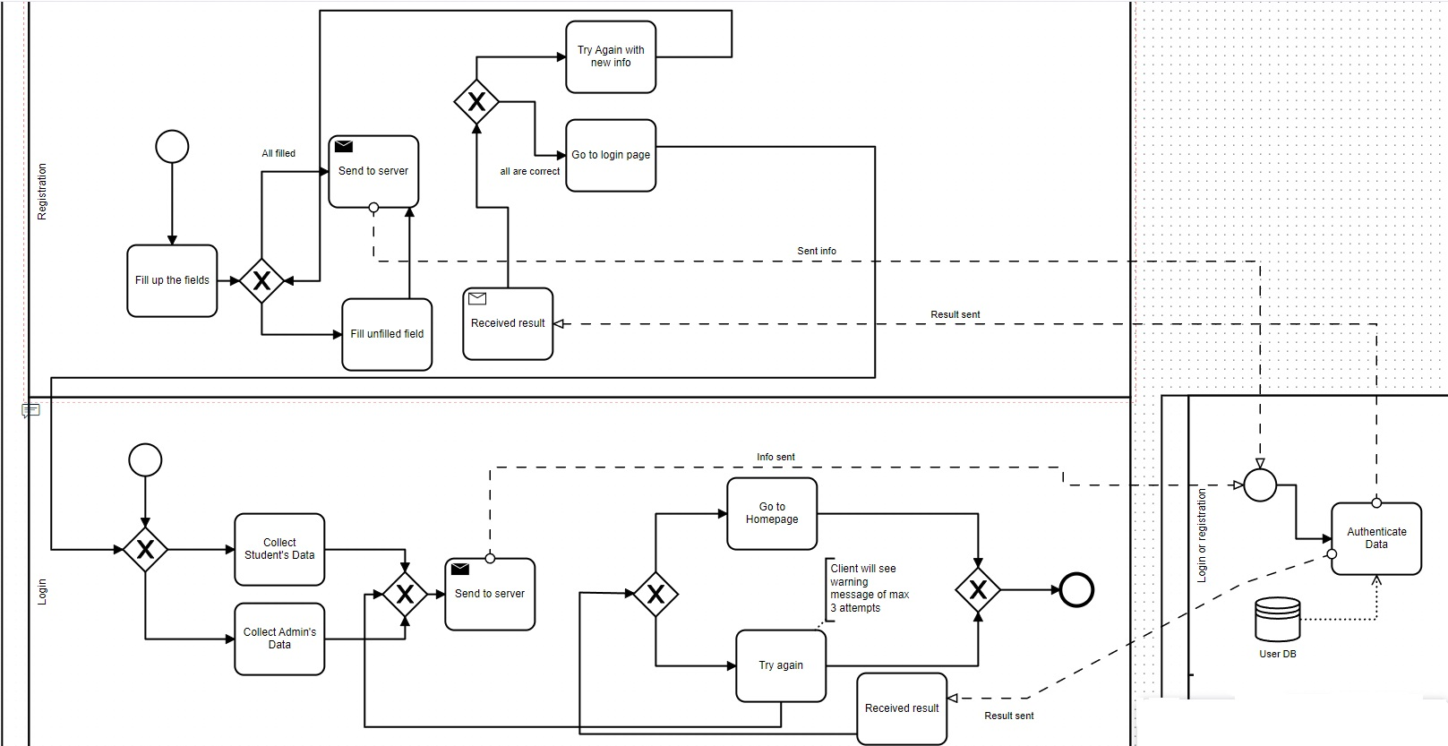
Registration & Login

Slide 4
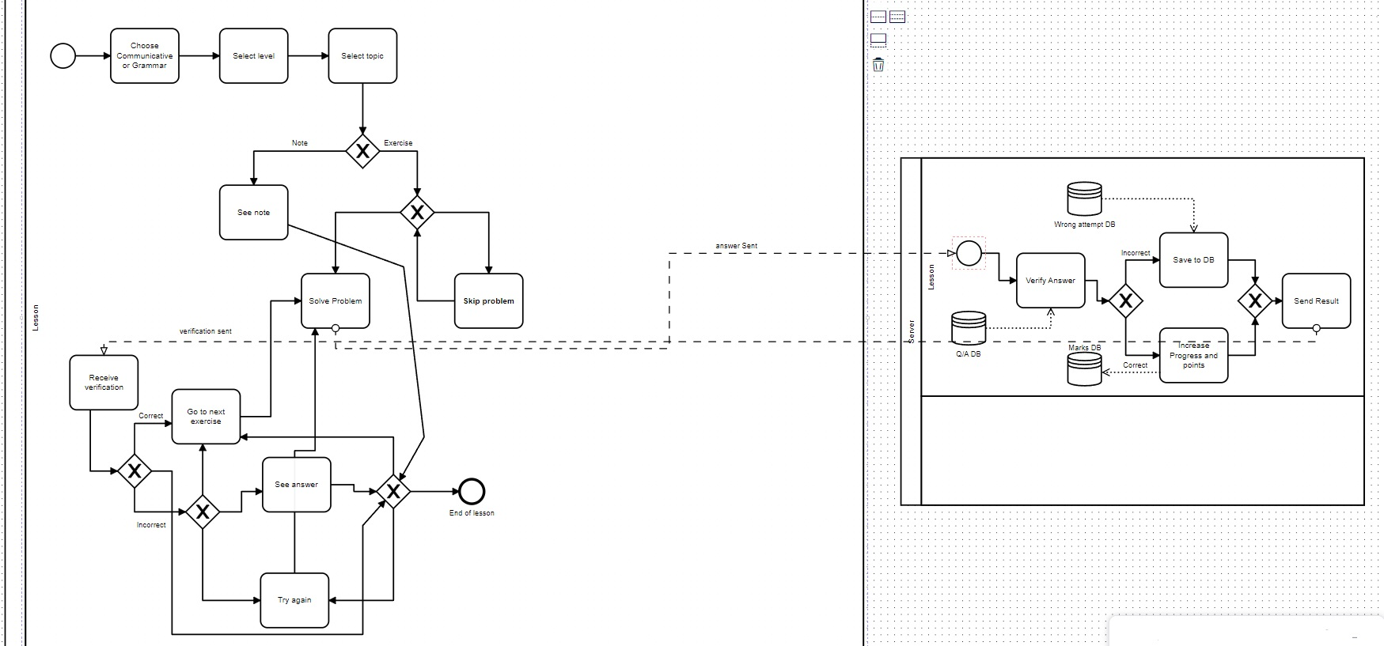
Lesson

Slide 5
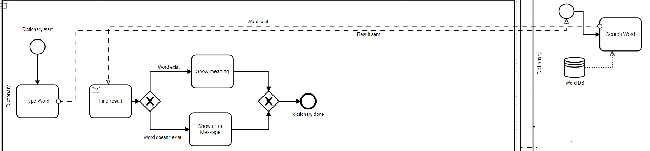
Dictionary

Slide 6
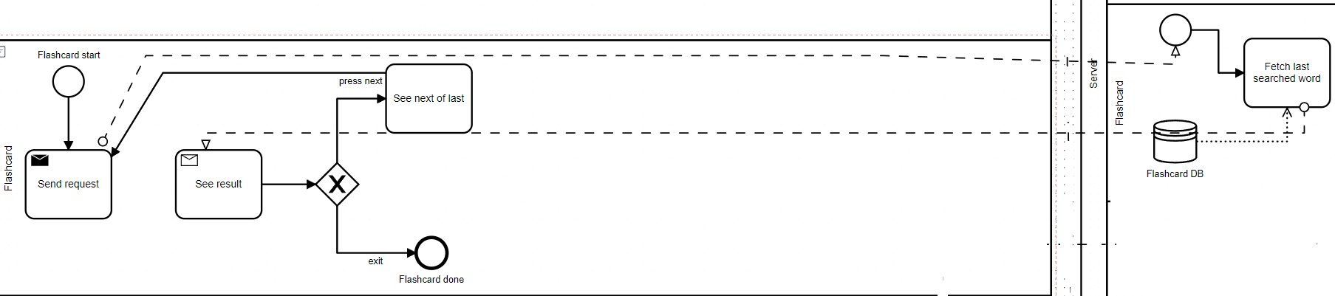
Flashcard

Slide 7
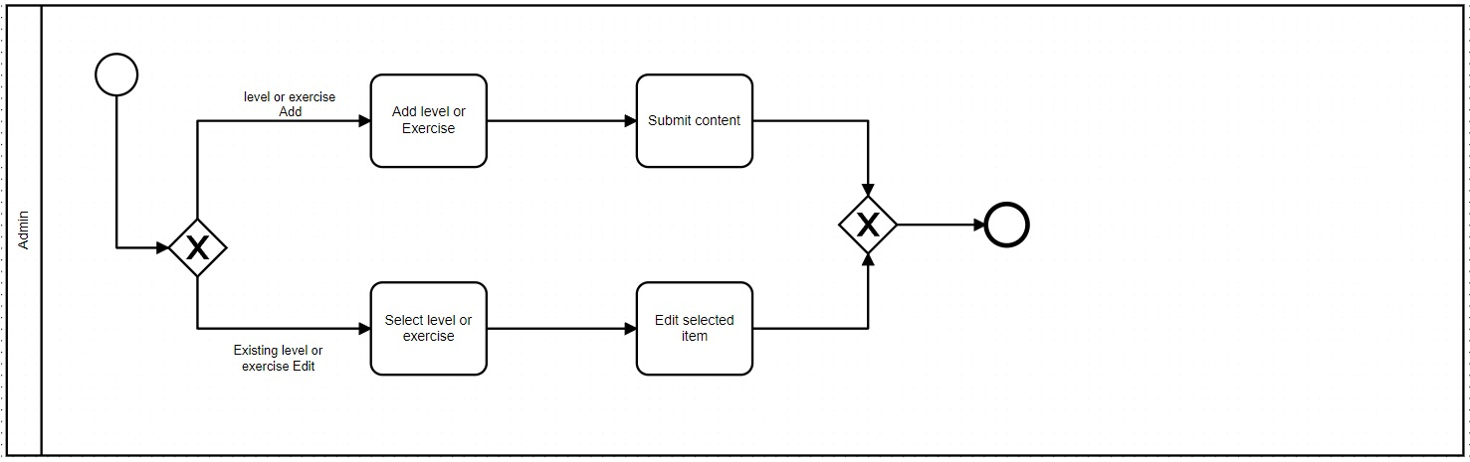
Admin

Slide 8
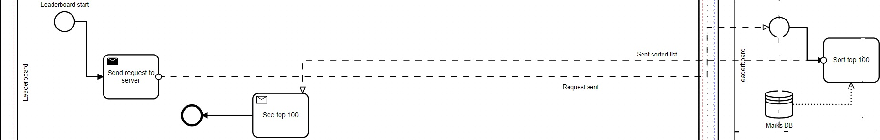
Leaderboard

Slide 9
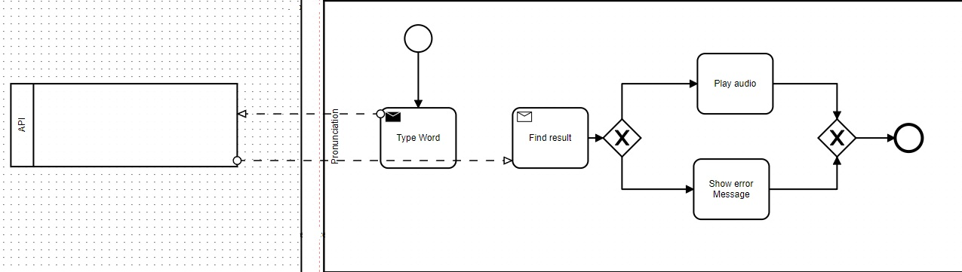
Pronunciation

Slide 10
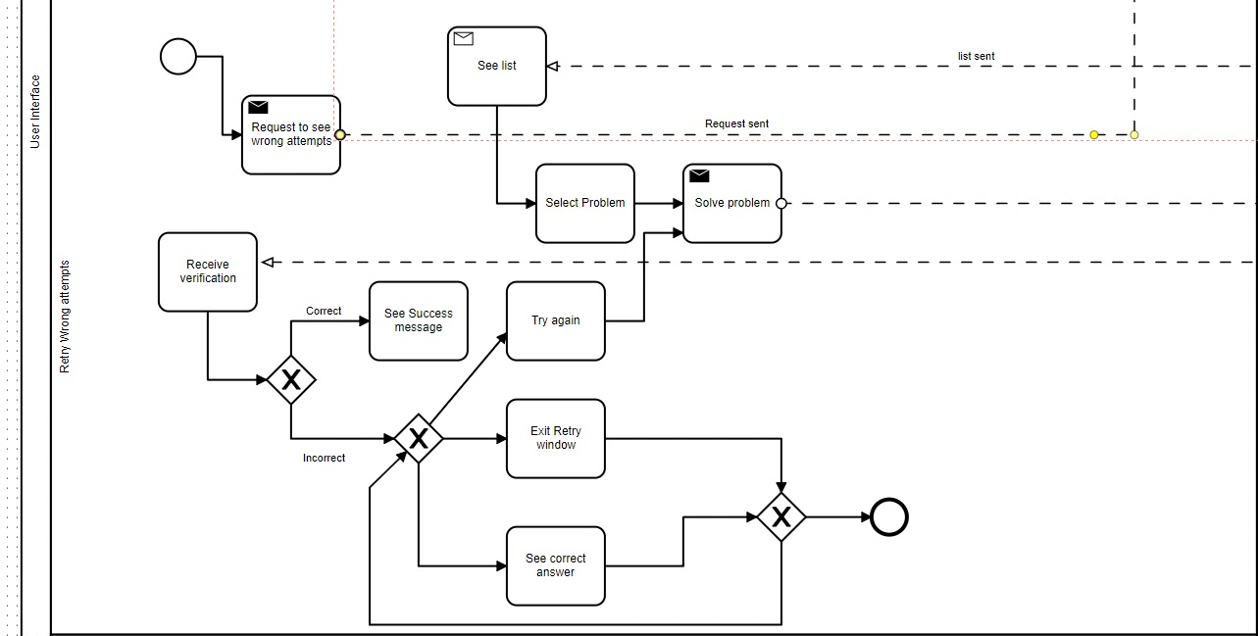
Retry Wrong Attempts(User Part)

Slide 11
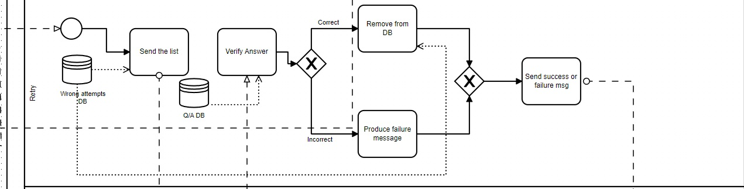
Retry Wrong Attempts(Server Part)

Slide 12
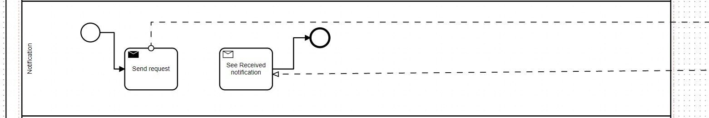
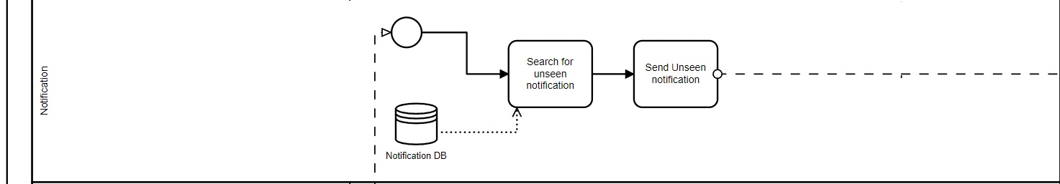
Notification

Slide 13
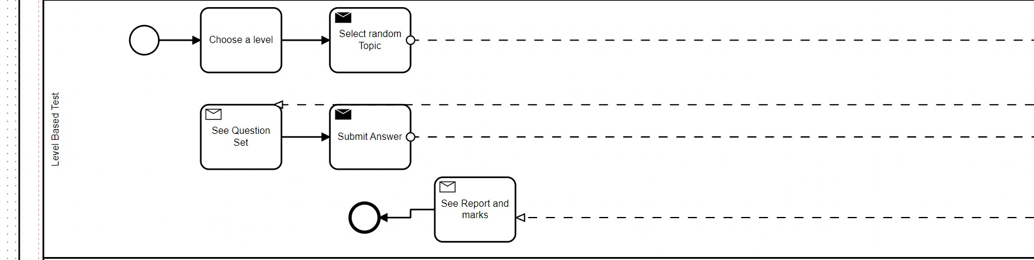
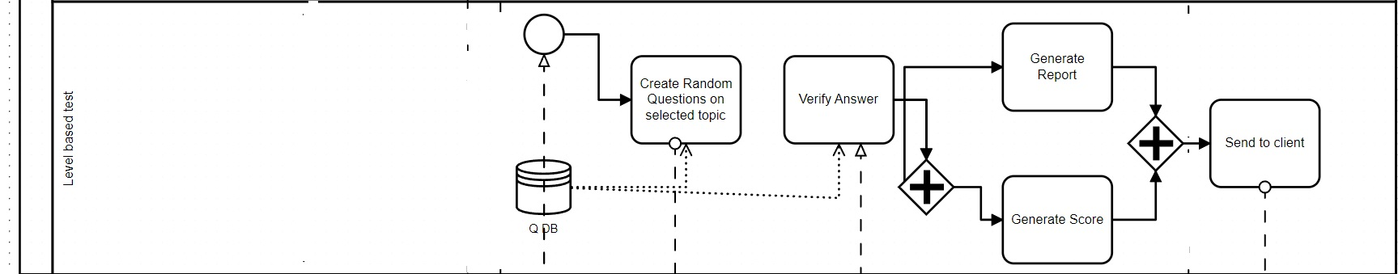
Level Based Test

Slide 14
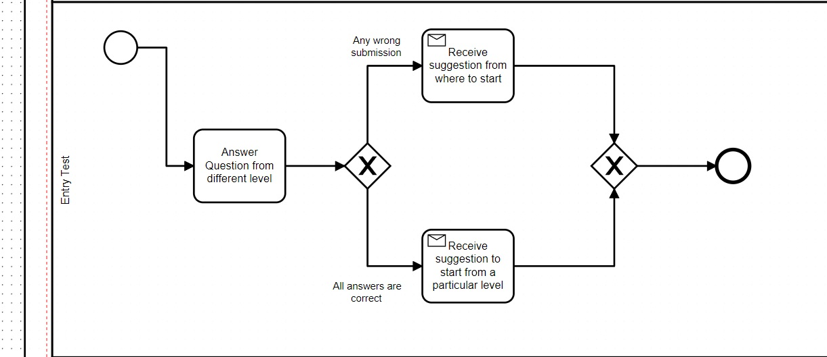
Entry Test

Slide 15
Whole BPMN Diagram
https://drive.google.com/file/d/1IRjmedHaAPWlkTjVuzK7p6y9ZftbLImn/view?usp=sharing

Slide 16
Thank You

