Slide 1
TCP Libra
Presenting By: 1705013

Slide 2
Experimental Topology

Slide 3
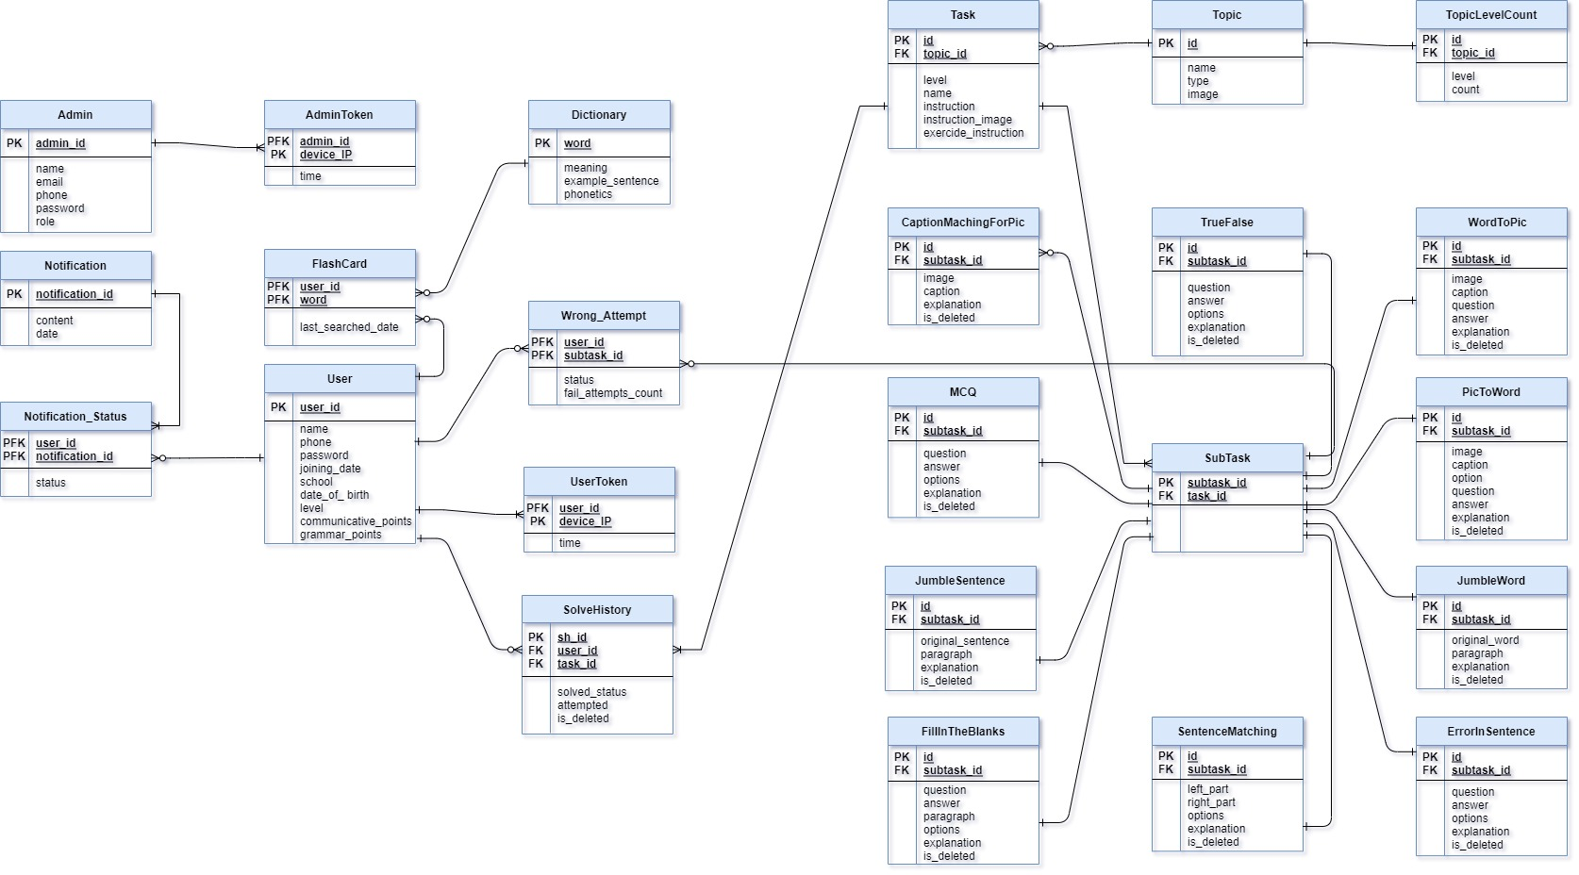
Full ERD dIAGRAM

Slide 4
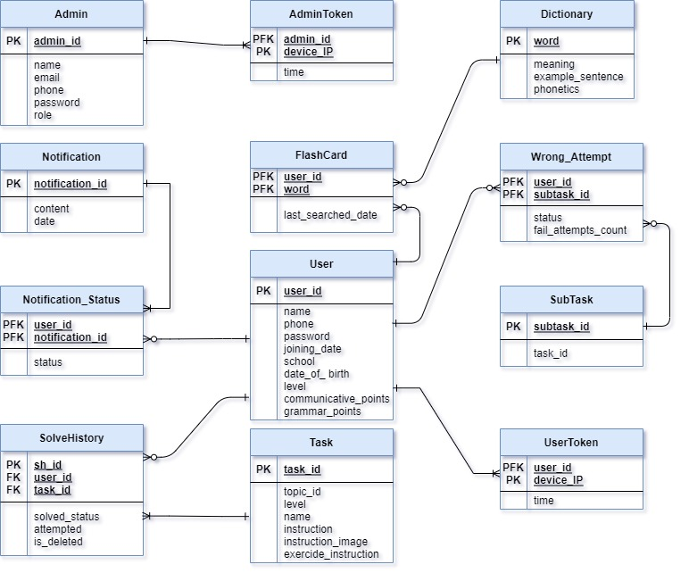
ERD Diagram Part 1

Slide 5
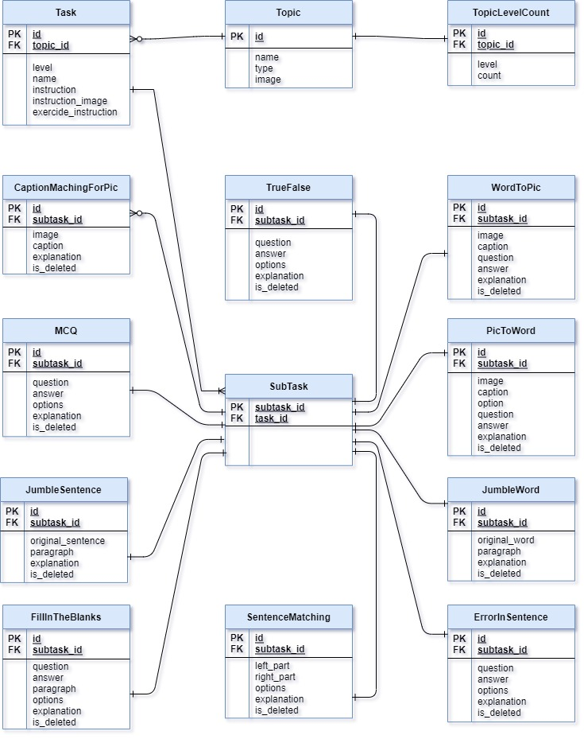
ERD Diagram Part 2

Slide 6
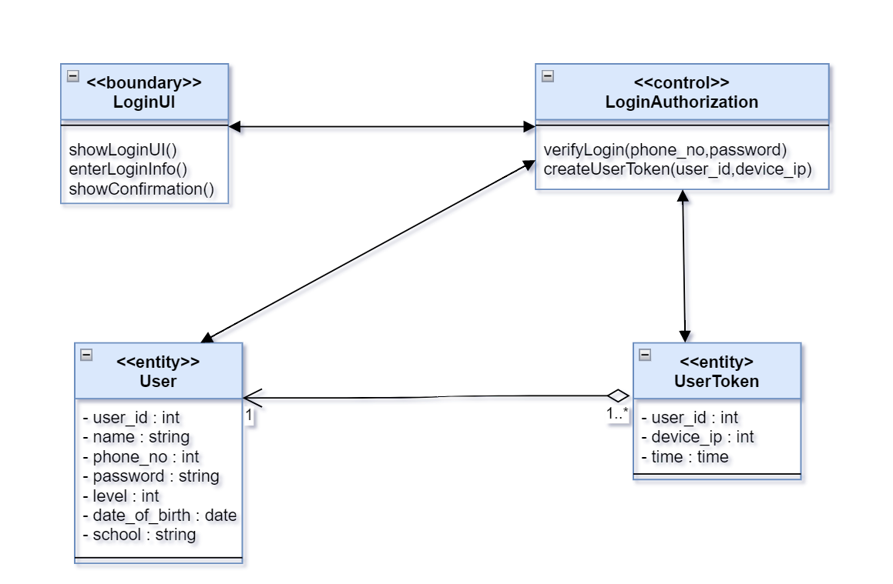
lOGIN

Slide 7
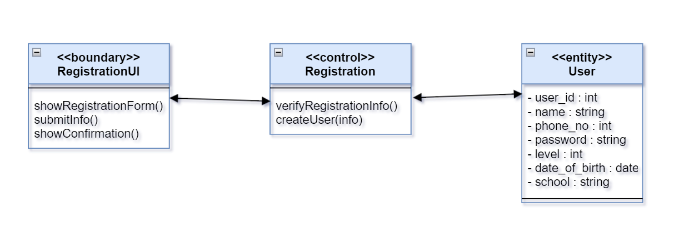
Registration

Slide 8
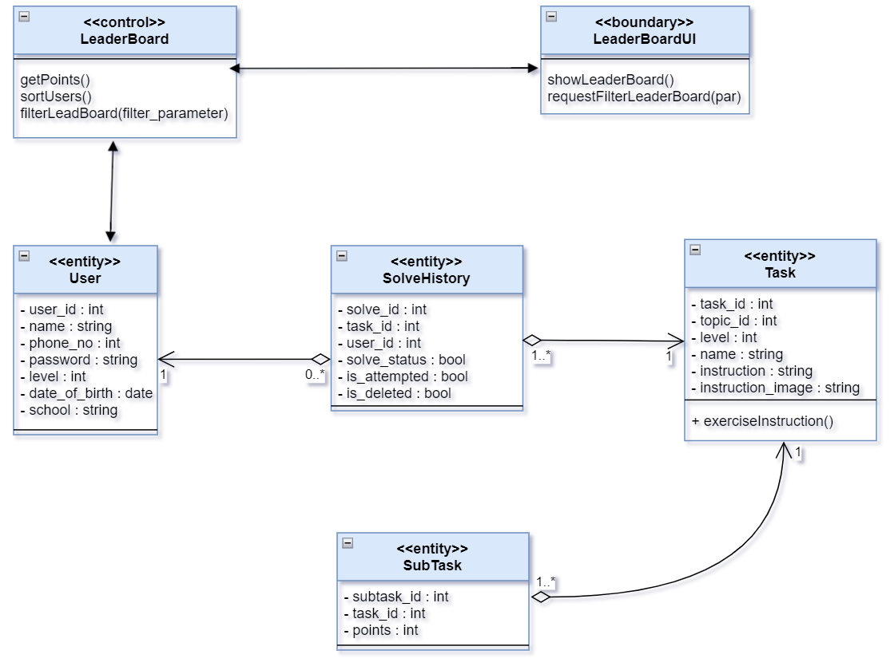
LEADER BOARD

Slide 9
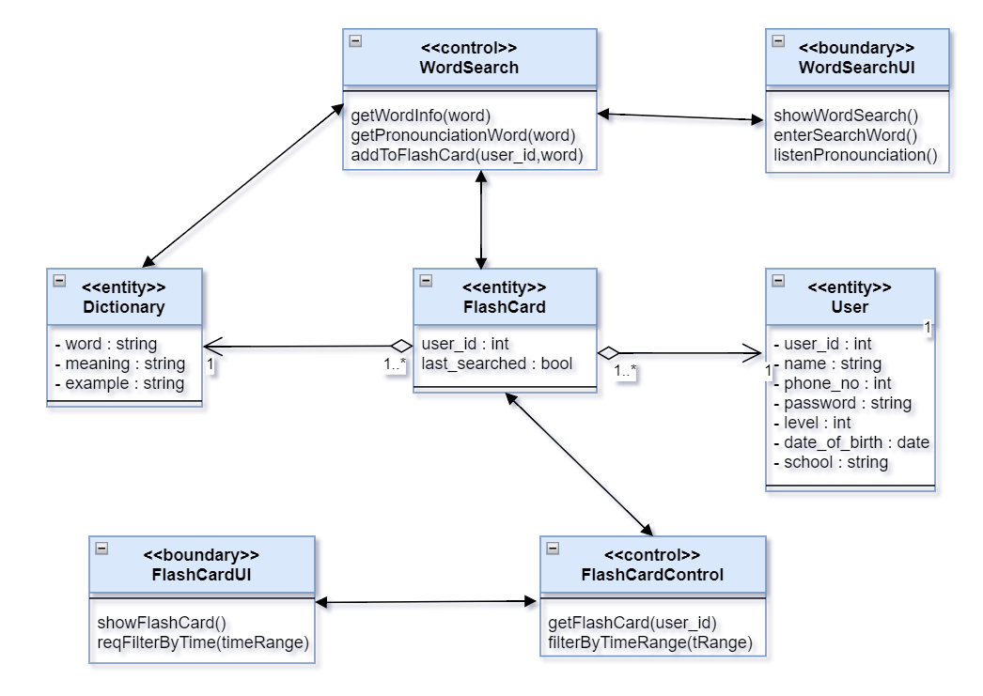
WORD SEARCH & Flash card

Slide 10
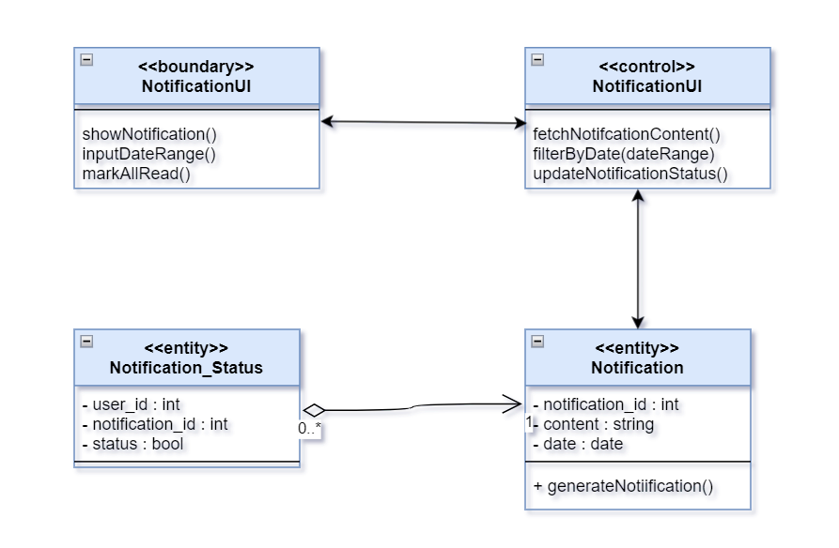
notification

Slide 11
THANK YOU

