Slide 1
Vashashikkha Interaction Diagrams
Group – 4
Members –
1705007,1705013,1705018,
1705021,1705023,1705025

Slide 2
Use Cases
Entry Test (User)
Leaderboard (User)
Section (User)
Topic (User)
Word Search (User)
Level Based Test (User)
Add New Level (Admin)
Modify Section (Admin)
Modify Test (Admin)
View Users (Admin)

Slide 3
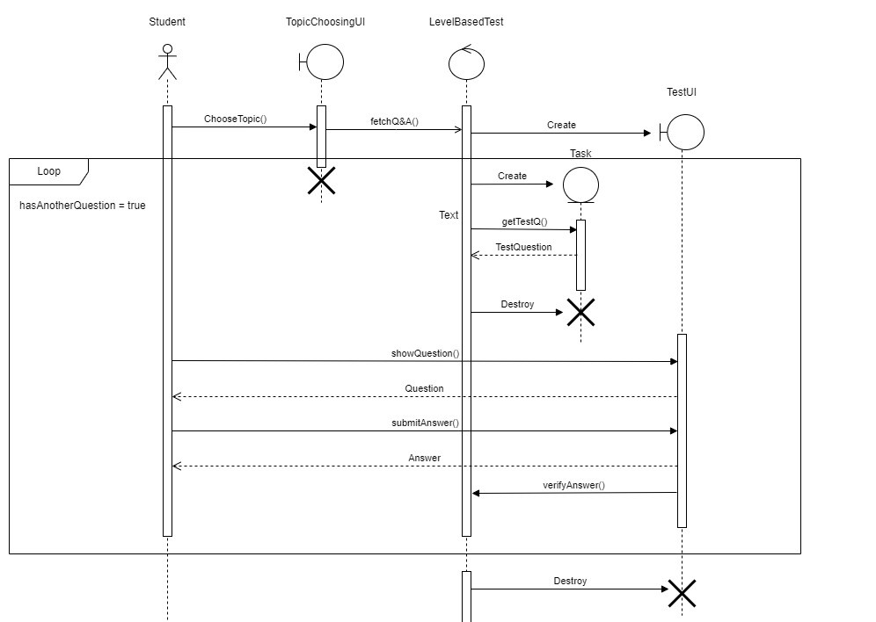
Level BASED TEST

Slide 4
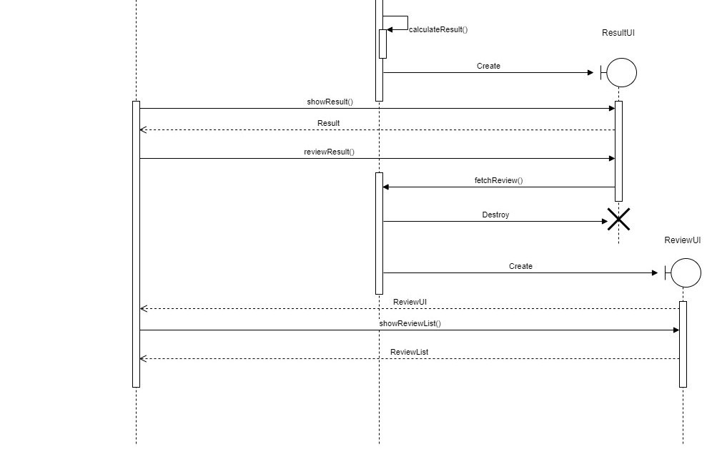
LEVEL BASED TEST
(Continued)

Slide 5
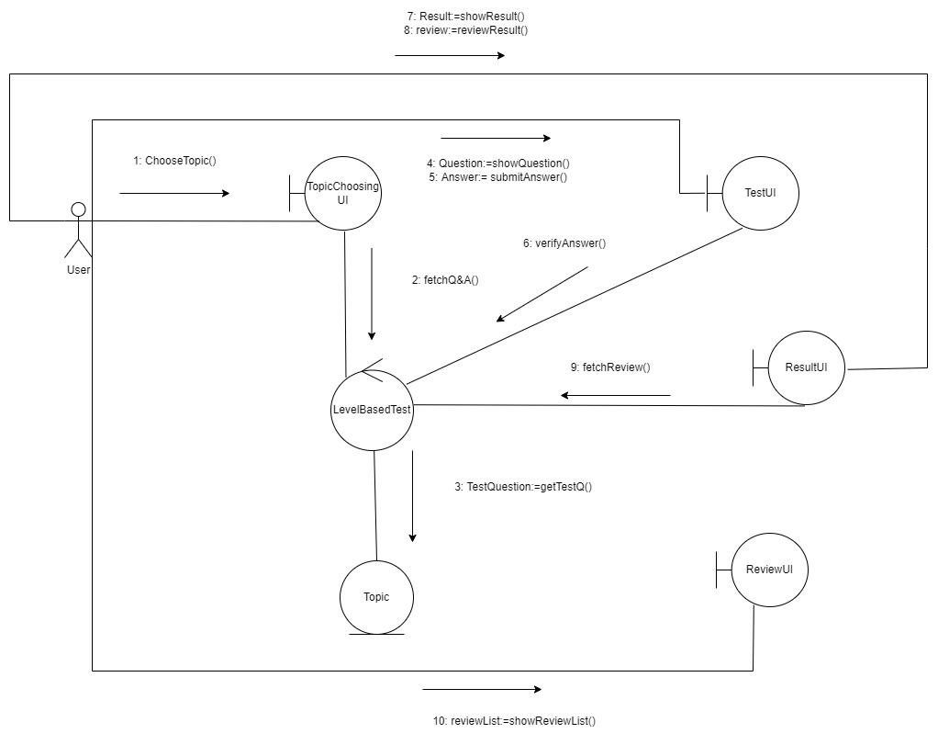
LEVEL BASED TEST
Collaboration Diagram

Slide 6
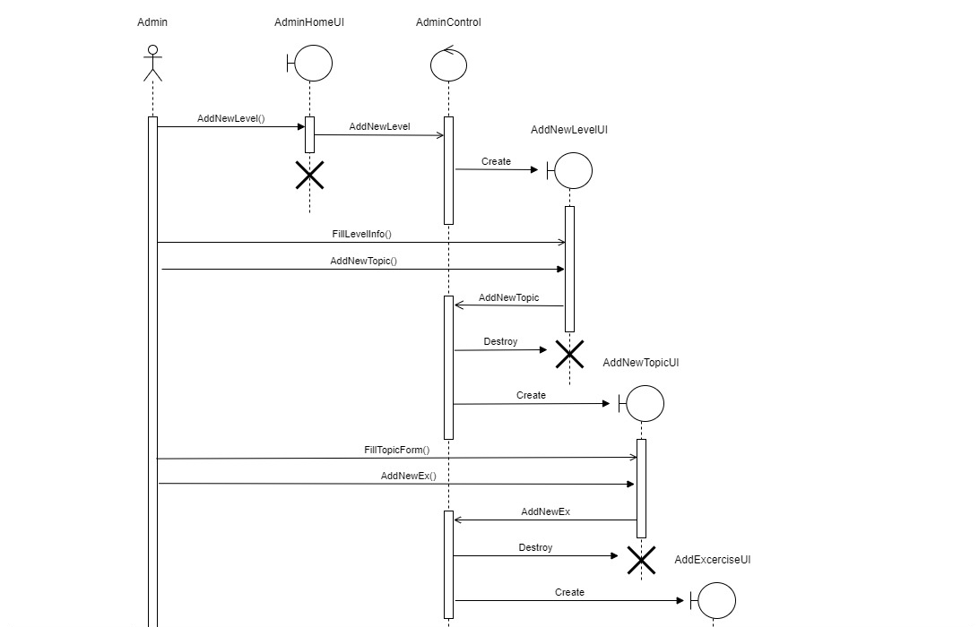
Add NEW LEVEL

Slide 7
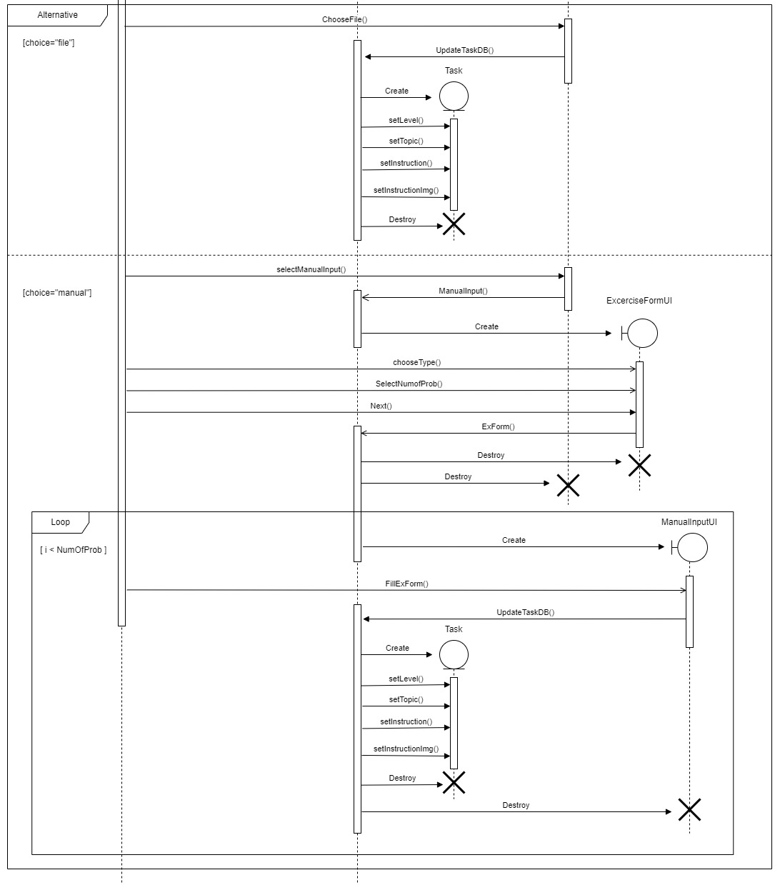
ADD NEW LEVEL
(Continued)

Slide 8
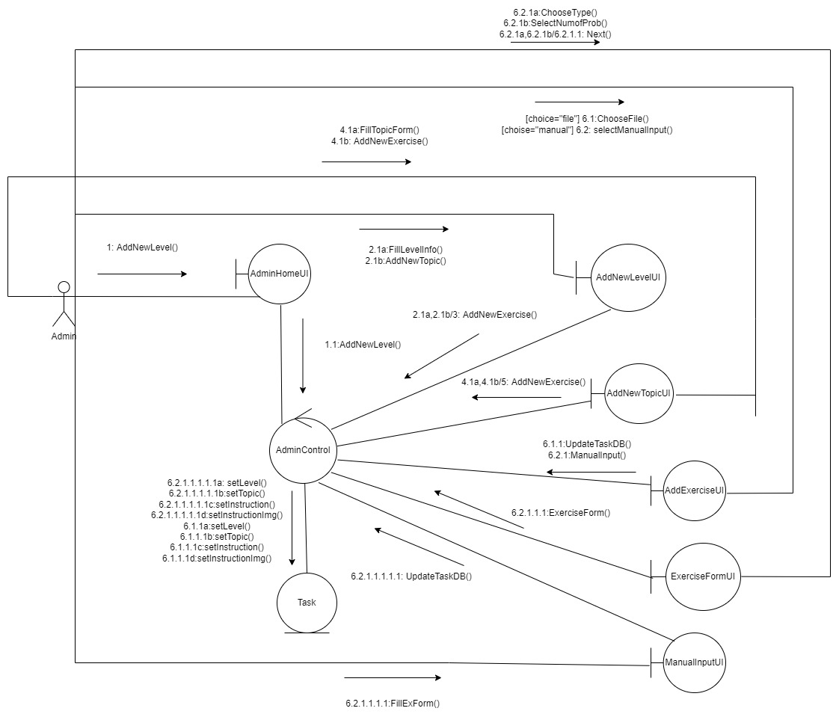
ADD NEW LEVEL
Collaboration Diagram

Slide 9
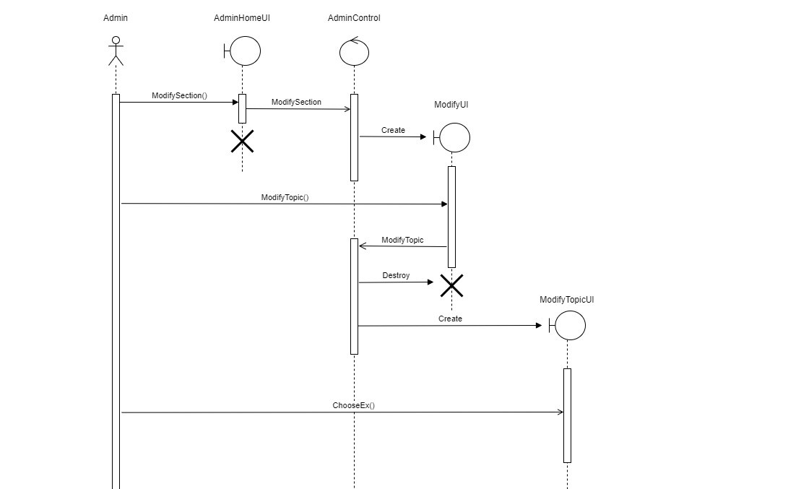
Modify SECTION

Slide 10
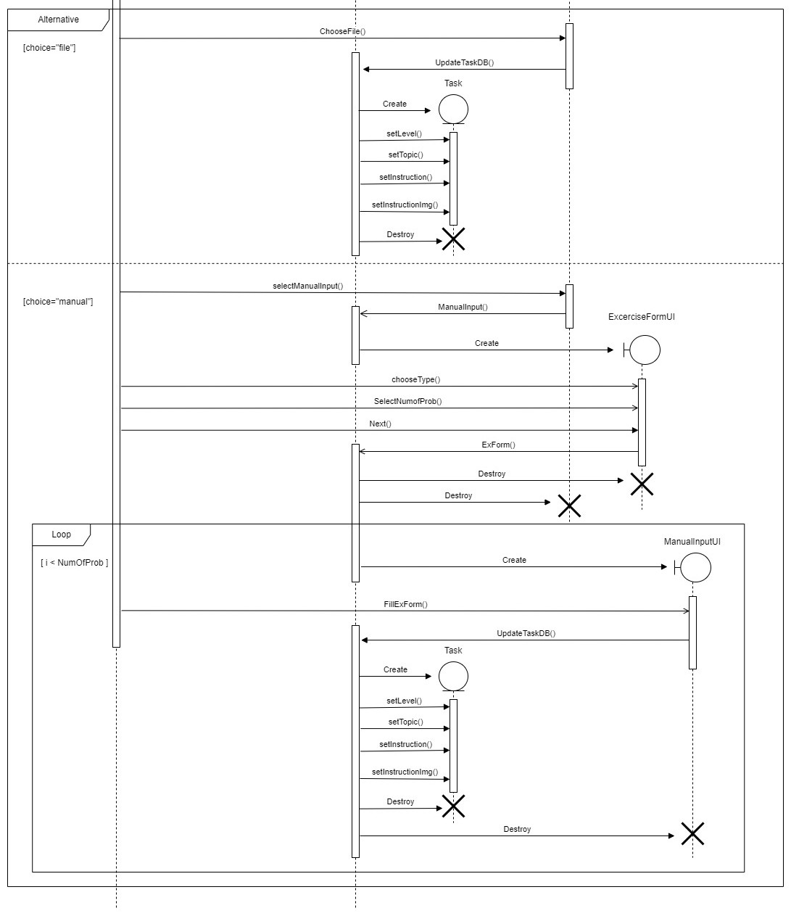
Modify section
(Continued)

Slide 11
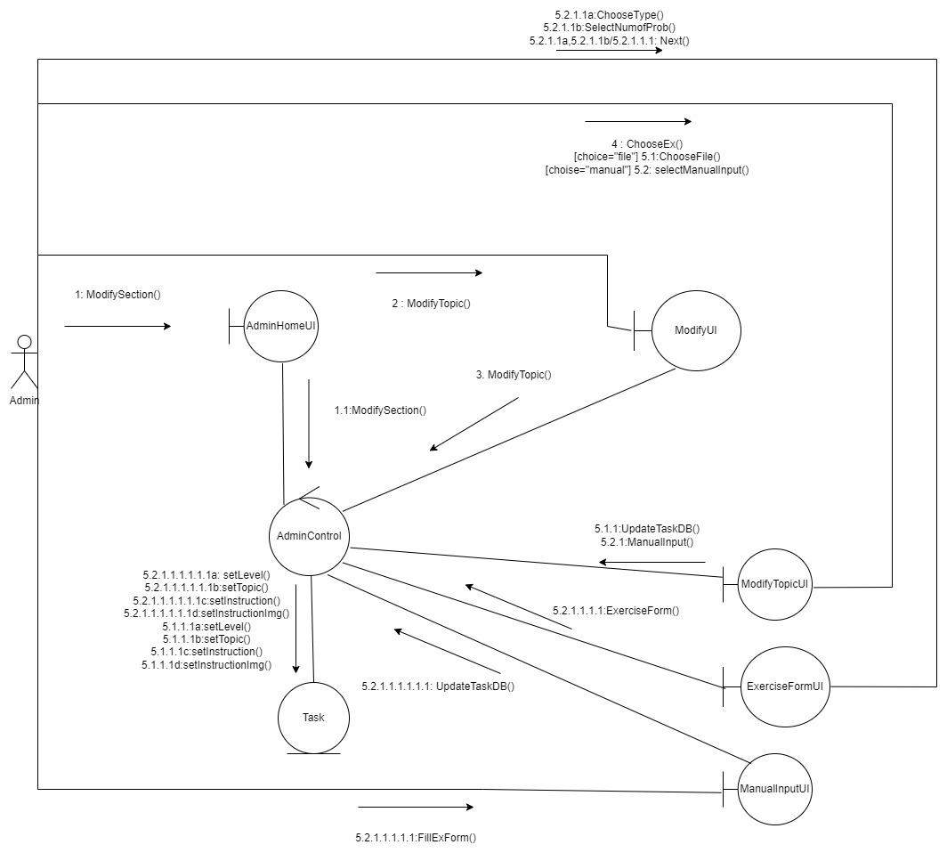
MODIFY SECTION
Collaboration Diagram

Slide 12
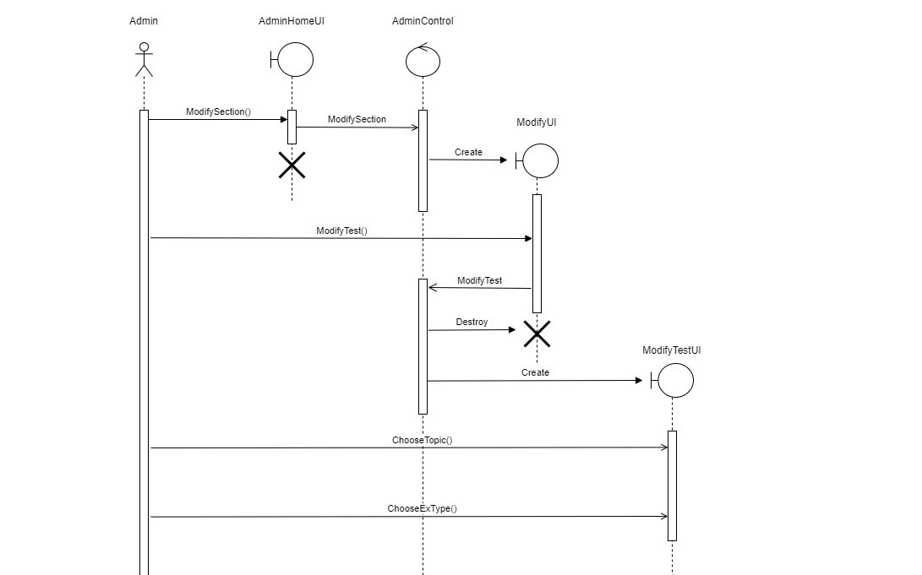
Modify TEST

Slide 13

Modify TEST
(Continued)

Slide 14
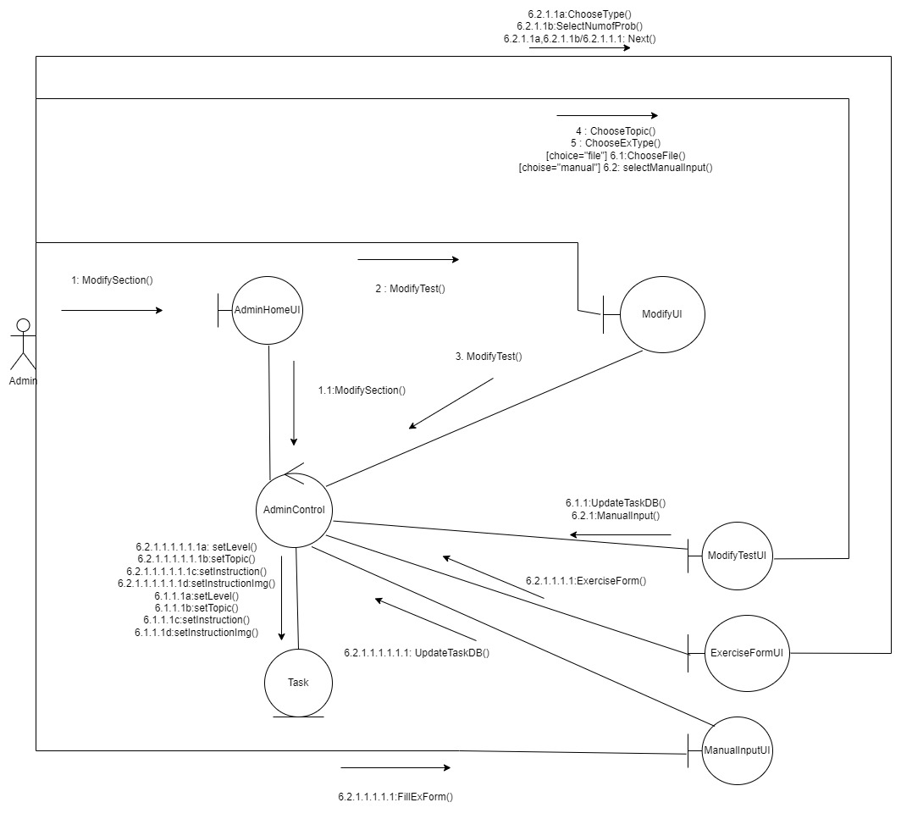
MODIFY Test
Collaboration Diagram

Slide 15
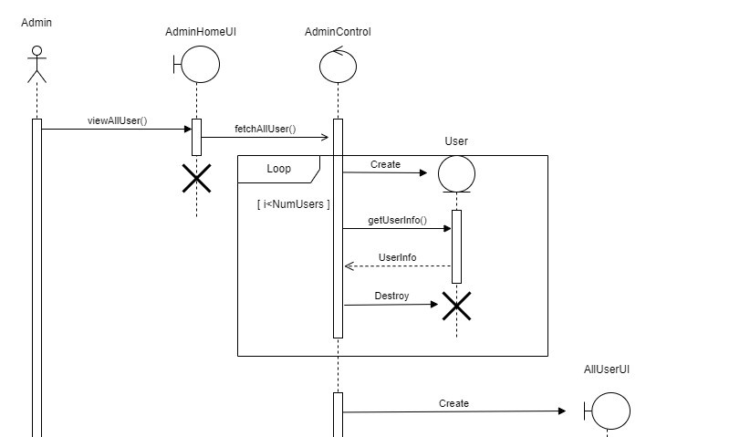
VIEW USERS
(All Users)

Slide 16
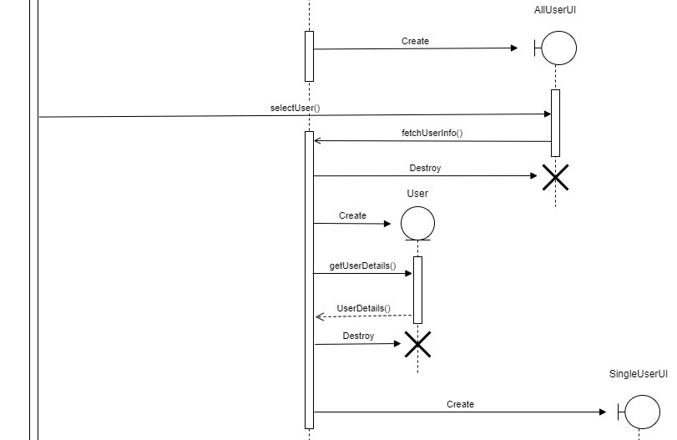
VIEW USERS
(Single User)

Slide 17
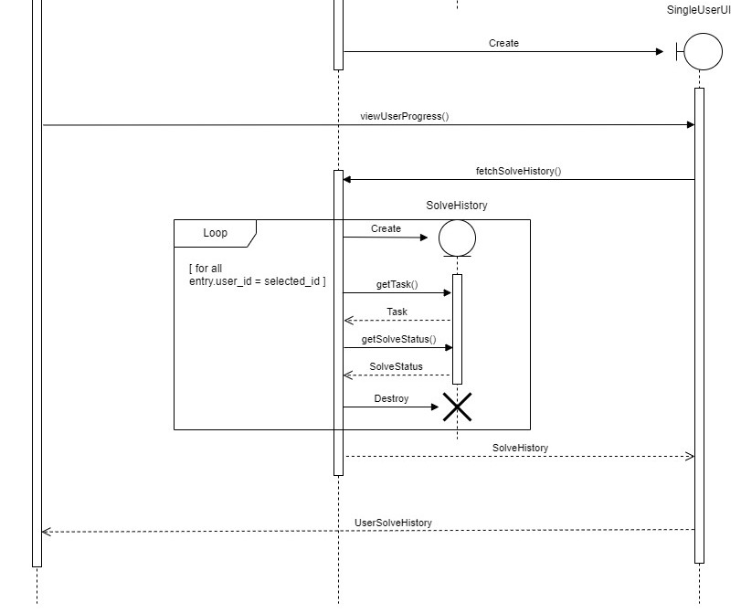
VIEW USERS
(User Progress)

Slide 18
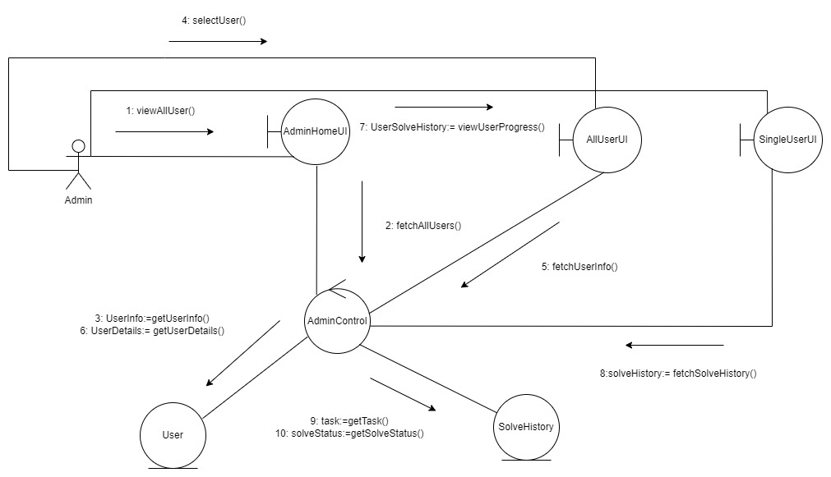
VIEW USERS
Collaboration
Diagram

Slide 19
THANK YOU

