Slide 1


VashaShikkha
Group-04
1705007,1705013,1705018,1705021,1705023,1705025

Slide 2
Use cases
USER
ADMIN
ENTRY TEST
LEADERBOARD
SECTION
TOPIC
LEVEL BASED TEST
WORD SEARCH & FLASHCARD
Add New Level (Admin)
Modify Section (Admin)
Modify Test (Admin)
View Users (Admin)

Slide 3
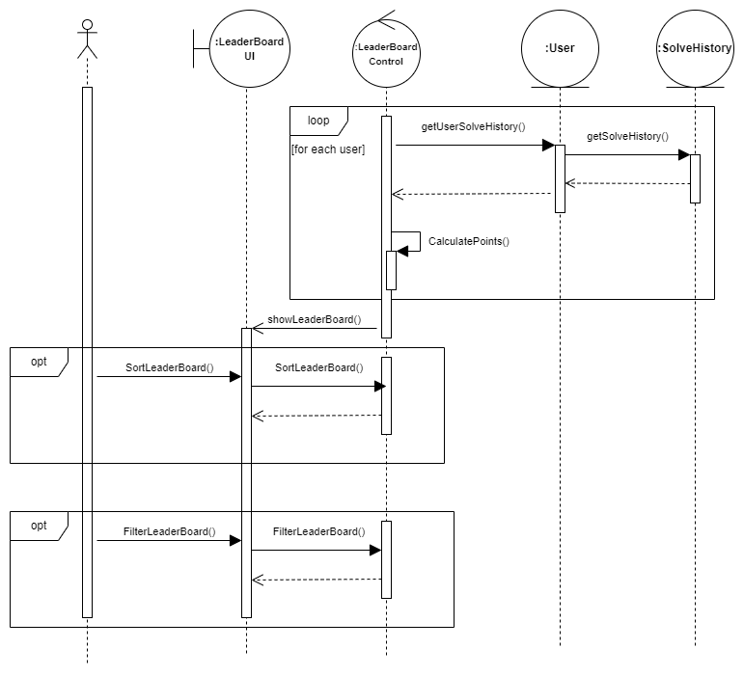
LEADERBOARD

Slide 4
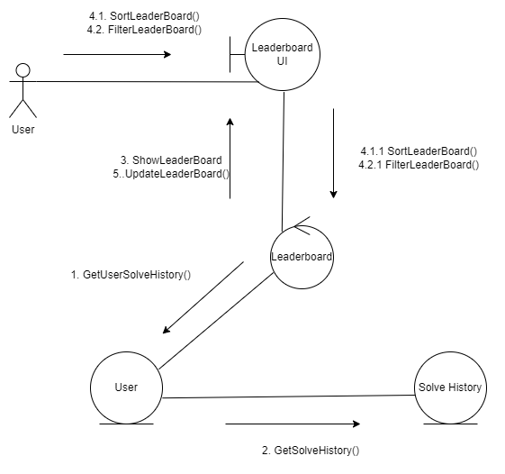
LEADERBOARD

Slide 5
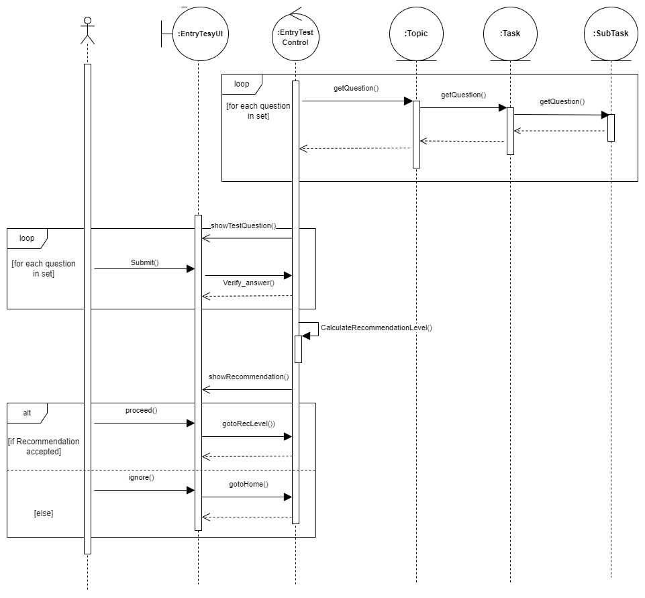
ENTRY TEST

Slide 6
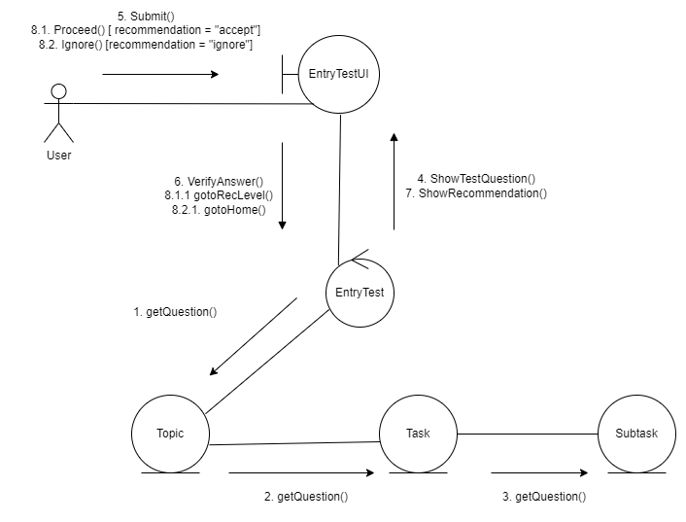
ENTRY TEST

Slide 7
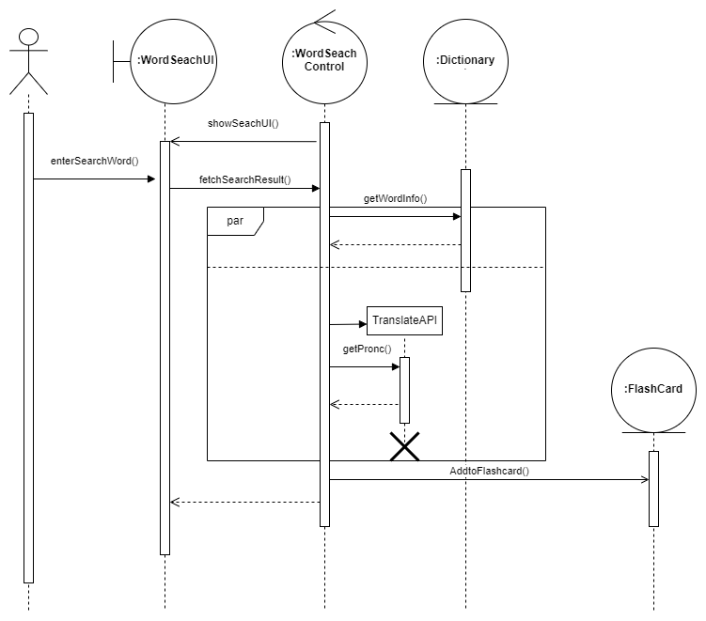
WORD SEARCH & FLASHCARD

Slide 8
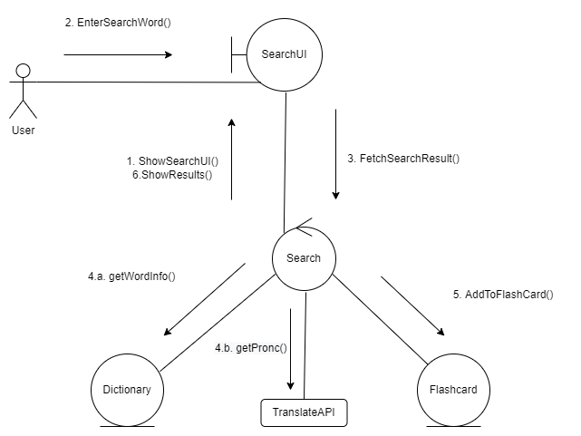
WORD SEARCH & FLASHCARD

Slide 9
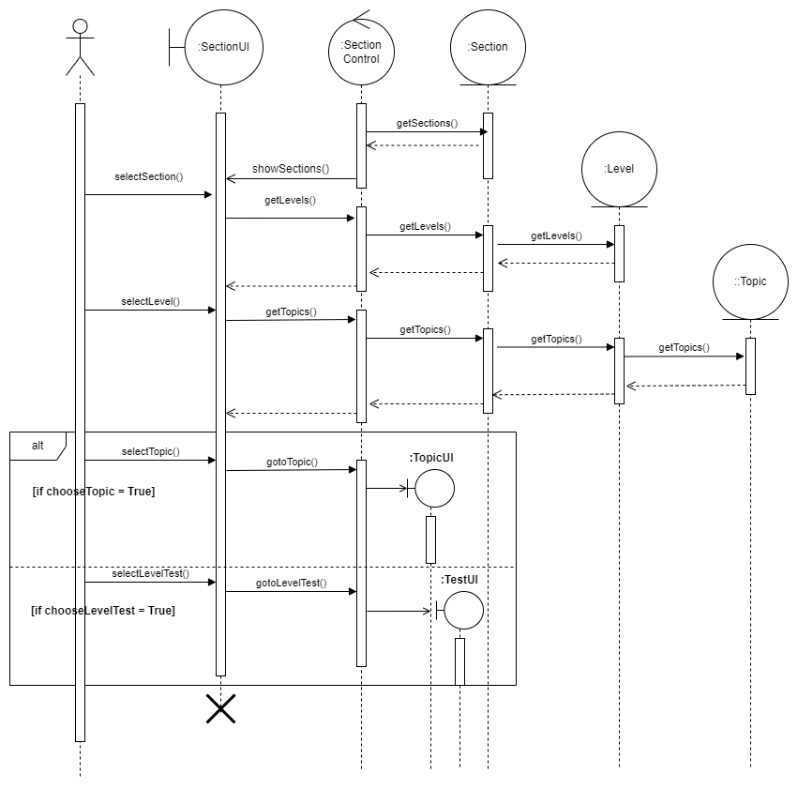
SECTION

Slide 10
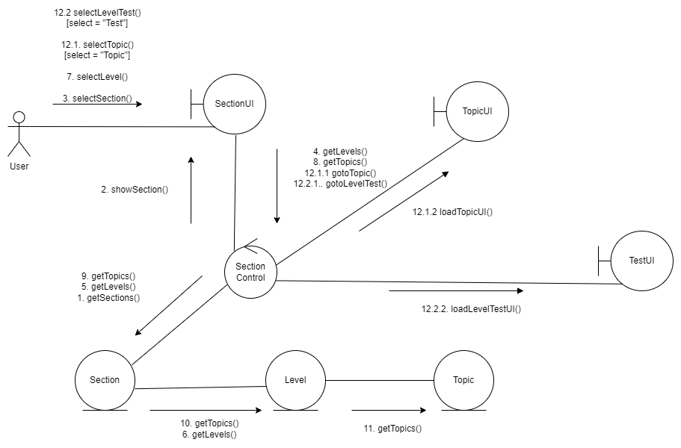
SECTION

Slide 11
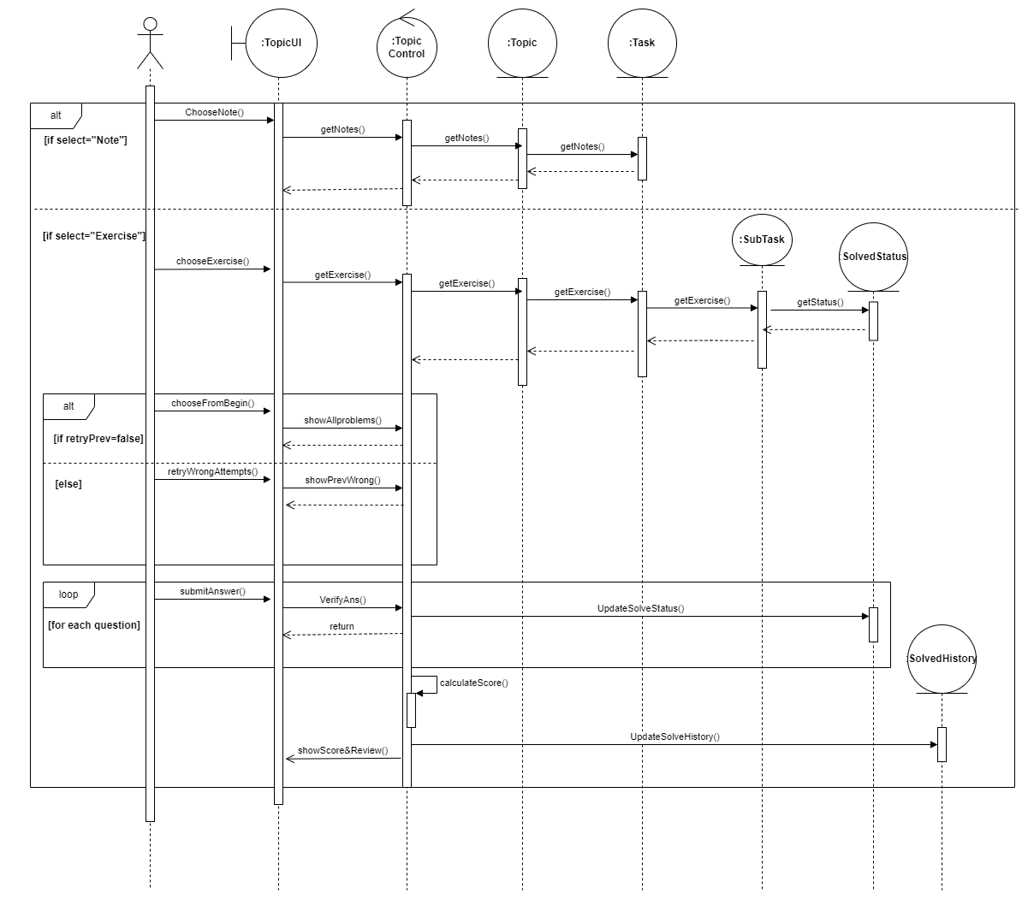
TOPIC

Slide 12
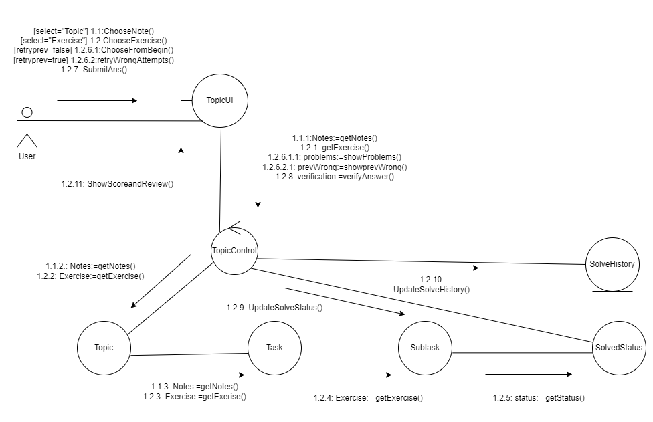
TOPIC

Slide 13
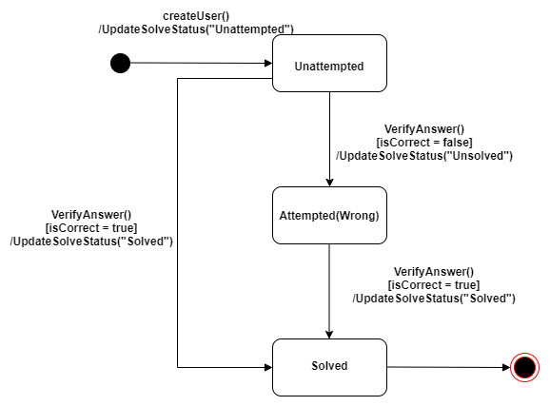
Solve Status

Slide 14
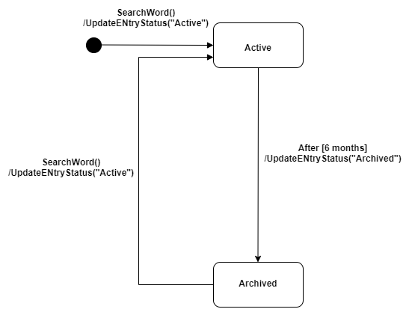
Flashcard Entry Status

Slide 15
THANK YOU

