Slide 1
CS 165
Lab 1: Find, Trigger & Fix
A hands-on introduction to finding and fixing memory-safety bugs in C
1
Notes:
Open with the lab goal. Do not solve any bug during this slide.

Slide 2
What You Will Do
1.
Generate
Create the instance tied to your student ID.
2.
Build
Compile with AddressSanitizer and run a sample script.
3.
Investigate
Read the source and create an input that exposes one bug.
4.
Fix
Make a targeted change, then rerun the trigger and samples.
5.
Submit
Package your patched source, trigger files, and writeup.
Repeat the investigation and fix process for all five bugs.
2
Notes:
Walk through the workflow once. Students should return to this sequence whenever they get stuck.

Slide 3
Getting Started
1. Generate your personal instance
python3 make_recman.py <your-student-id>
2. Build with AddressSanitizer
make
3. Run a benign sample
./recman tests/sample1.txt
Your main working files: recman.c, triggers/bug1.txt through triggers/bug5.txt, and writeup.md
3
Notes:
Pause here until students have generated, built, and run a sample. These commands match the handout.

Slide 4
AddressSanitizer Reports
When ASan stops the program, start with the first error it reports.
Error class
Examples include stack-buffer-overflow and heap-use-after-free.
Function
This identifies the code path that triggered the error.
Source location
Use the file and line number to inspect the unsafe operation.
Your input
Connect the command sequence to the failure in your writeup.
Save the relevant report lines before you patch the program.
4
Notes:
Use a harmless preparation example or a screenshot from the prep exercise during delivery. Do not display a solution to Lab 1.

Slide 5
Checkpoints and Submission
Before you leave the lab
□
Your program builds and the supplied samples run.
□
You can show a TA one real ASan crash from your generated build.
□
After each patch, the trigger no longer aborts and the samples still work.
Submission
Run make tar to create lab1-submission.tgz.
The archive contains recman.c, your trigger files, and writeup.md.
5
Notes:
Close with logistics. Remind students that they need to preserve their original trigger evidence before patching.

Slide 6
Memory Addresses and the Stack
The stack holds the active function calls in a running program.
Course model: Linux on x86-64
higher addresses
Earlier stack data
When a function needs more stack space, the stack grows toward lower addresses.
Current function frame
In this course, “above” means a higher address and “below” means a lower address. A compiler can arrange details differently, but the boundary rule for an array never changes.
stack pointer: boundary of active stack
lower addresses
2

Slide 7
A Function Call Creates a Stack Frame
Each active function has its own frame. A called function receives a new frame below its caller.
Before greet runs
While greet runs
int main(void) {
greet("Ada");
return 0;
}
main frame
main frame
greet frame
local variables
saved return information
When greet returns, its frame disappears and main continues.
3

Slide 8
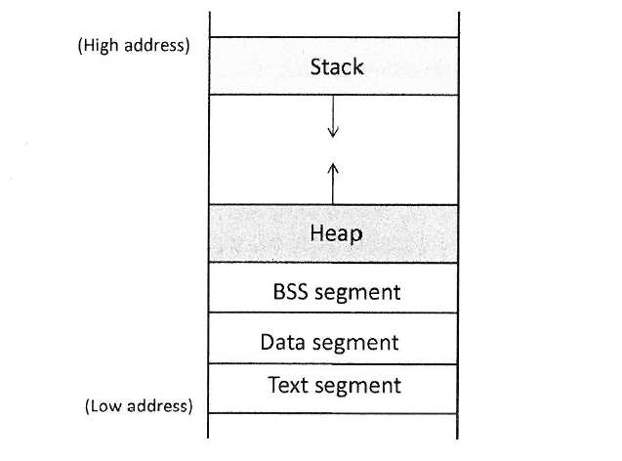
Program Memory Layout
Text segment : stores executable program
  executable
  Read - only
Data segment: static/global variables initialized by programmer
BSS (block started by symbol) segment:
  Stores uninitialized global/static variables
Heap : Provides space for dynamic memory allocation
Stack

Slide 9
Program Memory Layout
Stack
  Stores data for function calls
  Stores local variables
  By default non-executable

Slide 10
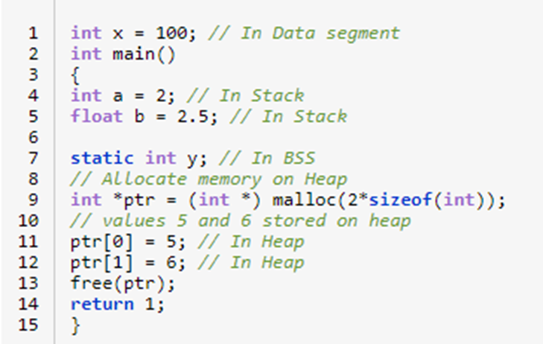
Program Memory Layout

Slide 11
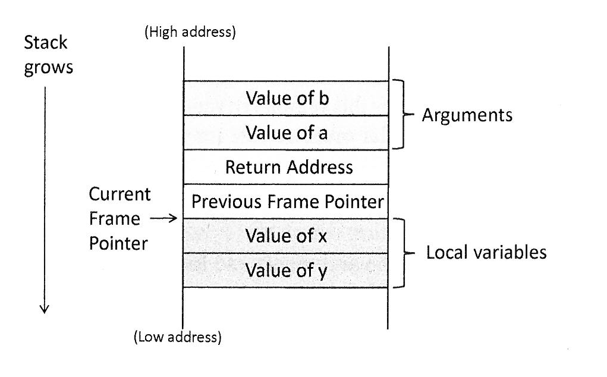
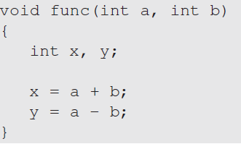
Stack and Function Invocation

Slide 12
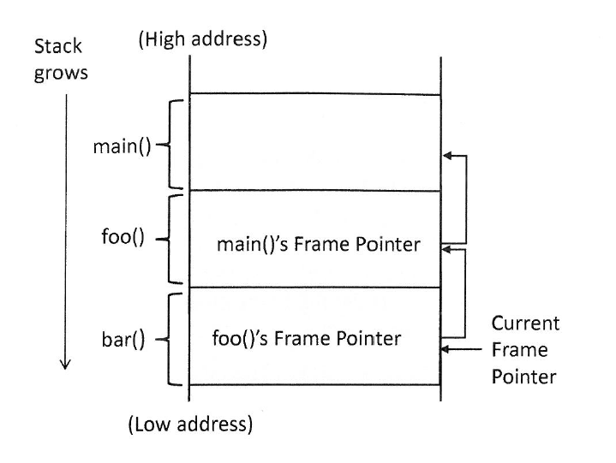
Stack and Function Invocation

Slide 13
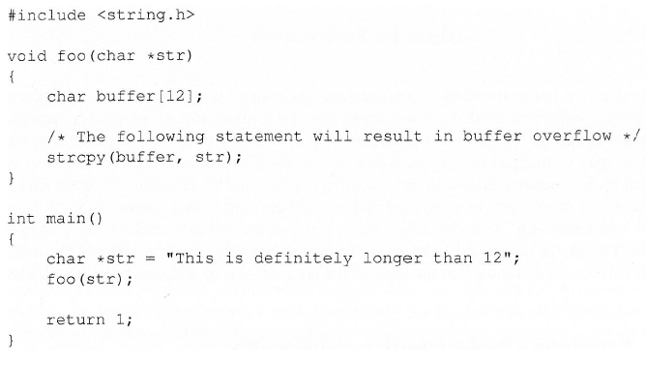
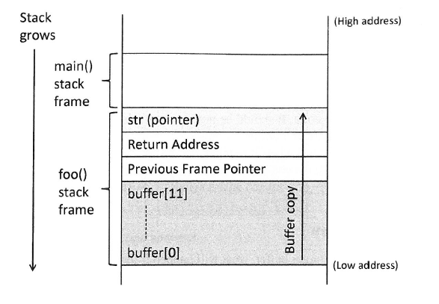
Buffer Overflow

Slide 14
What char buf[10] Creates
This declaration reserves ten consecutive bytes inside the current stack frame.
Each cell holds one char
char buf[10];
buf[0]
buf[1]
buf[2]
buf[3]
buf[4]
buf[5]
buf[6]
buf[7]
buf[8]
buf[9]
+0
+1
+2
+3
+4
+5
+6
+7
+8
+9
first element
last valid element
A C string needs one extra byte for its terminating '\0'. Therefore buf can hold at most nine visible characters as a string.
4

Slide 15
How a Stack Buffer Overflow Happens
An overflow occurs when a copy writes beyond the last byte reserved for the array.
Only 10 bytes exist inside buf
char buf[10];
strcpy(buf, "AAAAAAAAAA");
A
A
A
A
A
A
A
A
A
A
\0
10 visible characters + '\0' = 11 bytes copied
0
1
2
3
4
5
6
7
8
9
byte 11
outside buf
The extra '\0' byte writes into nearby stack memory. The exact neighbor depends on the compiler, but the write is always outside buf.
5

