Slide 1
CREDIT FOLLOW-UP
EMAIL AGENT
Automating overdue invoice follow-ups using LLM-powered tone escalation
Task 2 : Finance Agent | | LLM : Llama 3.3 70B | | Framework : LangChain | | UI : Streamlit

Slide 2

THE PROBLEM
What finance teams deal with every day
HOURS WASTED
INCONSISTENT TONE
FINANCE TEAMS MANUALLY WRITE FOLLOW-UP EMAILS FOR EVERY OVERDUE INVOICE
DIFFERENT PEOPLE WRITE DIFFERENT EMAILS - NO STANDARD ESCALATION
NO AUDIT TRAIL
LATE ESCALATION
NO RECORD OF WHAT WAS SENT, WHEN, AND IN WHAT TONE
OVERDUE ACCOUNTS SLIP THROUGH BECAUSE NO ONE IS TRACKING DAYS

Slide 3

THE SOLUTION
An AI agent that automates the entire follow-up workflow
AUTO-DETECTION
TONE ESCALATION
READS INVOICE CSV AND CALCULATES DAYS OVERDUE FROM TODAY'S DATE AUTOMATICALLY
4 ESCALATION STAGES FROM WARM TO STERN BASED ON DAYS OVERDUE
LLM EMAILS
LEGAL FLAG
LLAMA 3.3 70B GENERATES PERSONALISED EMAILS WITH CORRECT TONE PER INVOICE
30+ DAY INVOICES ARE FLAGGED FOR LEGAL REVIEW — NO AUTO EMAIL SENT
AUDIT TRAIL
DASHBOARD
EVERY EMAIL LOGGED WITH TIMESTAMP, STAGE, TONE, AND STATUS
STREAMLIT UI FOR VISUAL CONTROL, MONITORING, AND LOG DOWNLOAD

Slide 4

HOW THE AGENT WORKS
1
2
3
4
5
CSV INPUT
TRIGGER LOGIC
ESCALATION
ENGINE
LLM GENERATOR
AUDIT LOGGER
INVOICE DATA LOADED
VIA PANDAS
DAYS OVERDUE CALCULATED
FROM TODAY'S DATE
STAGE 1-4 OR LEGAL
FLAG ASSIGNED
GROQ API GENERATES
PERSONALISED EMAIL
LOGGED TO JSON WITH
TIMESTAMP & STATUS

Slide 5
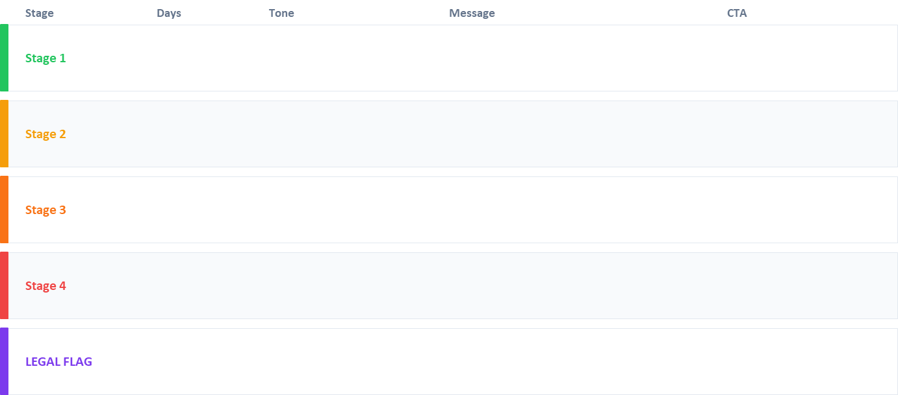
TONE ESCALATION MATRIX
Each stage has a different tone, message, and call to action
1–7 DAYS
WARM & FRIENDLY
GENTLE REMINDER, ASSUME OVERSIGHT
PAY NOW LINK
8–14 DAYS
POLITE BUT FIRM
PAYMENT STILL PENDING, REQUEST CONFIRMATION
CONFIRM PAYMENT DATE
15–21 DAYS
FORMAL & SERIOUS
ESCALATING CONCERN, MENTION IMPACT
RESPOND WITHIN 48HRS
22–30 DAYS
STERN & URGENT
FINAL REMINDER BEFORE ESCALATION
PAY IMMEDIATELY
30+ DAYS
NO EMAIL SENT
FLAGGED FOR FINANCE MANAGER REVIEW
MANUAL REVIEW REQUIRED

Slide 6
TECH STACK
LLM - Llama 3.3 70B via Groq: Free tier, fast inference, excellent JSON output
Framework - LangChain: Industry standard, easy LLM integration
Data - CSV via pandas: Simple, portable, meets task requirement
Email - Dry-run log (JSON): Safe testing, no accidental sends
UI - Streamlit: Fast dashboard, easy to demo
Security - python-dotenv: API keys in .env, never hardcoded

Slide 7
SECURITY RISK MITIGATION
All mandatory security risks addressed
PROMPT INJECTION
Invoice fields injected as structured variables, JSON-only output enforced
API KEY EXPOSURE
.env file used, .gitignore excludes it, .env.example provided for GitHub
DATA PRIVACY / PII
Data processed locally, no raw PII in logs, no third-party data sharing
Structured JSON output, human review via dashboard before live send
HALLUCINATION RISK
UNAUTHORISED ACCESS
Agent runs locally, no public endpoint, dry-run ON by default
ACCIDENTAL EMAIL SEND
Dry-run mode is default, live send requires manual toggle in dashboard

Slide 8
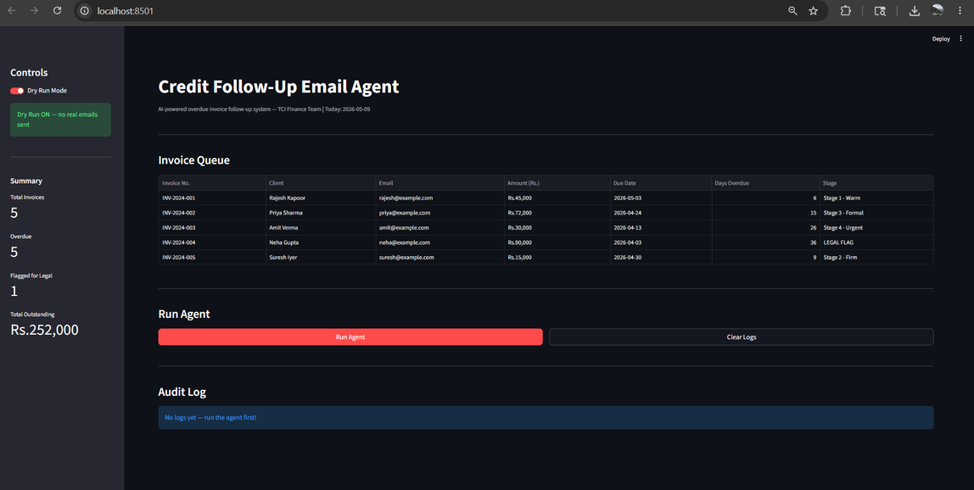
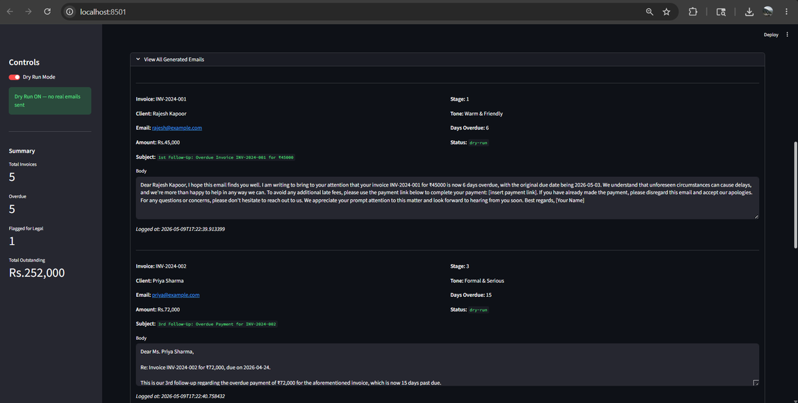
LIVE DASHBOARD
Streamlit UI
Home page
Generated Mails

Slide 9

AI-GENERATED EMAILS - TONE COMPARISON
Stage 1: Warm & Friendly
Stage 4 — Stern & Urgent
Subject: Quick Reminder – Invoice #INV-2024-001 | Rs.45,000 Due
Dear Rajesh Kapoor,
I hope this email finds you well! This is a friendly reminder that Invoice #INV-2024-001 for Rs.45,000 was due on 03-May-2026.
If you have already processed this, please disregard. Otherwise, please use the payment link below to complete your payment.
Thank you for your prompt attention!
Best regards,
TCI Finance Team
Subject: FINAL NOTICE – Invoice #INV-2024-003 – Immediate Action Required
Dear Mr. Amit Verma,
This is our final reminder. Invoice #INV-2024-003 for Rs.30,000 is now 25 days overdue.
Failure to remit payment within 24 hours will result in escalation to our legal and recovery team.
Please act immediately. Contact us urgently to resolve this matter.
TCI Finance Team

Slide 10

LEARNINGS & NEXT STEPS
What I Built & Learned
Production Next Steps
→ End-to-end AI agent pipeline from data to output
→ Replace CSV with live database (PostgreSQL)
→ LangChain for structured LLM integration
→ Add APScheduler for automatic daily runs
→ Prompt engineering for consistent JSON output
→ Integrate SendGrid for real email delivery
→ Security best practices for AI applications
→ Add Pydantic validation on LLM output
→ Streamlit for rapid AI dashboard development
→ Deploy on cloud (AWS / Azure)
→ Git and GitHub for version control
→ Add LangSmith tracing for observability

Slide 11
THANK
YOU

