Slide 1
BUS MANAGEMENT SYSTEM

Slide 2
WHY USE BMS ?
Say NO to queues.
User friendly.
Instant ticket booking and hassle free cancellation at your fingertips.
Easy management and insightful report generation for admin.

Slide 3
TECHNOLOGY STACK
Frontend Development – JSP, CSS, Bootstrap, Javascript, jQuery.
Middle tier business logic – Spring Framework, Hibernate ORM, Spring Data JPA.
Backend database – MySQL database.
Reporting(Excel) – Apache POI.

Slide 4
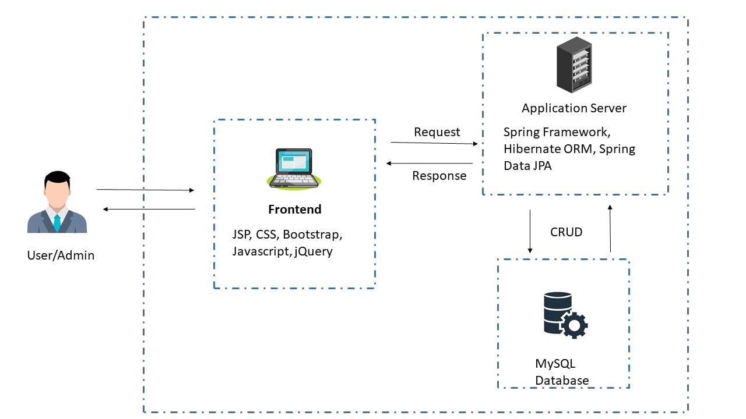
ARCHITECTURE

Slide 5
USER FUNCTIONALITIES
A walkthrough of the features BMS provides to its users.

Slide 6
STEPS TO BOOK A TICKET
User signup / Login
Select the most preferred bus from the list of available buses.
PNR generated and ticket booked successfully.
1
3
5
2
4
6
Select the source and destination details and journey date.
Select number of seats (maximum of 6 seats) to book and confirm other details
E-ticket sent to user’s registered email.

Slide 7
STEPS TO CANCEL A TICKET
User Login
Select the ticket you want to cancel .
Confirm ticket cancellation
1
3
5
2
4
6
Navigate to MyTickets page
Click on the cancel ticket button
Ticket is cancelled successfully and cancellation mail is sent

Slide 8
ADMIN FUNCTIONALITIES
A summary of features available to admin

Slide 9
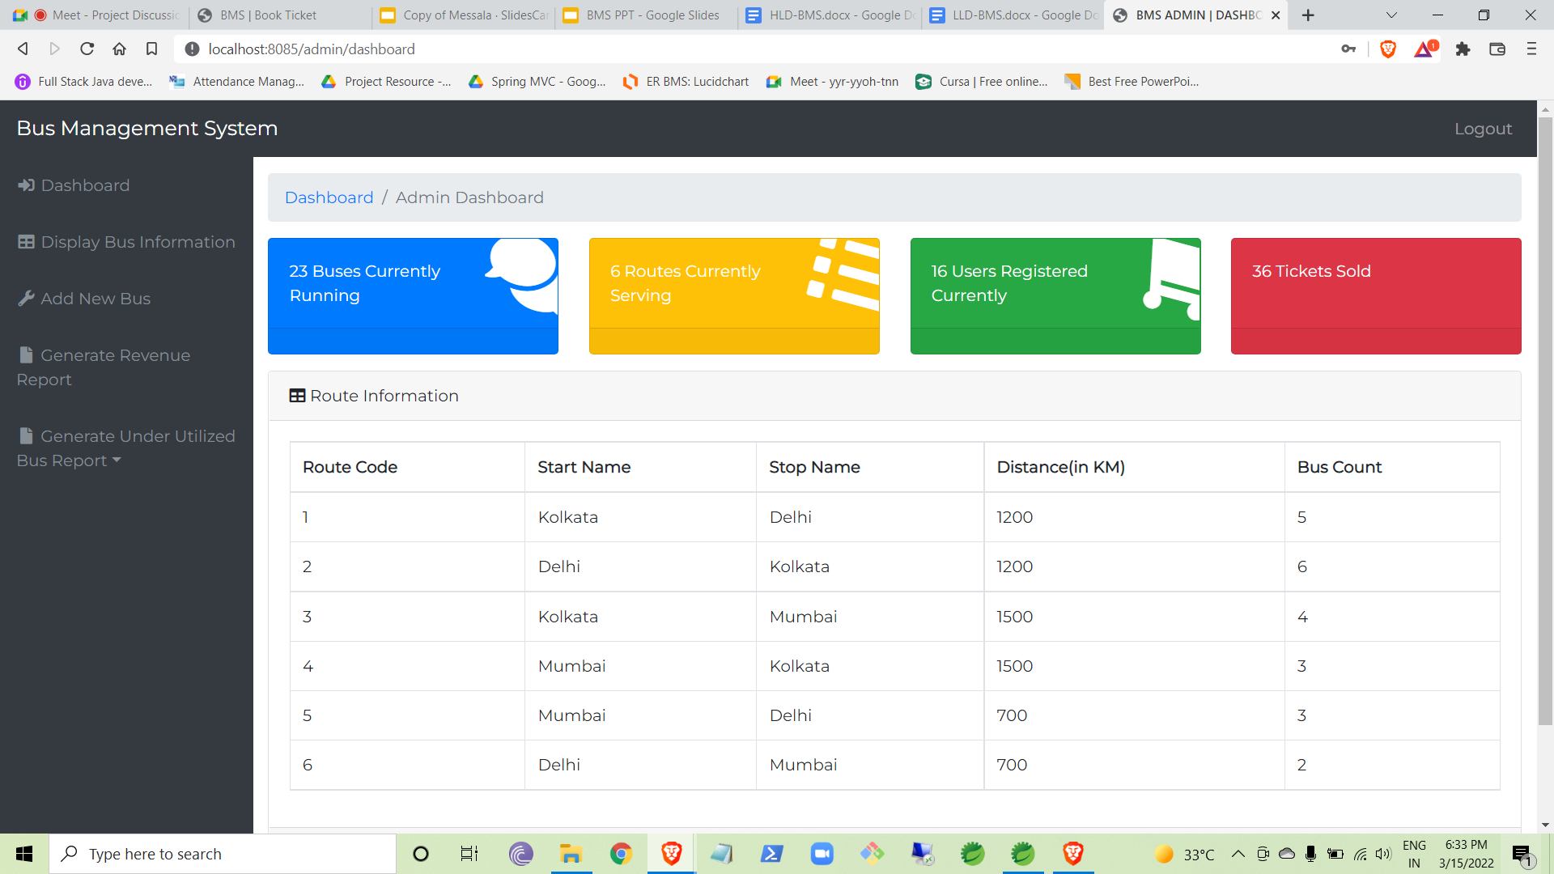
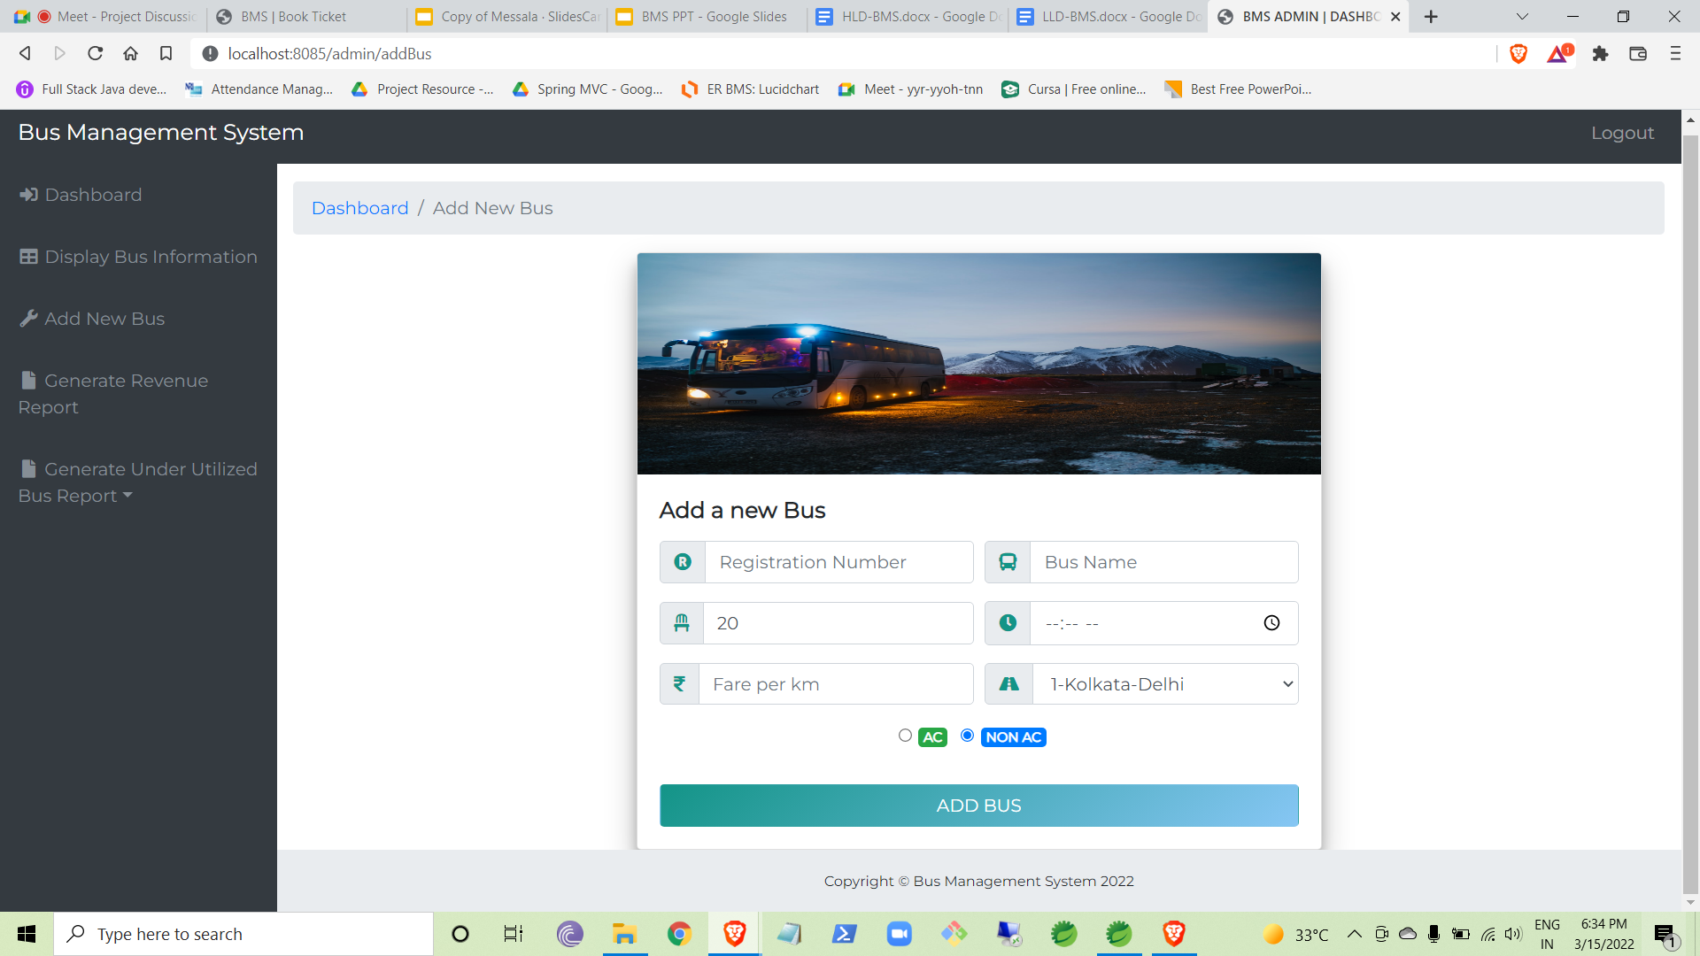
View relevant information
Admin can view relevant data related to the day to day running of the application.
Add Bus
Admin can add a bus if required

Slide 10
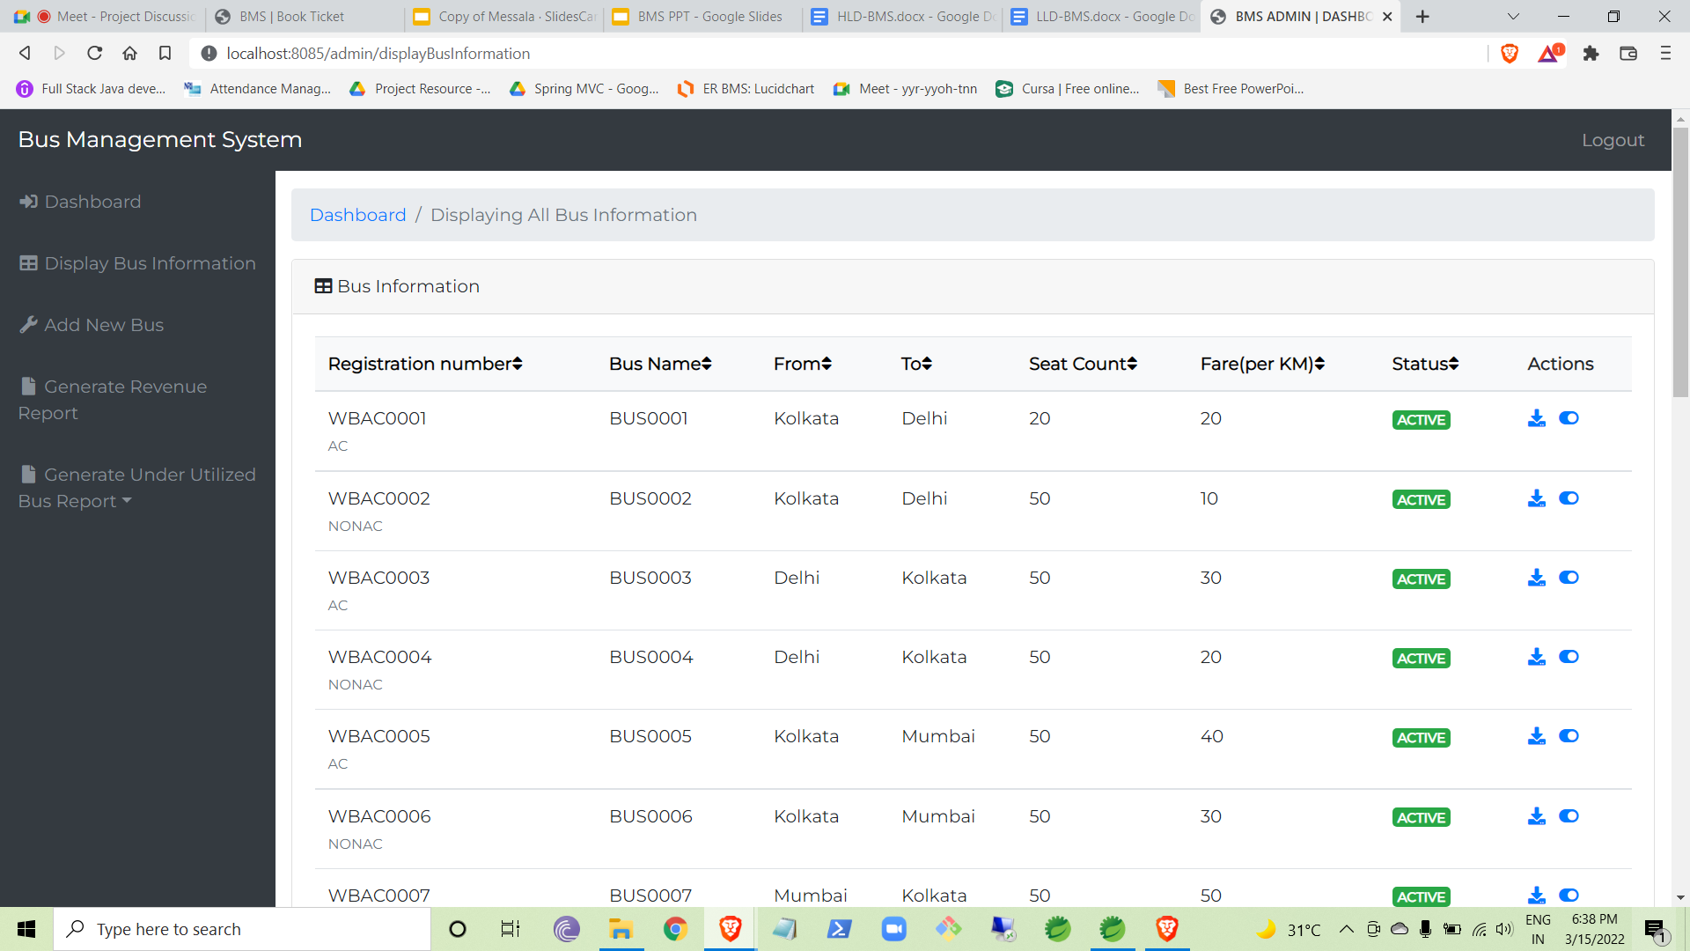
View and disable buses
Admin can view list of buses and disable a bus if needed

Slide 11
REPORT GENERATION
PNR Chart
Revenue Report
Bus utilization report
PNR chart of a bus containing all the information of the tickets booked for the next day can be generated by the admin.
Revenue report of all the routes used for the past 30 days can be generated. It will help take business decisions related to routes.
Underutilized bus report for buses used under a specific percentage for the past 30 days can be generated. This can be used to take business decisions related to the buses.

Slide 12
FUTURE SCOPE
Forgot password / change password feature.
Payment Gateway integration.
Selection of seat position.
Addition of routes.
Edit bus information.

Slide 13
OUR TEAM
Ankan Kumar Bose
Akashdeep Bhattacharya
Harsh Pagaria
Disha Bhattacharya
Shubham Jaiswal

Slide 14
THANKS!
Any questions?

