Slide 1





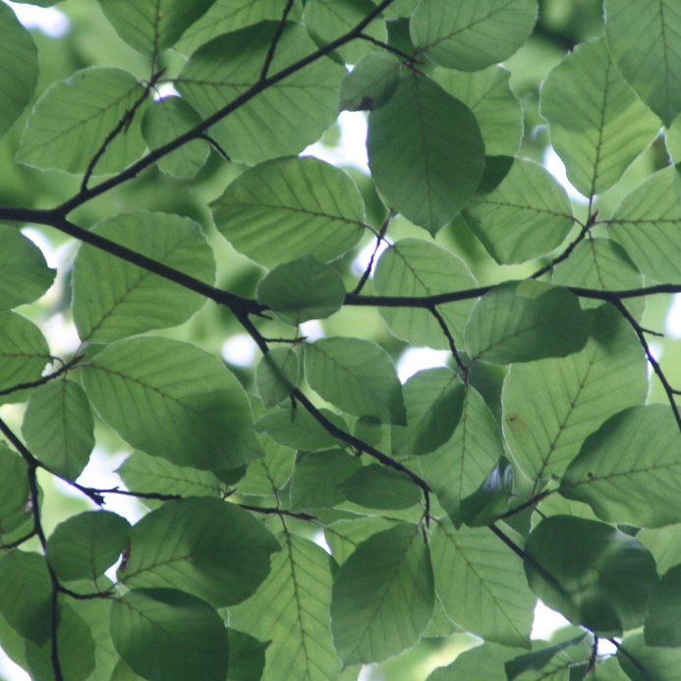
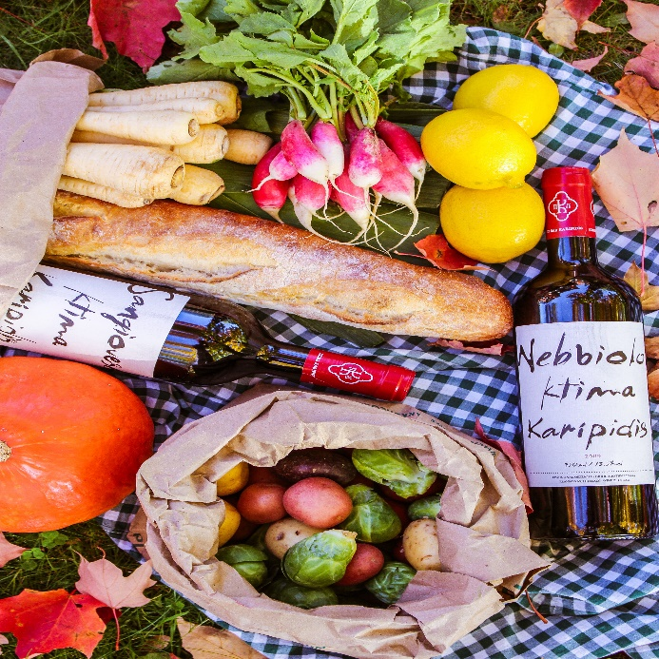
Let’s Picnic
Sun
Tree
Food
Copyright @ 2017 Web Course All right reserved Design：Chan Chih Fang

