Slide 1


PIZZA
BOXCAR

Slide 2


Hello
!
My name is Shashank Jain. In this project i solved a query related to the sales through SQL

Slide 3
QUESTIONS:
Retrieve the total number of orders placed.
Calculate the total revenue generated from pizza sales.
Identify the highest-priced pizza.
Identify the most common pizza size ordered.
List the top 5 most ordered pizza types along with their quantities.
Join the necessary tables to find the total quantity of each pizza category ordered.
Determine the distribution of orders by hour of the day.
Join relevant tables to find the category-wise distribution of pizzas.
Group the orders by date and calculate the average number of pizzas ordered per day.
Determine the top 3 most ordered pizza types based on revenue.

Slide 4

Calculate the percentage contribution of each pizza type to total revenue.
Analyze the cumulative revenue generated over time.
Determine the top 3 most ordered pizza types based on revenue for each pizza category.

Slide 5



Retrieve the total no of orders placed

Slide 6

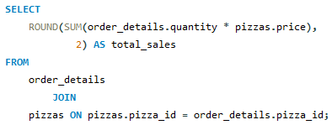

Calculate the total revenue generated from pizza sales

Slide 7

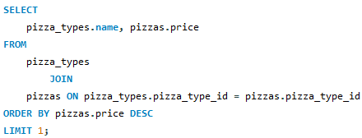

Identify the highest-priced
pizza

Slide 8
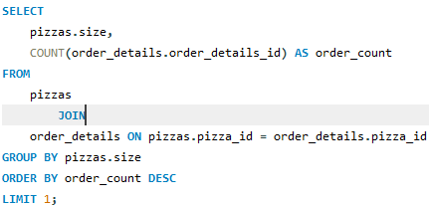

Identify the most common
pizza size ordered

Slide 9
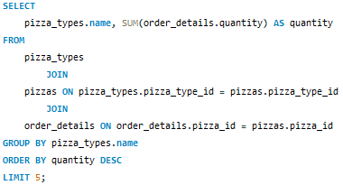
List the top 5 most ordered pizza
types along with their quantities

Slide 10
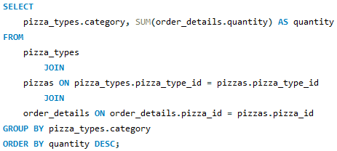

Join the necessary tables to find
the total quantity of each pizza
category ordered

Slide 11
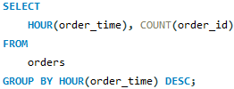
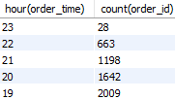
Determine the distribution of
orders by hour of the day

Slide 12
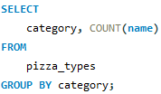

Join relevant tables to find the category-wise distribution of pizzas

Slide 13
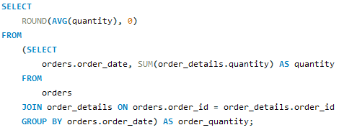

Group the orders by date and
calculate the average number of
pizzas ordered per day

Slide 14
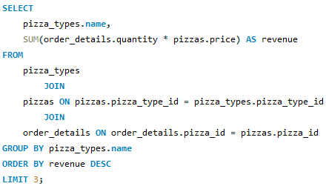

Determine the top 3 most ordered
pizza types based on revenue

Slide 15
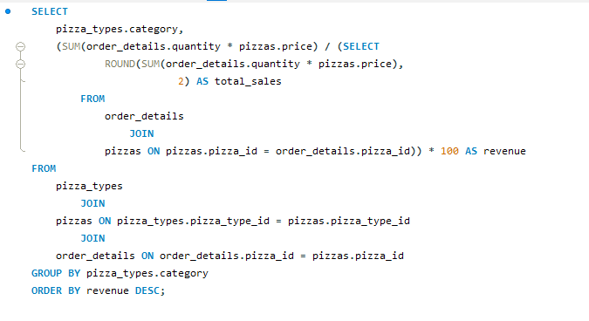
Calculate the percentage
contribution of each pizza type to
total revenue

Slide 16
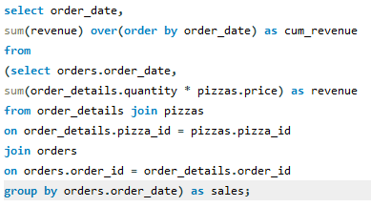
Analyze the cumulative revenue generated over time

Slide 17
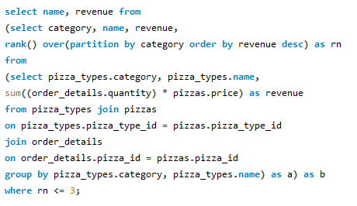
Determine the top 3 most
ordered pizza types based on
revenue for each pizza category

Slide 18
PIZZA PARTY!

