Slide 1

The Collector's Dilemma
The Tyranny of the Almost-Complete Set.
From,
-Sowmya. J

Slide 2
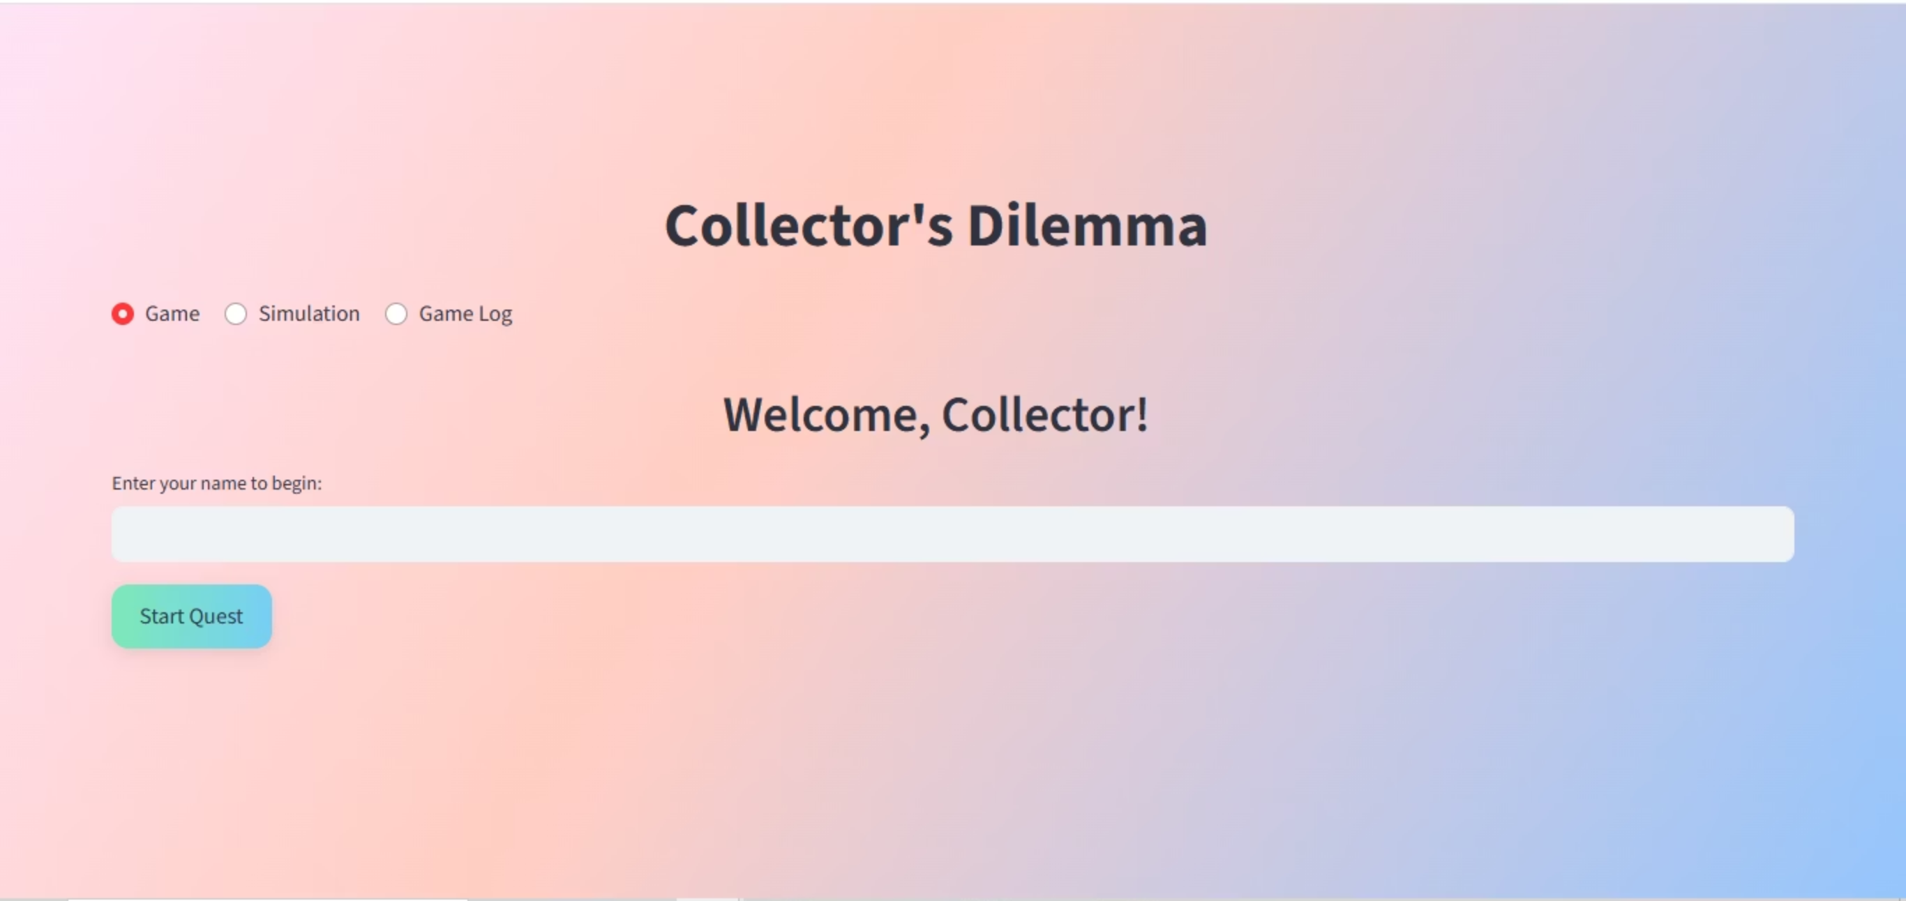
INPUT
OUTPUT
Player Choices
Attempts to Complete Set
Reward Designs
Total Cost
Simulation Parameters
Actionable Business Insights

Slide 3


Who Is This For?
The Player 🎮
The Business Strategist 📊
Experiences the psychology of "the chase" in a fun, interactive game.
Gets hard data to design smarter, more profitable marketing campaigns.

Slide 4









What's the Technology Used?
Python: The Engine
Streamlit: The Interactive UI
Plotly: The Visual Storyteller
Pandas: The Data Handler
Skills Growth: From a mathematical formula to a live data application, brought to life with Streamlit.

Slide 5






What's the Business Driver? 💰
Optimize Engagement
Maximize Revenue
Reduce Risk
Understand which reward model makes the most money.
Predict campaign costs and player drop-off before launch.
Find the "sweet spot" between fun and frustration.

Slide 6


Where Did I Get The Data?
Live Player Data
Simulated Mass Data
Where did it come from?
Where did it come from?
Generated in real-time, every time a user plays my interactive Streamlit game. This is my primary, ground-truth data.
Generated by my Monte Carlo simulation engine, which runs thousands of virtual trials in seconds. This is my high-volume, synthetic data.
How was it processed?
How was it processed?
No pre-processing was needed. The results were clean and logged directly into my "game_log.csv" file.
This was heavily post-processed. I used the Pandas library to structure the raw results, group them by design, and calculate the summary statistics (like mean cost) needed to create my Plotly charts.

Slide 7
The Mathematical Heartbeat: Validating My Simulation
My entire simulation is validated because my 'Equal Chance' model perfectly aligns with the established mathematical theory for the Coupon Collector's Problem.
Where:
E(T) = The Expected (or average) number of trials needed.
n = The total number of unique items in the set.
H_n = The n-th Harmonic Number, which is the sum of the reciprocals.
The Validation: My dashboard proves this. The average attempts from thousands of my simulated trials almost perfectly match the theoretical result from this equation. This confirms my simulation engine is accurate.

Slide 8
Challenges & Conquests
What were the challenges?
Making a dry statistical problem feel fun.
How did you conquer them?
I gamified it! The interactive UI makes the math invisible.
What would you do differently?
The main thing I'd change is to prioritize behavioral modeling; I'd integrate the Pity System and a Quitting Threshold right away. This would make the simulation instantly more realistic by measuring both the cost of being fair and the money lost when players quit from frustration.
Which was that terrible moment of despair?
The biggest hurdle was the confusion between my Monte Carlo Simulation and the term RCT. The despair came from realizing the code worked, but I lacked the language to prove its analytical rigor. The breakthrough was understanding that the simulation's structure mimics the principles of an RCT, allowing me to validate my data against the Theoretical Value and trust my predictions.

Slide 9




Reflections & What's Next
What did you truly learn?
How did you counter disagreements?
I learned that by strategically designing randomness, businesses can control customer emotions—turning a simple game into a powerful tool for loyalty and profit. And also how to create user interface using streamlit.
My most analytically crucial disagreement was when I challenged the realism of the high spending in my "Rare Item" model. Questioning it forced me to prove that the long "whisker" on my Box Plot wasn't a coding error, but a deliberate feature that showed the profit gained from targeting high-spending "whales." This was vital because it validated that my project had moved beyond simple math to analyze aggressive, real-world business strategy and risk.
What's next, after this project?
The euphoric Eureka moment?
This project was a masterclass in using AI to rapidly turn a complex theory into a working tool. What's next is applying this exact skill. I now know how to take a concept, create a logical framework, and direct an LLM to build the solution. That's a powerful process I can use on any big data problem.
I initially thought I forgot to add the RCT. The "Aha!" moment was realizing my whole Monte Carlo simulation is the RCT, perfectly mimicking a large-scale experiment with every run.
Final Thought: I learned that simulation is a powerful way to predict the consequences of a business strategy before it launches. My project shows I can quantify the precise financial trade-off between long-term customer loyalty and aggressive, short-term profit.

