Slide 1
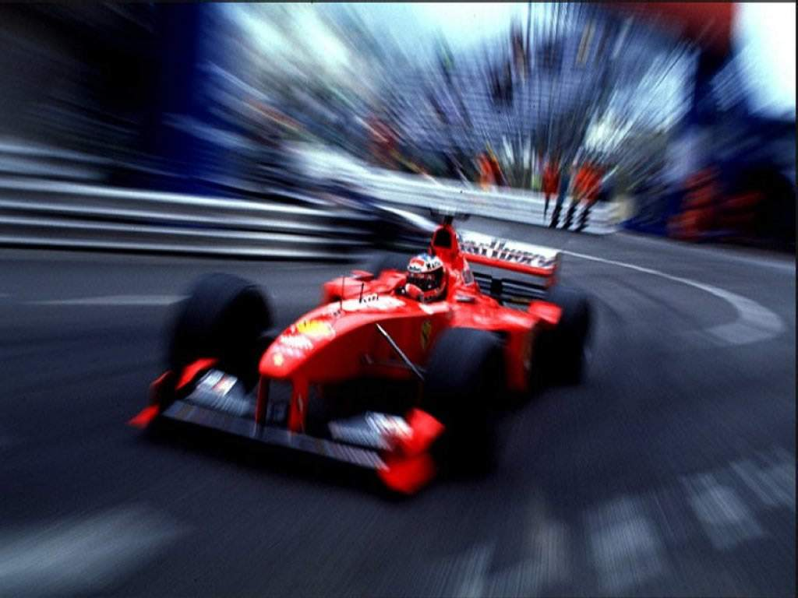
Rush Hour
Formule-i

Slide 2
Presentation
- Recap
- Adjustments
- Time improvement
- Results
- Follow-up

Slide 3
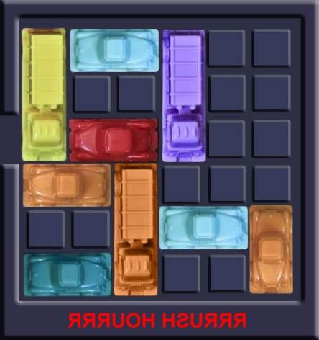
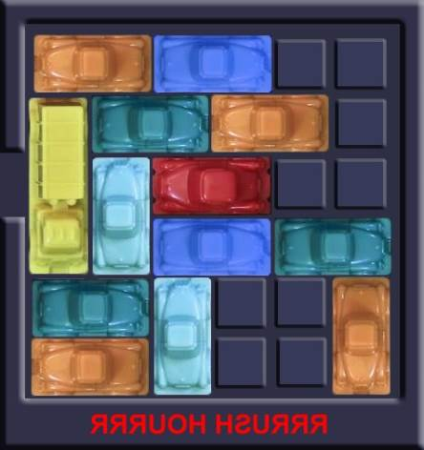
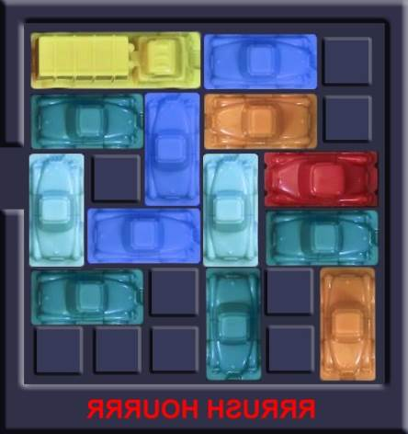
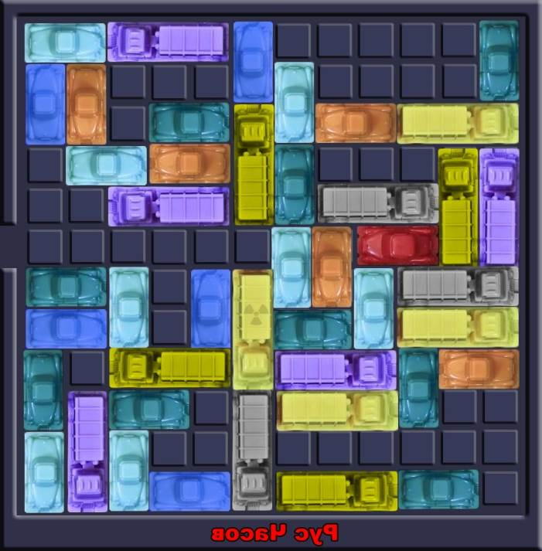
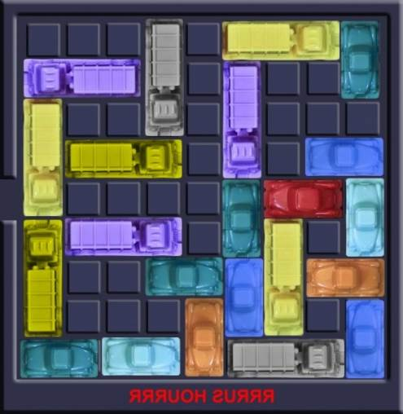
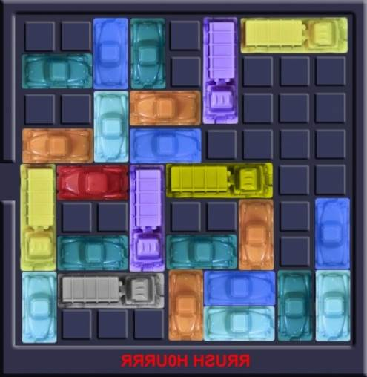
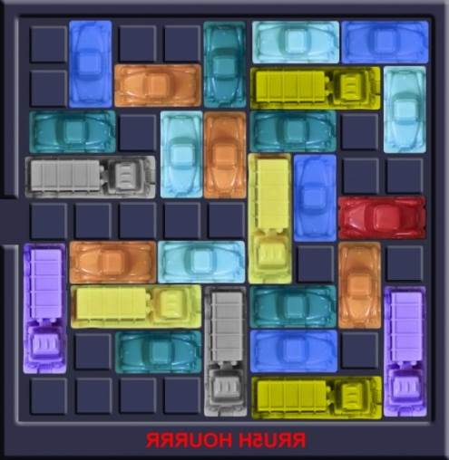
Recap

Slide 4
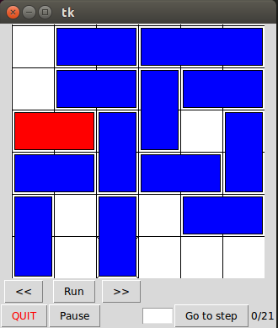
Recap
class Car
    length
    horizontal/vertical
    getPos()
class RedCar
class Parking
    array of columns
    moveCar(steps)
      car.getPos

Slide 5
Recap
BreadthFirstSimulation
  queue = (beginBoard)
  for board in queue
    for step in stepsRange
      child = board.moveCar(step)
      if RedCar on exit:
        JEAJ
      else:
        queue.push(child)

Slide 6
Adjustments
Results saved to file
  results
  time
  version
Multiple steps is one move
Visualization flows

Slide 7
Improved: boards
The way of saving a board
First
  List with lists
  Not hashable
  Slower storage
  mutable
Now
  Tuple with tuples
  Hashable
  Quicker storage
  Not mutable

Slide 8
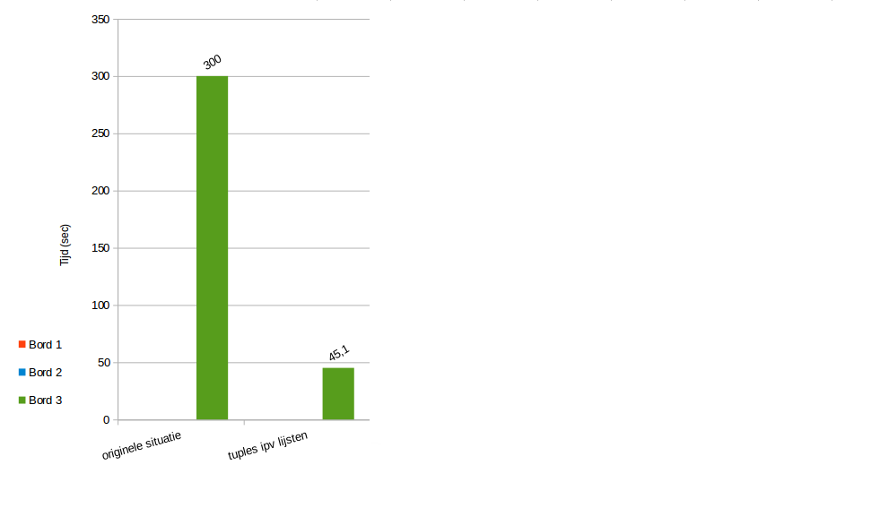
Improved: boards

Slide 9
Improved: moving
Only try to set more steps if you can set less

Slide 10
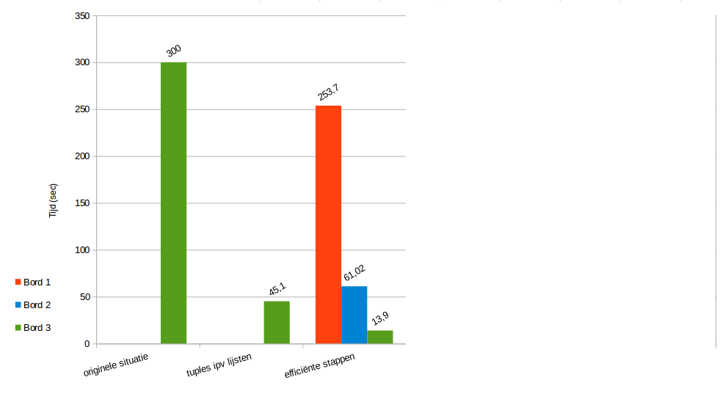
Improved: moving

Slide 11
Improved: copying
Only copy a board if you actually move a car

Slide 12
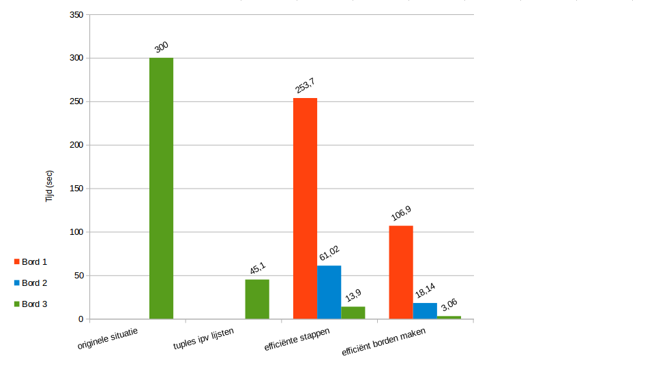
Improved: copying

Slide 13
Improved: copying (2nd)
No hardcopy of parts that did not change
Using copy.copy() instead of copy.deepcopy()

Slide 14
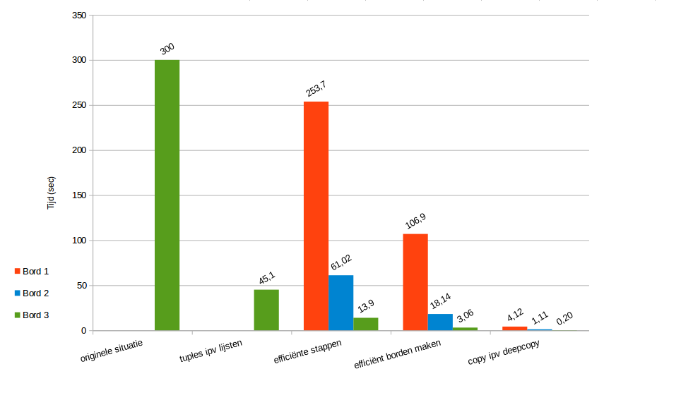
Improved: copying (2nd)

Slide 15
Improved: adjusting tuples
First:
  For each point:
    Tuple –-> list
    Adjust list
    List –-> tuple
Now:
  Tuple –-> list
  For each point:
    Adjust list
  List –-> tuple

Slide 16
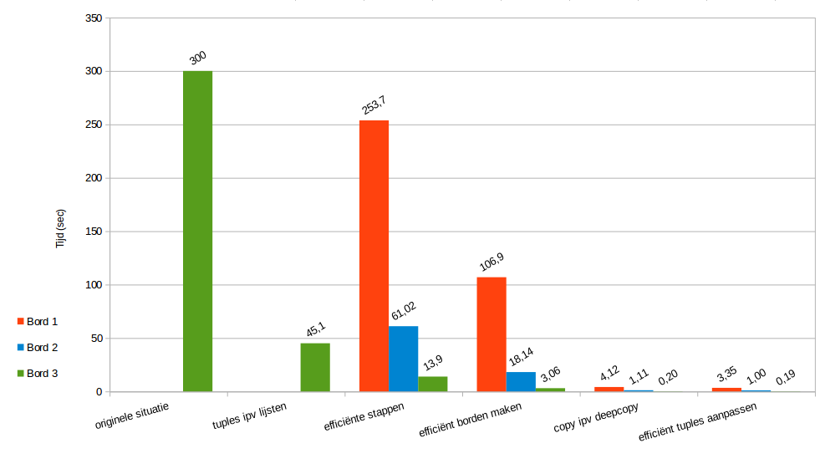
Improved: overview

Slide 17
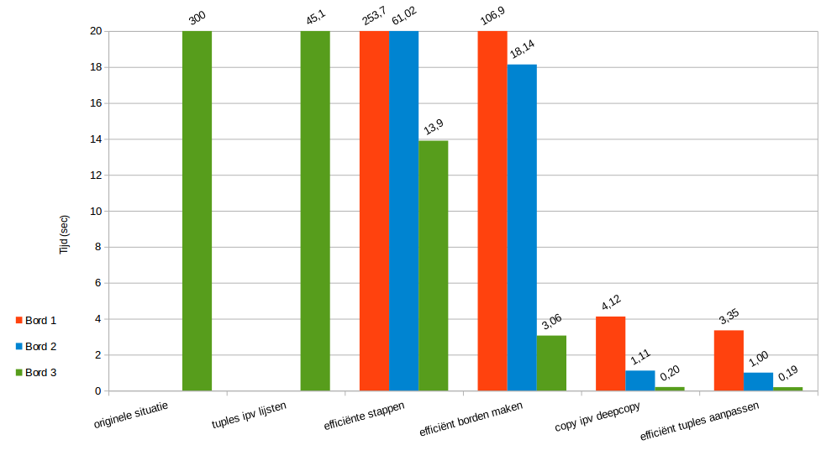

Slide 18
Bigger boards
Showtime!
  Board 4
Other boards too big

Slide 19
Future improvements
Calculate all steps at once
A*
  Heuristics / Priority Queue
Suggestions?

Slide 20
Questions
Feedback

