Slide 1
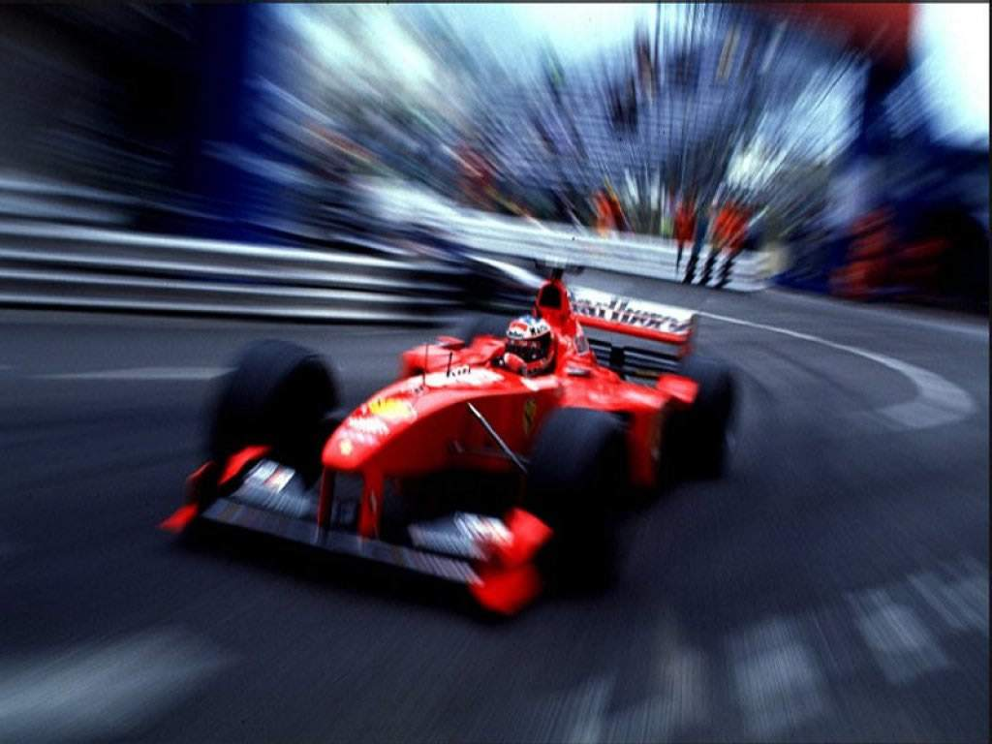
Rush Hour
Formule-i

Slide 2
Presentation
- Recap
- Adjustments
- Time improvement
- Results
- Follow-up

Slide 3
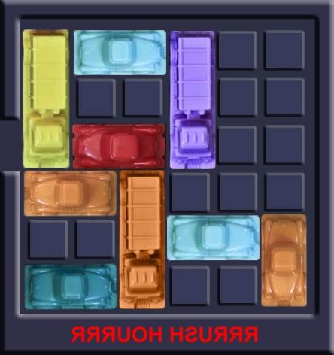
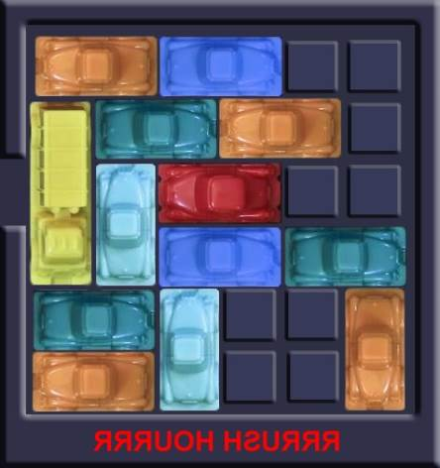
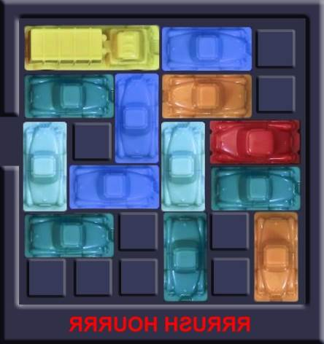
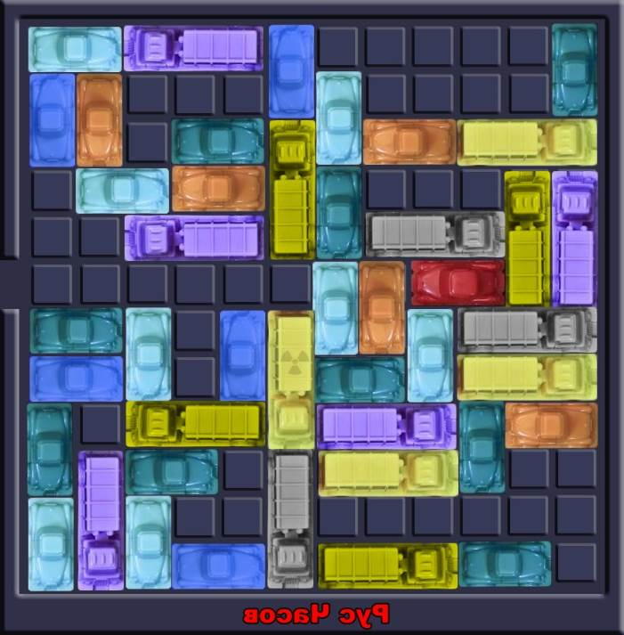
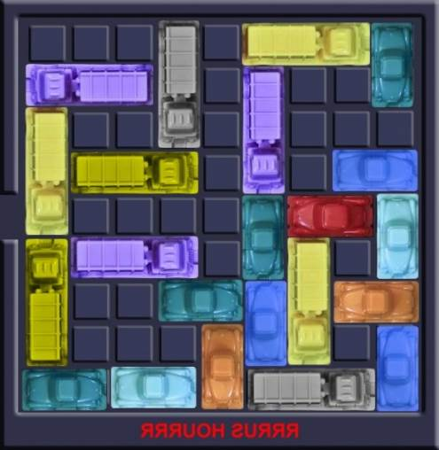
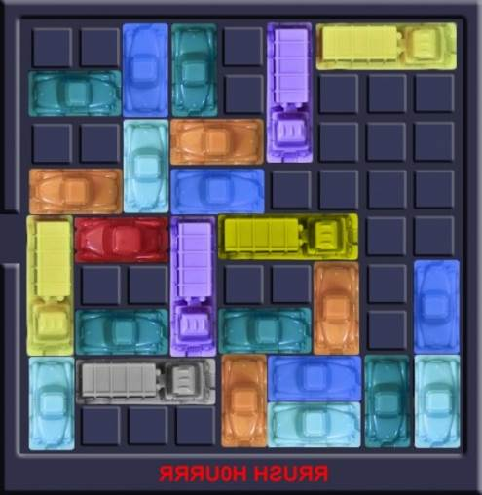
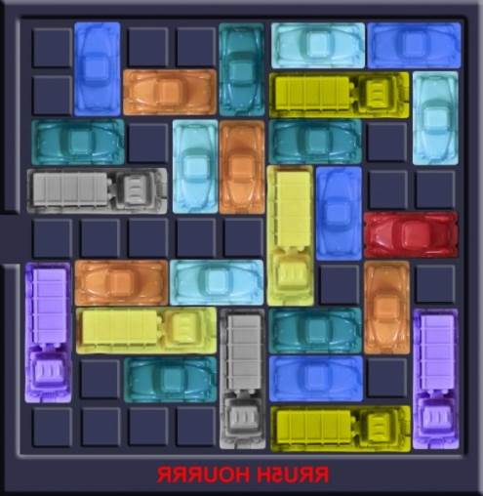
Recap

Slide 4
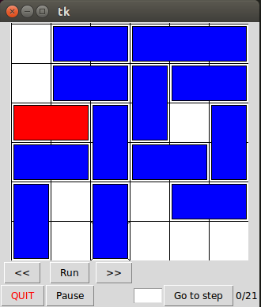
Recap
class Car
    length
    horizontal/vertical
    getPos
class RedCar
class Parking
    array of columns
    moveCar(steps)
      car.getPos

Slide 5
Recap
BreadthFirstSimulation
  queue = (beginBoard)
  for board in queue
    for step in stepsRange
      child = board.moveCar(step)
      if RedCar on exit:
        JEAJ
      else:
        queue.push(child)

Slide 6
Adjustments
Results saved to file
  results
  time
  version
Multiple steps is one move
Visualization flows

