Slide 1
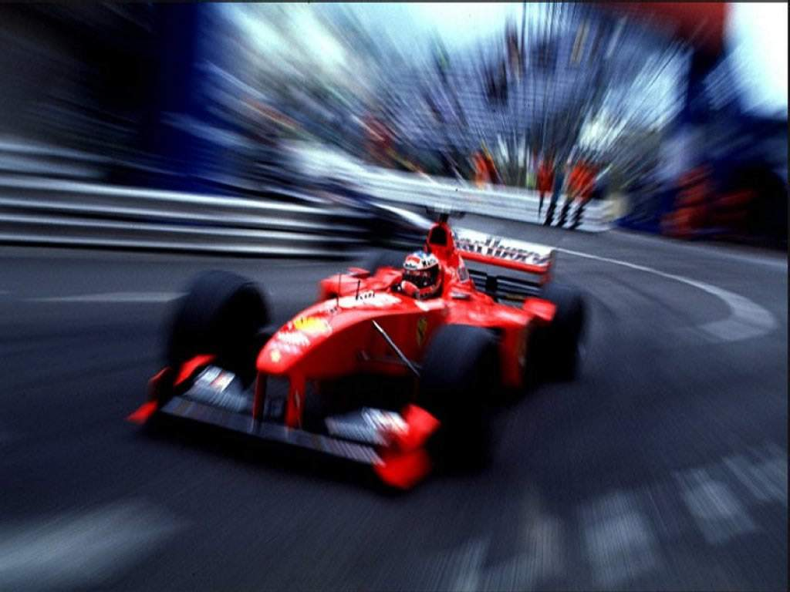

Slide 2
Formule i
Patrick Schilder
Alix Dodu
Sjoerd van der Heijden

Slide 3
Introduction
Rush Hour
Heuristics
Algorhitms
  Depth First
  Breadth First
  A*
Conclusion

Slide 4
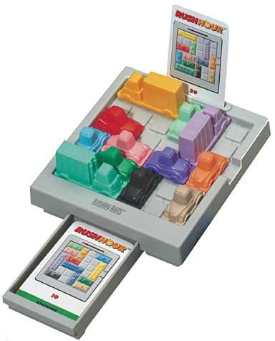
Rush Hour
???

Slide 5
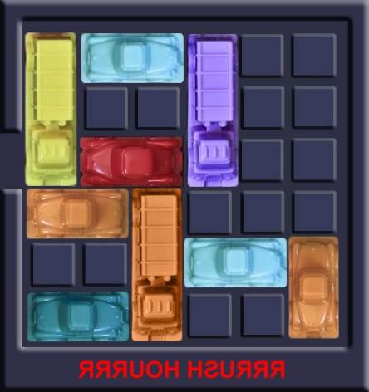
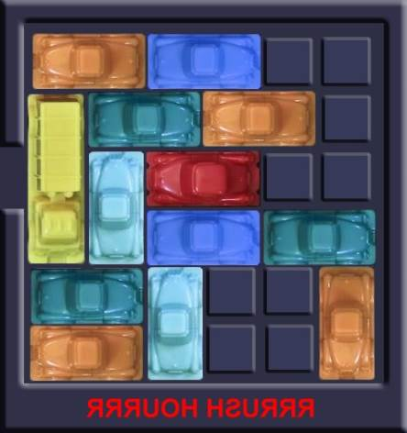
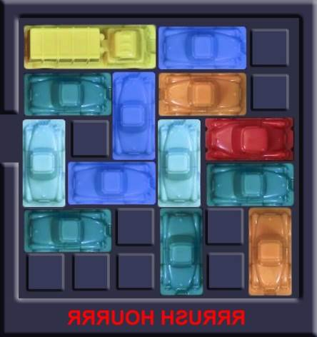
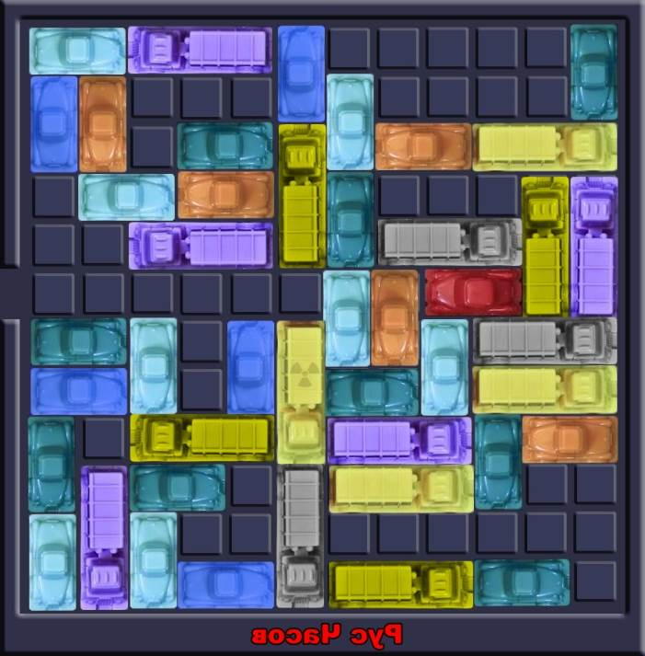
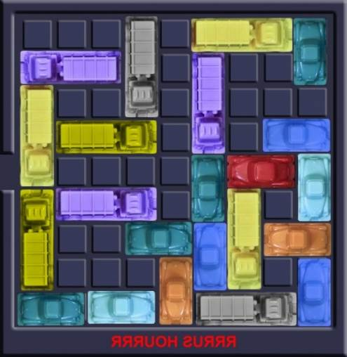
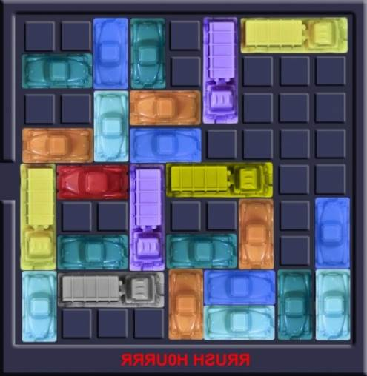
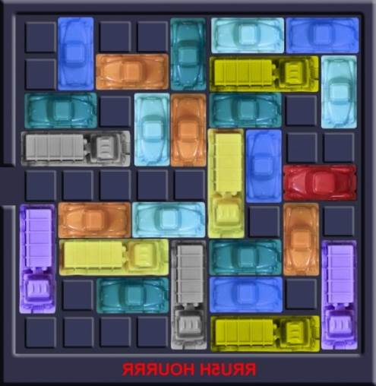
Rush Hour

Slide 6

Algorithms: Depth First
Memory efficient
Takes long time

Slide 7

Algorithms: Breadth First
Faster
First solution is best
Takes lots of memory

Slide 8

Algorithm: A*
Breadth First, but not
Priority Queue
Heuristics
Fast, light, reliable

Slide 9
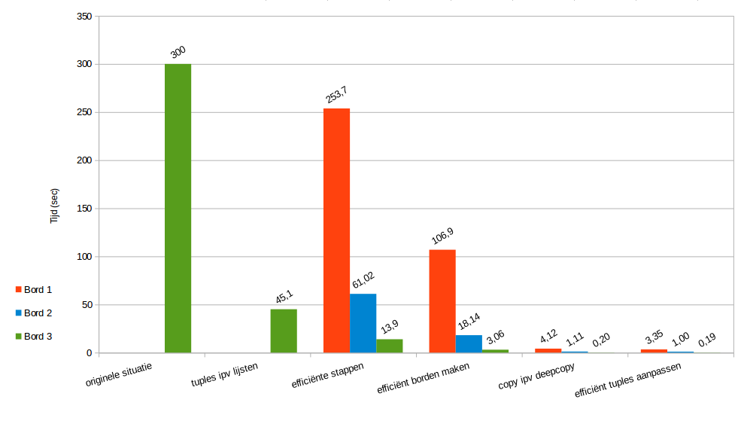
Improvement

Slide 10
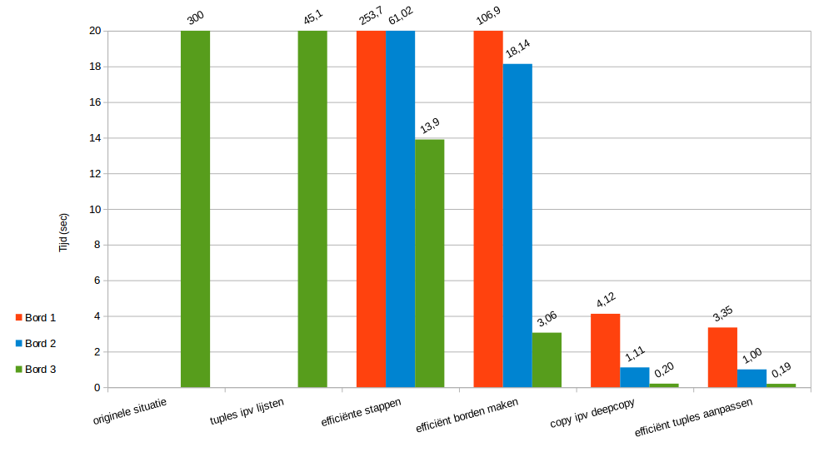

Slide 11
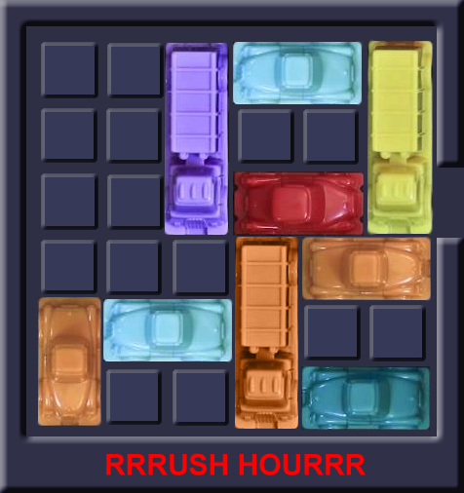
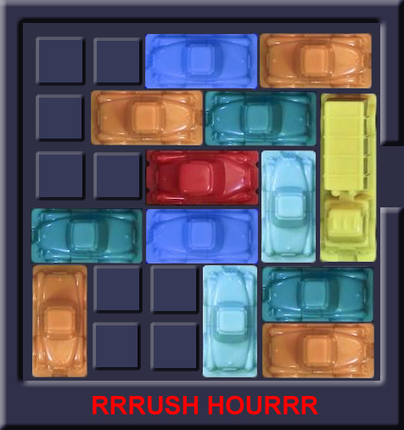
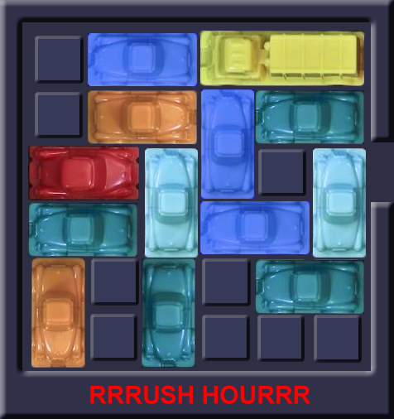
Toestandsruimte
1.000.000 227.812.500 9.122.500
→ 1*10^6 → 2*10^8 → 9*10^6

Slide 12
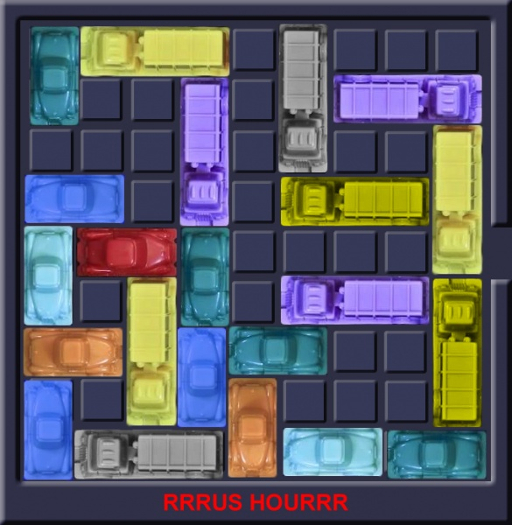
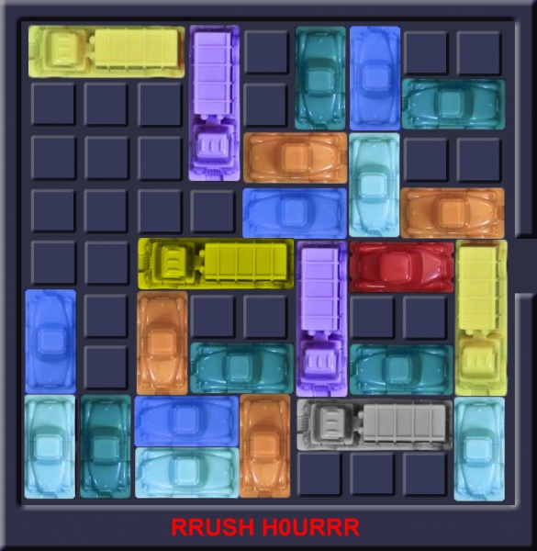
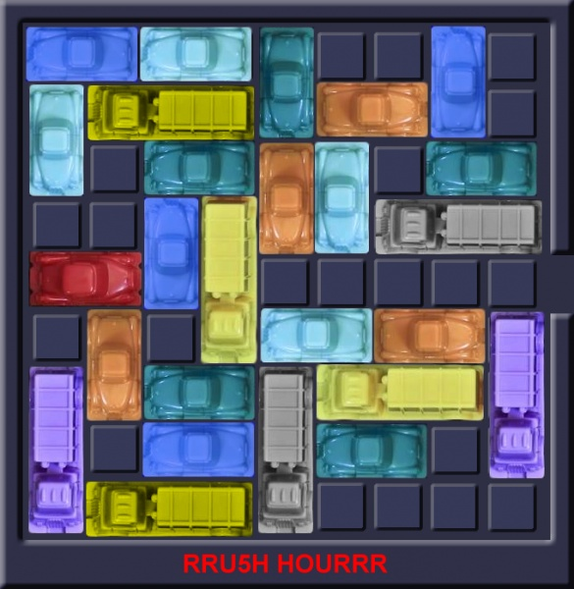
Toestandsruimte
722.670.236.467.200 1.203.948.748.800.000.000 6.968.605.851.648.000.000
→ 7*10^14 → 1*10^18 → 6*10^18

Slide 13
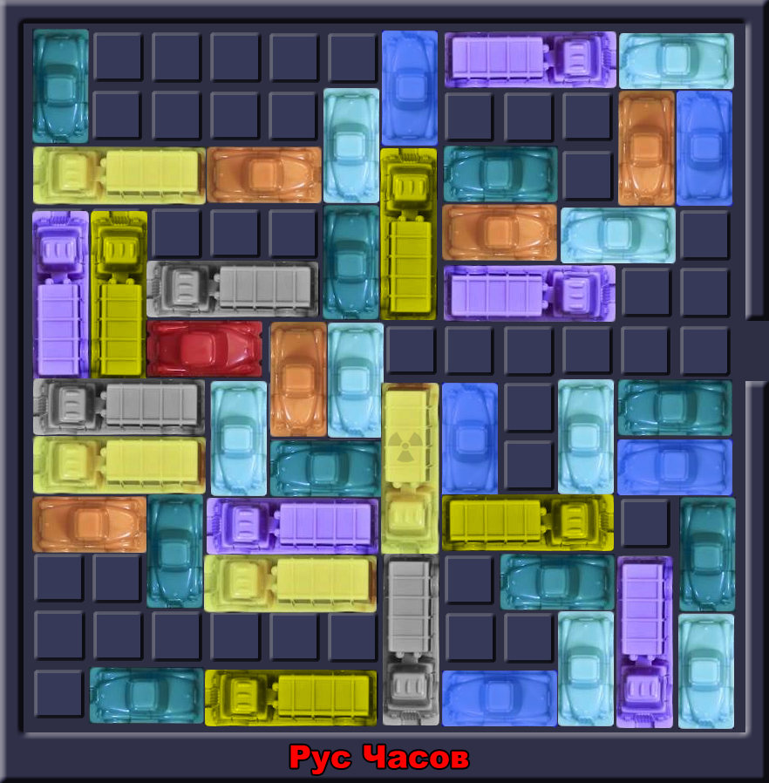
Toestandsruimte
904.172.676.316.862.775.788.159.631.360.000

Slide 14
Questions
Feedback

