Slide 2
Improved: boards
The way of saving a board
First
  List with lists
  Not hashable
  Slower storage
  mutable
Now
  Tuple with tuples
  Hashable
  Quicker storage
  Not mutable

Slide 3
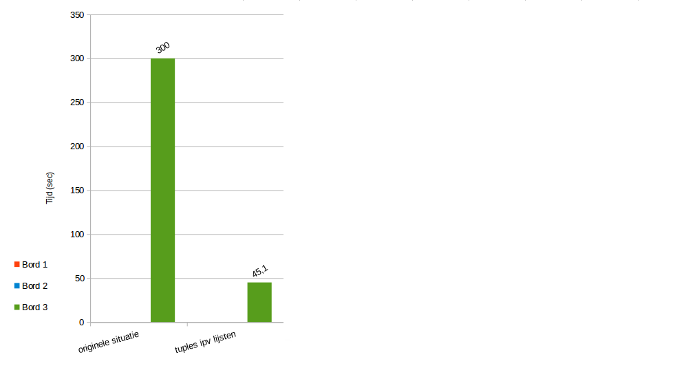
Improved: boards

Slide 4
Improved: moving
Only try to set more steps if you can set less

Slide 5
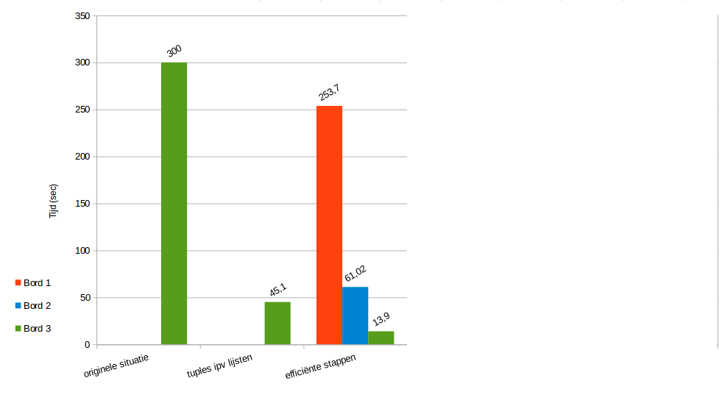
Improved: moving

Slide 6
Improved: copying
Only copy a board if you actually move a car

Slide 7
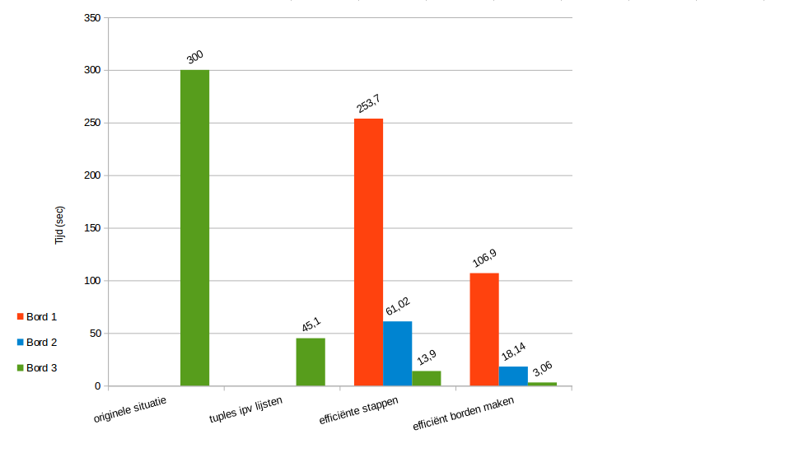
Improved: copying

Slide 8
Improved: copying (2nd)
No hardcopy of parts that did not change
Using copy.copy() instead of copy.deepcopy()

Slide 9
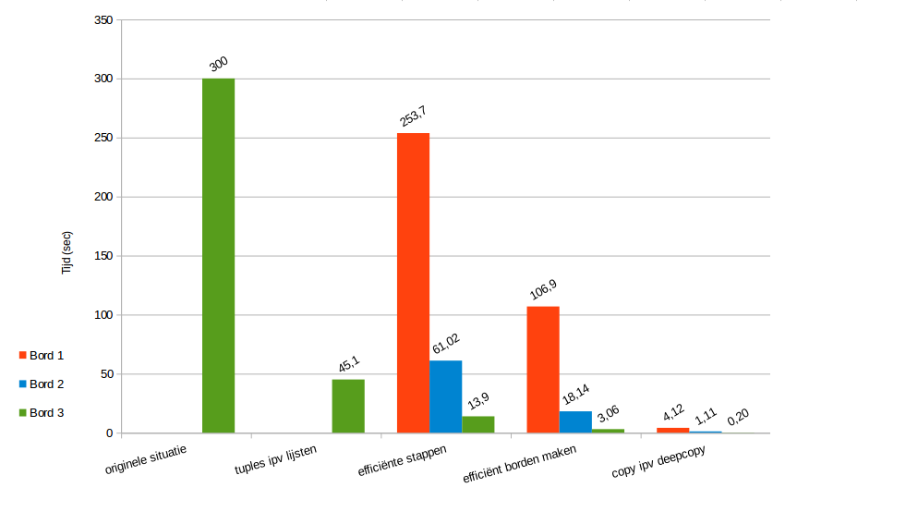
Improved: copying (2nd)

Slide 10
Improved: adjusting tuples
First:
  For each point:
    Tuple –-> list
    Adjust list
    List –-> tuple
Now:
  Tuple –-> list
  For each point:
    Adjust list
  List –-> tuple

Slide 11
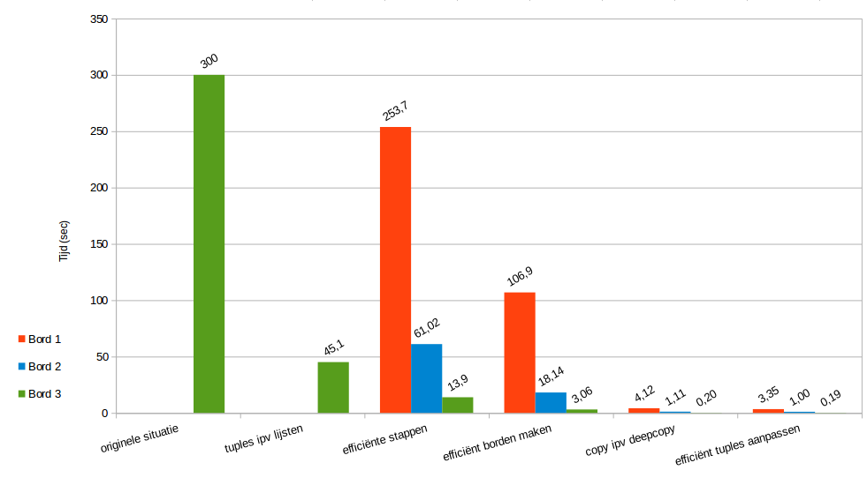
Improved: overview

Slide 12
