Slide 1

DOWNSCALING OF SATELLITE BASED AIR QUALITY MAPS
Project number:SIH1734 Batch Number: 8
Downscaling satellite-based a ir quality image mapping involves enhancing the spatial resolution of satellite data to better capture fine-scale variations in air quality.
TEAM MEMBERS:
Ps.Chandana -22BQ1A42C0 S.Bhavana - 22BQ1A42E8
Sk.Rihana -22BQ1A42E9
Sk.Hamidha -22BQ1A42D6

Slide 2
TOPIC: DOWNSCALING OF SATELLITE BASED AIR QUALTY MAPPING
Sharpening the View: Enhancing Spatial Resolution of Satellite Imagery

Slide 3
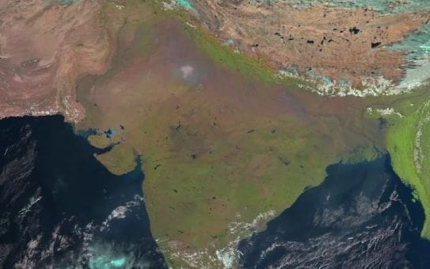
Generating high-resolution pollution maps, improving urban air quality modeling includes.

Slide 4
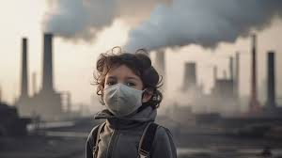
Satellite data (broad but coarse)
Ground-based data (precise but sparse)
Auxiliary data (contextual and high-resolution)

Slide 5
Selects Downscaling methods
supervised models (e.g., random forests, gradient boosting, neural networks) to learn relationships between satellite data and fine-scale features.

Slide 6
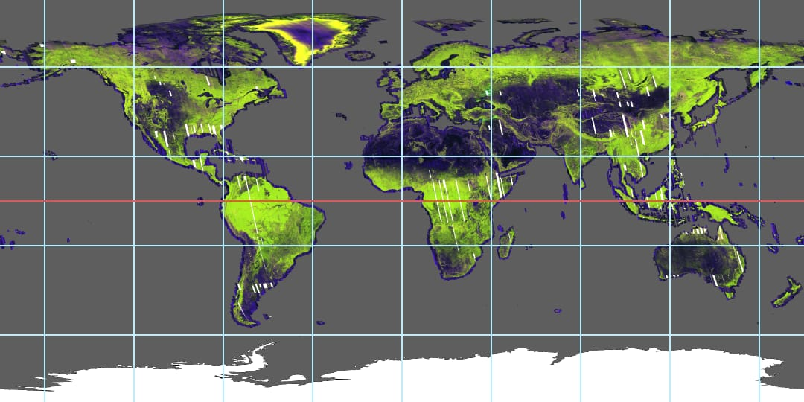
Generates Downscaled Maps
Visualize the downscaled maps using Python libraries (e.g., matplotlib, geopandas).

