Slide 1

INTRODUCTION
Name :- Sonar sanket Kailas
Project name :- MOVIES RECOMMANDATION SYSTEM
Batch :- ML09
Mentor :- Aswini kakade mam

Slide 2

CONTENT :
Introduction
Real life application
Library
Flow chart
Conclusion
Reference & Dataset detail

Slide 3

Introduction :
A movie recommendation system is a fancy way to describe a process to predict the items based on your past preference . we can say that a Recommendation System is a tool designed to predict/filter the items as per the user's behavior

Slide 4


Real life application

Slide 5

Library
Import numpy as np
Import pandas as pd
Import matplotlib.pyplot as plt
Import ast
from sklearn.feature_extraction.text import CountVectorizer
from sklearn.metrics.pairwise import cosine_similarity

Slide 6

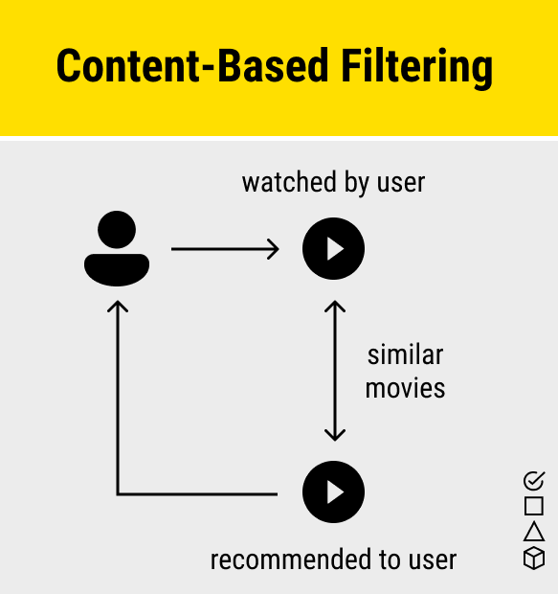
Flow chart

Slide 7

Conclusion :
In conclusion, creating a movie recommendation system with machine learning improves user experience. It offers personalized movie suggestions based on individual preferences
The recommendation system analyses the past preferences of the user concerned, and then it uses this information to try to find similar movies

Slide 8

Datasets Detail & Reference
I have collected the Two dataset’s for the Movies recommendation system from real world sensor data available in kaggle.com. 1) credits.csv 2) movies.csv
credits.csv : movie_id , title , cast , crew are the attribute are contain in dataset
movies.csv : budget , title, vote_count, popularity , id , vote_average , keywords etc. are the attribute are contain in dataset

