Slide 1

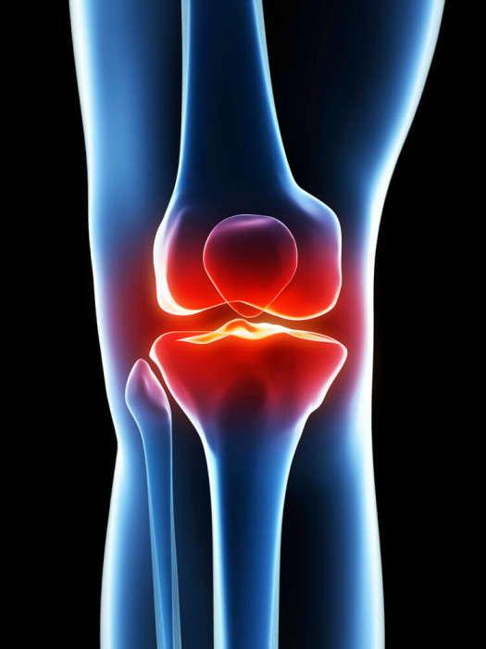
Knee Osteoarthritis Severity Detection Using Deep Learning
Shaik Gouse Mastan Vali
Sam Houston State University
Supervisor
Dr. Frank Liu
Committee Members
Dr. An Min
Dr. Islam ABM

Slide 2
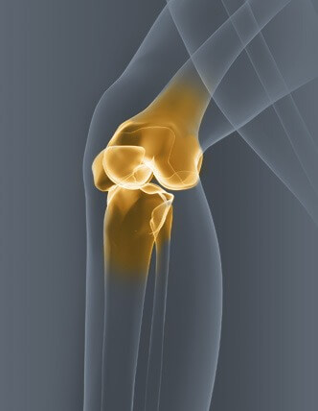
Contents
1
Motivation
2
Problem Statement
3
Related Research
4
Dataset
5
Data Pre-Process and Augmentation
6
Proposed Methodology
7
Model Training
8
Performance Evaluation
9
Results
10
Cross Validation
11
GUI
12
Tools
13
References

Slide 3
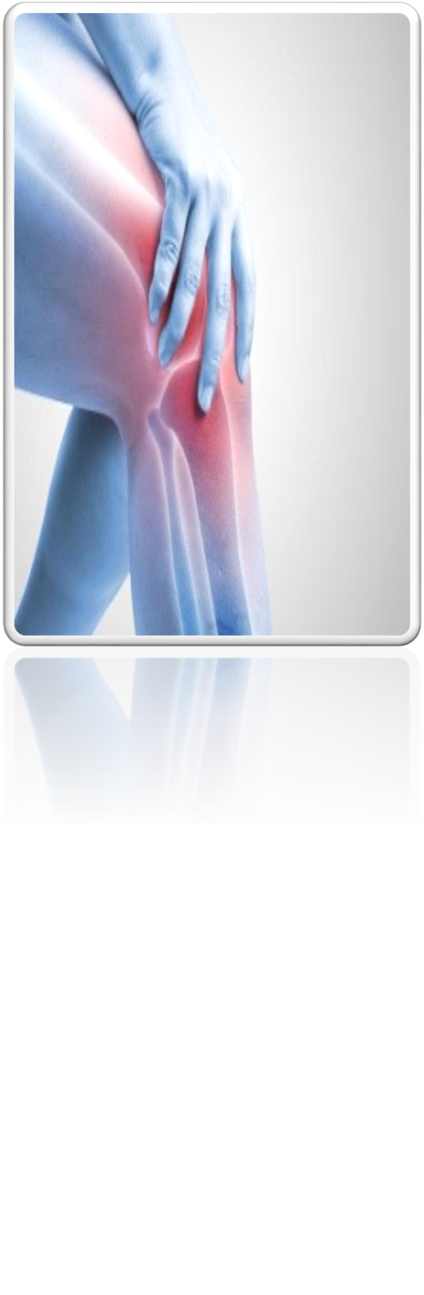
Motivation
Developing the Deep Learning model to identify the knee OA severity early. so that appropriate treatment can be provided to prevent further damage.
Preparing this project based on the dataset provided by the Mendeley Dataset [1] and Kaggle Dataset [12] with its motivation.

Slide 4
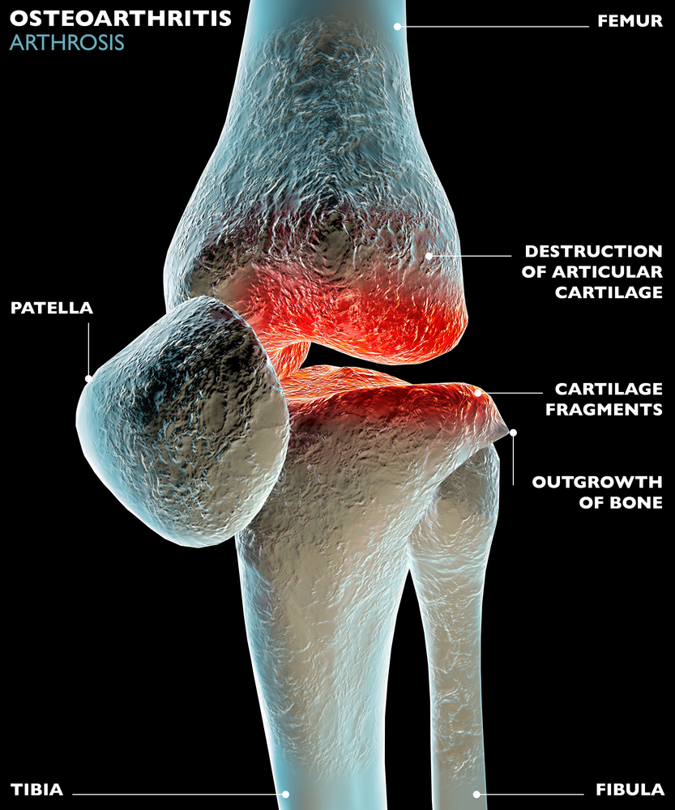
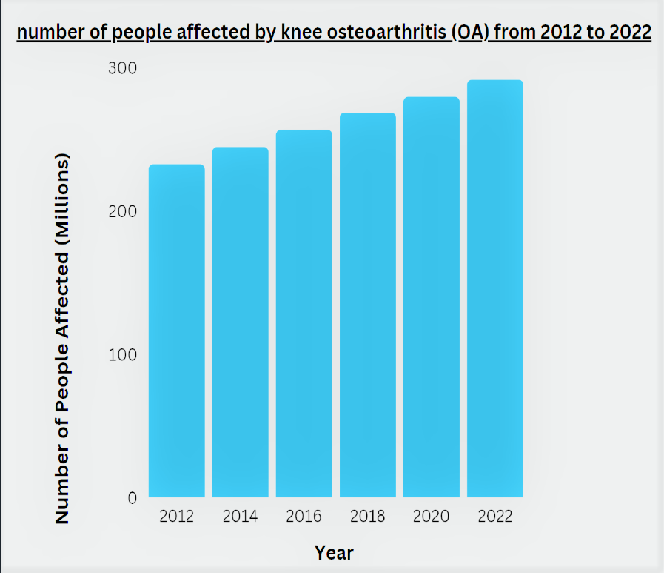
Problem Statement
Knee osteoarthritis is a degenerative joint disease that affects 90 million people. 60% of knee OA is occurring above 50+ years people. Listed in Top 50 diseases in the world [2]
It occurs when the cartilage in the knee joint breaks down over time. leads to causing pain, stiffness, swelling and reduce quality of life. In severe cases, knee osteoarthritis can lead to disability and require surgery.
Factor of effecting includes: genetics, environment, lifestyle choices and etc.
Source: https://www.ncbi.nlm.nih.gov/pmc/articles/PMC7704420/

Slide 5
Model:
Author:

Slide 6
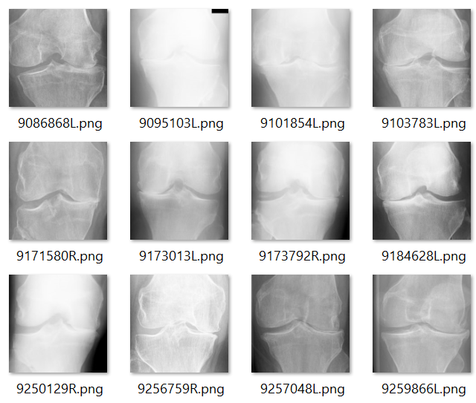
Dataset
Dataset -1
Dataset -2
Collected dataset from Mendeley Data platform [1]
It contain more than 8200 X-ray Images
All images resolution : 224 × 224 pixels
Labelled from 0-4 based on severity (0-healthy, 1-doubtful, 2-mild , 3-moderate, 4-severe)
Already Augmented Images
Need to perform Data Augmentation for balancing the data
Collected dataset from Kaggle [12]
It contain 1200 X-ray Images, developed by medical experts
All images resolution : 240 x 240 pixels
Labelled from 0-4 based on severity (0-healthy, 1-doubtful, 2-mild , 3-moderate, 4-severe)
Unique and original images
Need to perform Data Augmentation for balancing the data

Slide 7
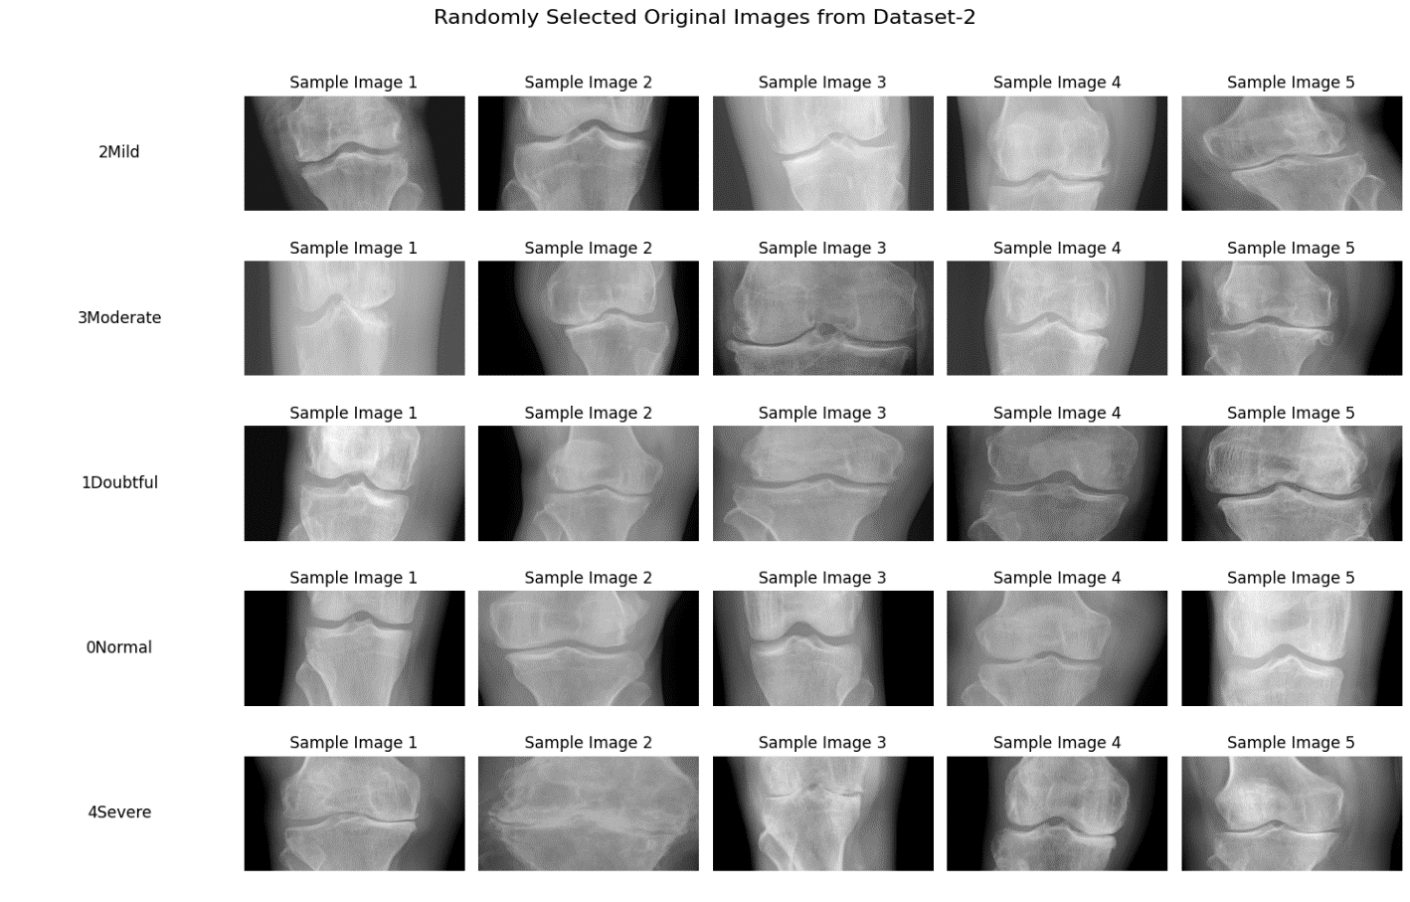
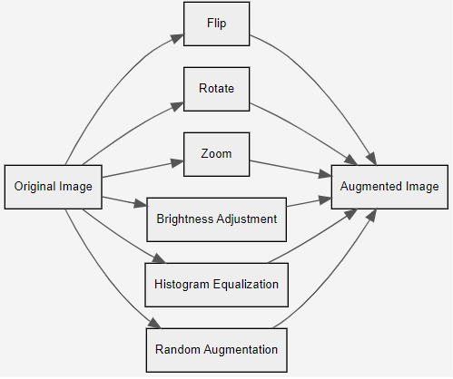
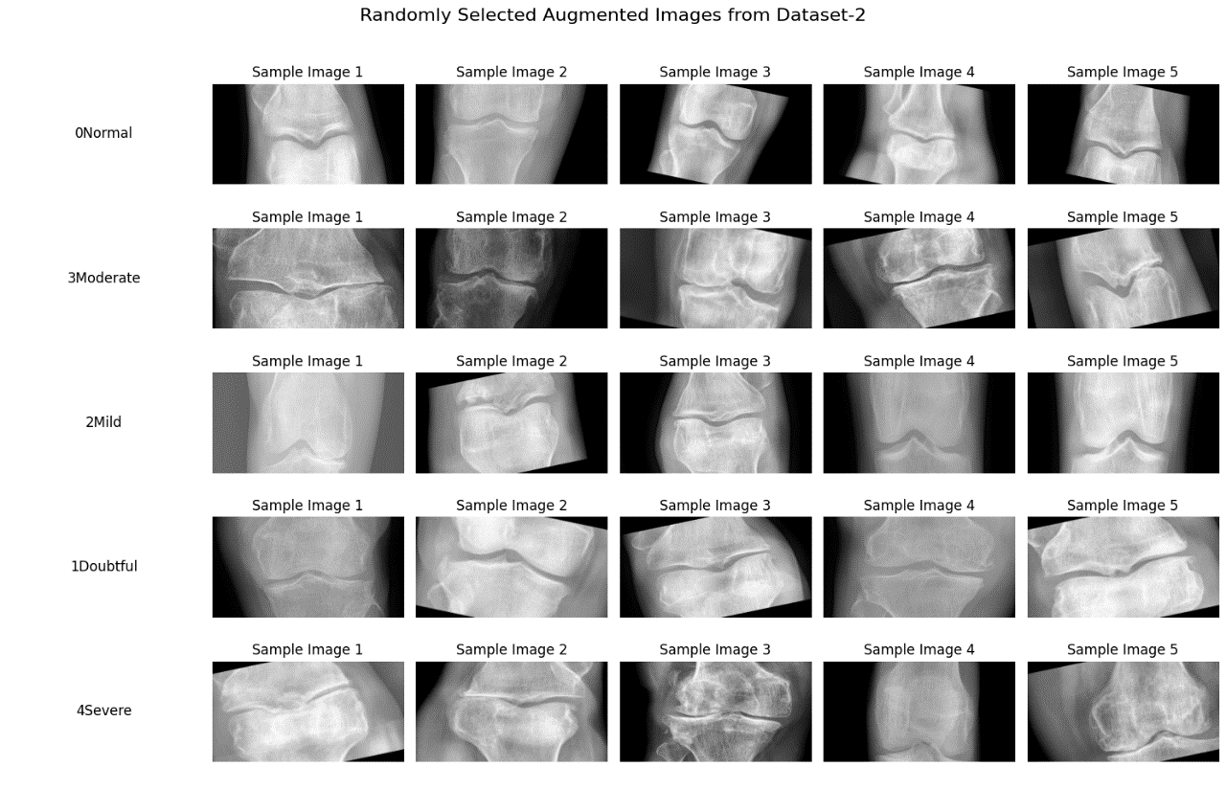
Data Pre-Processing and Augmentation
Resize of image
Normalization
Gray Scale Conversion
Histogram equalization
Noise Removal Gaussian filter
Before Augmentation
After Augmentation

Slide 8
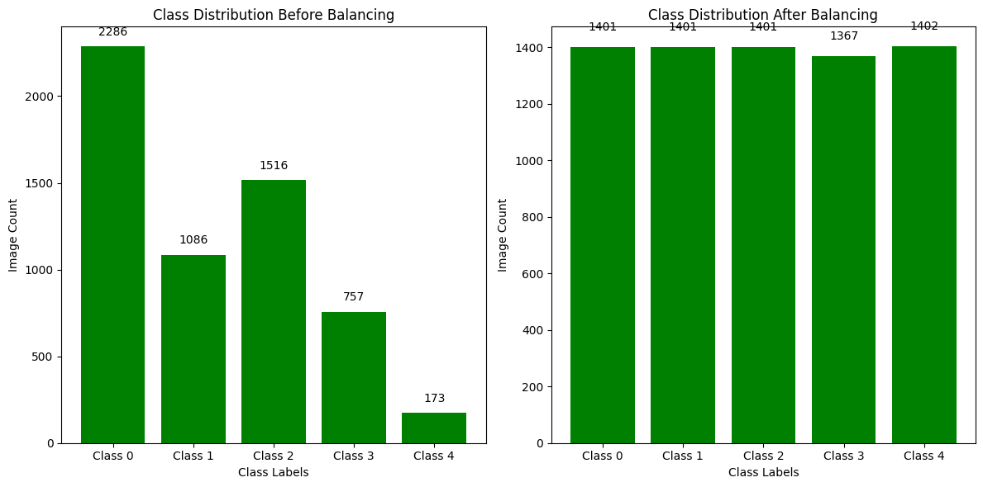
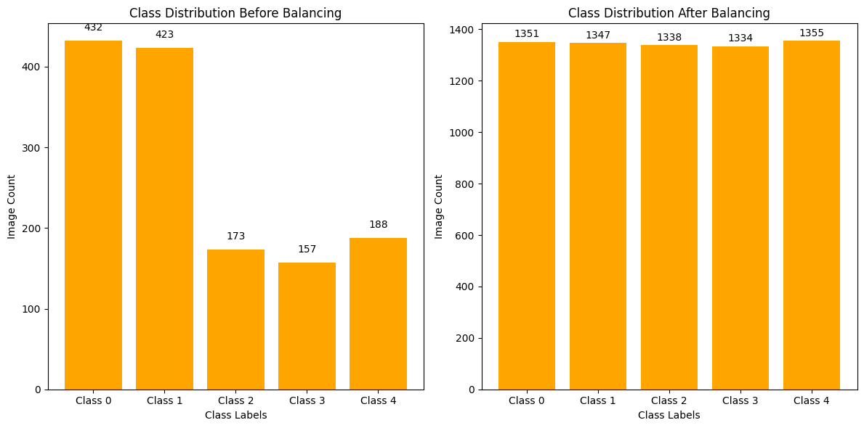
Data Pre-Processing and Augmentation (cont..)
Class balancing-Dataset 1
Class balancing-Dataset 2
Created separate datasets after augmentation
8000 images for Dataset 1
7000 images for Dataset 2
Split the 70%, 10%, 20%

Slide 9
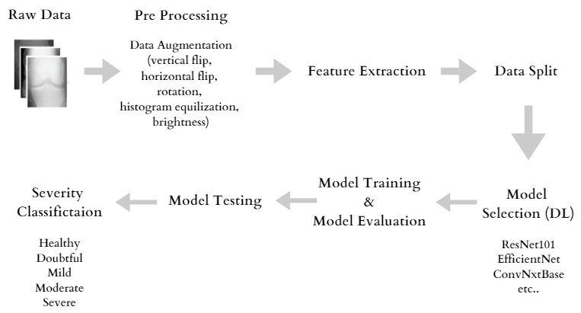
Proposed Methodology

Slide 10
Proposed Methodology (cont..)
Deep Learning Models for Classification
Dataset 1 :
Inception V3
VITB16
VGG16
ResNet101
DenseNet121
EfficientNetB0
ConvNextBase
Dataset 2:
Custom CNN
ResNet101
VGG16
EfficientNetB0
ConvNextBase

Slide 11
Model Training
We have Built Own CNN Model First,
Tried Different Transfer Learning Models
Leveraged and Fine Tuned Transfer Learning Model ConvNextBase for our Task.
Applied different Loss Functions
weighted CE (Cross Entropy),
Focal CE, Class Balanced CE,
Class Balanced Focal CE,
Categorical CE loss functions
Experimented and implemented with Different Learning Rate schedulings
Freeze the layers (weights update)
Batch Normalization
Global Avg Pooling
Fully connected layer
(Regularization and Dropout)
Output

Slide 12
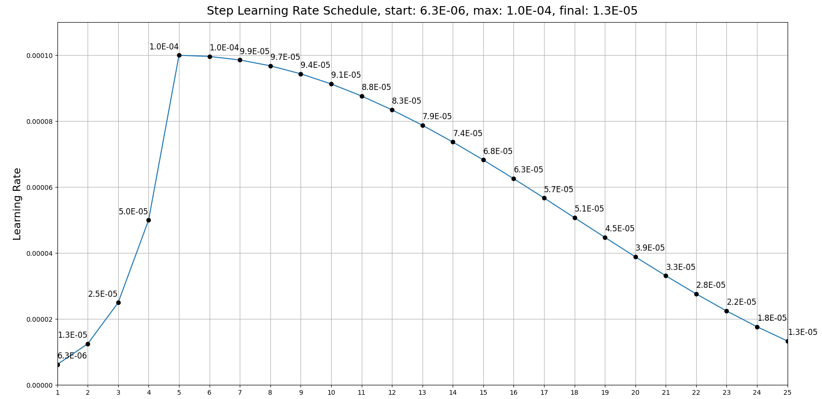
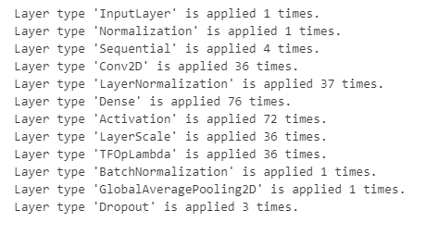
Model Training (cont..)
ConvxNextBase Layers
Custom Learning Rate Curve

Slide 13
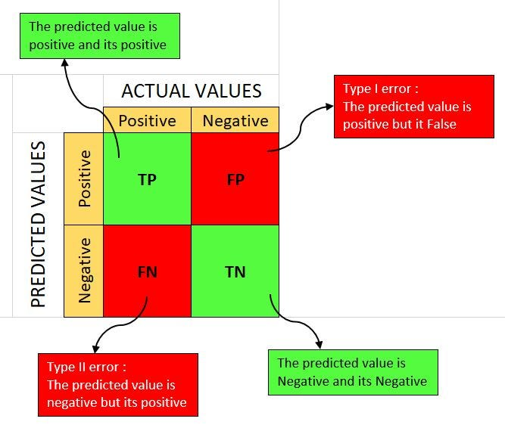
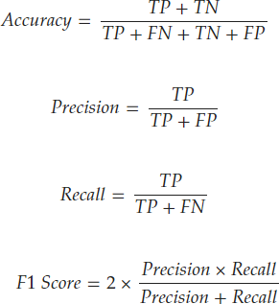
Performance evaluation
Confusion Matrix
Accuracy
Precision
Recall
F1 Score

Slide 14
Results
Dataset 1 (After Augmentation)
Dataset 1 (Before Augmentation i.e. Original Data)
Model | Accuracy | Precision | Recall | F1 score
DenseNet121 | 57 | 54 | 57 | 52
VGG16 | 62 | 62.6 | 62 | 61
InceptionV3 | 46 | 46.2 | 46 | 45.7
VIT-B16 | 48 | 48 | 48 | 48
EfficientNet-V1B0 | 65 | 65 | 65 | 65
ResNet101 | 64 | 64 | 64 | 64
ConvNextBase | 66 | 66 | 66 | 66
Model | Accuracy | Precision | Recall | F1 score
DenseNet121 | 62 | 67 | 62 | 63
VGG16 | 63 | 66 | 66 | 66
InceptionV3 | 47.2 | 47.5 | 47.2 | 47.2
VIT-B16 | 48 | 48.3 | 48 | 48.2
EfficientNet-V1B0 | 65 | 64 | 63 | 62
ResNet101 | 63 | 66 | 66 | 66
ConvNextBase | 66.3 | 66.1 | 64.2 | 65.7
Model | Loss Function | Accuracy | Precision | Recall | F1 score
ConvNextBase | Weighted CE | 70 | 70 | 71 | 70
ConvNextBase | Weighted Focal CE | 69 | 68 | 69 | 67
ConvNextBase | Categorical CE | 66 | 66 | 66 | 66
Dataset 1 (Original Data)

Slide 15
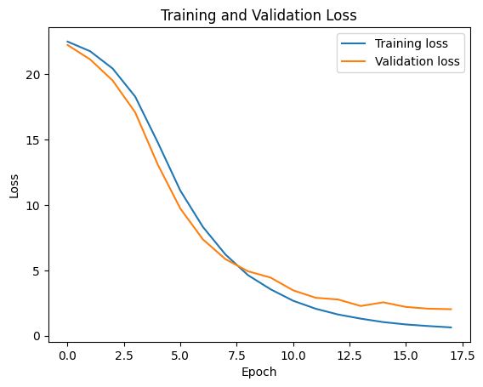
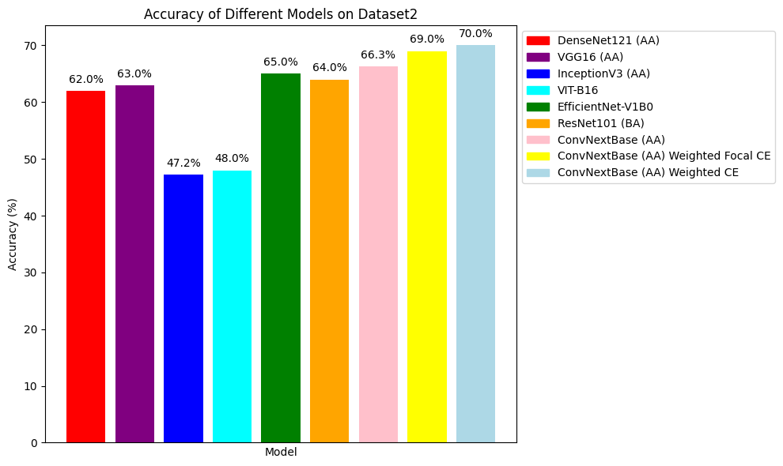
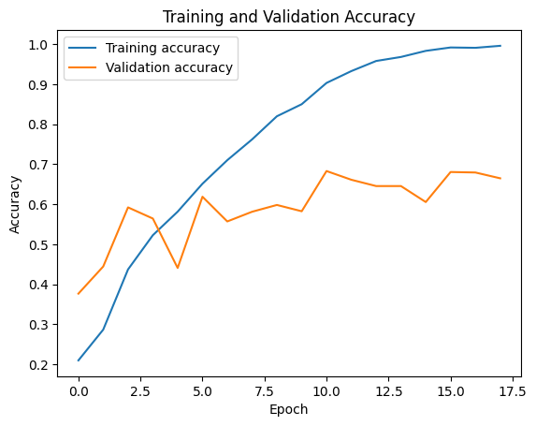
Results (cont..)
Dataset 1
ConvNextBase Model Weighted CE

Slide 16
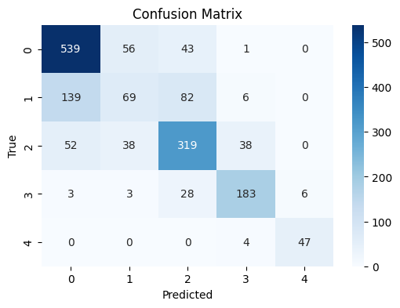
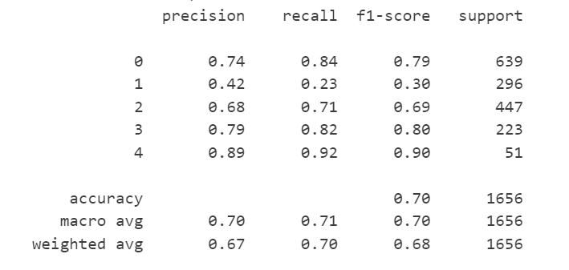
Results (cont..)
The classification report is as follows:
ConvNextBase Model Weighted CE

Slide 17
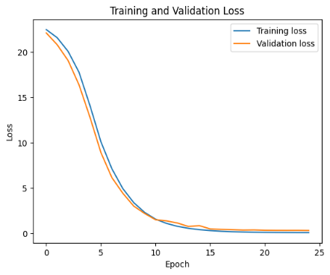
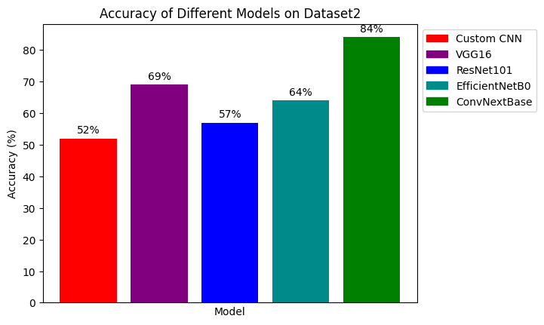
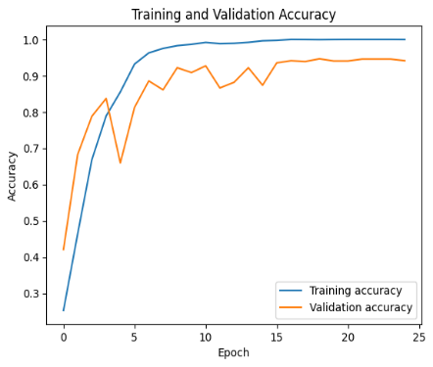
Results (cont..)
Dataset 2

Slide 18
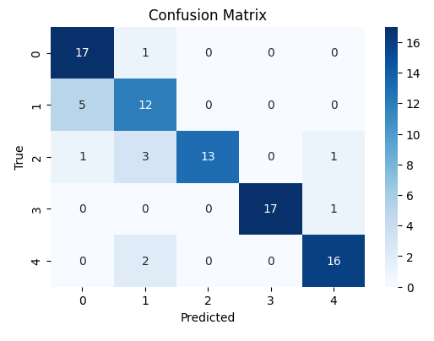
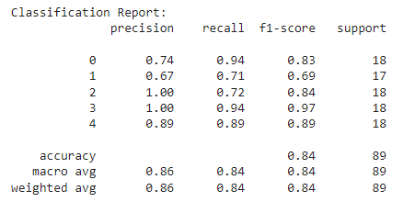
Results (cont..)
The classification report is as follows:

Slide 19
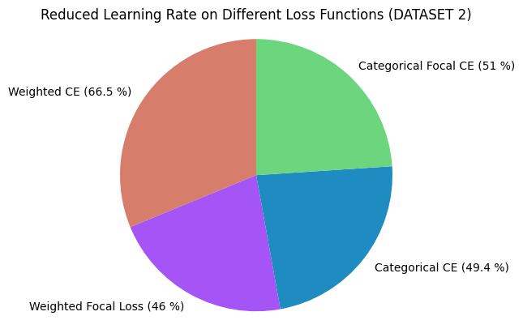
Dataset 2 (Augmented Data)
Model | Loss Function | Accuracy | Precision | Recall | F1 score
ConvNextBase | Weighted CE | 76 | 76 | 75.3 | 76
ConvNextBase | Weighted Focal CE | 83 | 85 | 83 | 83
ConvNextBase | Categorical CE | 84 | 86 | 84 | 84
ConvNextBase | Focal Loss | 84 | 85 | 84 | 84

Slide 20
Cross Validation
Performed K fold Validation on train data (5 fold)
Successfully trained the model on each fold, achieving an impressive 87% accuracy on average across all folds
Providing a more reliable estimate of model performance

Slide 21
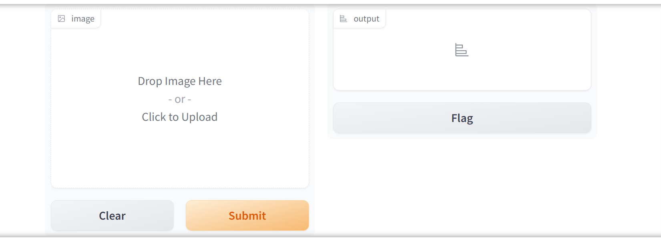
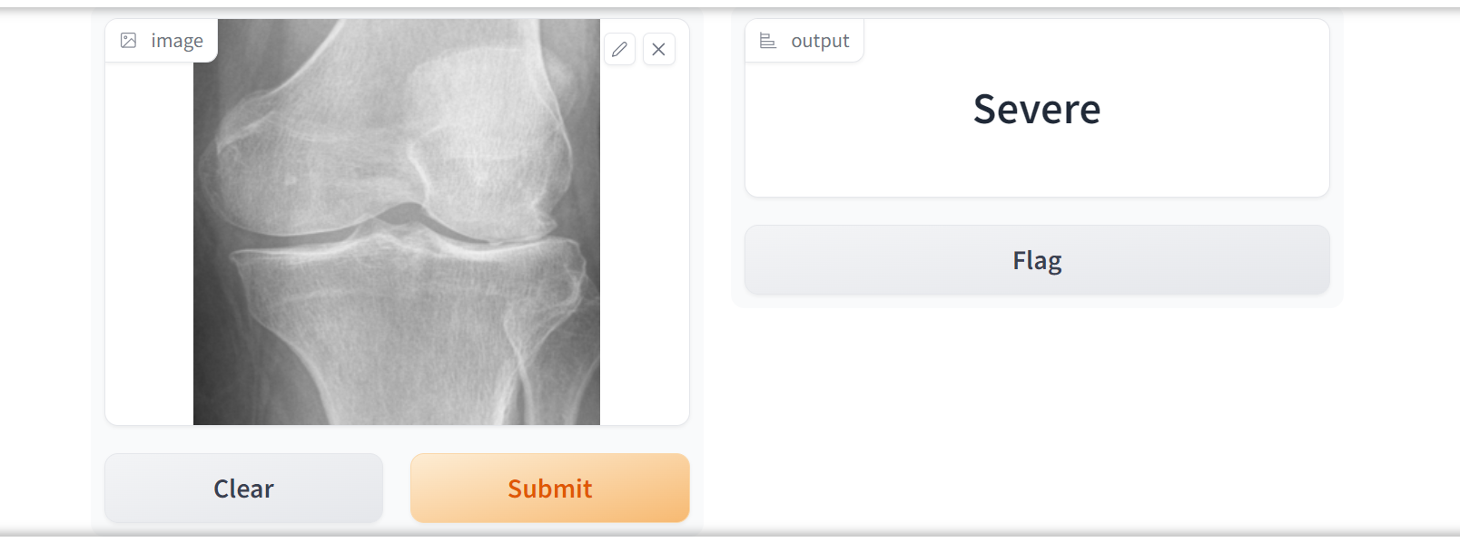
GUI
Created User-Friendly Gradio Interface
Load and then convert.h5 file to .tflite model using TFLite Converter
Integrate TFLite Model with Gradio Interface

Slide 22
Tools
Programming Language :
Python
Programming Libraries :
Keras
Tensorflow
Platform:
Google colaboratory

Slide 23
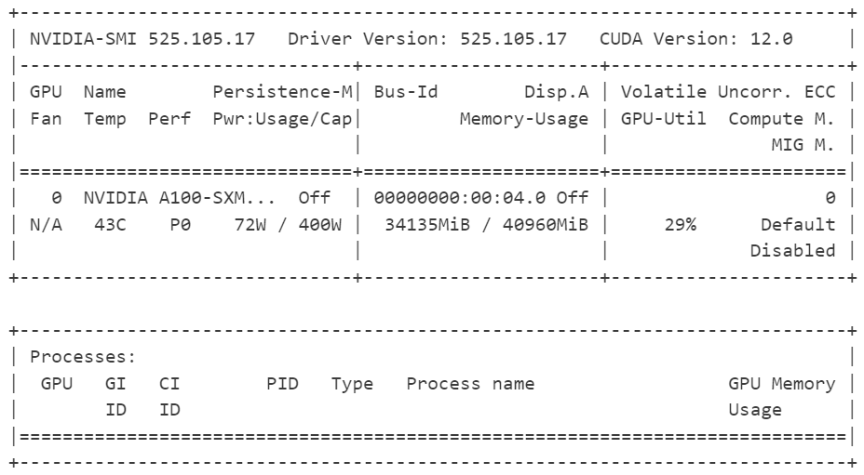
GPU Info
Driver Version: 525.105.17
(Version of Graphics driver that is used to control the graphics card)
CUDA Version: 12.0
(Version of the CUDA toolkit that is used to develop and run applications on GPUs)
GPU: NVIDIA A100-SXM
(This is the model of the graphics card)
Persistence Mode: Off
(GPU memory is preserved between kernel launches)
Power Usage: 72W/400W
(How much power the GPU is consuming)
Temperature: 43°C
(temperature of the GPU)
Memory Usage: 34135MiB/40960MiB (34GB out of 40 GB)
(GPU's memory is being used)
GPU Utilization: 29%
(How busy the GPU is)
Compute Mode: Default
Processes: No active GPU processes currently.

Slide 24
References
[1] https://data.mendeley.com/datasets/56rmx5bjcr/1
[2] https://www.ncbi.nlm.nih.gov/pmc/articles/PMC7704420/
[3] https://www.mdpi.com/2075-4418/13/8/1380
[4] https://arxiv.org/ftp/arxiv/papers/2207/2207.12521.pdf
[5] Brahim, A.; Jennane, R.; Riad, R.; Janvier, T.; Khedher, L.; Toumi, H.; Lespessailles, E. A decision support tool for early detection of knee OsteoArthritis using X-ray imaging and machine learning: Data from the OsteoArthritis Initiative. Comput. Med. Imaging Graph. 2019, 73, 11–18. [Google Scholar] [CrossRef] [PubMed]
[6] Saleem, M.; Farid, M.S.; Saleem, S.; Khan, M.H. X-ray image analysis for automated knee osteoarthritis detection. Signal Image Video Process. 2020, 14, 1079–1087. [Google Scholar] [CrossRef]
[7] Lim, J.; Kim, J.; Cheon, S. A deep neural network-based method for early detection of osteoarthritis using statistical data. Int. J. Environ. Res. Public Health 2019, 16, 1281. [Google Scholar] [CrossRef][Green Version]
[8] von Tycowicz, C. Towards shape-based knee osteoarthritis classification using graph convolutional networks. In Proceedings of the 2020 IEEE 17th International Symposium on Biomedical Imaging (ISBI), Iowa City, IA, USA, 3–7 April 2020; IEEE: Piscataway, NJ, USA, 2020; pp. 750–753. [Google Scholar]
[9] Wang, Y.; Li, S.; Zhao, B.; Zhang, J.; Yang, Y.; Li, B. A ResNet-based approach for accurate radiographic diagnosis of knee osteoarthritis. CAAI Trans. Intell. Technol. 2022, 7, 512–521. [Google Scholar] [CrossRef]
10. Jakaite, L.; Schetinin, V.; Hladůvka, J.; Minaev, S.; Ambia, A.; Krzanowski, W. Deep learning for early detection of pathological changes in x-ray bone microstructures: Case of osteoarthritis. Sci. Rep. 2021, 11, 1–9. [Google Scholar] [CrossRef]
11. Thomas, K.A.; Kidziński, Ł.; Halilaj, E.; Fleming, S.L.; Venkataraman, G.R.; Oei, E.H.; Delp, S.L. Automated classification of radiographic knee osteoarthritis severity using deep neural networks. Radiology. Artif. Intell. 2020, 2, e190065. [Google Scholar]
[12] https://www.kaggle.com/datasets/tommyngx/digital-knee-xray/data?select=MedicalExpert-I

Slide 25
Thank you

Slide 26
Q&A

