Slide 1
Spam detection
Presented by: Yassir benabdallah

Slide 2
Table of content
Introduction
Related Work
Methodology & Experiments
Dataset Description
Naïve-Bayes
Logistic Regression
RNN & LSTM
Conclusion & Future work

Slide 3
Introduction
Emergence of communication through emails worldwide
300.4 billion emails were sent everyday in 2020
4 billion email users worldwide
Spam messages pose threat to email users
47.3% of all emails in 2020 were spam
Illegally access other users’ sensitive data
There is a need for spam filtering technology

Slide 4
Related work
Gauri Jain, Yann; Yoshua Bengio; and Geoffrey Hinton
Combination of both CNN and RNN
Google
Usage of many forms of spam detection
Ahmed, Ishtiaq; Guan, Donghai; and Chung, Tae Cho
Naïve-Bayes classifier with Apriori algorithm
Almeida, Tiag
SVM algorithm

Slide 5
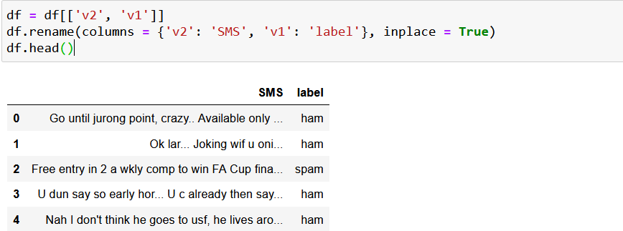
Methodology & Experiments Dataset Description
SMS Messages
5572 samples
747 spam
4825 ham

Slide 6



Methodology & Experiments Naïve-Bayes
Bayes Theorem
Task: finding the probability that a certain message or email is spam given the words that form it.
we calculate the probability of finding a word 𝑤i in an already known spam message

Slide 7
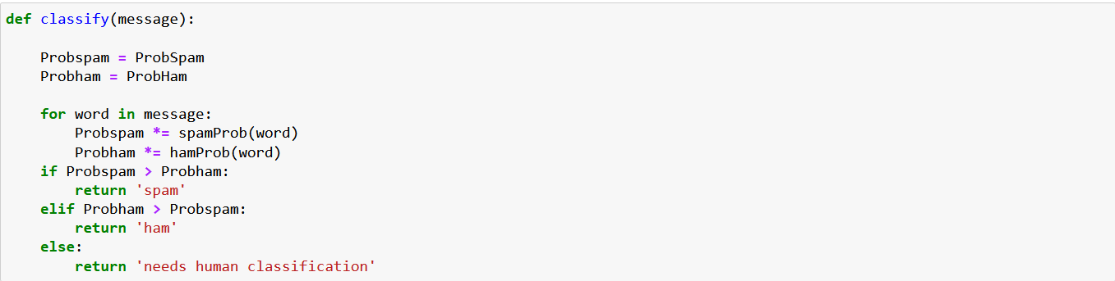
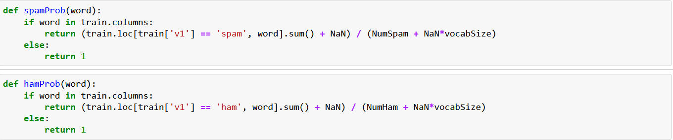
Methodology & Experiments Naïve-Bayes (Contd.)
Methods to find the probability of a certain word being spam or ham.
Classification Method based the product of the probabilities of each word being spam or ham

Slide 8
Methodology & Experiments Logistic regression
One of the best methods for binary classification
Associate each input with a value and a weight
Output tends to 1 (spam) or 0 (ham) as Z goes to infinity or negative infinity respectively

Slide 9

Methodology & Experiments RNN & LSTM
RNN is a more developed version of feedforward NN
The experiment is performed according to the following steps 1. We load the data and split it into training and testing 2. Data tokenization 3. We sort tokens 4. Padding 5. Build and train

Slide 10
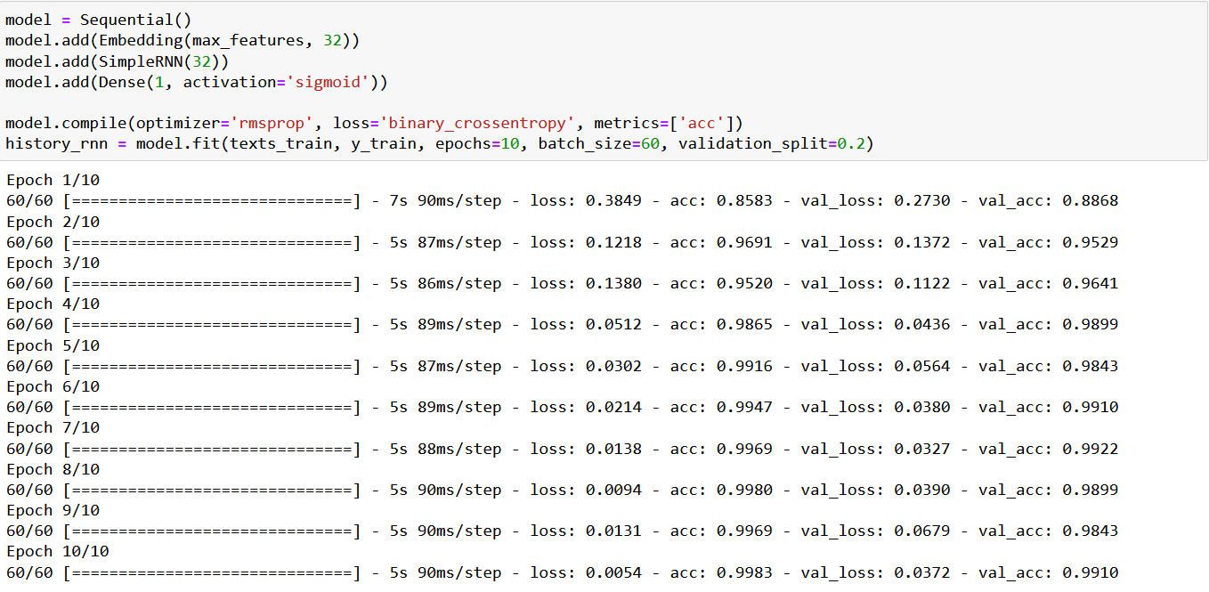
Methodology & Experiments RNN & LSTM (contd.)
RNN is a more developed version of feedforward NN
The experiment is performed according to the following steps 1. We load the data and split it into training and testing 2. Data tokenization 3. We sort tokens 4. Padding 5. Build and train

Slide 11
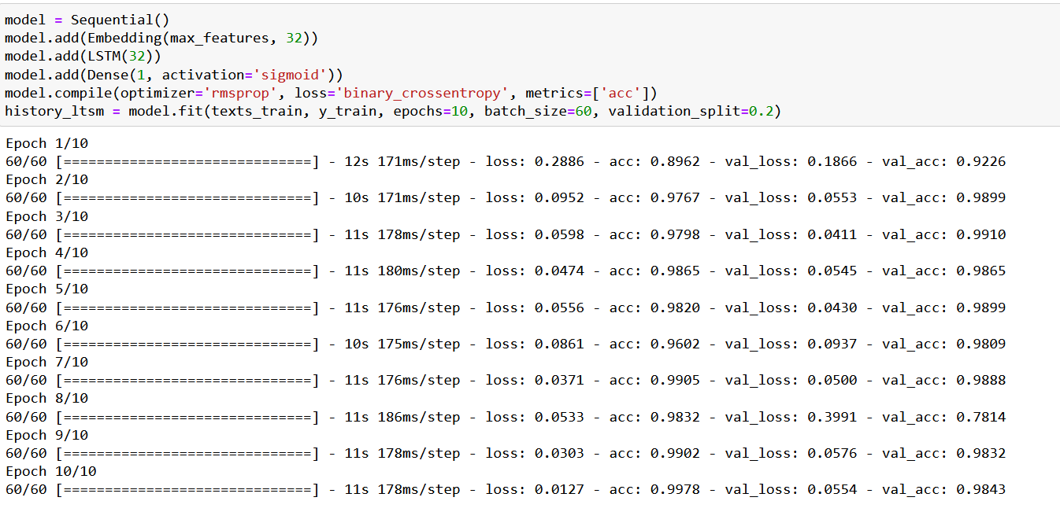
Methodology & Experiments RNN & LSTM (contd.)
Vanishing Gradient Problem
3 gates: Forget, Input and Output

Slide 12
Conclusion & Future work
Better results with more complicated methods
Implement SVM Method
Develop the used Methods
Method | Accuracy
Naïve-Bayes | 96.55%
Logistic Regression | 96.84%
RNN | 98.43%
LSTM | 98.88%

Slide 13
Thank you for your attention ☺

