Slide 1
Map Reduce, Types, Formats and Features

Slide 2
What is Map Reduce ?
MapReduce is a computational model and an implementation for processing and generating big data sets with a parallel, distributed kind of algorithm on a cluster of data. A MapReduce consists of the following procedures
Map procedure: Performs a filtering and sorting operation
Reduce procedure: Performs a summary operation

Slide 3
Overview of Map Reduce
Data processing is the key in Map Reduce, it consists of inputs and outputs for the map and reduce functions used as key-value pairs.
This presentation consists of MapReduce model in detail, and in particular at how data in various formats, Types and features available in the model.

Slide 4
Functions of Map Reduce
Map Reduce serves two essential functions:
It filters and distributes work to various nodes within the cluster or map, a function sometimes referred to as the mapper.
It collects, organizes and reduces the results from each node into a collective answer, referred to as the reducer.

Slide 5
Map Reduce Features
Counters - They are a useful channel for gathering statistics about the job like quality control.
Hadoop maintains some built in counters for every job that report various metrics for your job.
Types of counters - Task counters, Job counters, User-Defined Java Counters.
Sorting - Ability to sort data is at the heart of MapReduce.
Types of sorts - Partial sort, Total sort, Secondary sort
For any particular key, values are not sorted.

Slide 6
Map Reduce Features
Joins - MapReduce can perform joins between large datasets, but writing code to do joins from scratch is fairly involved. Ex: Map-side joins, Reduced-side join.
Basic idea is that the mapper tags each record with its source and uses the join key as map output key, so that the records with same key are brought together in the reducer.
Side Data Distribution - It can be defined as extra read only data needed by job to process the main dataset.
Challenge is to make side data available to all the map or reduce tasks in convenient and efficient fashion.

Slide 7
Map Reduce Features
Using the Job Configuration - We can set arbitrary key-value pairs in the job configuration using various setter methods on Configuration.
Distributed Cache - Rather than serializing side data in job configuration, it is preferable to distribute datasets using Hadoop's distributed cache mechanism.
Distributed Cache API - Most applications don’t need to use distributed cache API as they can use the cache via GenericOptionsParser.
MapReduce Library Classes - Hadoop comes with library of mappers and reducers for commonly used functions.

Slide 8
Input Format
Input Format takes care about how input file is split and read by Hadoop.
It uses input format interface and TextInputFormat is the default.
Each Input file is broken into splits and each map processes a single split.Each Split is further divided into records of key/value pairs which are processed by map tasks one record at a time.
Record reader creates key/value pairs from input splits and writes on context, which will be shared with Mapper class.

Slide 9
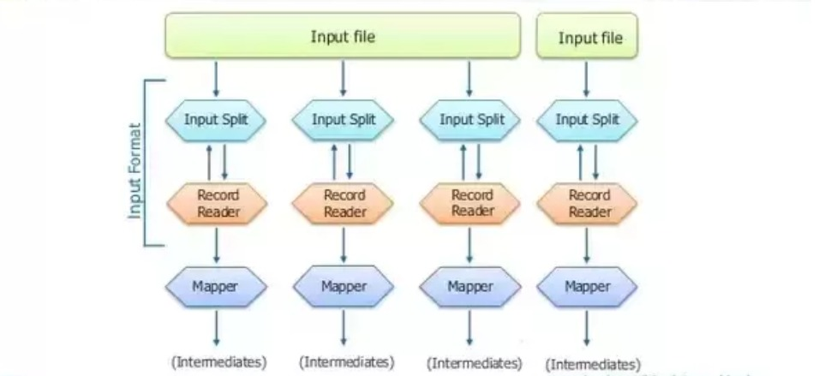
Input Format

Slide 10
Types of Input File Format
FileInputFormat: It is the base class for all file-based Input Formats. It specifies input directory where data files are located. It will read all files and divides these files into one or more Input Splits.
TextInputFormat: Each line in the text file is a record.Key:Byte offset of line Value: Content of the line.
KeyValueTextInputFormat: Everything before the separator is the key, and everything after is value.
SequenceFileInputFormat: To read any sequence files. Key and values are user defined.

Slide 11
Types of Input File Format
SequenceFileasTextInputFormat: Similar to SequenceFileInputFormat. It converts sequence file key values to text objects.
SequenceFileasBinaryInputFormat: To read any sequence files. It is used to extract sequence files keys and values as opaque binary object.
NLineInputFormat: Similar to TextInputFormat, But each split is guaranteed to have exactly N lines.
DBInputFormat: To read data from RDS. Key is LongWrittables and values are DB Writable.

Slide 12
Output Formats
The OutputFormat checks the Output-Specification for execution of the Map- Reduce job. For e.g check that the output directory doesn’t already exist.
It determines how RecordWriter Implementation is used to write output to output files. Output Files are stored in a File System.
The OutputFormat decides the way the output key-value pairs are written in the output files by RecordWriter.

Slide 13
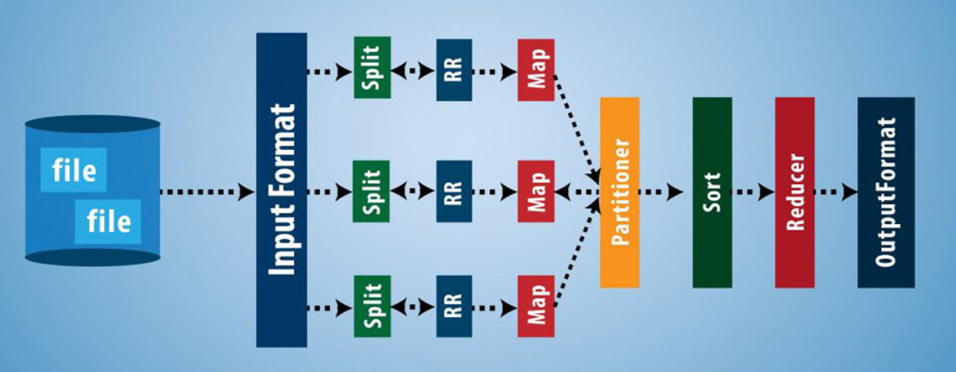
Output Format

Slide 14
Types of Output Formats
TextOutputFormat : It is the MapReduce default Hadoop reducer Output Format which writes key,value pairs on individual lines of text files.
SequenceFileOutputFormat : It writes sequences files for its output and it is the intermediate format use between MapReduce jobs.
MapFileOutputFormat: It writes output as map files.The key in the MapFile must be added in order to ensure that the reducer emits keys in sorted order.

Slide 15
Types of Output Formats
MultipleOutputs : It allows writing data to files whose names are derived from the output keys and values.
LazyOutputFormat : It is a wrapper OutputFormat which ensures that the output file will be created only when the record is emitted for a given partition
DBOutputFormat : It writes to the relational database and HBase and sends the reduce output to a SQL Table.

Slide 16
Sorting
MapReduce Framework automatically sort the keys generated by the mapper.
Reducer in MapReduce starts a new reduce task when the next key in the sorted input data is different than the previous. Each reduce task takes key value pairs as input and generates key-value pair as output.
Secondary Sorting in MapReduce:
If we want to sort reducer values, then we use a secondary sorting technique. This technique enables us to sort the values (in ascending or descending order) passed to each reducer.

Slide 17
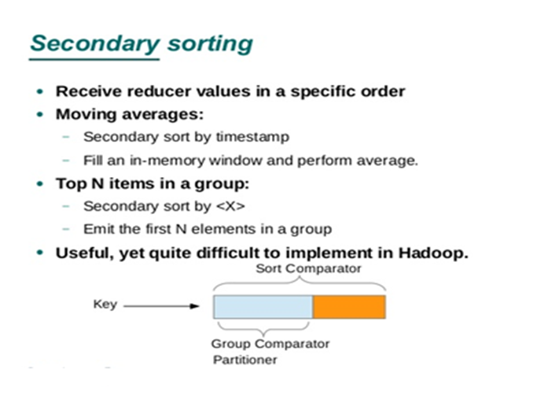
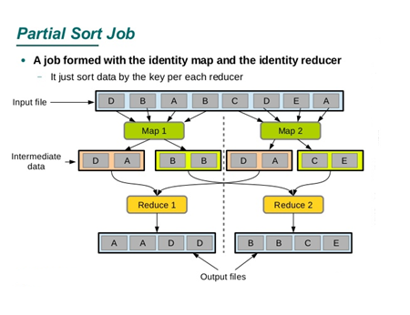
Sorting

Slide 18
Counters
Counters provides a way to measure the progress or the number of operations that occur within map reduce.
There are basically 2 types of MapReduce Counters:
Built-In Counters in MapReduce:
Hadoop maintains some built-in Hadoop counters for every job and these report various metrics, like, there are counters for the number of bytes and records, which allow us to confirm that the expected amount of input is consumed and the expected amount of output is produced.
User-Defined Counters/Custom Counters in Hadoop MapReduce.
In addition to MapReduce built-in counters, MapReduce allows user code to define a set of counters
For example, in Java, ‘enum’ is used to define counters.

Slide 19
Joins
Large datasets can be combined by using joints in MapReduce.
When processing large data sets, the need for joining data by a common key can be very useful.
There are two types of joins
Map side join
Reduce side join

Slide 20
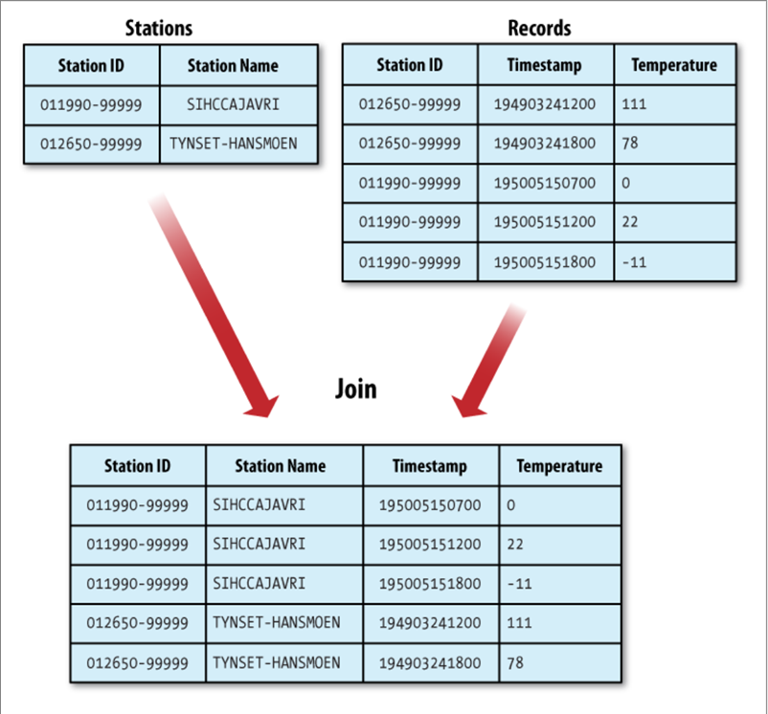
Joins

Slide 21
Reduce-side join
If the join is performed by the reducer it is called a reduce-side join.
Reduce-side join is easier to implement than the map-side join as there is no need for us to structure the datasets in a particular way. But it is less efficient as the datasets have to be shuffled.
To perform the join, we simply need to cache a key and compare it to incoming keys. As long as the keys match, we can join the values from the corresponding keys.
In reduce-side joins, there are two different scenarios that we can consider:
one-to-one
one-to-many

Slide 22
Map-side join e Graph Querying
When the join function is performed by the mapper it is called map side join.
Expects a strong prerequisite before joining data at map side. The prerequisites are:
Data should be partitioned and sorted in particular way.
Each input data should be divided in same number of partition.
Must be sorted with same key.
All the records for a particular key must reside in the same partition.

Slide 23
Conclusion
The MapReduce programming model is being used at many places for many functions.
The model is easy to use by everyone since it hides the underlying details (parallelization, fault-tolerance, neighborhood optimization, and load equalization)
MapReduce is employed for the generation of data like sorting, data processing, machine learning and so on.
The implementation makes economical use of the machine resources. Hence it is apt to be used on large machine issues.

Slide 24
Conclusion (conti)
Network information measure is a scarce resource. Various optimizations are aimed at reducing the quantity of data sent across the network.
This optimization allows us to browse information from native disks.
Writing one copy of the information to native disk saves network bandwidth.

Slide 25
Summary
Topics covered:
Map Reduce
Functions of Map Reduce
Features of Map Reduce
Input Formats
Output Formats
Sorting
Counters
Joins and Types
Conclusion

Slide 26
Thank you

