Slide 1
Diabetes Prediction Model Using Machine Learning

Slide 2
Introduction
Diabetes is a common chronic disease that can be dangerous. Diabetes can be identified when blood glucose is higher than normal level, which is caused by high secretion of insulin or biological effects. Diabetes can cause various damage to our body and can disfunction tissues, kidneys, eyes and blood vessels. Diabetes can be divided into two categories, type 1 diabetes and type 2 diabetes. Patients with type 1 diabetes are normally younger with an age less then 30 years old. The clinical symptoms are increase thirst and frequent urination this type of diabetes cannot be cleared by medications as it requires therapy. Type 2 diabetes occurs more commonly on middle-aged and old people, which can show hypertension, obesity and other diseases. with our living standards diabetes has increased commonly in people’s daily life. So how to analyze diabetes is worth studying

Slide 3
Proposed System
Our proposed system aims at Predicting the number of Diabetes patients and eliminating the risk of False Negatives Drastically. In proposed System, we use Random forest, Decision tree, Logistic Regression and Gradient Boosting Classifier to classify the Patients who are affected with Diabetes or not. Random Forest and Decision Tree are the algorithms which can be used for both classification and regression. The dataset is classified into trained and test dataset where the data can be trained individually, these algorithms are very easy to implement as well as very efficient in producing better results and can able to process large amount of data. Even for large dataset these algorithms are extremely fast and can able to give accuracy of about over 90%.

Slide 4
Machine Learning Workflow
We can define the machine learning workflow in 5 stages.
Gathering data
Data pre-processing
Researching the model that will be best for the type of data
Training and testing the model
Evaluation

Slide 5
Training and Testing the model.
Training is the most important part, where we train our model using the data available and make the machine learn and understand the data.
When the model has learned from the data, we provide the model with another dataset to evaluate how good our model is performing, if it is performing well, we then test the model using test data, where we get to know the final performance of our model, which can be measure using various metrics, such as Accuracy, recall, precision, and through classification report.

Slide 6
Algorithms(1/4)
The Random Forest Classifier Random Forest is a popular machine learning algorithm that belongs to the supervised learning technique. It is one of the widely used algorithms, which perform well with any kind of dataset, be it classification or regression.
It learning, which is a process of combining multiple classifiers to solve a complex problem, and at the end, the results are either made an average of all the classifiers or mode of all the classifiers. is based on the concept of ensemble

Slide 7
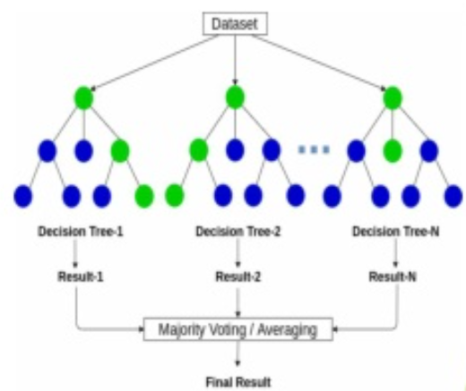

Slide 8
Algorithms(2/4)
Decision Tree Decision tree, as the name suggests, creates a branch of nodes.
Where each internal node denotes a test on an attribute, each branch represents an outcome of the test, and the last nodes are termed as the leaf nodes.
Leaf node means there cannot be any nodes attached to them, and each leaf node (terminal node) holds a class label.
The decision tree is one of the most popular algorithms in machine learning, it can be sued for both classification and regression.

Slide 9
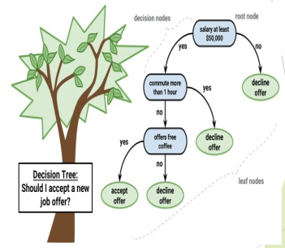

Slide 10
Algorithms(3/4)
Logistic Regression Logistic regression models a relationship between predictor variables and a categorical response variable.
Logistic regression helps us estimate a probability of falling into a certain level of the categorical response given a set of predictors.
We can choose from three types of logistic regression, depending on the nature of the categorical response variable.

Slide 11
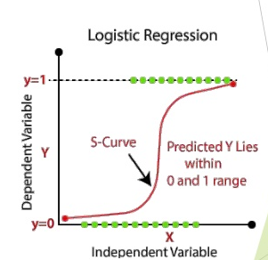

Slide 12
Algorithm(4/4)
Gradient boosting is a powerful ensemble machine learning algorithm.
It’s popular for structured predictive modeling problems, such as classification and regression on tabular data, and is often the main algorithm or one of the main algorithms used in winning solutions to machine learning competitions, like those on Kaggle.
There are many implementations of gradient boosting available, including standard implementations in SciPy and efficient third-party libraries. Each uses a different interface and even different names for the algorithm.

