Slide 1
Introducing Information Retrieval

Slide 2
Information Retrieval
Information Retrieval (IR) is finding material (usually documents) of an unstructured nature (usually text) that satisfies an information need from within large collections (usually stored on computers).
These days we frequently think first of web search, but there are many other cases:
E-mail search
Searching your laptop
Corporate knowledge bases
Legal information retrieval

Slide 3
Unstructured (text) vs. structured (database) data in the mid-nineties

Slide 4
Unstructured (text) vs. structured (database) data today
Notes:
To the surprise of many, the search box has become the preferred method of information access.
Customers ask: Why can’t I search my database in the same way?

Slide 5
Basic assumptions of Information Retrieval
Sec. 1.1
Collection: A set of documents
Assume it is a static collection for the moment
Goal: Retrieve documents with information that is relevant to the user’s information need and helps the user complete a task

Slide 6
How good are the retrieved docs?
Sec. 1.1
Precision : Fraction of retrieved docs that are relevant to the user’s information need
Recall : Fraction of relevant docs in collection that are retrieved
More precise definitions and measurements to follow later

Slide 7
Introducing Information Retrieval
and Web Search

Slide 8
Term-document incidence matrices

Slide 9
Unstructured data in 1620
Sec. 1.1
Which plays of Shakespeare contain the words Brutus AND Caesar but NOT Calpurnia?
One could grep all of Shakespeare’s plays for Brutus and Caesar, then strip out lines containing Calpurnia?
Why is that not the answer?
Slow (for large corpora)
NOT Calpurnia is non-trivial
Other operations (e.g., find the word Romans near countrymen) not feasible
Ranked retrieval (best documents to return)
Later lectures
Notes:
Grep is line-oriented; IR is document oriented.

Slide 10
Term-document incidence matrices
Sec. 1.1
1 if play contains word, 0 otherwise
Brutus AND Caesar BUT NOT Calpurnia

Slide 11
Incidence vectors
Sec. 1.1
So we have a 0/1 vector for each term.
To answer query: take the vectors for Brutus, Caesar and Calpurnia (complemented) ➔ bitwise AND.
110100 AND
110111 AND
101111 =
100100

Slide 12
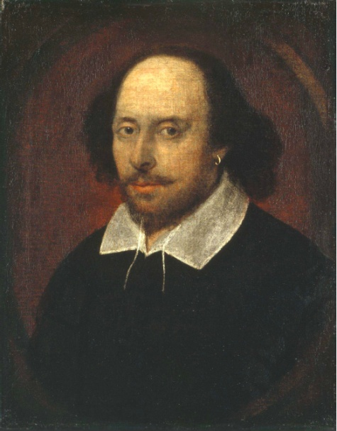
Answers to query
Sec. 1.1
Antony and Cleopatra, Act III, Scene ii
Agrippa [Aside to DOMITIUS ENOBARBUS]: Why, Enobarbus,
When Antony found Julius Caesar dead,
He cried almost to roaring; and he wept
When at Philippi he found Brutus slain.
Hamlet, Act III, Scene ii
Lord Polonius: I did enact Julius Caesar I was killed i’ the
Capitol; Brutus killed me.
Notes:
Wikimedia commons picture of Shake

Slide 13
Bigger collections
Sec. 1.1
Consider N = 1 million documents, each with about 1000 words.
Avg 6 bytes/word including spaces/punctuation
6GB of data in the documents.
Say there are M = 500K distinct terms among these.

Slide 14
Can’t build the matrix
Sec. 1.1
500K x 1M matrix has half-a-trillion 0’s and 1’s.
But it has no more than one billion 1’s.
matrix is extremely sparse.
What’s a better representation?
We only record the 1 positions.
Why?

Slide 15
Term-document incidence matrices

Slide 16
The Inverted Index
The key data structure underlying modern IR

Slide 17
Inverted index
Sec. 1.2
For each term t, we must store a list of all documents that contain t.
Identify each doc by a docID, a document serial number
Can we used fixed-size arrays for this?
Brutus
1
2
4
11
31
45
173
174
Caesar
1
2
4
5
6
16
57
132
Calpurnia
2
31
54
101
What happens if the word Caesar is added to document 14?

Slide 18
Inverted index
Sec. 1.2
We need variable-size postings lists
On disk, a continuous run of postings is normal and best
In memory, can use linked lists or variable length arrays
Some tradeoffs in size/ease of insertion
Posting
Brutus
1
2
4
11
31
45
173
174
Caesar
1
2
4
5
6
16
57
132
Calpurnia
2
31
54
101
Dictionary
Postings
Sorted by docID (more later on why).
Notes:
Linked lists generally preferred to arrays
Dynamic space allocation
Insertion of terms into documents easy
Space overhead of pointers

Slide 19


Slide 20
Building an inverted index
1. Collect the documents to be indexed
2. Tokenize the text, turning each document into a list of tokens
3. Do linguistic preprocessing, producing a list of normalized tokens, which are the indexing terms
4. Index the documents that each term occurs in by creating an inverted index, consisting of a dictionary and posting

Slide 21

Inverted index construction
Sec. 1.2
Documents to
be indexed
Friends, Romans, countrymen.
Tokenizer
Token stream
Friends
Romans
Countrymen
Linguistic modules
Modified tokens
friend
roman
countryman
Indexer
friend
2
4
roman
1
2
Inverted index
countryman
13
16
Notes:
Document icons from free icon set: http://www.icojoy.com/articles/44/

Slide 22
Inverted index construction
Sec. 1.2
Documents to
be indexed
Friends, Romans, countrymen.
Tokenizer
Token stream
Friends
Romans
Countrymen
More on
these later.
Linguistic modules
Modified tokens
friend
roman
countryman
Indexer
friend
2
4
roman
1
2
Inverted index
countryman
13
16
Notes:
Document icons from free icon set: http://www.icojoy.com/articles/44/

Slide 23
Initial stages of text processing
Tokenization
Cut character sequence into word tokens
Deal with “John’s”, a state-of-the-art solution
Normalization
Map text and query term to same form
You want U.S.A. and USA to match
Stemming
We may wish different forms of a root to match
authorize, authorization
Stop words
We may omit very common words (or not)
the, a, to, of

Slide 24
Indexer steps: Token sequence
Sec. 1.2
Sequence of (Modified token, Document ID) pairs.
Doc 1
Doc 2
I did enact Julius
Caesar I was killed
i’ the Capitol;
Brutus killed me.
So let it be with
Caesar. The noble
Brutus hath told you
Caesar was ambitious

Slide 25
Indexer steps: Sort
Sec. 1.2
Sort by terms
At least conceptually
And then docID
Core indexing step

Slide 26
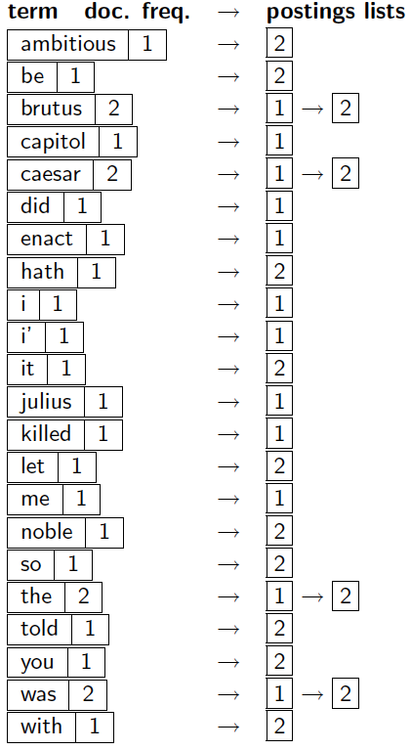
Indexer steps: Dictionary & Postings
Sec. 1.2
Multiple term entries in a single document are merged.
Split into Dictionary and Postings
Doc. frequency information is added.
Why frequency?
Will discuss later.

Slide 27
Where do we pay in storage?
Sec. 1.2
Lists of docIDs
Terms and counts
IR system implementation
How do we index efficiently?
How much storage do we need?
Pointers

Slide 28
The Inverted Index
The key data structure underlying modern IR

Slide 29
Query processing with an inverted index

Slide 30
The index we just built
Sec. 1.3
How do we process a query?
Later – what kinds of queries can we process?
Our focus

Slide 31
Query processing: AND
Sec. 1.3
Consider processing the query:
Brutus AND Caesar
Locate Brutus in the Dictionary;
Retrieve its posting list.
Locate Caesar in the Dictionary;
Retrieve its posting list.
Intersect the two postings (“merge” the document sets):
2
4
8
16
32
64
128
Brutus
1
2
3
5
8
13
21
34
Caesar

Slide 32
The merge
Sec. 1.3
Walk through the two postings simultaneously, in time linear in the total number of postings entries
2
4
8
16
32
64
128
Brutus
1
2
3
5
8
13
21
34
Caesar
If the list lengths are x and y, the merge takes O(x+y)
operations.
Crucial: postings sorted by docID.

Slide 33
The merge
Sec. 1.3
Walk through the two postings simultaneously, in time linear in the total number of postings entries
2
2
4
4
8
8
16
16
32
64
128
32
64
128
Brutus
2
8
1
Caesar
1
2
2
3
5
5
8
8
13
13
21
21
34
3
34
If the list lengths are x and y, the merge takes O(x+y)
operations.
Crucial: postings sorted by docID.

Slide 34
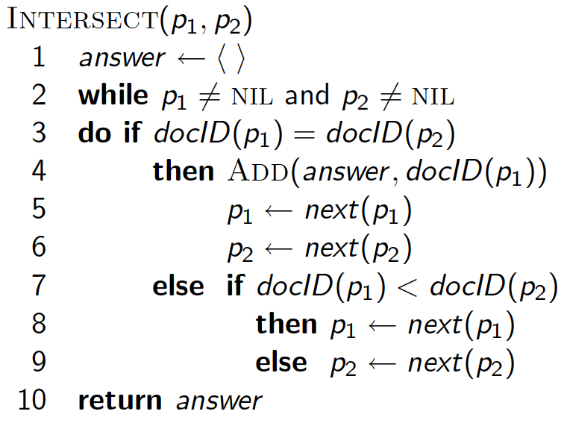
Intersecting two postings lists (a “merge” algorithm)

Slide 35
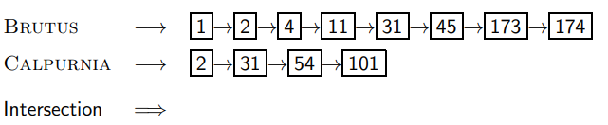
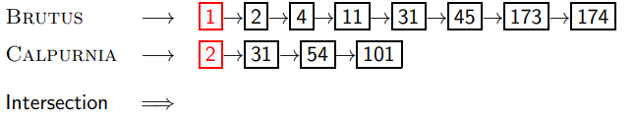
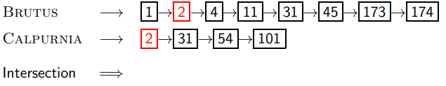
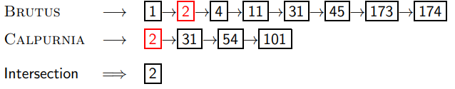
Intersecting two postings lists
1
2
3
4

Slide 36
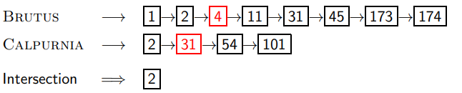
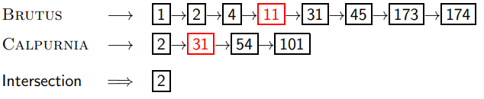
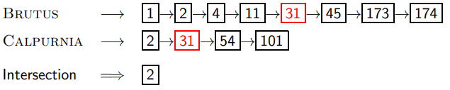
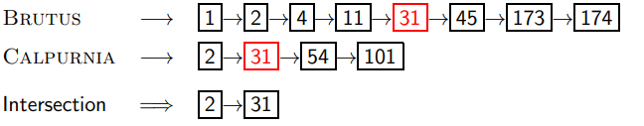
Intersecting two postings lists
5
6
7
8

Slide 37
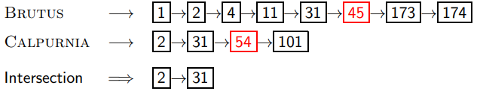
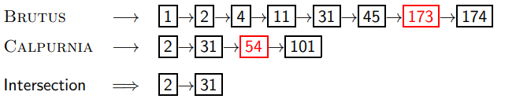
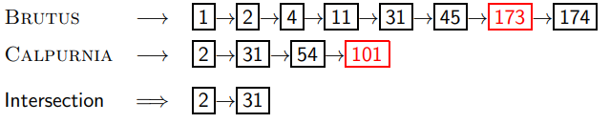
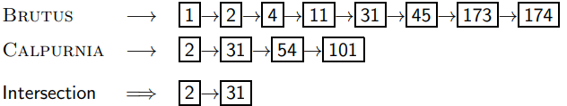
9
10
11
12
This only works if postings lists are sorted

Slide 38
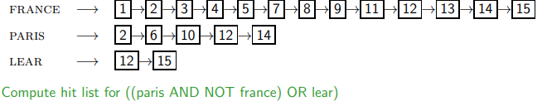
Query processing: Exercise

Slide 39
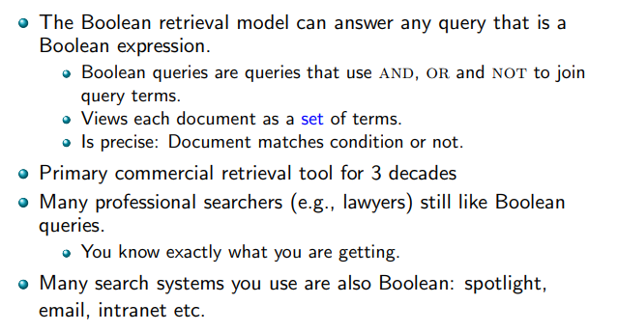
Boolean retrieval model: Assessment

Slide 40
The Boolean Retrieval Model
& Extended Boolean Models

Slide 41
Query optimization
Consider a query that is an and of n terms, n > 2
For each of the terms, get its postings list,
then and them together
Example query: Brutus AND Calpurnia AND Caesar What is the best order for processing this query?
Simple and effective optimization:
Process in order of increasing frequency
Start with the shortest postings list, then keep cutting further

Slide 42
Boolean queries: Exact match
Sec. 1.3
The Boolean retrieval model is being able to ask a query that is a Boolean expression:
Boolean Queries are queries using AND, OR and NOT to join query terms
Views each document as a set of words
Is precise: document matches condition or not.
Perhaps the simplest model to build an IR system on
Primary commercial retrieval tool for 3 decades.
Many search systems you still use are Boolean:
Email, library catalog, macOS Spotlight

Slide 43
Example: WestLaw http://www.westlaw.com/
Sec. 1.4
Largest commercial (paying subscribers) legal search service (started 1975; ranking added 1992; new federated search added 2010)
Tens of terabytes of data; ~700,000 users
Majority of users still use boolean queries
Example query:
What is the statute of limitations in cases involving the federal tort claims act?
LIMIT! /3 STATUTE ACTION /S FEDERAL /2 TORT /3 CLAIM
/3 = within 3 words, /S = in same sentence

Slide 44
Example: WestLaw http://www.westlaw.com/
Sec. 1.4
Another example query:
Requirements for disabled people to be able to access a workplace
disabl! /p access! /s work-site work-place (employment /3 place
Note that SPACE is disjunction, not conjunction!
Long, precise queries; proximity operators; incrementally developed; not like web search
Many professional searchers still like Boolean search
You know exactly what you are getting
But that doesn’t mean it actually works better….

Slide 45
Boolean queries: More general merges
Sec. 1.3
Exercise: Adapt the merge for the queries:
Brutus AND NOT Caesar
Brutus OR NOT Caesar
Can we still run through the merge in time O(x+y)? What can we achieve?

Slide 46
Merging
Sec. 1.3
What about an arbitrary Boolean formula?
(Brutus OR Caesar) AND NOT
(Antony OR Cleopatra)
Can we always merge in “linear” time?
Linear in what?
Can we do better?

Slide 47
Query optimization
Sec. 1.3
What is the best order for query processing?
Consider a query that is an AND of n terms.
For each of the n terms, get its postings, then AND them together.
Brutus
2
4
8
16
32
64
128
Caesar
1
2
3
5
8
16
21
34
Calpurnia
13
16
Query: Brutus AND Calpurnia AND Caesar
47

Slide 48
Query optimization example
Sec. 1.3
Process in order of increasing freq:
start with smallest set, then keep cutting further.
This is why we kept
document freq. in dictionary
Brutus
2
4
8
16
32
64
128
Caesar
1
2
3
5
8
16
21
34
Calpurnia
13
16
Execute the query as (Calpurnia AND Brutus) AND Caesar.

Slide 49
Exercise
Recommend a query processing order for
Which two terms should we process first?
(tangerine OR trees) AND
(marmalade OR skies) AND
(kaleidoscope OR eyes)

Slide 50
More general optimization
Sec. 1.3
e.g., (madding OR crowd) AND (ignoble OR strife)
Get doc. freq.’s for all terms.
Estimate the size of each OR by the sum of its doc. freq.’s (conservative).
Process in increasing order of OR sizes.

Slide 51
For the queries below, can we still run through the intersection in time O(x + y), where x and y are the lengths of the postings lists for Brutus and Caesar? If not, what can we achieve?
a. Brutus AND NOT Caesar
b. Brutus OR NOT Caesar

Slide 52
Try using the Boolean search features on a couple of major web search engines. For instance, choose a word, such as burglar, and submit the queries (i) burglar, (ii) burglar AND burglar, and (iii) burglar OR burglar. Look at the estimated number of results and top hits. Do they make sense in terms of Boolean logic? Often they haven’t for major search engines. Can you make sense of what is going on? What about if you try different words? For example, query for (i) knight, (ii) conquer, and then (iii) knight OR conquer. What bound should the number of results from the first two queries place on the third query? Is this bound observed?

Slide 53
Query processing exercises
Exercise: If the query is friends AND romans AND (NOT countrymen), how could we use the freq of countrymen?
Exercise: Extend the merge to an arbitrary Boolean query. Can we always guarantee execution in time linear in the total postings size?
Hint: Begin with the case of a Boolean formula query: in this, each query term appears only once in the query.

Slide 54
Westlaw: Example queries
Information need: Information on the legal theories involved in preventing the disclosure of trade secrets by employees formerly employed by a competing company
Query: “trade secret” /s disclos! /s prevent /s employe!
Information need: Requirements for disabled people to be able to access a workplace
Query: disab! /p access! /s work-site work-place (employment /3 place)
Information need: Cases about a host’s responsibility for drunk guests
Query: host! /p (responsib! liab!) /p (intoxicat! drunk!) /p guest

Slide 55
Cont…
On Google, the default interpretation of a query [w1 w2 . . .wn] is w1 AND w2 AND . . . AND wn
Cases where you get hits that do not contain one of the wi :
anchor text page contains variant of wi (morphology, spelling correction, synonym)
long queries (n large) boolean expression generates very few hits
Simple Boolean vs. Ranking of result set Simple Boolean retrieval returns matching documents in no particular order.
Google (and most well designed Boolean engines) rank the result set – they rank good hits (according to some estimator of relevance) higher than bad hits

