Slide 1
Naïve Bayes Classifier
Ke Chen
http://intranet.cs.man.ac.uk/mlo/comp20411/
Extended by Longin Jan Latecki
latecki@temple.edu
COMP20411 Machine Learning

Slide 2



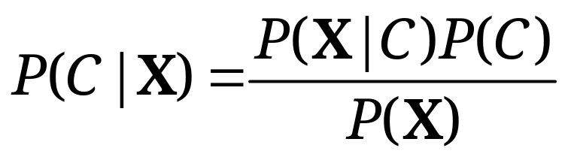
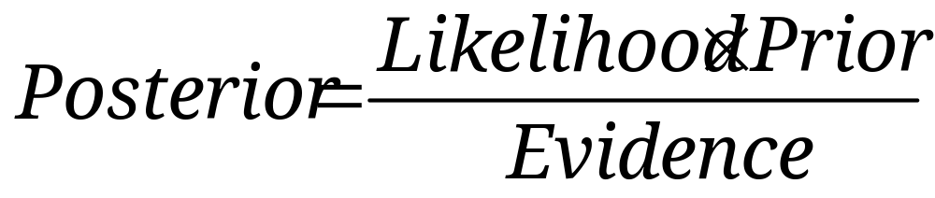
Probability Basics
Prior, conditional and joint probability
  Prior probability:
  Conditional probability:
  Joint probability:
  Relationship:
  Independence:
Bayesian Rule
COMP20411 Machine Learning

Slide 3
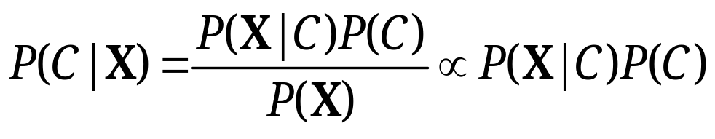
Probabilistic Classification
Establishing a probabilistic model for classification
  Discriminative model
  Generative model
MAP classification rule
  MAP: Maximum A Posterior
  Assign x to c* if
Generative classification with the MAP rule
  Apply Bayesian rule to convert:
COMP20411 Machine Learning

Slide 4

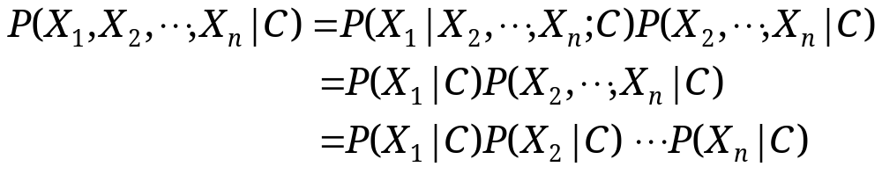
Naïve Bayes
Bayes classification
  Difficulty: learning the joint probability
Naïve Bayes classification
  Making the assumption that all input attributes are independent
  MAP classification rule
COMP20411 Machine Learning

Slide 5
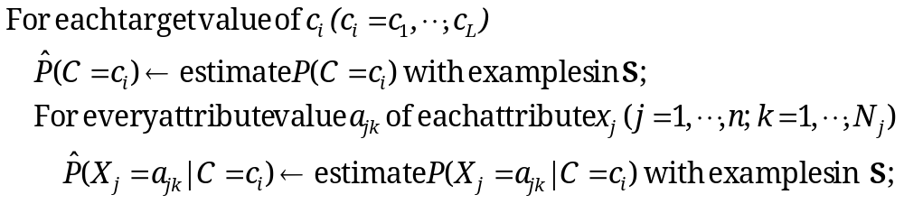


Naïve Bayes
Naïve Bayes Algorithm (for discrete input attributes)
  Learning Phase: Given a training set S,
  Output: conditional probability tables; for elements
  Test Phase: Given an unknown instance ,
  Look up tables to assign the label c* to X’ if
COMP20411 Machine Learning

Slide 6

Example
Example: Play Tennis
COMP20411 Machine Learning

Slide 7
Example
Learning Phase
Outlook | Play=Yes | Play=No
Sunny | 2/9 | 3/5
Overcast | 4/9 | 0/5
Rain | 3/9 | 2/5
Temperature | Play=Yes | Play=No
Hot | 2/9 | 2/5
Mild | 4/9 | 2/5
Cool | 3/9 | 1/5
Humidity | Play=Yes | Play=No
High | 3/9 | 4/5
Normal | 6/9 | 1/5
Wind | Play=Yes | Play=No
Strong | 3/9 | 3/5
Weak | 6/9 | 2/5
P(Play=Yes) = 9/14
P(Play=No) = 5/14
COMP20411 Machine Learning

Slide 8
Example
Test Phase
  Given a new instance,
  x’=(Outlook=Sunny, Temperature=Cool, Humidity=High, Wind=Strong)
  Look up tables
  MAP rule
P(Outlook=Sunny|Play=Yes) = 2/9
P(Temperature=Cool|Play=Yes) = 3/9
P(Huminity=High|Play=Yes) = 3/9
P(Wind=Strong|Play=Yes) = 3/9
P(Play=Yes) = 9/14
P(Outlook=Sunny|Play=No) = 3/5
P(Temperature=Cool|Play==No) = 1/5
P(Huminity=High|Play=No) = 4/5
P(Wind=Strong|Play=No) = 3/5
P(Play=No) = 5/14
P(Yes|x’): [P(Sunny|Yes)P(Cool|Yes)P(High|Yes)P(Strong|Yes)]P(Play=Yes) = 0.0053
P(No|x’): [P(Sunny|No) P(Cool|No)P(High|No)P(Strong|No)]P(Play=No) = 0.0206
Given the fact P(Yes|x’) < P(No|x’), we label x’ to be “No”.
COMP20411 Machine Learning

Slide 9

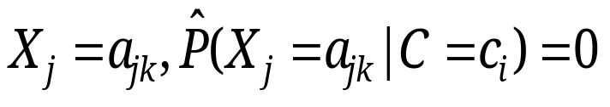
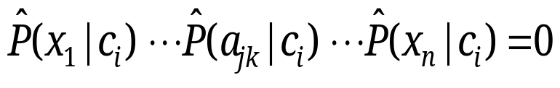
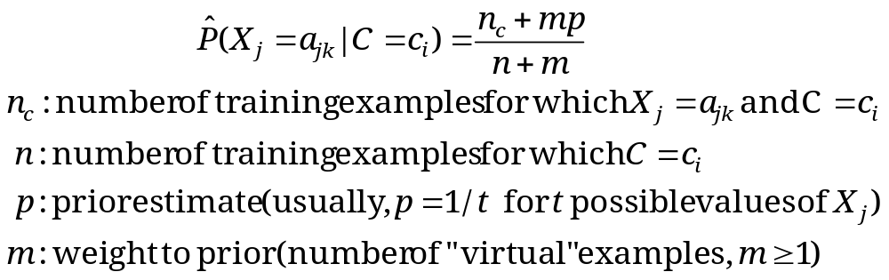
Relevant Issues
Violation of Independence Assumption
  For many real world tasks,
  Nevertheless, naïve Bayes works surprisingly well anyway!
Zero conditional probability Problem
  If no example contains the attribute value
  In this circumstance, during test
  For a remedy, conditional probabilities estimated with
COMP20411 Machine Learning

Slide 10
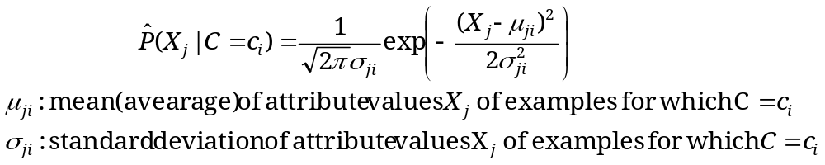




Relevant Issues
Continuous-valued Input Attributes
  Numberless values for an attribute
  Conditional probability modeled with the normal distribution
  Learning Phase:
  Output: normal distributions and
  Test Phase:
    Calculate conditional probabilities with all the normal distributions
    Apply the MAP rule to make a decision
COMP20411 Machine Learning

Slide 11
Conclusions
Naïve Bayes based on the independence assumption
  Training is very easy and fast; just requiring considering each attribute in each class separately
  Test is straightforward; just looking up tables or calculating conditional probabilities with normal distributions
A popular generative model
  Performance competitive to most of state-of-the-art classifiers even in presence of violating independence assumption
  Many successful applications, e.g., spam mail filtering
  Apart from classification, naïve Bayes can do more…
COMP20411 Machine Learning

