Slide 1
Snake and Quick Typing
Player Name
Buttons or text box fields
Snake Game
Input Name
Text
Start
Press any arrow key to start
SNAKE GAME
Leaderboard
Exit
Back
Confirm
Leaderboard
Snake Game Score
Typing Speed Challenge
Player 1
Snake score number
Player 2
Sentence
Typing Speed Score
Player 3
Input box
Typing Score Number
Player 4
Player 5

Slide 2
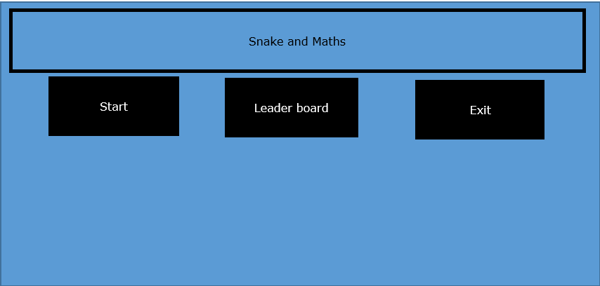
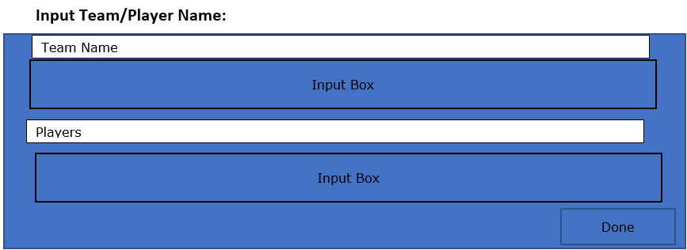
Menu

