Slide 2
Scalable Machine Learning and Data Science with F#
Tomas Petricek, fsharpWorks
@tomaspetricek | http://tomasp.net

Slide 3
non-profit books and tutorials cross-platform community data science F# Software Foundation commercial support open-source contributions machine learning www.fsharp.org web and cloud consulting user groups research

Slide 4
❶ Data science ❷ Machine learning ❸ Scaling to the cloud

Slide 5
Acquire
Explore
Visualize

Slide 6
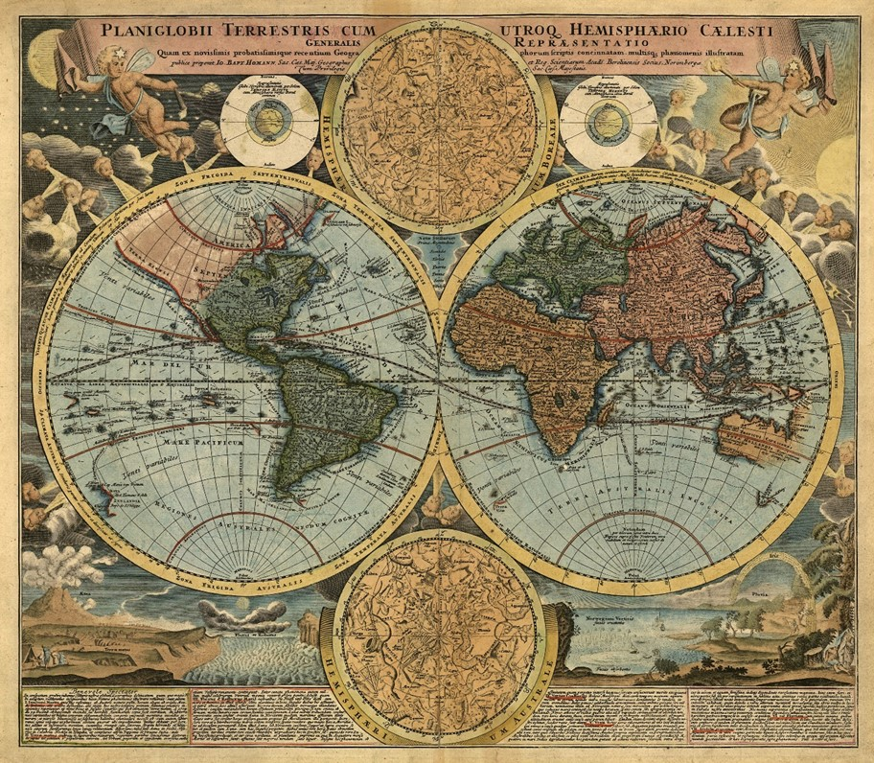
Data Science
Visualizing World Indicators

Slide 7



FsLab
Unified data-science package
F# Data
Type providers for data access
Deedle
Data frame & time-series for .NET

Slide 8
Machine Learning
Clustering Countries

Slide 9
distance : ('T -> 'T -> float) ->
aggregate : ('T -> 'T[] -> 'T[]) ->
count:int -> input:'T[] -> Clustering

Slide 10
Cloud
Scaling with M-Brace

Slide 11
async { }

Slide 12
cloud { }

Slide 13
Summary
Data Science Package www.fslab.org
Fit for Machine Learning www.fsharp.org
Scales to the Cloud www.m-brace.net
Learn more
Come for a Chat at the Poster Session!
F# Meetup on Web + Azure tonight
F# Friday Chat (on campus, Friday 5)
Contact
Tomas Petricek (@tomaspetricek & tomas@tomasp.net)

