Slide 1
Server-Side WebAssembly
in Practice
Skaara Poncin · Storm van Loon · Gabriel Uwaila

Slide 2
Learning goals
Understand what Server-Side Wasm is
Explain how Wasm + WASI work together
Compare modules vs components
See practical use cases: HTTP, AI, edge/cloud
Know current limitations and when to use Wasm

Slide 3
What is Server-Side WebAssembly?
WebAssembly (.wasm) is a portable binary format
Usually known from browsers, but also runs on servers
A runtime (e.g. Wasmtime) executes Wasm in a sandbox
Goal: safe, fast, portable execution across environments

Slide 4
Why should students care?
Performance close to native for many workloads
Strong isolation for untrusted or third-party code
Good for polyglot systems (Rust, Go, C/C++, etc.)
Useful in modern systems: edge, serverless, plugins, AI helpers

Slide 5
How execution works (high level)
Compile source code to .wasm
Runtime loads + validates the module
Runtime compiles/interprets for the host CPU
Code runs inside a sandbox with controlled access
Host app and Wasm app communicate through imports/exports

Slide 6
WASI (why it matters)
Wasm alone has no direct filesystem/network access
WASI provides standardized system interfaces
Examples: HTTP handling, clocks/timers, I/O capabilities
Key idea: explicit permissions, not full machine access

Slide 7
Security model
Capabilities must be granted explicitly
Sandbox limits impact of bugs and malicious code
Components can improve isolation further (shared-nothing)
Trade-off: .wasm is binary, so debugging often uses .wat

Slide 8
Runtime ecosystem (examples)
General/server: Wasmtime, Wasmer, WasmEdge
JavaScript world: Node and Deno support Wasm too
IoT-focused: WAMR, wasm3
Choice depends on target platform + feature support

Slide 9
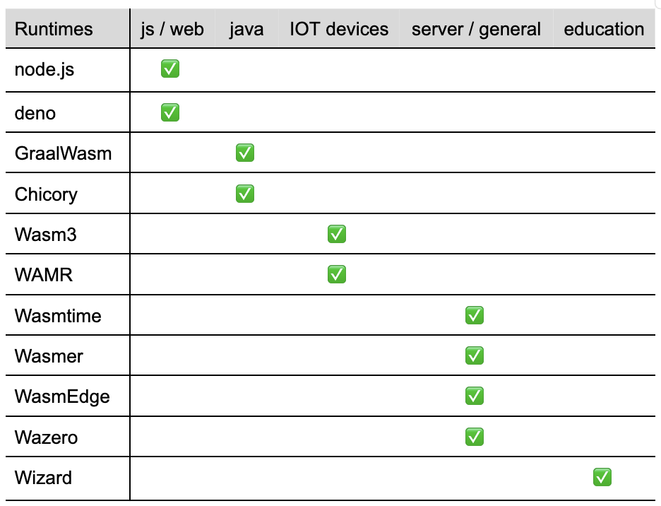

Slide 10
Modules vs Components
Module: basic unit, simpler, widely supported
Component: higher-level packaging with better interoperability
Components are designed for composition and safer boundaries
In practice: support is improving, but not equal everywhere

Slide 11
WIT in one slide
WIT = WebAssembly Interface Types
Describes function contracts and data types across languages
Helps avoid custom glue code for every language pair
Enables more reliable cross-language integration

Slide 12
Example 1: HTTP service with Wasm
We implemented wasi:http/incoming-handler
Same service idea across Rust, TinyGo, and C++
Shows portability of interface-based development
Main lesson for students: same contract, different language ergonomics

Slide 13
Example 2: AI inference with Wasm
Image in -> vector embedding out (ONNX-based flow)
Inference logic in Rust compiled to Wasm
Good fit for sandboxed edge/serverless execution
Important practical point: warm/cached execution matters

Slide 14
Where Server-Side Wasm fits best today
Edge/CDN compute close to users
Serverless functions with fast cold starts
Plugin systems with untrusted extensions
Sandboxed compute near data (e.g., database UDF scenarios)

Slide 15
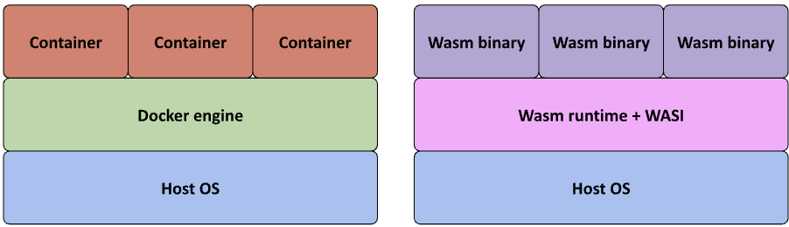
Cloud and deployment landscape
Hosts/platforms: Spin and WasmCloud are common entry points
Kubernetes integration exists but can require extra setup
Not a full replacement for containers in every case
Best viewed as an additional tool in your architecture toolbox

Slide 16
Current limitations (important for engineering decisions)
Tooling maturity varies by language/runtime
Documentation quality is inconsistent across projects
New WASI/component features are not uniformly implemented
Debugging and observability are still less mature than mainstream stacks

Slide 17
Takeaway for students
Server-Side Wasm is practical, not just hype
Think of it as: portable sandboxed compute
Use it where isolation, startup speed, or portability matter most
Keep expectations realistic: evaluate runtime/tooling support first

