Slide 1
Covid Housing Study
How did COVID- 19 affect the housing market?
Project by Preeti Wadhwa, Shannon Williams, Alana Castellano, David Cortez, and Robert Crozier

Slide 2
Our questions:
Housing Prices
Financial Changes
Context
Building Materials
How did COVID impact the housing market?
What was the increase in house prices in CA and TX?
Did % of houses sold over listing price change?
Did remote work options increase during COVID?
How did average wage change during and after COVID?
How were mortgage rates affected by COVID?
Did changes in price of building materials affect housing costs?

Slide 3
How did COVID impact the housing market?
How did the home prices fair in the Post Covid days?
The HPI data indicates that the home prices increased steeply during the Post Covid years of 2020 and 2021

Slide 4
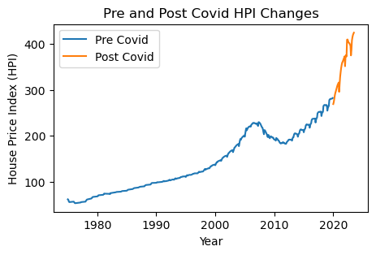
Over HPI Performance
Average change for all Pre Covid years: 4.94
Average change for Post Covid years : 43.30

Slide 5
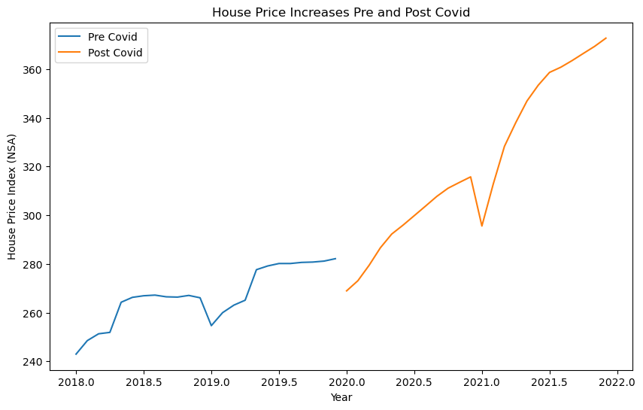
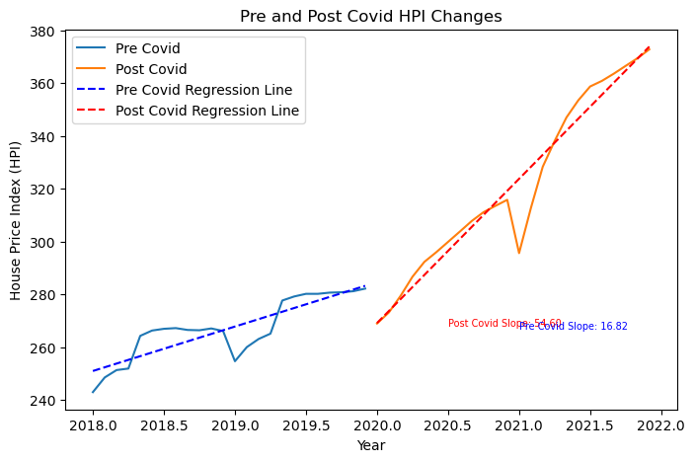
Price increases in Pre and Post Covid Periods
Regression model for price increases
Average change Pre Covid: 16.82
Average change Post Covid: 54.59

Slide 6
What was the increase in house prices in California and Texas
The price changes in California and Texas followed the same path

Slide 7
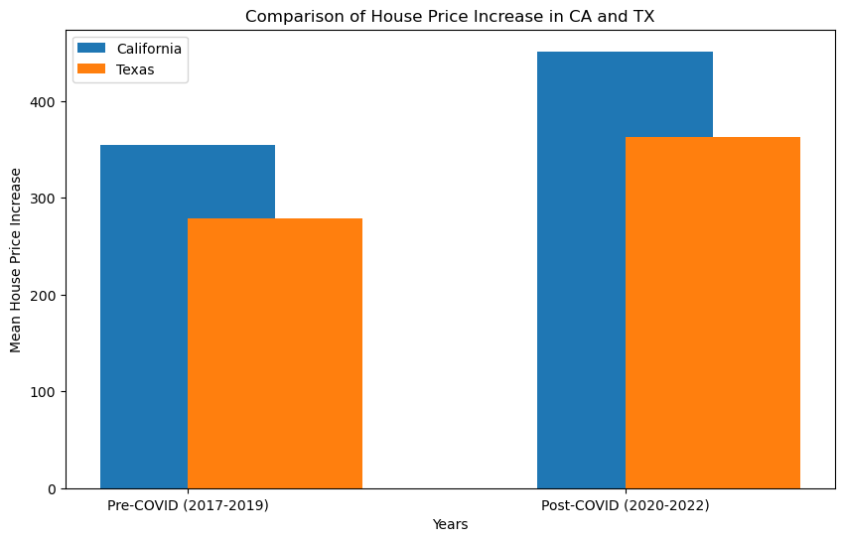
House Price Increases in California and Texas
Average change for all Pre Covid years: 4.94
Average change for Post Covid years : 43.30

Slide 8
How did job opportunities affect the housing market, Pre & Post Covid?
What percentage of people work from home each year?
Steep increase in the percentage of people working from home that occurs during 2020.
In 2018, 5% of people reported working from home. At the height of the graph, in
In 2020, 60% of people are working from home.
After 2020, % of people working from home begins decreasing
Numbers stop decreasing around 30% in 2021.

Slide 9
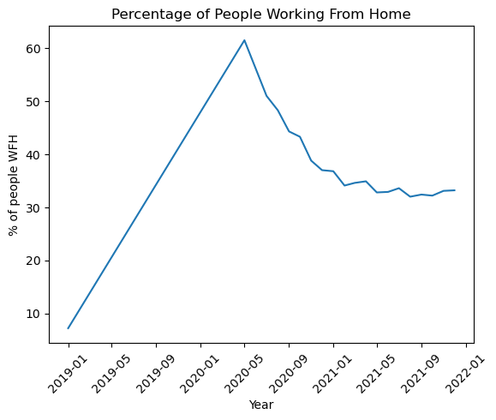

Slide 10
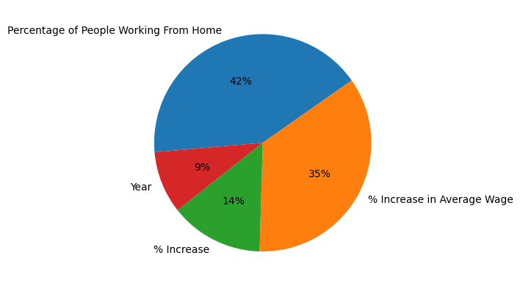
Percentage of People Working From Home

Slide 11
How did average wage affect the housing market, pre & post Covid?
How did the average wage change throughout the covid era?
Average wage slowly increases over time, and has since 1985
Sharp increase in 2020, right after COVID-19 begins.

Slide 12
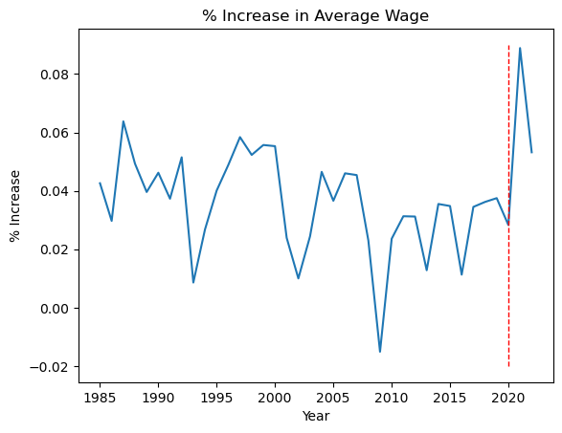

Slide 13
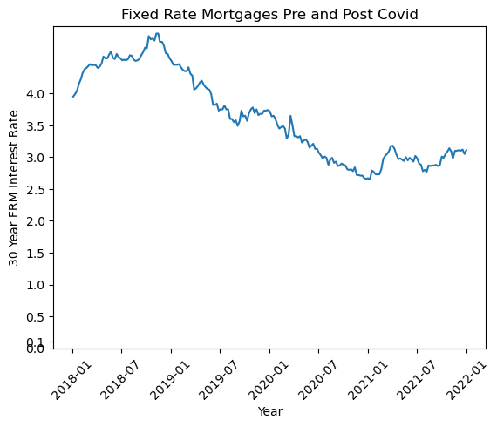
How did mortgage interest rates affect the housing market, Pre and Post Covid?
No relationship found.
2018-2019, interest rates increased steadily
Late 2018 started a decrease
Decrease continues till 2021

Slide 14
Signs of Demand
Discussed in earlier slide and the ability to work from home. This drove up demand for homes. With average buyers competing for the same supply there was an increase in the number of homes sold above asking price.

Slide 15
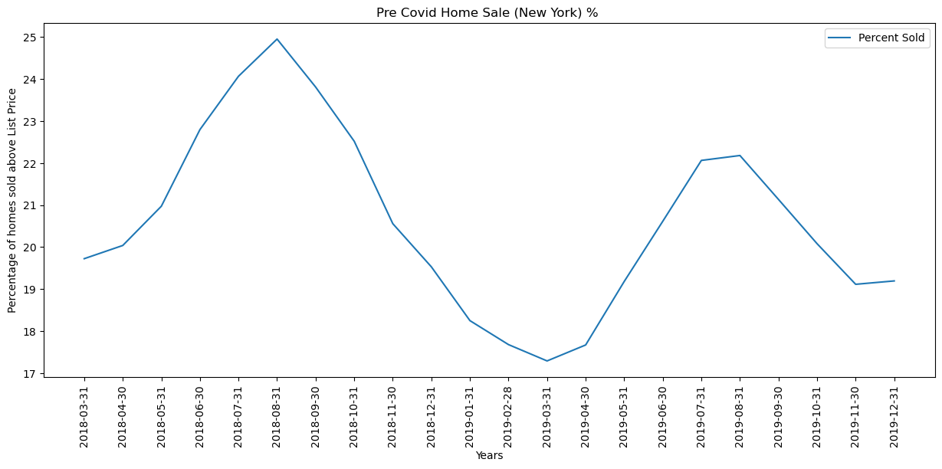
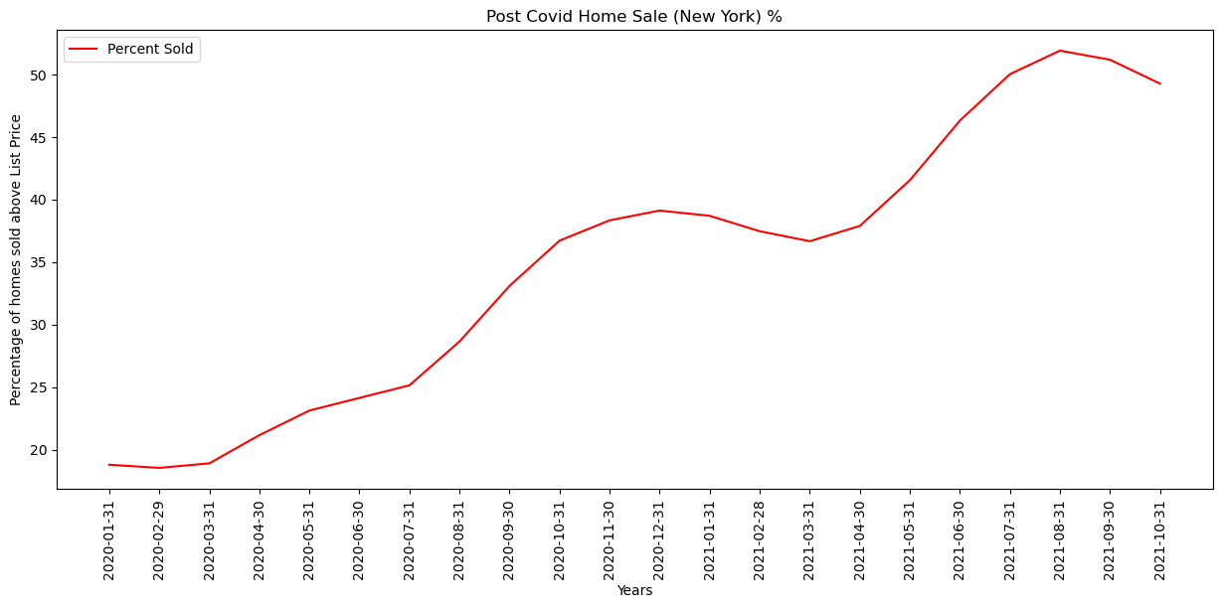
Pre & Post Covid
% of Homes Sold Above Listing Price (NYC)

Slide 16
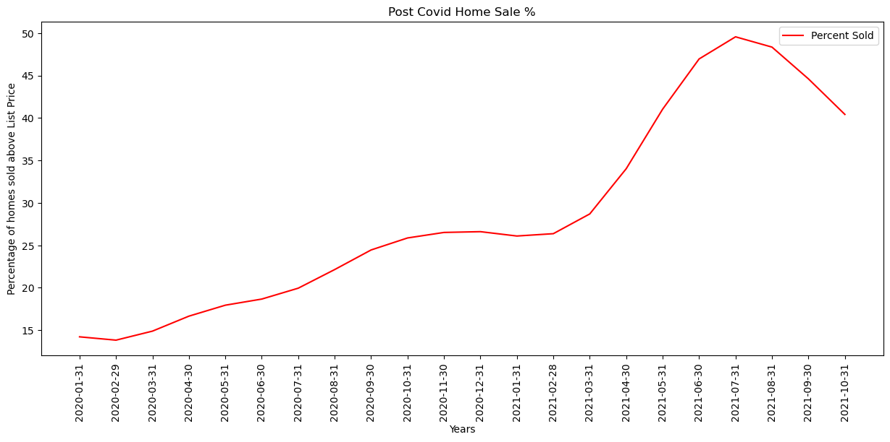
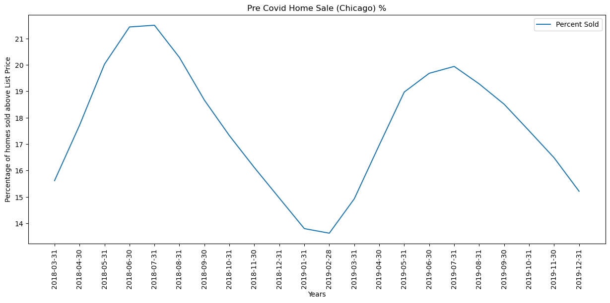
Pre & Post Covid
% of Homes Sold Above Listing Price (Chicago)

Slide 17
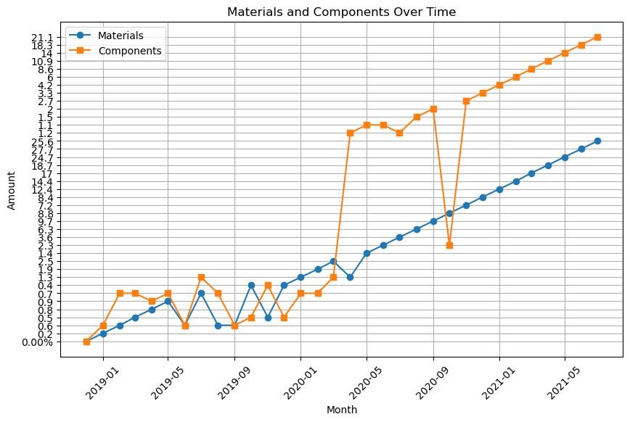
Price of building a home
Over the time you can clearly see an upward trajectory
Components had the most drastic increase and outlier between the 2 variables

Slide 18
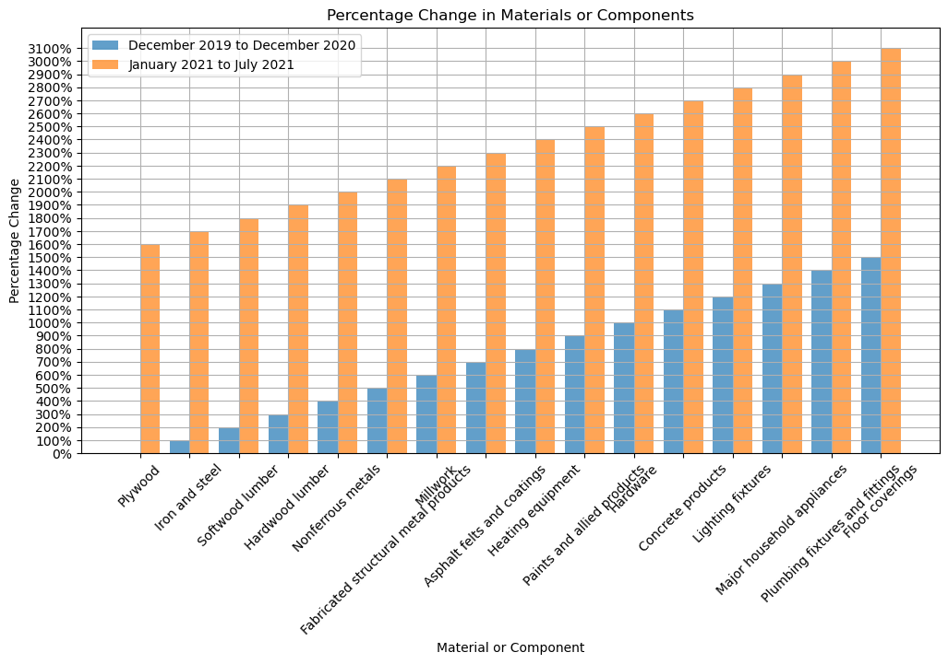
Percentage change break down side by side comparison
This bar graph shows the percentage change of individual types of material.
Plumbing fixtures fittings and Floor coverings saw the highest cost increases.

Slide 19
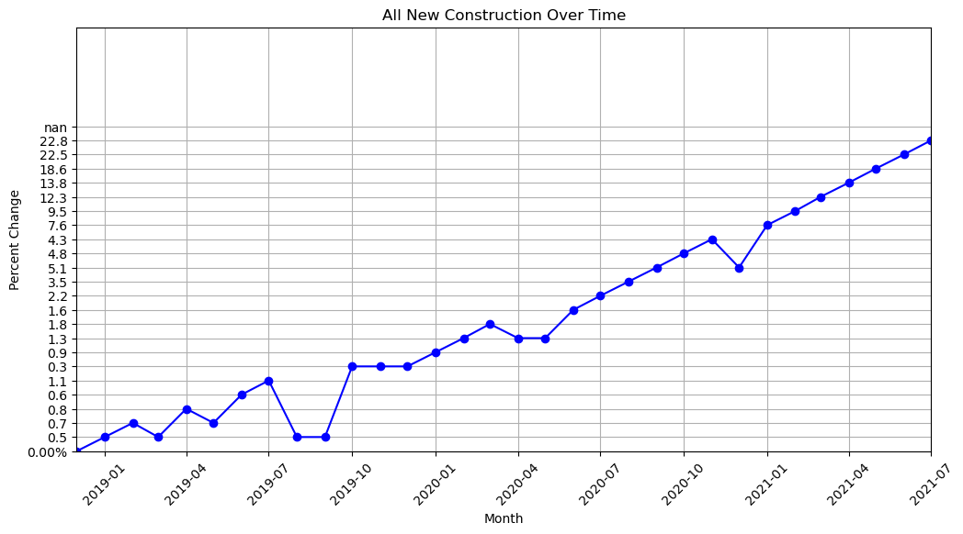
New construction over time percent change
This graph shows the percentage change by month starting in January 2019
You can see how the market initially had inconsistent months going up and down, then once the pandemic hit you saw up to 20% increase in construction costs.

Slide 20
In conclusion…
We looked at all the supporting data and agree that COVID had a direct affect on housing prices, specifically, it lead to an increase in price. Our conclusion is supported by the following data analysis:
A steep rise in housing price index during and post covid as compared to previous years
Job opportunities to work remotely increased, and the average wage of the American worker increased as well
Increase in demand for housing is demonstrated by the percentage of houses sold above listing price
Mortgage rates, while not directly affected by COVID, nonetheless decreased during this period, making buying a house more affordable and desirable.
Limited supply of homes, which was created by price increase in housing materials, caused an increase in price as well

