Slide 1
Software Engineering Group Project - UI Presentation
Author(s): Jack Thompson [jat92@aber.ac.uk]
Tyler Lewis [tyw1@aber.ac.uk]
Sean Hobson [seh25@aber.ac.uk]
Config Ref: UI-Spec-Pres-GP9
Date: 23 February 2023
Version: 0.6
Status: Review

Slide 2
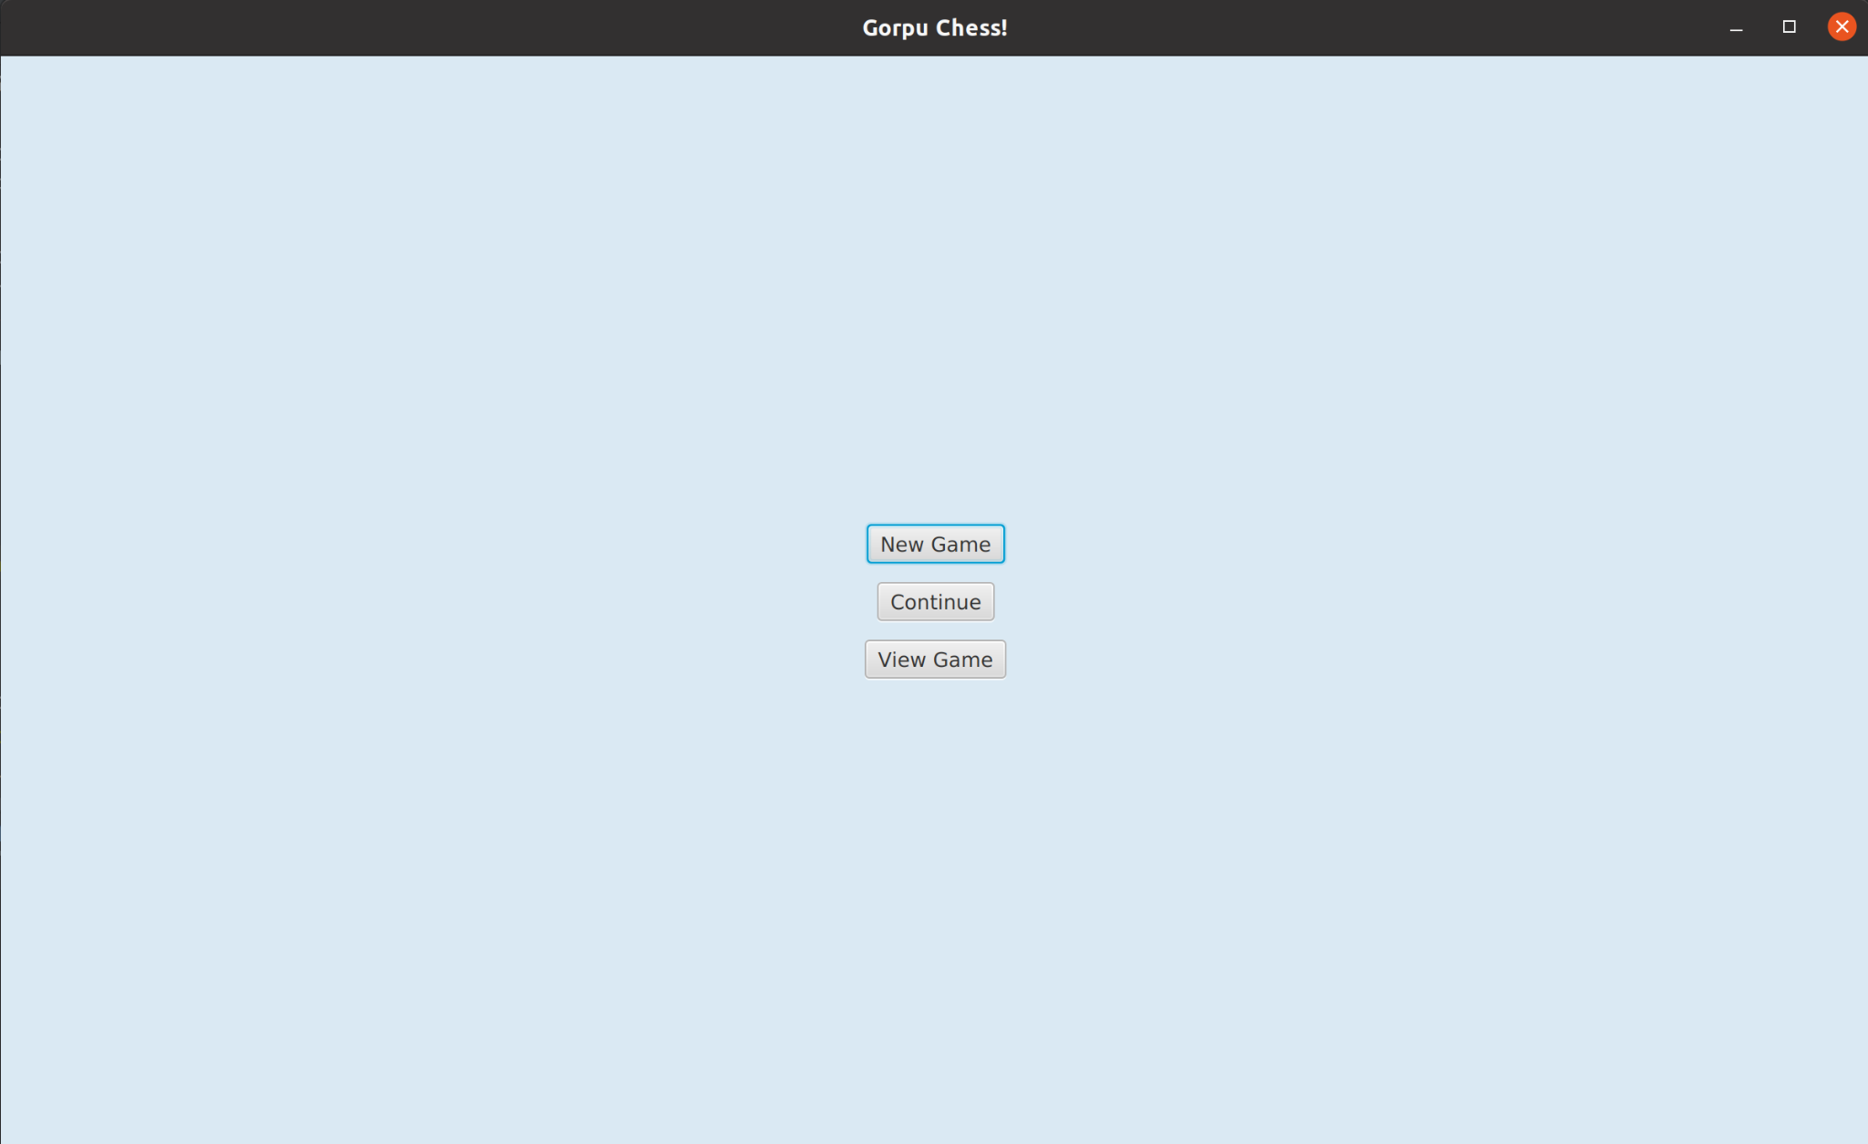
Use Case - UC-0.0
Task:
Launching The Application
Action:
Launch the application
Result:
The main menu appears with 3 buttons.

Slide 3
Use Case - UC-0.1
Task:
Starting a New Game
Action:
Click on the New Game button
Result:
The user will be prompted to enter the names of the players.

Slide 4
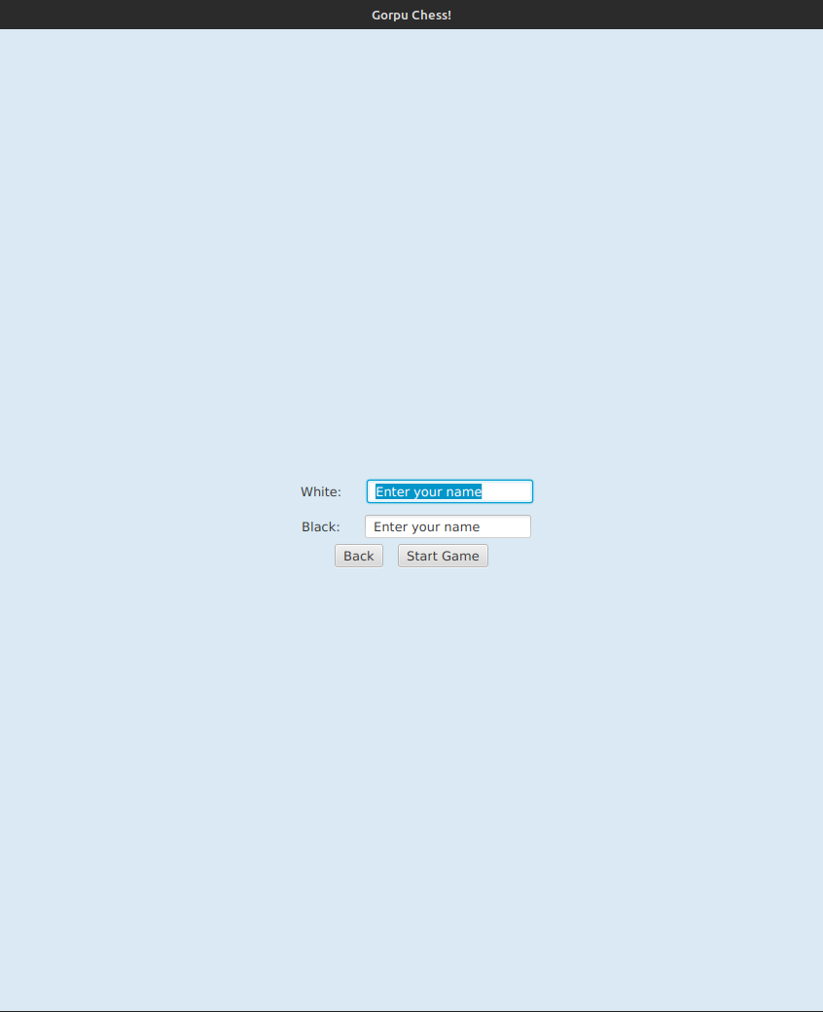
Use Case - UC-0.1
Task:
Starting a New Game
Action:
Enter Player names
Result:
The game window will open displaying the board, pieces and other game features.

Slide 5
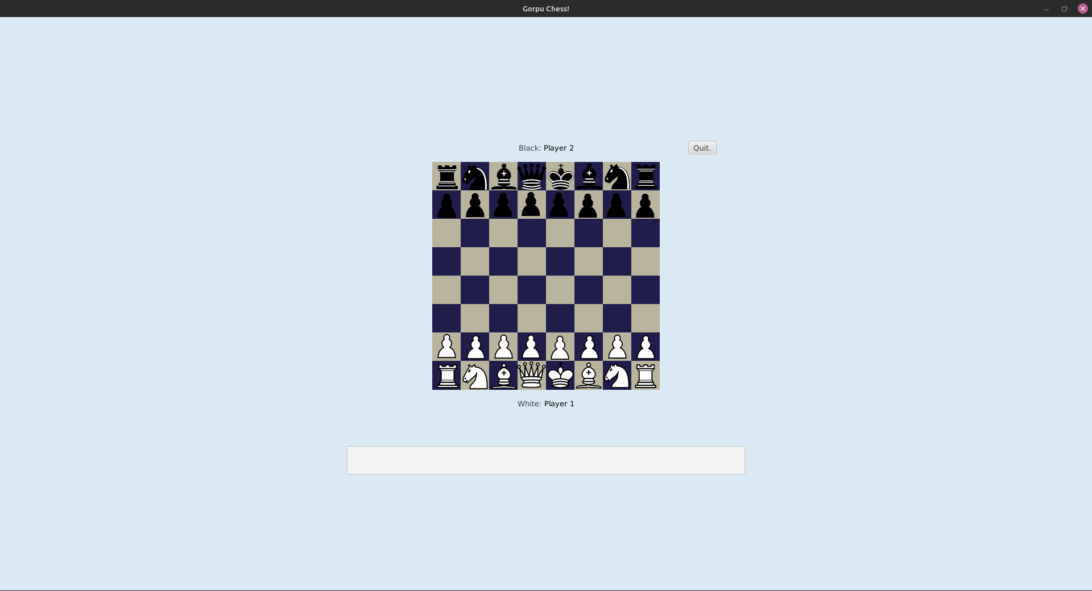
Use Case - UC-0.1
Task:
Starting a New Game
Final State:
The board, pieces and other game features are displayed. The game is ready to start.
Chess Pieces Image credit: Wikipedia user Cburnett, CC BY-SA 3.0
commons.wikimedia.org/wiki/Category:PNG_chess_pieces/
Notes:
We need to update this pic once this part of the front end is finished.

Slide 6
Insert pic of the game prompting the user for player names
Use Case - UC-0.2
Task:
Restoring a Previous Game
Action:
Click the Continue button
Result:
The user is shown a list of saved files.
Notes:
We do not have a load game button …

Slide 7
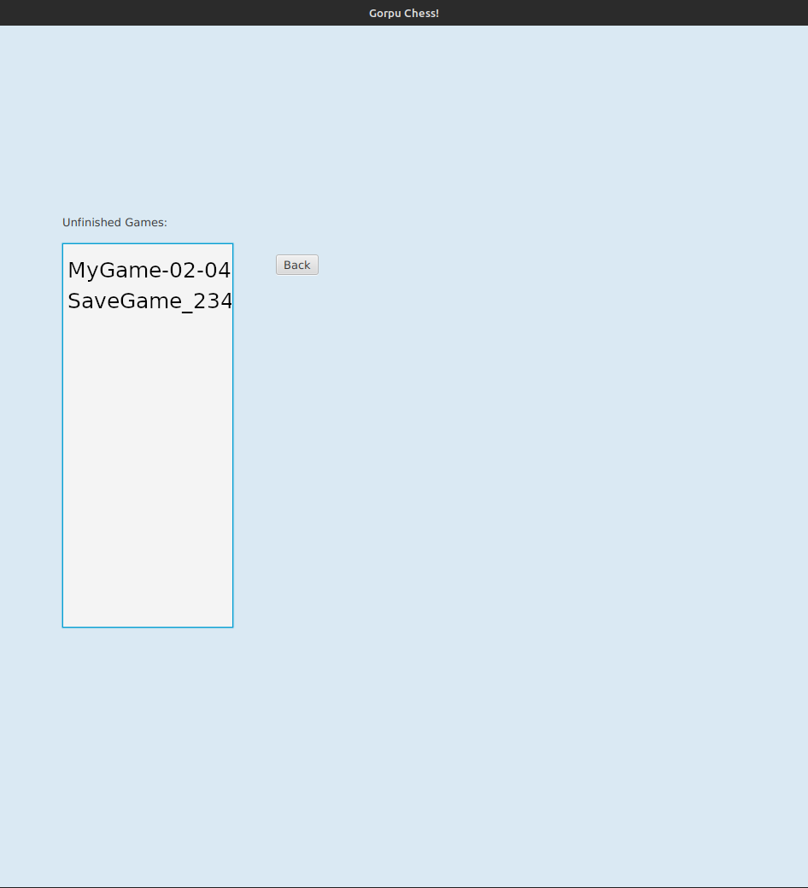
Use Case - UC-0.2
Task:
Restoring a Previous Game
Action:
Select a save file
Result:
The board is set correctly according to the save file.

Slide 8
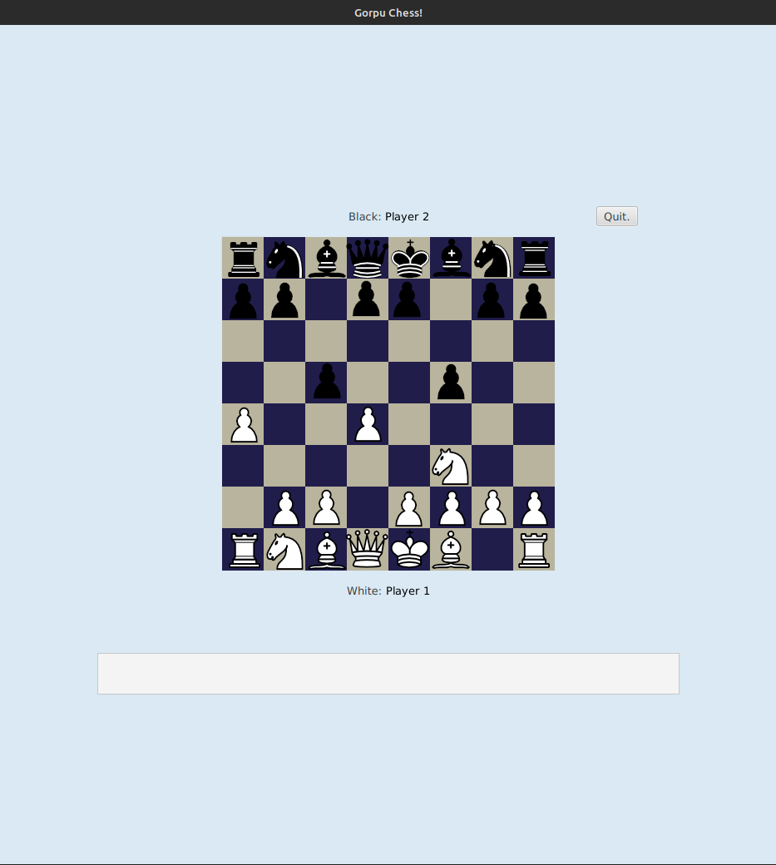
Use Case - UC-0.2
Task:
Restoring a Previous Game
Final State:
The board pieces are set correctly according to the saved file.
Chess Pieces Image credit: Wikipedia user Cburnett, CC BY-SA 3.0
commons.wikimedia.org/wiki/Category:PNG_chess_pieces/

Slide 9
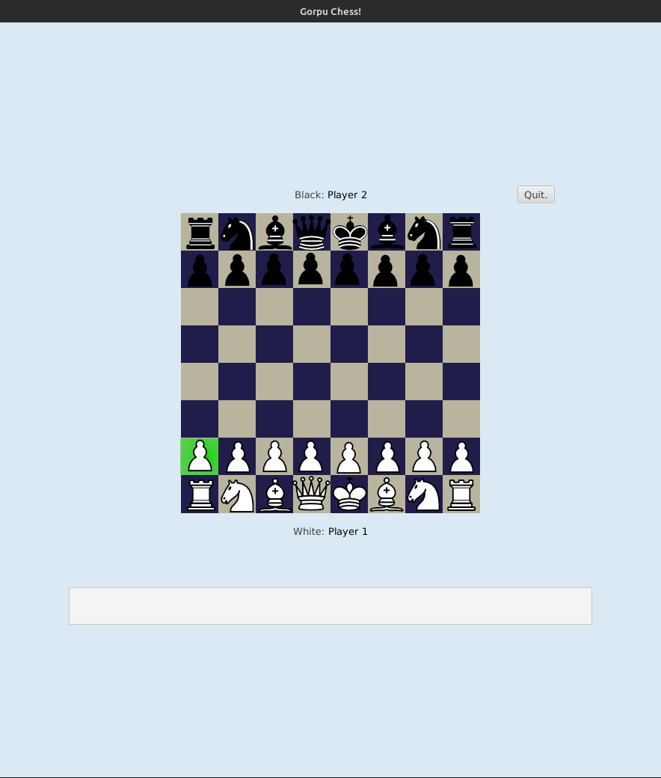
Use Case - UC-1.0
Task:
Selecting a Piece
Action:
Click on the white pawn
Result:
The selected piece is highlighted.
Chess Pieces Image credit: Wikipedia user Cburnett, CC BY-SA 3.0
commons.wikimedia.org/wiki/Category:PNG_chess_pieces/

Slide 10
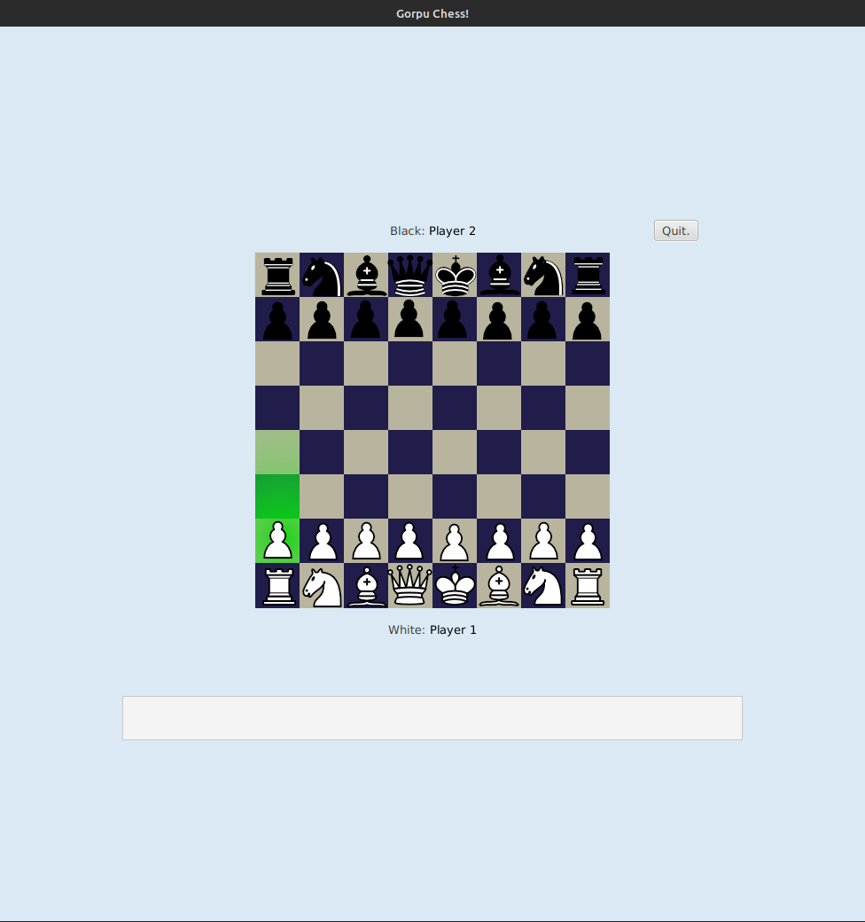
Use Case - UC-1.1
Task:
Moving a piece
Action:
Move the selected piece from the current position to the square two positions ahead.
Result:
The selected piece moves to the target position..
Chess Pieces Image credit: Wikipedia user Cburnett, CC BY-SA 3.0
commons.wikimedia.org/wiki/Category:PNG_chess_pieces/

Slide 11
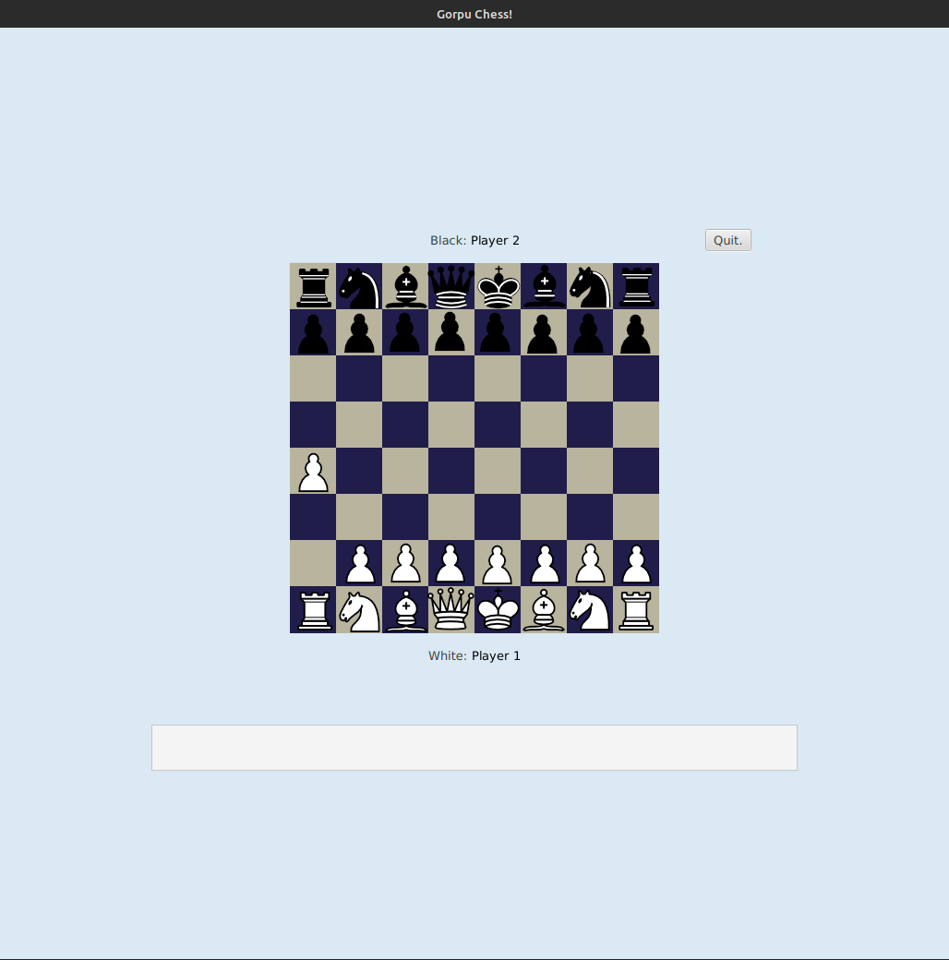
Use Case - UC-1.1
Task:
Moving a piece
Final State:
The board showing the (reference to relevant piece) moved to the new position with all other pieces in the same position.
Chess Pieces Image credit: Wikipedia user Cburnett, CC BY-SA 3.0
commons.wikimedia.org/wiki/Category:PNG_chess_pieces/

Slide 12
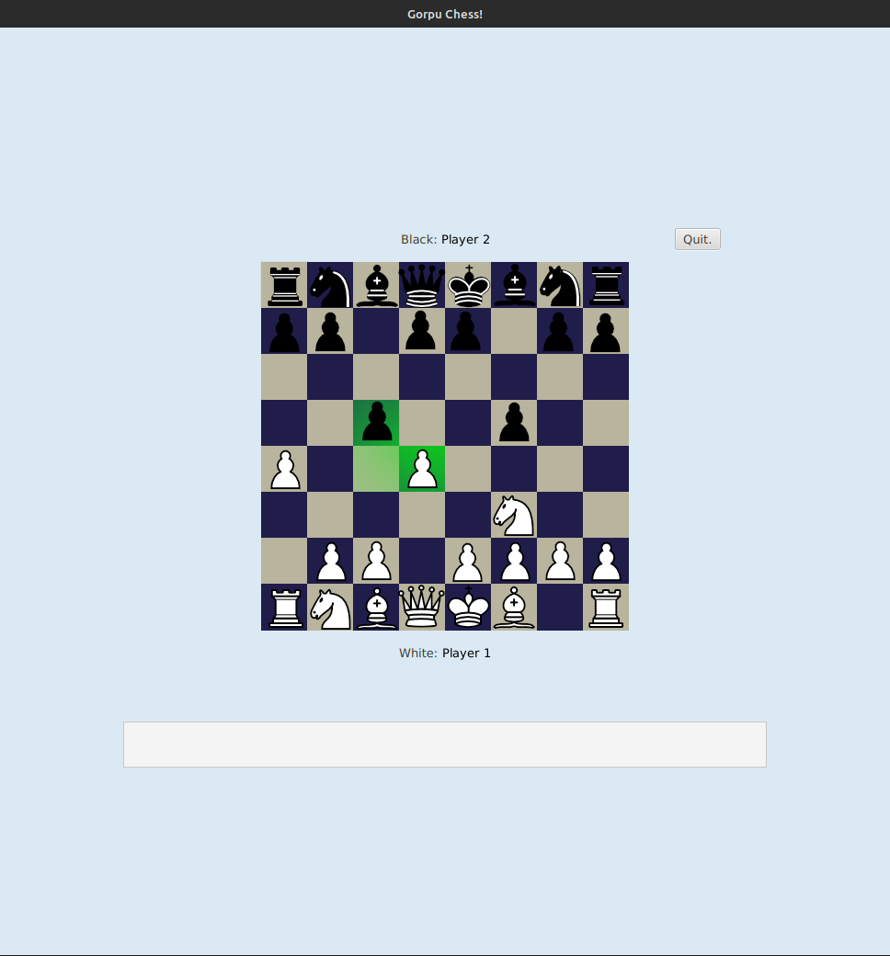
Use Case - UC-1.2
Task:
Capturing a Piece
Action:
Click the (ref to piece) that will capture the (ref to piece)
Result:
The (ref to piece) will move to the board tile that the (ref to piece) was on. The (ref to piece) will no longer be visible on the board.
Chess Pieces Image credit: Wikipedia user Cburnett, CC BY-SA 3.0
commons.wikimedia.org/wiki/Category:PNG_chess_pieces/

Slide 13
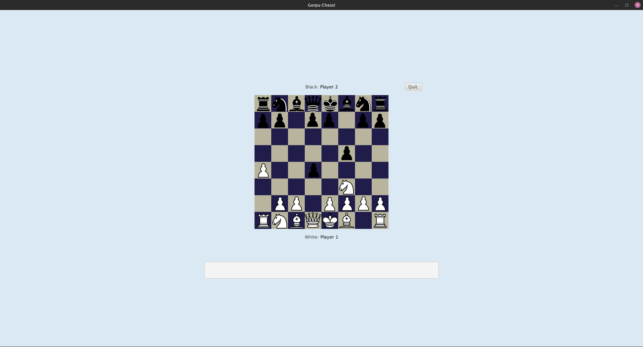
Use Case - UC-1.2
Task:
Capturing a Piece
Final State:
The board showing the (ref to piece) moved to where the (ref to piece) was. The (ref to piece) is no longer visible on the board.
Chess Pieces Image credit: Wikipedia user Cburnett, CC BY-SA 3.0
commons.wikimedia.org/wiki/Category:PNG_chess_pieces/

Slide 14
Use Case - UC-1.3
Task:
Changing Piece Selection
Action:
Initially the (ref to piece) is selected
Result:
Only the selected piece (does something including highlighted squares it can move to).
Chess Pieces Image credit: Wikipedia user Cburnett, CC BY-SA 3.0
commons.wikimedia.org/wiki/Category:PNG_chess_pieces/

Slide 15
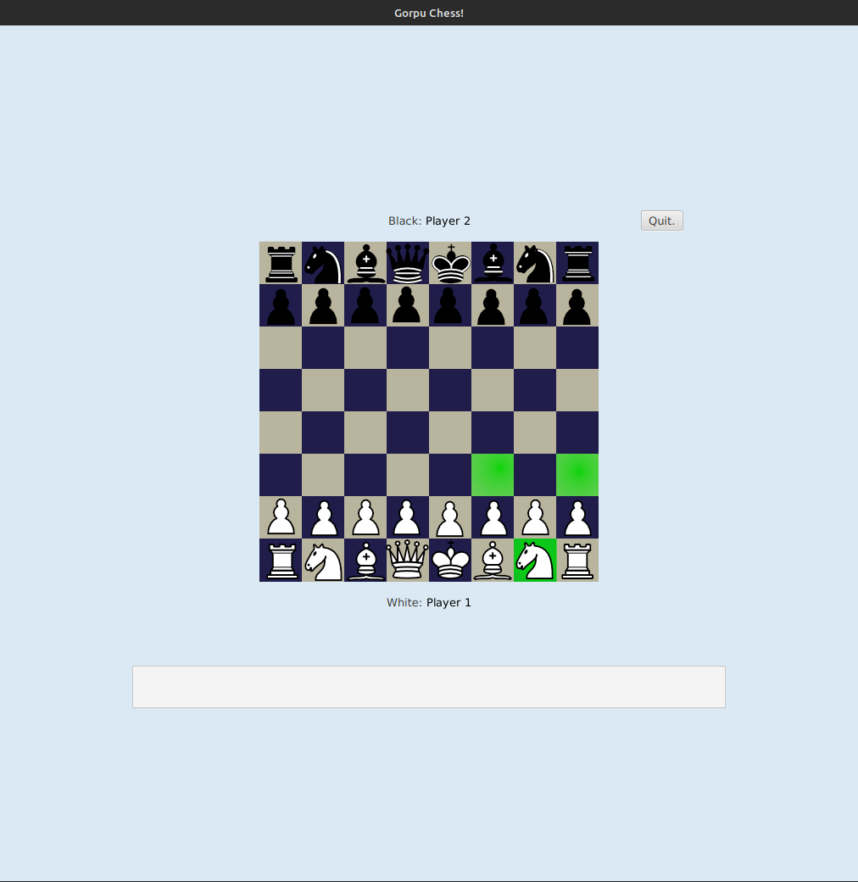
Use Case - UC-1.3
Task:
Changing Piece Selection
Action:
The (ref to new piece) is now selected
Result:
The newly selected piece (does something including highlighted squares it can move to).
Chess Pieces Image credit: Wikipedia user Cburnett, CC BY-SA 3.0
commons.wikimedia.org/wiki/Category:PNG_chess_pieces/

Slide 16
Use Case - UC-2.0
Task:
Quitting a Game
Action:
The in-game menu button is clicked
Result:
The in-game menu button displaying (whatever the options will be).
Chess Pieces Image credit: Wikipedia user Cburnett, CC BY-SA 3.0
commons.wikimedia.org/wiki/Category:PNG_chess_pieces/
Notes:
What will the ingame menu look like?

Slide 17
Use Case - UC-2.0
Task:
Quitting a Game
Action:
The quit option is clicked
Result:
The user will be taken back to the main menu. The game will have been saved but the user will not see this. (inc this last sentence?).

Slide 18
Use Case - UC-2.0
Task:
Quitting a Game
Final State:
The main menu is displayed.

Slide 19
An image to show the in game menu.
Use Case - UC-3.0
Task:
Reviewing a Previous Game
Action:
The View Game button is selected from the main menu.
Result:
The user will be shown a list of possible previous games to view.
Notes:
Checking with Tyler this might be same as UC 0.3

Slide 20
Use Case - UC-3.0
Task:
Reviewing a Previous Game
Action:
(ref to game) is selected
Result:
The user will be shown a list of possible previous games to view.
Notes:
Checking with Tyler this might be same as UC 0.3

Slide 21
Use Case - UC-3.0
Task:
Reviewing a Previous Game
Final State:
The board is shown in the starting position. Buttons appear to show “Step Forward” and “Step Backward”.
Chess Pieces Image credit: Wikipedia user Cburnett, CC BY-SA 3.0
commons.wikimedia.org/wiki/Category:PNG_chess_pieces/

Slide 22
Use Case - UC-3.1
Task:
Stepping Forward
Action:
The “Step Forward” button is selected.
Result:
The board state is shown after the first move.
Chess Pieces Image credit: Wikipedia user Cburnett, CC BY-SA 3.0
commons.wikimedia.org/wiki/Category:PNG_chess_pieces/

Slide 23
Use Case - UC-3.2
Task:
Stepping Backward
Action:
The “Step Backward” button is selected.
Result:
The board state is shown from before the last move (turn).
Chess Pieces Image credit: Wikipedia user Cburnett, CC BY-SA 3.0
commons.wikimedia.org/wiki/Category:PNG_chess_pieces/

Slide 24
Use Case - UC-4.0
Task:
End of Game
Action:
Click the “End Game” button.
Result:
A pop up appears notifying the user that the game will be saved for replay at a future point.
Game Ended! Player 1 surrendered! Player 2 wins!
Return to Main Menu Your game has been saved and can be reviewed at any time
Chess Pieces Image credit: Wikipedia user Cburnett, CC BY-SA 3.0
commons.wikimedia.org/wiki/Category:PNG_chess_pieces/

Slide 25
Use Case - UC-4.1
Task:
Detecting Check
Action:
Move the (ref to piece) to check the (ref to colour) king.
Result:
The (ref to piece) and (ref to colour) king will be highlighted.
Notes:
Assuming we do not need to do demonstrate intermediary: prior board state -> piece selection -> piece move -> highlight king and attacking piece(s). As this has already been done in UC 1.1
We can just show prior board state -> highlight king and attacking piece(s) for UC 4.1

Slide 26
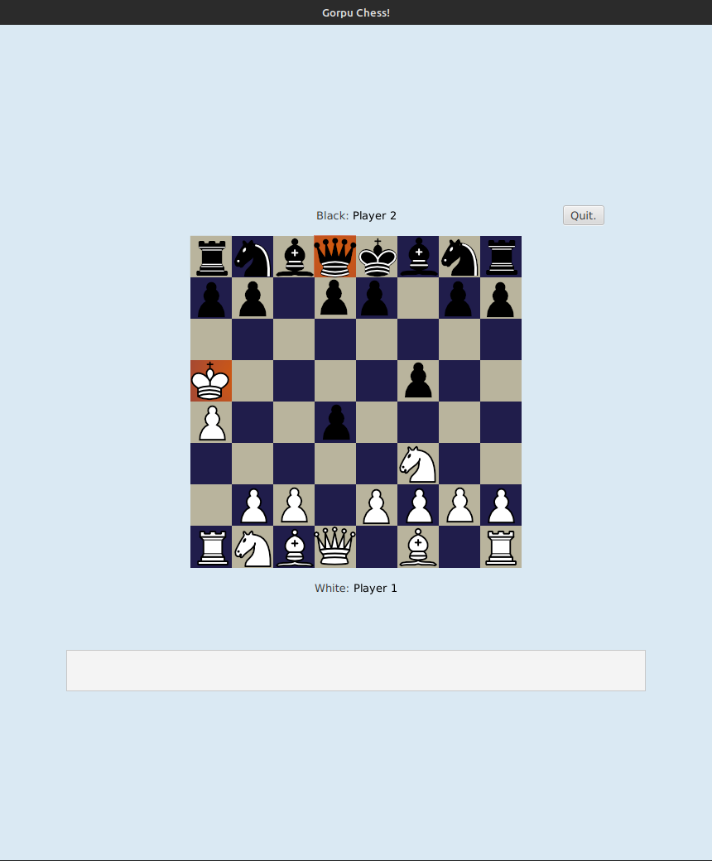
Use Case - UC-4.1
Task:
Detecting Check
Final State:
The board state after the (ref to piece) has moved to attack the (ref to colour) king. Both the king and attacking piece are highlighted.

Slide 27
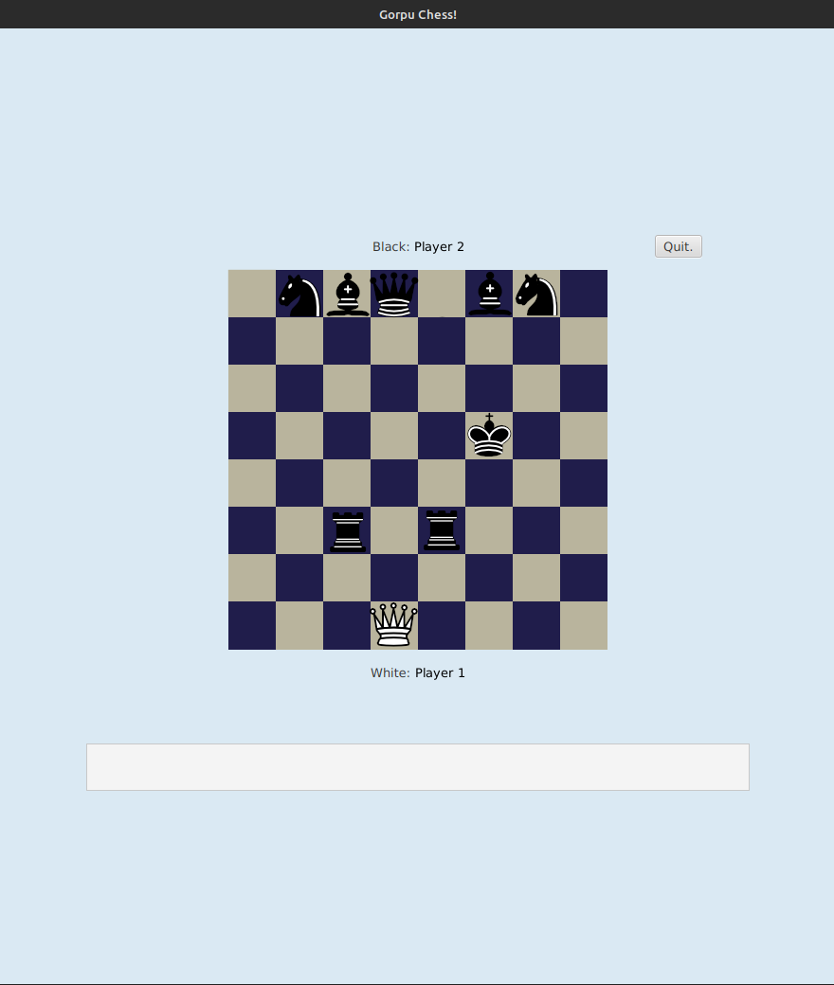
Use Case - UC-4.2
Task:
Detecting Checkmate
Action:
Move the (ref to piece) to checkmate the (ref to colour) king.
Result:
The game will end and a message will be displayed to show which player has won.
Notes:
Assuming we do not need to do demonstrate intermediary: prior board state -> piece selection -> piece move -> highlight king and attacking piece(s). As this has already been done in UC 1.1
We can just show prior board state -> highlight king and attacking piece(s) for UC 4.1

Slide 28
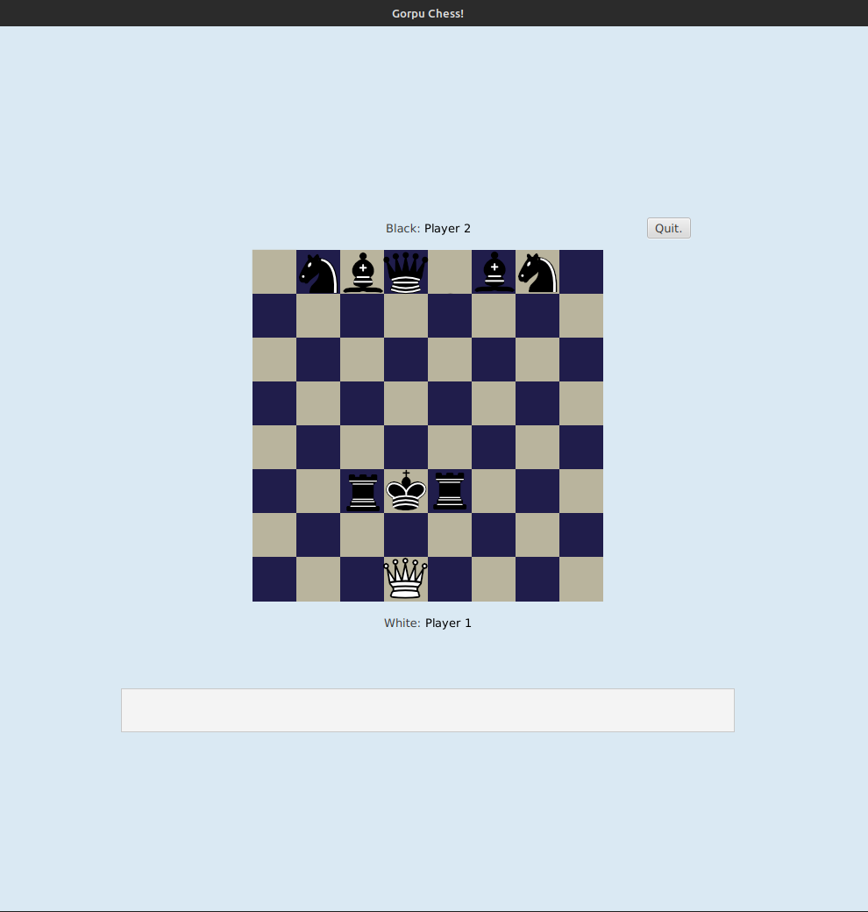
Use Case - UC-4.2
Task:
Detecting Checkmate
Action:
Close the message
Result:
The main menu will appear.
Game Ended! Player 2 put Player 1 into checkmate! Player 2 wins!
Return to Main Menu Your game has been saved and can be reviewed at any time
Notes:
Assuming we do not need to do demonstrate intermediary: prior board state -> piece selection -> piece move -> highlight king and attacking piece(s). As this has already been done in UC 1.1
We can just show prior board state -> highlight king and attacking piece(s) for UC 4.1

Slide 29
Use Case - UC-4.2
Task:
Detecting Checkmate
Final State:
The player is returned to the main menu.

Slide 30
Chess Pieces Image credit: Wikipedia user Cburnett, CC BY-SA 3.0
commons.wikimedia.org/wiki/Category:PNG_chess_pieces/

