Slide 1
Software Engineering Group Project - UI Presentation
Author(s): Jack Thompson [jat92@aber.ac.uk]
Tyler Lewis [tyw1@aber.ac.uk]
Sean Hobson [seh25@aber.ac.uk]
Config Ref: UI-Spec-Pres-GP9
Date: 11 May 2023
Version: 2.0
Status: Release

Slide 2
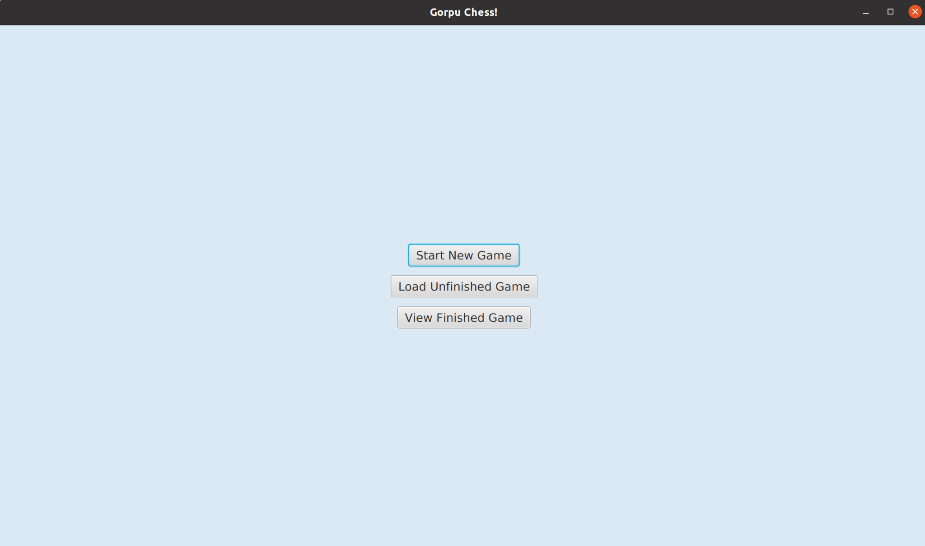
Use Case - UC-0.0
Task:
Launching The Application
Action:
Launch the application
Result:
The main menu appears with 3 buttons.

Slide 3
Use Case - UC-0.1
Task:
Starting a New Game
Action:
Click on the Start New Game button
Result:
The user will be prompted to enter the names of the players and respective piece colours.

Slide 4
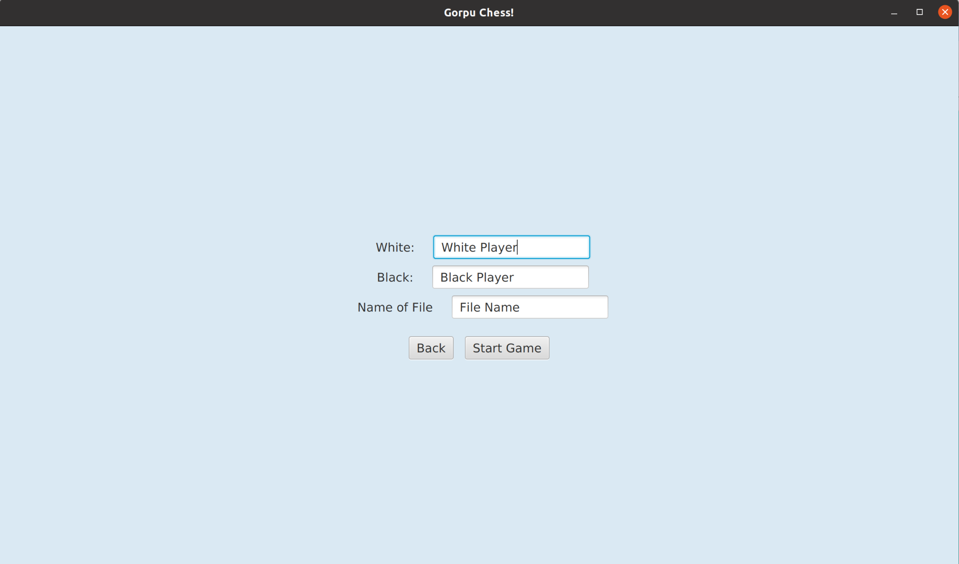
Use Case - UC-0.1
Task:
Starting a New Game
Action:
Enter Player names
Result:
The game window will open displaying the board, pieces and other game features.

Slide 5
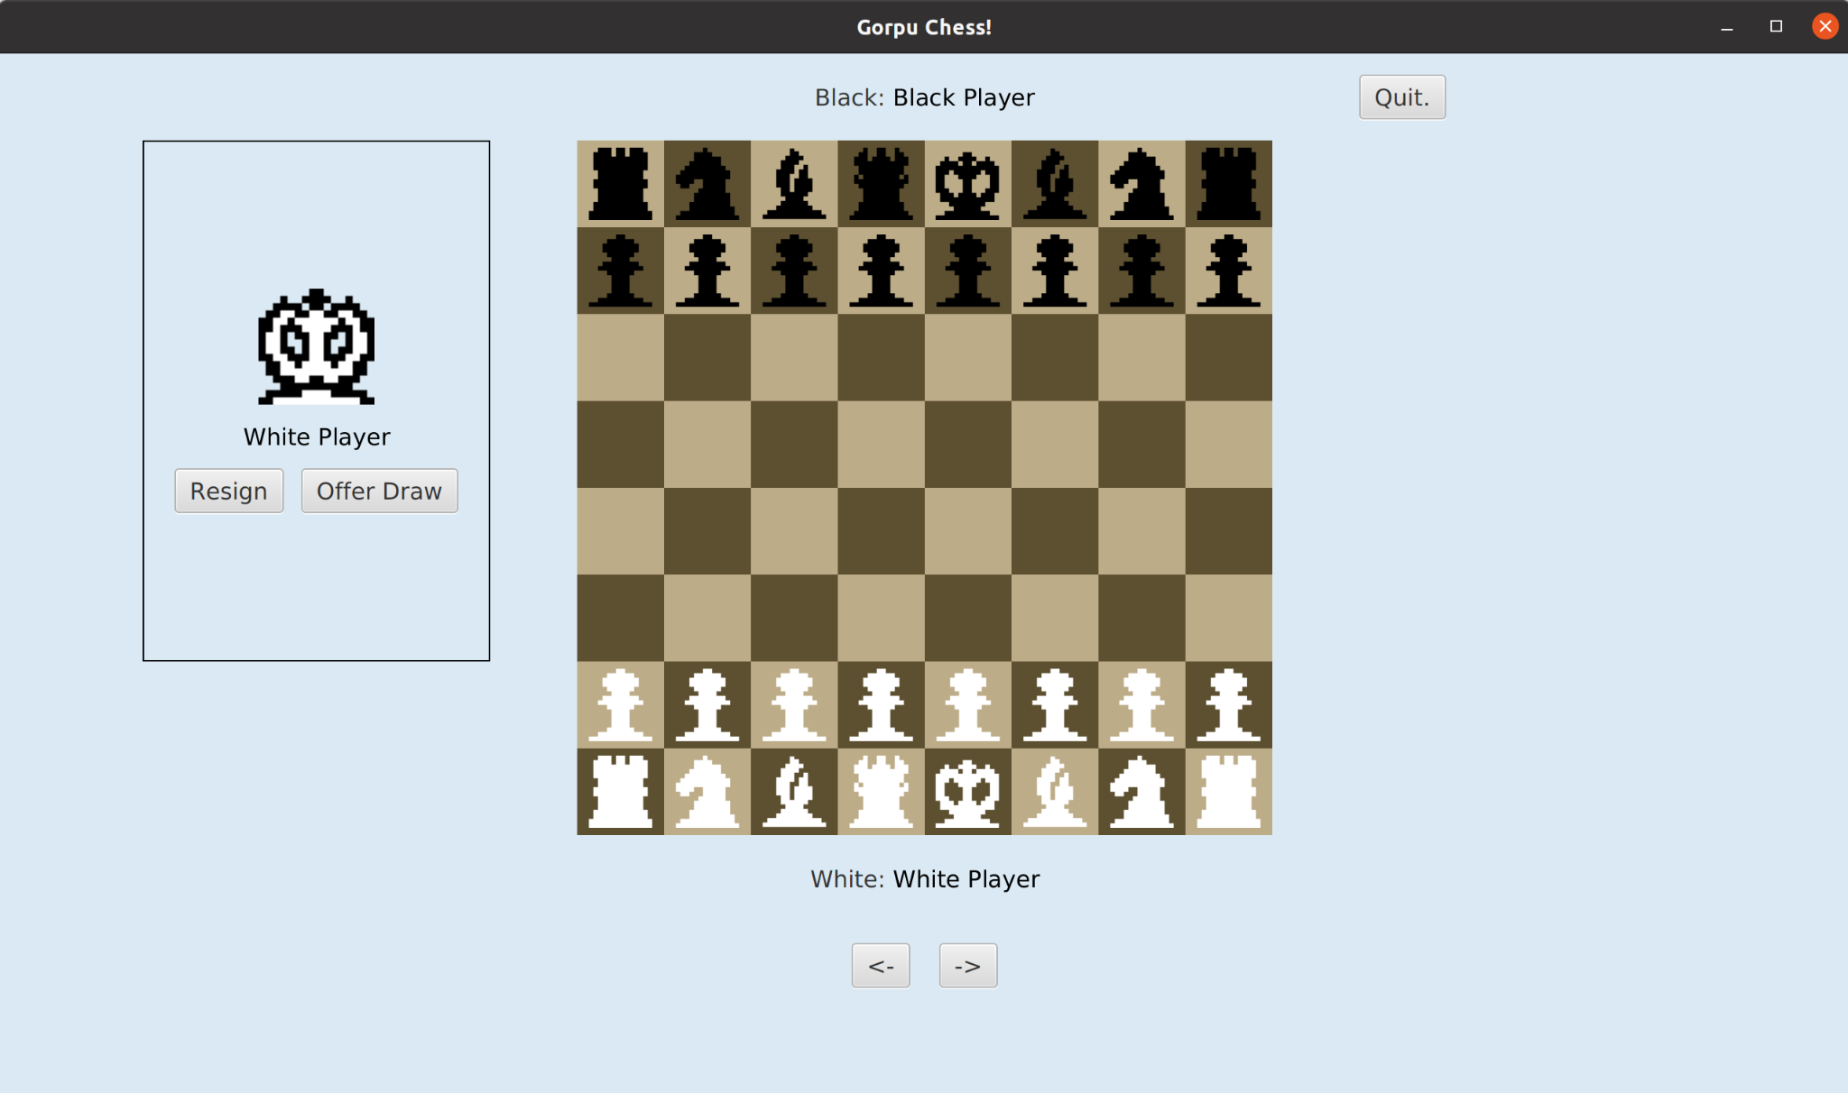
Use Case - UC-0.1
Task:
Starting a New Game
Final State:
The board, pieces and other game features are displayed. White pieces are at the bottom of the screen and black pieces are at the top. The game is ready to start.

Slide 6
Insert pic of the game prompting the user for player names
Use Case - UC-0.2
Task:
Restoring a Previous Game
Action:
Click the Load Unfinished Game button
Result:
The user is shown a list of saved files.
Notes:
We do not have a load game button …

Slide 7
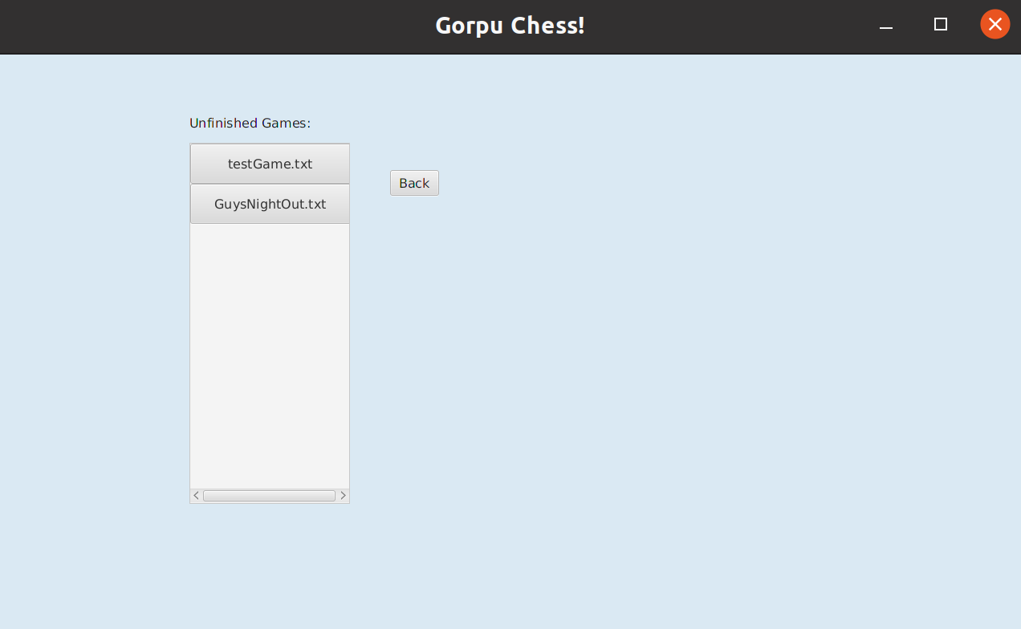
Use Case - UC-0.2
Task:
Restoring a Previous Game
Action:
Select a save file
Result:
The board is set correctly according to the save file.

Slide 8
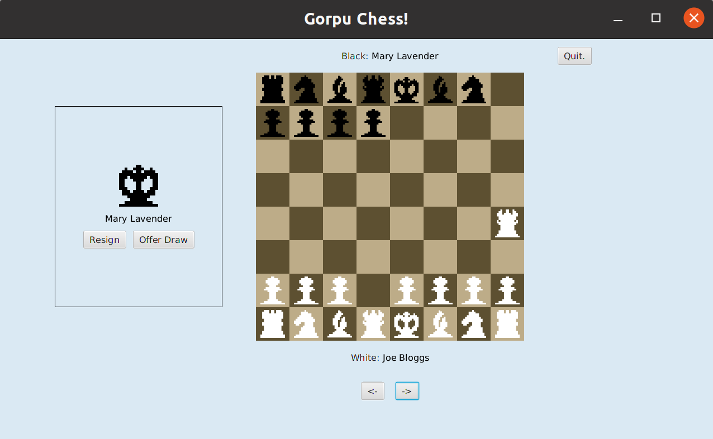
Use Case - UC-0.2
Task:
Restoring a Previous Game
Final State:
The board pieces are set correctly according to the saved file.

Slide 9
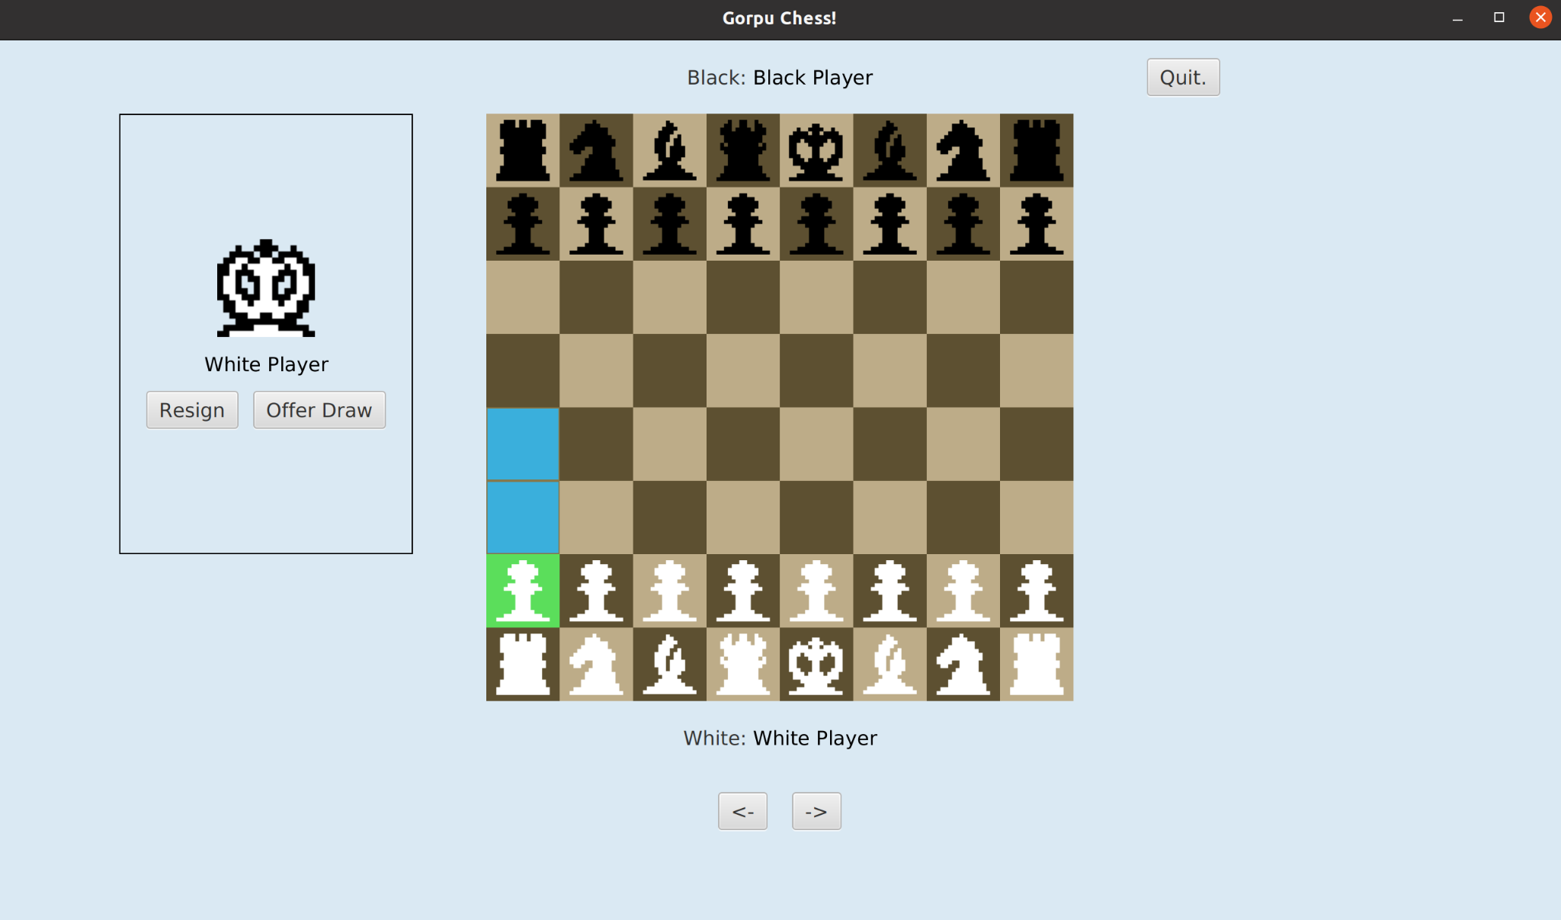
Use Case - UC-1.0
Task:
Selecting a Piece
Action:
Click on the white pawn
Result:
The square of the selected piece is highlighted and shows the possible piece moves.

Slide 10
Use Case - UC-1.1
Task:
Moving a piece
Action:
Move the selected piece from the current position to the square two positions ahead.
Result:
The selected piece moves to the target position..

Slide 11
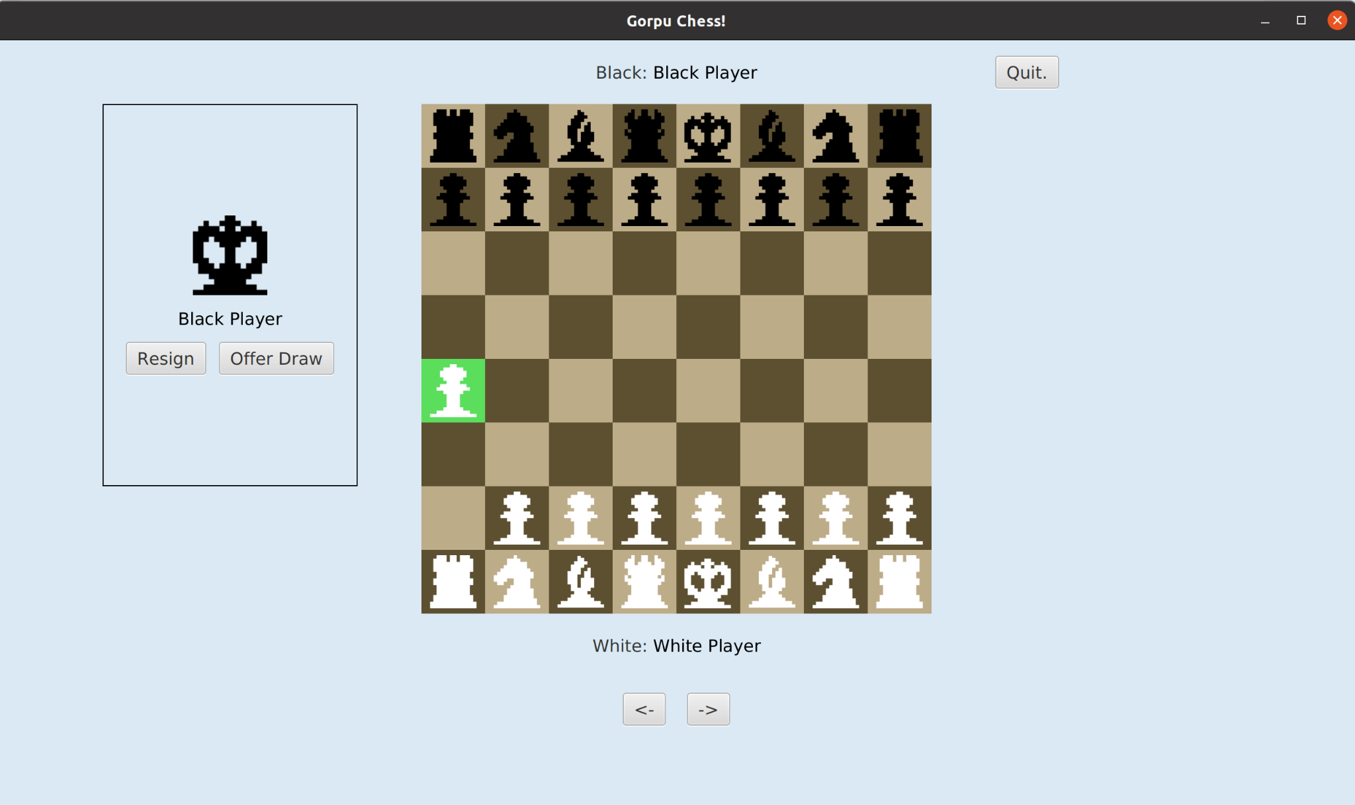
Use Case - UC-1.1
Task:
Moving a piece
Final State:
The board showing the a2 pawn moved to the a4 square with all other pieces in the same position.

Slide 12
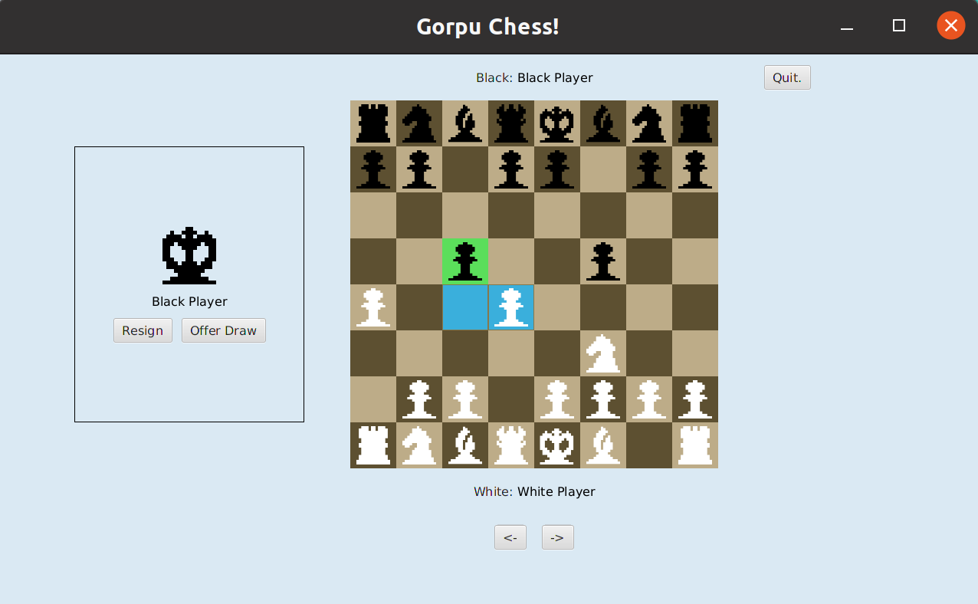
Use Case - UC-1.2
Task:
Capturing a Piece
Action:
Click the black pawn in c5 that will capture the white pawn in d4.
Result:
The black pawn will move to the board tile that the white pawn was on. The white pawn will no longer be visible on the board.

Slide 13

Use Case - UC-1.2
Task:
Capturing a Piece
Final State:
The board showing the black pawn in c5 moved to where the white pawn in d4 was. The white pawn is no longer visible on the board.

Slide 14
Use Case - UC-1.3
Task:
Changing Piece Selection
Action:
Initially the a2 pawn is selected.
Result:
Only the board square of the a2 pawn and it’s legal moves is highlighted.

Slide 15
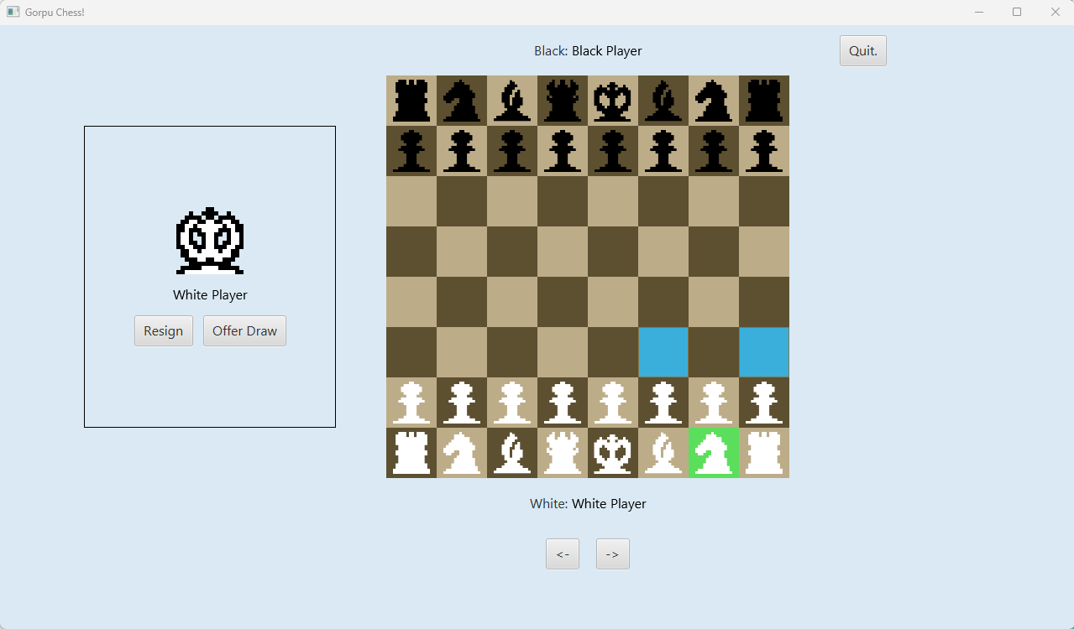
Use Case - UC-1.3
Task:
Changing Piece Selection
Action:
The g1 knight is now selected
Result:
The board square of the newly selected knight piece is highlighted.

Slide 16
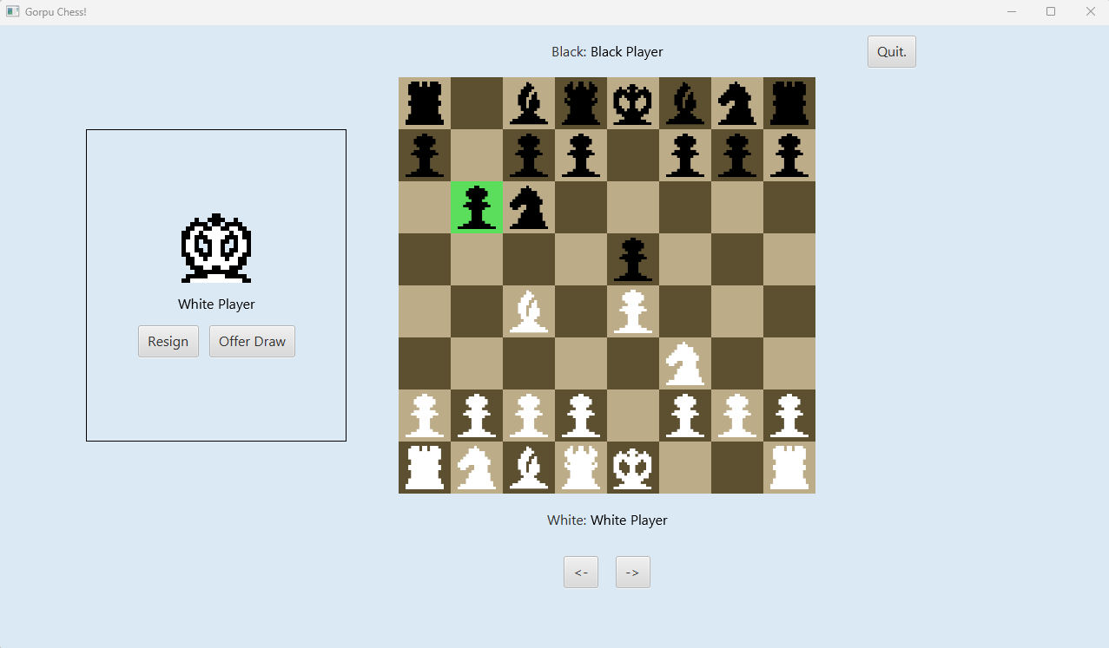
Use Case - UC-1.4
Task:
Special Moves
Action:
Click the white king piece
Result:
The white king piece is selected showing all legal moves including castling.

Slide 17
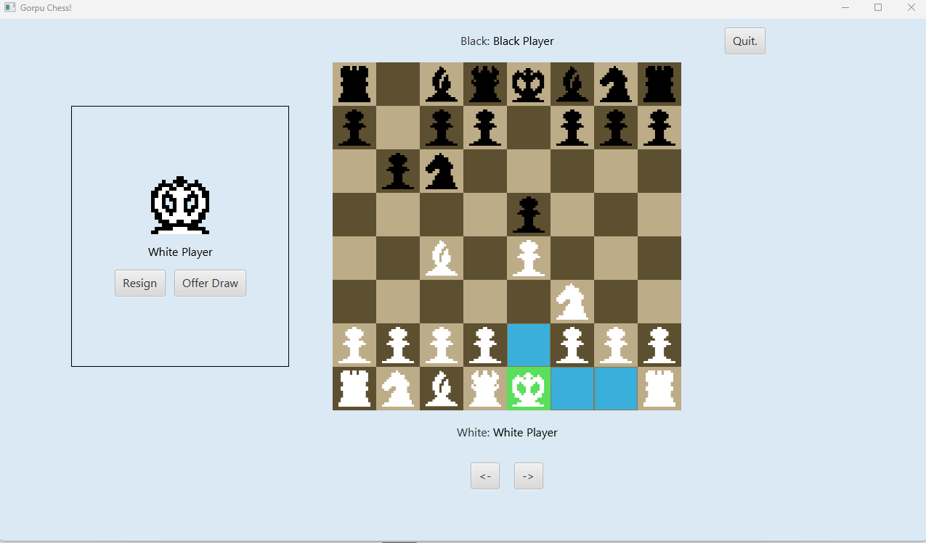
Use Case - UC-1.4
Task:
Special moves
Action:
The king side rook piece is selected.
Result:
The king will move 2 squares to the right and the kingside rook will move 2 squares to the left.

Slide 18
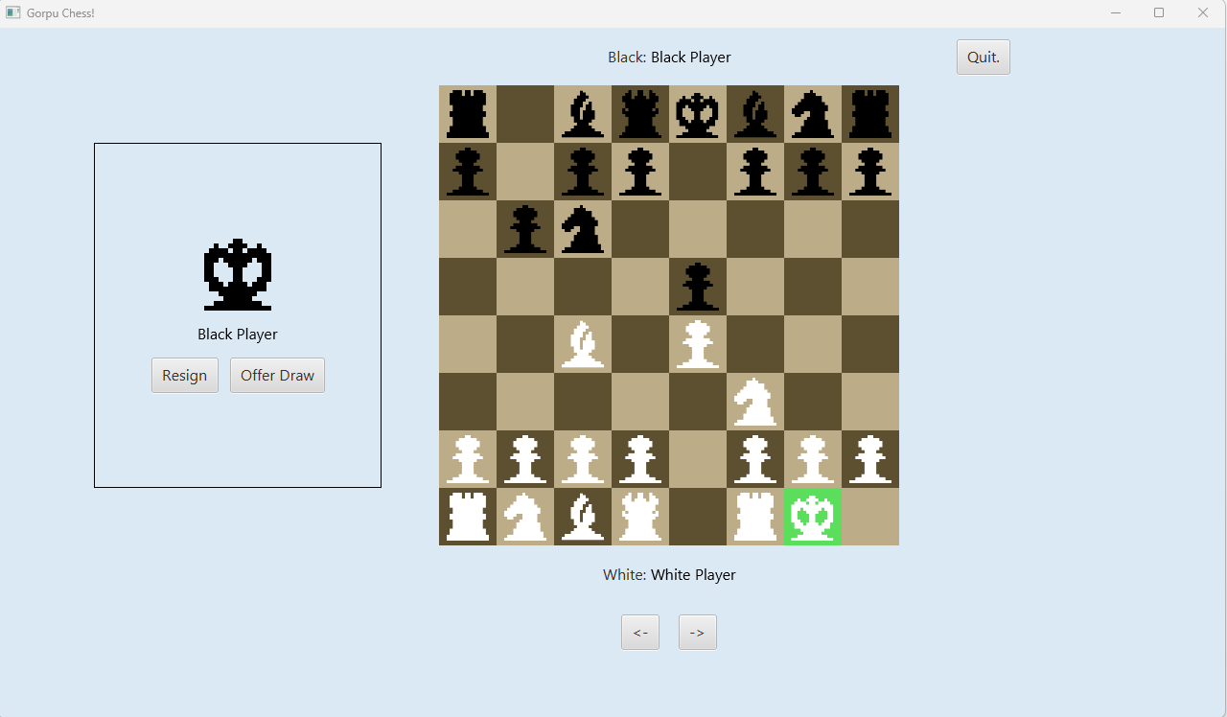
Use Case - UC-1.4
Task:
Special Moves
Final State:
The board is displayed after a successful king side castle.

Slide 19
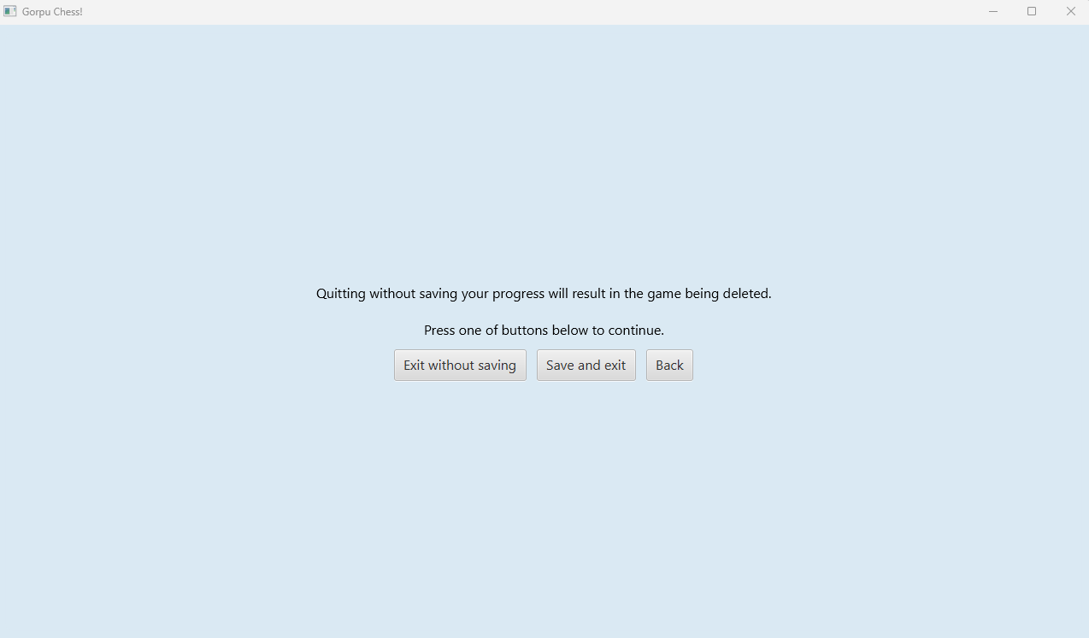
Use Case - UC-2.0
Task:
Quitting a Game
Action:
The quit button is clicked
Result:
A pop up will appear, asking the user if they are sure they would like to quit.
Notes:
We need an extra slide after this showing the pop up.

Slide 20
Use Case - UC-2.0
Task:
Quitting a Game
Action:
The save and exit button is clicked.
Result:
The user will be taken back to the main menu. The game will have been saved but the user will not see this.

Slide 21
Use Case - UC-2.0
Task:
Quitting a Game
Final State:
The main menu is displayed.

Slide 22
An image to show the in game menu.
Use Case - UC-3.0
Task:
Reviewing a Previous Game
Action:
The View Finished Game button is selected from the main menu.
Result:
The user will be shown a list of possible previous games to view.
Notes:
Checking with Tyler this might be same as UC 0.3

Slide 23
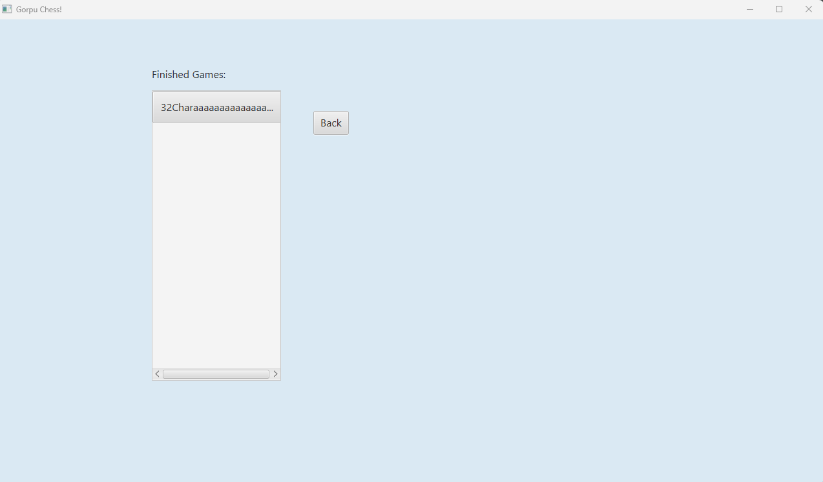
Use Case - UC-3.0
Task:
Reviewing a Previous Game
Action:
32Chara.. button is selected
Result:
The user will be shown a list of possible previous games to view.

Slide 24
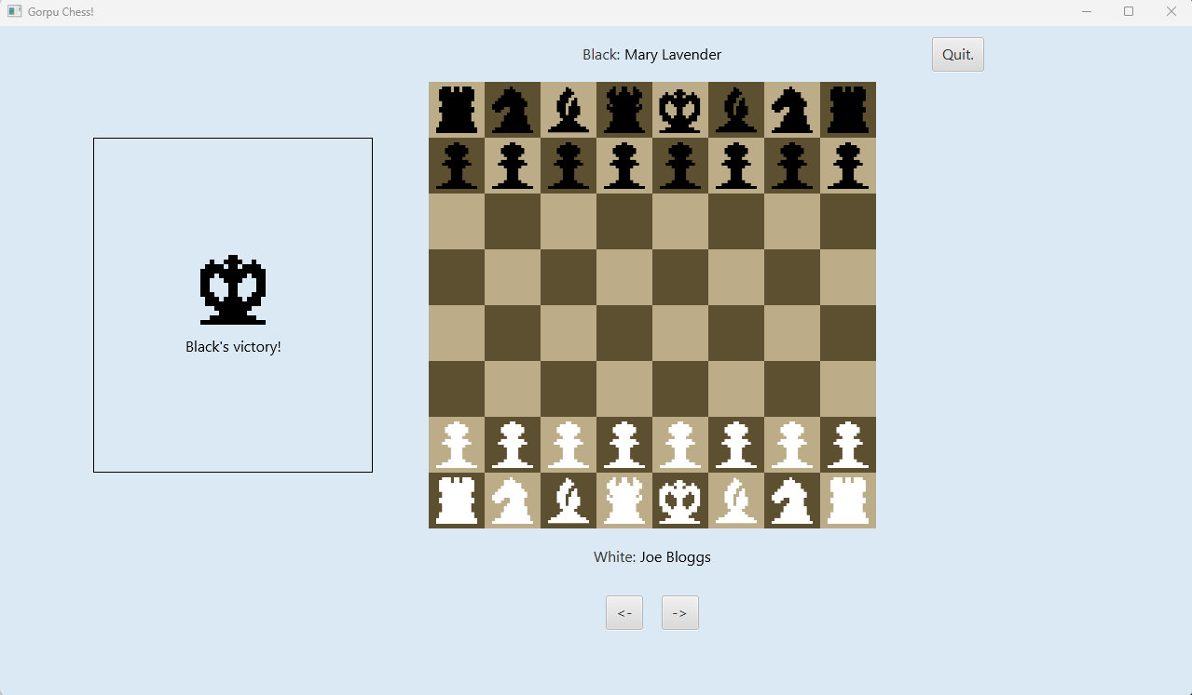
Use Case - UC-3.0
Task:
Reviewing a Previous Game
Final State:
The board is shown in the starting position. Buttons appear to indicate “Step Forward” and “Step Backward”.

Slide 25
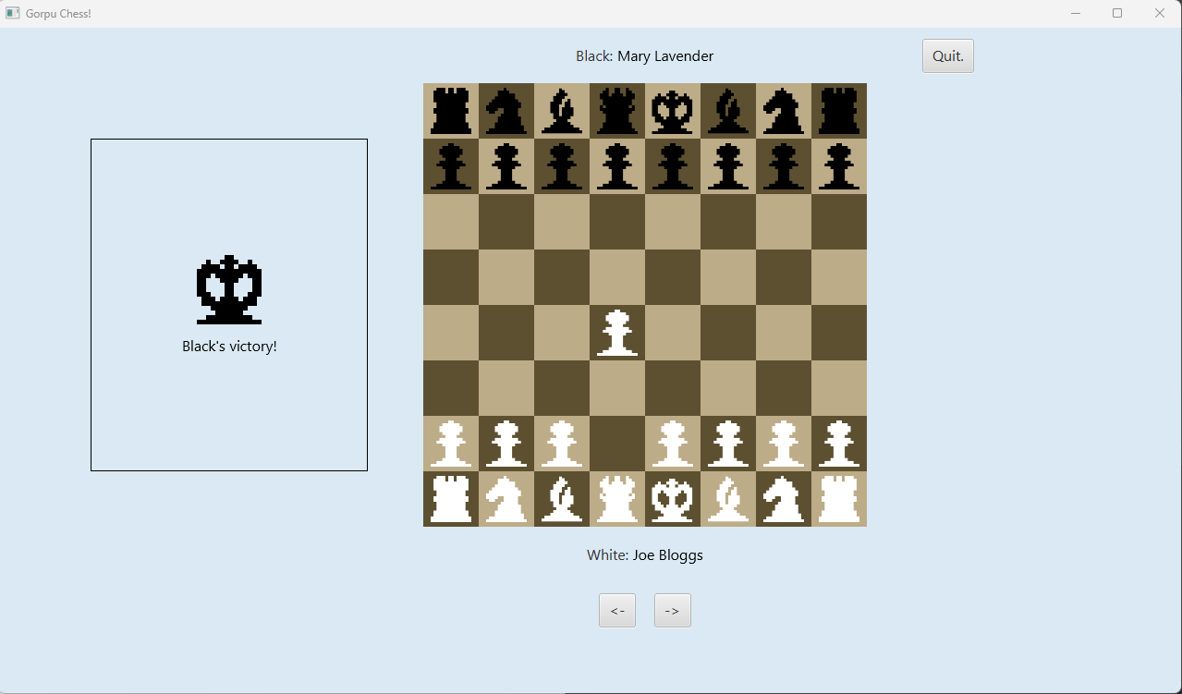
Use Case - UC-3.1
Task:
Stepping Forward
Action:
The forward arrow button is selected.
Result:
The board state is shown after the first move.

Slide 26
Use Case - UC-3.2
Task:
Stepping Backward
Action:
The backward arrow button is selected.
Result:
The board state is shown from before the last move.

Slide 27
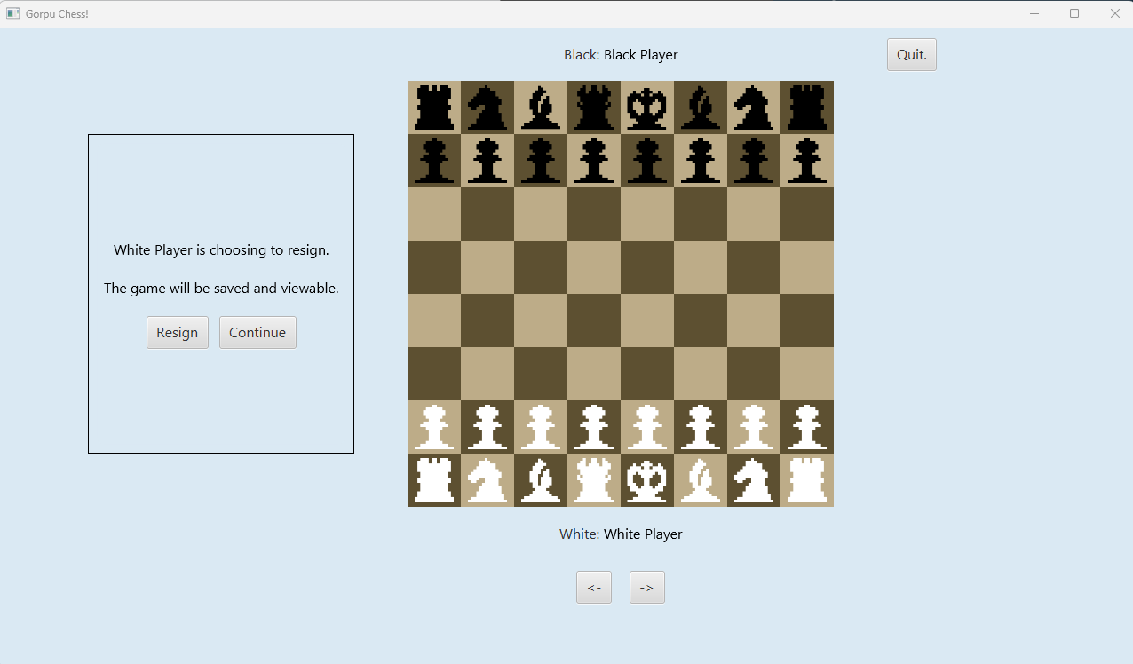
Use Case - UC-4.0
Task:
End of Game
Action:
Click the “Resign” button.
Result:
A pop up appears notifying the user that the game will be saved for replay at a future point.

Slide 28
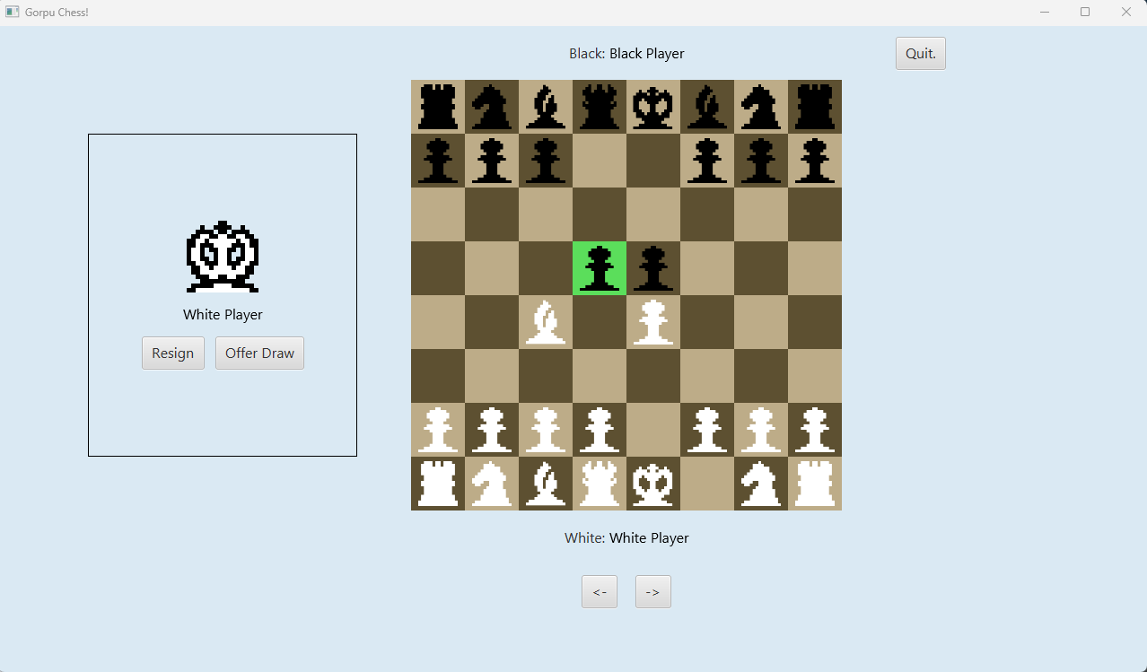
Use Case - UC-4.1
Task:
Detecting Check
Action:
Move the white bishop to check the black king.
Result:
The white bishop and black king will be highlighted.

Slide 29
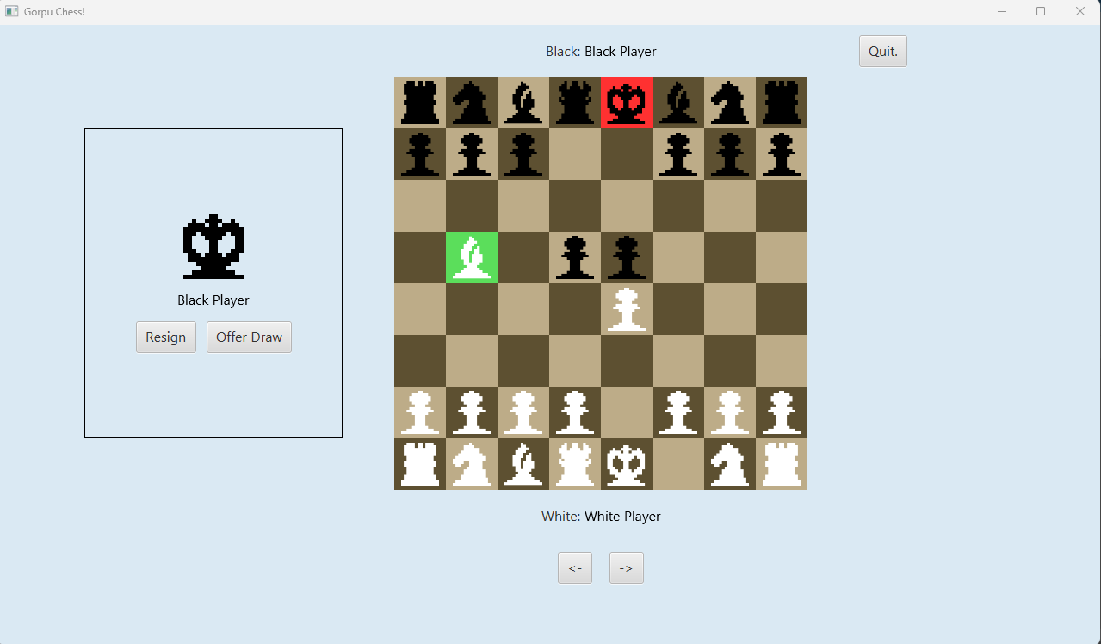
Use Case - UC-4.1
Task:
Detecting Check
Final State:
The board state after the white bishop has moved to attack the black king. Both the king and attacking piece are highlighted.

Slide 30

Use Case - UC-4.2
Task:
Detecting Checkmate
Action:
Move the white queen to checkmate the black king.
Result:
A message will appear in the side pane indicating white has won

Slide 31
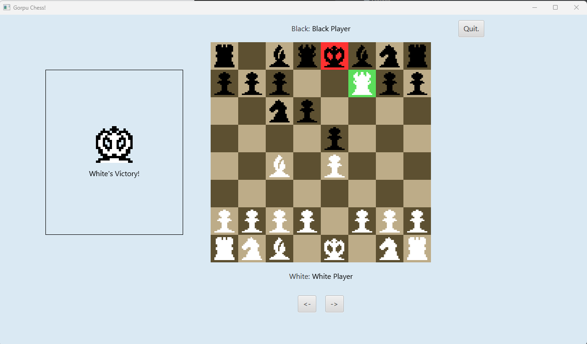
Use Case - UC-4.2
Task:
Detecting Checkmate
Final State:
A message will appear in the side pane indicating white has won.

